Slide 1
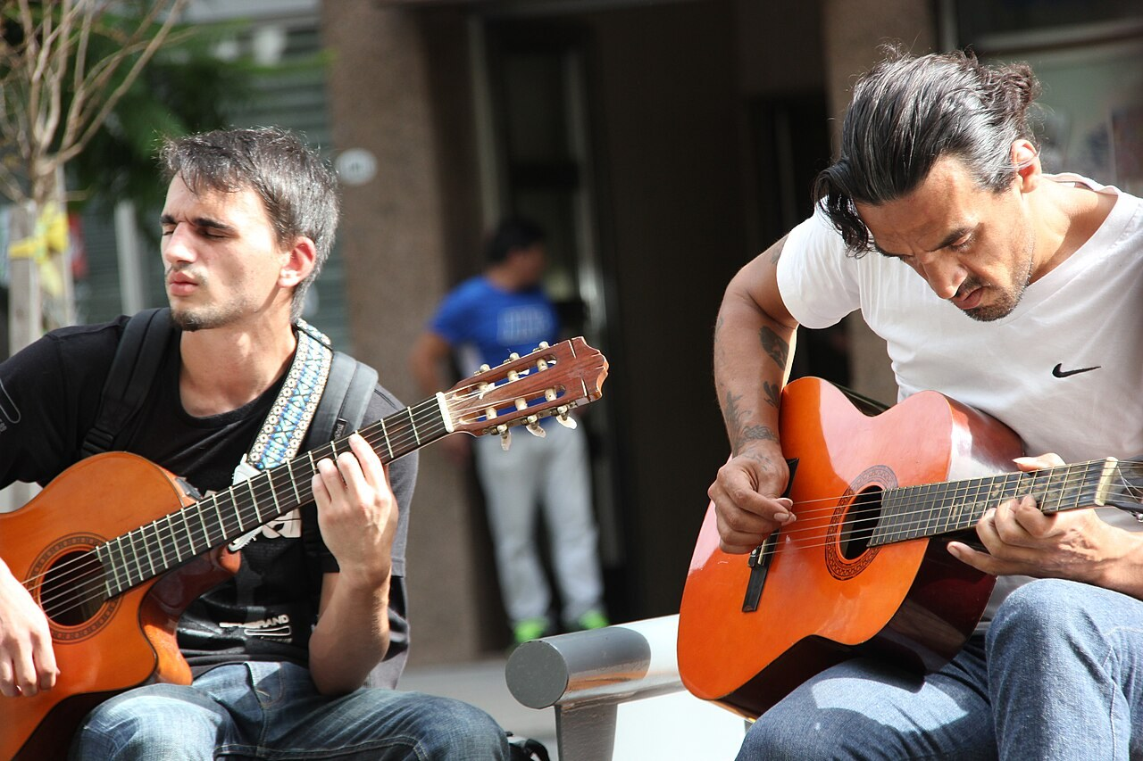
GRADE 8 · LESSON 9
Wordpower: People and Their Hobbies
Mashg‘ulot egalari (-er, -ist) va o‘tgan zamon
Wordpower! (Unit 2)
Lars Curfs (Grashoofd) · CC BY-SA 3.0 nl
sozlar.com

Slide 2
LESSON AIMS
Bugungi maqsad
1
Form fourteen person nouns (cyclist, gamer, golfer, guitarist, painter, photographer, pianist, player, skater, surfer, violinist, windsurfer, footballer, collector)
2
Spell the tricky ones: photographer, collector, cyclist
3
Use nine regular and ten irregular past simple forms, and the negative didn't
4
Tell a partner about a hobby they started in the past

Slide 3
VOCABULARY
A. People with -er (1/2)
🕹️
a gamer
geymer (video o‘yin ishqibozi)
My cousin was a real gamer — he played online every evening.
⛳️
a golfer
golfchi
The golfer hit the ball and it went straight into the hole.
🖌️
a painter
rassom
The painter finished a big picture of the mountains last week.
📸️
a photographer
fotograf
A photographer came to our school and took a photo of every class.
🎲️
a player
o‘yinchi
Every player in our team got a medal after the match.

Slide 4
VOCABULARY
A. People with -er (2/2)
⛸️
a skater
konkida uchuvchi
The young skater fell once but finished her programme with a smile.
🏄️
a surfer
serfer (to‘lqinda taxtada suzuvchi)
The surfer waited a long time for a big wave.
🌬️
a windsurfer
vindserfer (yelkanli taxtada suzuvchi)
On a windy day we watched a windsurfer on the lake.
⚽️
a footballer
futbolchi
My grandfather was a footballer when he was young.
🗃️
a collector
kolleksioner (yig‘uvchi)
The stamp collector showed us a very old stamp from 1920.

Slide 5
VOCABULARY
B. People with -ist
🚴️
a cyclist
velosipedchi
A cyclist from Fergana came first in the city race.
🎸️
a guitarist
gitarachi
The guitarist played a song and everybody sang along.
🎹️
a pianist
pianinochi, pianist
The pianist practised for five hours before the concert.
🎻️
a violinist
skripkachi
The violinist played a sad song at the end of the concert.

Slide 6
VOCABULARY
C. More sport and music people (1/2)
🏊️
a swimmer
suzuvchi (sportchi)
The swimmer trained in the pool every morning before school.
⛷️
a skier
chang‘ichi
The skier went down the mountain at Chimgan very fast.
🥊️
a boxer
bokschi
The boxer won a gold medal for Uzbekistan.
🏃️
a runner
yuguruvchi
The fastest runner finished the race in twelve seconds.

Slide 7
VOCABULARY
C. More sport and music people (2/2)
💃️
a dancer
raqqos, raqqosa
My sister was the best dancer at the Navruz concert.
🎙️
a singer
qo‘shiqchi
A famous singer visited our school last year.
🥁️
a drummer
barabanchi
The drummer in the band played very loudly.

Slide 8
VOCABULARY
D. Words from the stories (1/2)
🏁️
win a race
poygada g‘olib bo‘lmoq
Javohir won the race on his new bike.
🔢️
a point
ochko, ball
Our team got ten points and won the quiz.
🖍️
an art class
tasviriy san’at darsi
In our art class yesterday we painted autumn trees.
🥅️
football practice
futbol mashg‘uloti
I didn’t go to football practice yesterday because it rained.

Slide 9
VOCABULARY
D. Words from the stories (2/2)
🎁️
a gift shop
sovg‘alar do‘koni
At the museum we bought a small toy in the gift shop.
👨‍👩‍👧
relatives
qarindoshlar
All our relatives came to my brother’s wedding.
🗄️
a shelf
javon, tokcha
Last week I put my new trophy on the shelf above my bed.

Slide 10
TODAY'S WORDS IN CONTEXT
My brother the collector (1/2)
My brother Sanjar is a collector. Two years ago our aunt gave him a small toy penguin. He liked it so much that he decided to collect them. Last summer we went to the zoo and saw real penguins. In the gift shop he chose a big one and our dad bought it for him.
Sanjar isn't only a collector. He's also a good guitarist, a fast swimmer and a terrible skater — he fell ten times on the ice last winter! My sister is a photographer: she took photos of all the penguins on his shelf for his profile page.
Cover the word list. Can you understand the words in bold from the sentence?

Slide 11
TODAY'S WORDS IN CONTEXT
My brother the collector (2/2)
And me? I'm a gamer. Yesterday I played online for three hours and didn't do my homework. Mum wasn't happy!
Cover the word list. Can you understand the words in bold from the sentence?

Slide 12
TODAY'S WORDS IN CONTEXT
Read and answer
1
Who gave Sanjar his first penguin?
2
Where did the family see real penguins?
3
Is Sanjar a good skater?
4
What does the writer's sister do?
5
Why wasn't Mum happy?

Slide 13
PAIRS · ESDA QOLDIMI?
Memory check — who is it?
Juftingiz faoliyatni aytadi, siz odamni aytasiz; keyin fe’lning o‘tgan zamonini.
1
cycle · paint · collect · violin · surf · football
2
swim · ski · box · run · dance · drum → the person? and the past simple?
3
Spell: photographer · collector · swimmer · runner

Slide 14
FOCUS
Word building — people from hobbies (p. 17)
• -er: game → gamer, golf → golfer, paint → painter, play → player, skate → skater, surf → surfer.
• -ist (instruments, cycle): guitar → guitarist, piano → pianist, violin → violinist, cycle → cyclist.
• Be careful! (p. 17 box) collect → collector, football → footballer, guitar → guitarist.
• Past simple: regular + -ed (stop → stopped, study → studied); irregular — learn them: go → went, see → saw, take → took.
• Negative / question: didn't + verb · Did you + verb? — Did you see Matt? (NOT Did you saw).

Slide 15
BOOK TASK · 10 MINUTES
Book tasks — Laser A2, pp. 16–17
Wordpower and a quick look back at the past simple.
1
p.17 Wordpower ex.1 Look at the pictures and write the person for each word (cycle, game, golf…).
2
p.17 ex.2 Write one word from ex.1 in each gap (six sentences).
3
p.16 ex.1 Put the verbs into the past simple (six sentences).
4
p.16 ex.3 The penguin collector — write the verbs in the past simple.

Slide 16
PRONUNCIATION
Say it — don’t just read it
SoundSpot preview (p. 18) — stress in person nouns; compare PHOtograph → phoTOgrapher, piAno → PIanist:
photographer /fəˈtɒɡrəfə/
pianist /ˈpiːənɪst/
guitarist /ɡɪˈtɑːrɪst/
violinist /ˌvaɪəˈlɪnɪst/
cyclist /ˈsaɪklɪst/
windsurfer /ˈwɪndsɜːfə/
a skier /ˈskiːə/
relatives /ˈrelətɪvz/
The photographer took lots of photographs. The pianist played a big white piano.

Slide 17
WHOLE CLASS
Practice — complete the sentence (1/2)
1
Someone who plays the guitar is a ________.
2
Someone who takes photographs is a ________.
3
Someone who collects things is a ________ (careful with the spelling!).
4
The ________ with the fastest bike won the race.
5
My sister's a real ________ and spends hours playing online.
6
At the school concert, the ________ played a beautiful song on the piano. (piano)

Slide 18
WHOLE CLASS
Practice — complete the sentence (2/2)
7
I ________ at home on Saturday and watched TV. (stay)
8
My cousin ________ maths at university. (study)
9
I ________ to the cinema last night and ________ a great film. (go · see)
10
My dad ________ me some coins a year ago. (give)
11
Leon ________ ________ with us because he was ill. (not come)
12
________ Lucy and Zoe with you on Monday? (be)

Slide 19
PAIR / GROUP WORK · 8 MINUTES
Vocabulary activity
1
Match the beginnings (1-10) with the endings (a-j).
2
Read your complete sentences aloud.
3
Give the Uzbek meaning of the key word in each sentence.
4
When you finish, swap tables with the other group.

Slide 20
PAIRS
Speaking
Guess the person: say a hobby, your partner says the person — 'I play the violin.' 'You're a violinist!'
Tell your partner how you started a hobby: When? Who helped you? What did you buy / get?

Slide 21
UZ
Qiyin joyi — o‘zbekcha
O‘zbekcha -chi qo‘shimchasiga o‘xshaydi: gitarachi — guitarist, futbolchi — footballer.
collector — oxiri -or; photographer — oxiri -er. Imloni yod oling.
O‘tgan zamon inkori: didn't + fe’l (asl shakl): didn't come, didn't came emas.
was — I/he/she/it, were — you/we/they.

Slide 22
HOMEWORK
Uy vazifasi
1
Laser A2 Workbook pp. 12–13 (past simple ex.1–3, Wordpower ex.1–2).
2
Learn the 28 items with the flashcards: sozlar.com/vocab/cards/?set=grade8-lesson9
3
Write about a hobby you started: when, how, who helped you (six sentences in the past simple).

Slide 23
IMAGE CREDITS
Rasmlar manbasi
cover
Lars Curfs (Grashoofd) · CC BY-SA 3.0 nl · https://commons.wikimedia.org/wiki/File:Guitar_players_in_the_city_centre_of_Buenos_Aires.JPG

Slide 24
Uchta so‘z — ertaga ham esingizda qoladi
Juftingizga ayting, so‘ng daftaringizga yozib qo‘ying.
sozlar.com/vocab/cards/?set=grade8-lesson9

