Slide 1
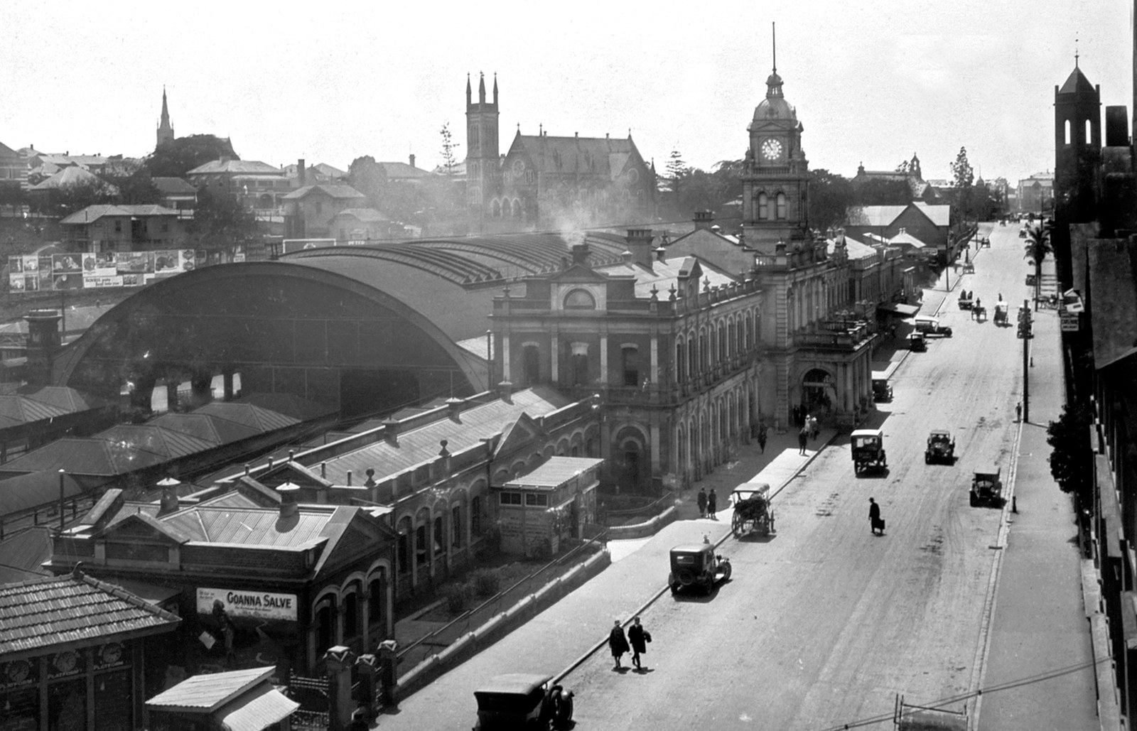
GRADE 10 · LESSON 9
Word Box: Transport
So‘zlar qutisi: transport
Word box: Transport (Unit 2)
Queensland State Archives · Public domain
sozlar.com

Slide 2
LESSON AIMS
Bugungi maqsad
1
Match six definitions from Laser p. 15 ex. 4
2
Describe a station scene in the past continuous (Solutions p. 20)
3
Form ten words from roots (invention, passenger, flight…)
4
Argue for one form of transport with 'in my opinion / on the other hand'

Slide 3
VOCABULARY
A. Vehicles (1/2)
🚗️
a vehicle
transport vositasi, ulov
No vehicles are allowed in the old part of Bukhara.
🚤️
a hydrofoil
suv osti qanotli kema (gidrofoil)
We crossed the lake on a hydrofoil in just twenty minutes.
🛥️
a hovercraft
havo yostig‘idagi kema
A hovercraft can travel over water, sand and even ice.
🐴️
a cart
arava
The farmer took his melons to the market in a cart.
🚵️
a mountain bike
tog‘ velosipedi
He rides his mountain bike on the rocky paths near Chimgan.

Slide 4
VOCABULARY
A. Vehicles (2/2)
🏍️
a motorbike
mototsikl
Food couriers on motorbikes deliver orders all over the city.
🚚️
a lorry
yuk mashinasi
A big lorry brought cotton to the factory.
🚍️
a coach
shaharlararo avtobus
We went to Samarkand by coach because it was cheaper than the train.
🚋️
a tram
tramvay
Trams run on rails in the middle of the street.
🚁️
a helicopter
vertolyot
A helicopter took the injured climber to hospital.

Slide 5
VOCABULARY
B. Parts and how they move (1/2)
🛤️
rails
relslar
Workers are replacing the old rails on the line to Termez.
🚲️
a pedal
pedal
My little sister’s feet can’t reach the pedals yet.
⚙️
an engine
dvigatel
The car won’t start — there’s a problem with the engine.
💨️
a cushion of air
havo yostig‘i
The boat moves on a cushion of air, so it doesn’t touch the water.
🛟️
float
suv yuzida qalqib turmoq
Plastic bottles float on the river.

Slide 6
VOCABULARY
B. Parts and how they move (2/2)
🪢️
be pulled by
(ot va h.k.) tomonidan tortilmoq
In the old days, carts were pulled by horses or donkeys.
🛢️
fuel
yoqilg‘i
Big planes use a lot of fuel.
🛑️
the brakes
tormoz
The driver hit the brakes and the bus stopped just in time.
🚘️
a steering wheel
rul (mashina ruli)
Hold the steering wheel with both hands.

Slide 7
VOCABULARY
C. At the station (1/2)
🚉️
a platform
perron
The fast train to Andijan leaves from platform 2.
🚆️
step off the train
poyezddan tushmoq
When I stepped off the train, my grandparents were waiting for me.
🏃️
catch a train
poyezdga ulgurmoq
We ran all the way to the station to catch the train.
👋️
wave goodbye
qo‘l silkitib xayrlashmoq
The children waved goodbye to their father at the airport.
🧳️
a traveller
sayohatchi, yo‘lovchi
The station was full of travellers with heavy bags.

Slide 8
VOCABULARY
C. At the station (2/2)
🗓️
a timetable
qatnov jadvali
Check the timetable — the last bus leaves at ten.
🎫️
a return ticket
borish-qaytish chiptasi
I bought a return ticket to Fergana because I’m coming back on Sunday.
🪙️
a fare
yo‘l haqi, yo‘lkira
The bus fare in our town is very cheap.
🚇️
public transport
jamoat transporti
Public transport in Tashkent is cheap and fast.

Slide 9
VOCABULARY
D. Transport and our lives (1/2)
🚦️
a traffic jam
tirbandlik
We were stuck in a traffic jam for an hour.
🕗️
the rush hour
eng gavjum vaqt (ishga borish-qaytish payti)
The metro is very crowded during the rush hour.
🏭️
pollution
ifloslanish
Cars and lorries cause a lot of air pollution.

Slide 10
VOCABULARY
D. Transport and our lives (2/2)
🌐️
have an influence on
…ga ta’sir ko‘rsatmoq
The internet has had a huge influence on the way we live.
🔀️
make a difference
o‘zgarish olib kelmoq, ta’sir qilmoq
The new metro line has made a big difference to people’s lives.
⏳️
save time
vaqtni tejamoq
Taking the metro instead of a taxi saves time.

Slide 11
TODAY'S WORDS IN CONTEXT
Getting around — then and now (1/2)
My grandfather remembers when his village had no buses. People went to market in a cart pulled by a horse, and a trip to the city took all day. Today the same trip takes forty minutes by car.
Last month I travelled to Tashkent by train. When I stepped off the train, the platform was crowded: travellers were carrying heavy bags, children were waving goodbye, and a man near the exit was shouting that the next train was late. I checked the timetable for Sunday — luckily I already had a return ticket.
Cover the word list. Can you understand the words in bold from the sentence?

Slide 12
TODAY'S WORDS IN CONTEXT
Getting around — then and now (2/2)
Which form of transport has had the biggest influence on our lives? In my opinion, it's the train. It's cheap and easy to use, it saves time and there are no traffic jams on the rails, even in the rush hour. On the other hand, cars go everywhere. Without them, my grandfather's village would still be a day away from the city.
Cover the word list. Can you understand the words in bold from the sentence?

Slide 13
TODAY'S WORDS IN CONTEXT
Read and answer
1
How did people in the village go to market in the past?
2
What was happening on the platform when the writer arrived?
3
What kind of ticket did the writer already have?
4
Why does the writer choose the train?

Slide 14
PAIRS · ESDA QOLDIMI?
Memory check — define it
Juftingiz so‘zni aytadi, siz inglizcha ta’rif berasiz (a … that …).
1
hovercraft · hydrofoil · cart · rails · pedal · tram
2
Give the word: TRAVEL (a person) · POLLUTE (a noun) · STEER (… wheel)
3
Say two advantages and one disadvantage of the car.

Slide 15
FOCUS
Word box — define, group, build
• Define with a general word + detail: a hovercraft is a vehicle that floats on a cushion of air.
• Group by place: land (cart, lorry, coach, tram), water (hydrofoil), air (helicopter), both (hovercraft).
• Build words: invent → invention, drive → driver, travel → traveller, danger → dangerous, harm → unharmed.
• Station scene = past continuous: People were running to catch trains; travellers were carrying bags.
• Opinion: In my opinion… because… · On the other hand… · Without it, …

Slide 16
BOOK TASK · 5 MINUTES
Book task — Laser B1+, p. 15, ex. 4
Match the words from the text with the definitions.
1
a kind of fast ship that partly lifts out of the water
2
a general word for a car, a bus, etc.
3
this floats on a cushion of air on land or on water
4
trains travel on two of these, made of metal
5
it has two or four wheels and might be pulled by a horse
6
you put your foot on this on a bicycle

Slide 17
PRONUNCIATION
Say it — don’t just read it
Word stress in transport words:
VEhicle /ˈviːəkl/
HOVercraft /ˈhɒvəkrɑːft/
HYdrofoil /ˈhaɪdrəfɔɪl/
HELicopter /ˈhelɪkɒptə/
STEERing wheel /ˈstɪərɪŋ wiːl/
FUel /ˈfjuːəl/
TRAVeller /ˈtrævələ/
polLUtion /pəˈluːʃn/
The h in vehicle is silent: /ˈviːəkl/.

Slide 18
WHOLE CLASS
Practice — complete the sentence (1/2)
1
This is a general word for a car, a bus, etc.: a ________.
2
A ________ floats on a cushion of air on land or on water.
3
A kind of fast ship that partly lifts out of the water: a ________.
4
Trains travel on two of these, made of metal: ________.
5
It has two or four wheels and might be pulled by a horse: a ________.
6
You put your foot on this on a bicycle: a ________.

Slide 19
WHOLE CLASS
Practice — complete the sentence (2/2)
7
I stepped ________ the train onto the crowded platform.
8
People were running to ________ their trains.
9
The driver turned the ________ ________ quickly to miss the dog.
10
There was a long traffic ________ on the bridge, so we were late for school.
11
In my ________, the plane has had the biggest influence on our lives.
12
Planes are fast. On the ________ ________, they cause a lot of pollution.

Slide 20
GROUPS OF THREE
Speaking
Have your say! Choose one form of transport and convince your group it has had the biggest influence on our lives.
Describe a station, airport or bus stop you know — what were people doing the last time you were there?

Slide 21
PAIR / GROUP WORK · 8 MINUTES
Vocabulary activity
1
Part A — write the correct form of the word in CAPITALS (10 items).
2
Part B — complete each phrase with ONE word from the box.
3
Work alone first, then compare with your partner and explain your choice.
4
Part C — discuss the questions in groups of three.

Slide 22
UZ
Qiyin joyi — o‘zbekcha
vehicle — umumiy so‘z: avtomobil, avtobus, yuk mashinasi — hammasi vehicle; h o‘qilmaydi.
lorry (Britaniya) = truck (Amerika) — yuk mashinasi.
catch a train — «poyezdga ulgurmoq»; miss a train — «poyezddan qolmoq».
the rush hour — ishga borish-qaytish payti, eng gavjum vaqt; shu paytda traffic jam (tirbandlik) ko‘p bo‘ladi.
So‘z yasash: -ion (invention), -er/-or (driver, traveller), -ous (dangerous), -ity (popularity), un-…-ed (unharmed).

Slide 23
HOMEWORK
Uy vazifasi
1
Laser B1+ Workbook pp. 11–12, ex. 1–2.
2
Learn the 34 items with the flashcards: sozlar.com/vocab/cards/?set=grade10-lesson9
3
Write 100 words: the form of transport that has had the biggest influence on our lives.

Slide 24
IMAGE CREDITS
Rasmlar manbasi
cover
Queensland State Archives · Public domain · https://commons.wikimedia.org/w/index.php?curid=107535138

Slide 25
Uchta so‘z — ertaga ham esingizda qoladi
Juftingizga ayting, so‘ng daftaringizga yozib qo‘ying.
sozlar.com/vocab/cards/?set=grade10-lesson9

