Slide 1
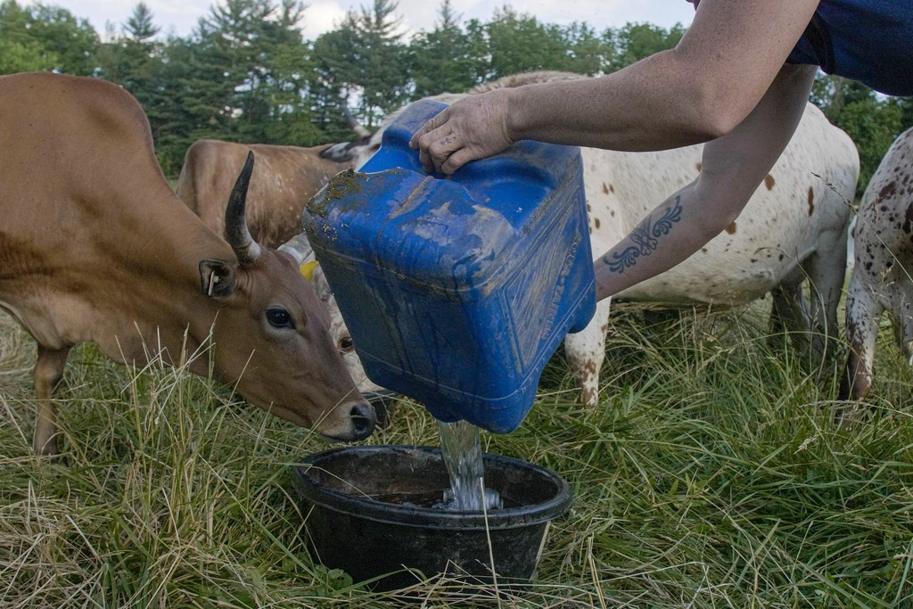
GRADE 7 · LESSON 9
Grammar: Present Simple
Hozirgi oddiy zamon (Present Simple)
Grammar: present simple (Unit 2)
U.S. Department of Agriculture · CC0 1.0
sozlar.com

Slide 2
LESSON AIMS
Bugungi maqsad
1
Add -s / -es / -ies correctly after he, she, it
2
Make negatives with don't / doesn't + verb
3
Ask and answer Do…? / Does…? questions with short answers
4
Use four time phrases for routines

Slide 3
FOCUS
Present simple — the rules from p. 16
QOIDA
QOIDA
I / you / we / they + verb: We go to the farm every Saturday.
he / she / it + verb-s: wakes, eats; go → goes, watch → watches, study → studies, have → has.
Negative: don't / doesn't + verb — He doesn't walk (NOT doesn't walks).
Question: Do / Does + subject + verb — Does she work…? Short answers: Yes, she does. / No, she doesn't.
Use: things that happen always, never, every day, usually or regularly.

Slide 4
BOOK TASK · 10 MINUTES
Book tasks — Laser A1+, p. 16
Do the exercises in order — each one uses the sentences from ex. 1.
1
ex.1 Choose the correct word (six sentences about the farm).
2
ex.2 Make the sentences in ex. 1 negative: The cows don't wake up…
3
ex.3 Make questions from ex. 1: Do the cows wake up…?
4
ex.4 Caroline's day — put the 13 verbs in the correct form.

Slide 5
VOCABULARY
A. Everyday actions (1/4)
💼️
work
ishlamoq
My sister works at a farm near Tashkent.
🏠️
live
yashamoq
Most people live in towns and cities these days.
🍽️
eat
yemoq
This dog eats everything — even my socks!
❤️
love
juda yaxshi ko‘rmoq
Caroline loves her job on the farm.

Slide 6
VOCABULARY
A. Everyday actions (2/4)
🎁️
want
xohlamoq
My little brother wants a puppy for his birthday.
🚶️
walk
piyoda yurmoq, piyoda bormoq
My grandfather walks to the bazaar every morning.
🏃️
run
yugurmoq
The old donkey doesn’t run much any more.
👀️
see
ko‘rmoq
City children don’t see cows very often.

Slide 7
VOCABULARY
A. Everyday actions (3/4)
🍲️
cook
ovqat pishirmoq
Grandma cooks plov for the whole family on Sundays.
👨‍🏫
teach
o‘rgatmoq, dars bermoq
Mr Karimov teaches maths at our school.
✅️
make sure
ishonch hosil qilmoq, kuzatib turmoq
The sheepdog makes sure the sheep don’t get lost.
🙌️
help
yordam bermoq
Aziz helps his dad in the shop after school.

Slide 8
VOCABULARY
A. Everyday actions (4/4)
🚪️
leave
jo‘nab ketmoq, (uydan) chiqmoq
Dad leaves the house at seven every day.
🚏️
arrive
yetib kelmoq
Our school bus arrives at half past seven.
🍵️
drink
ichmoq
My grandfather drinks green tea after every meal.
📰️
read the newspaper
gazeta o‘qimoq
Dad reads the newspaper after breakfast.

Slide 9
VOCABULARY
B. Work and places
🚌️
go to work
ishga bormoq
My mum goes to work by bus.
🏡️
a village
qishloq
My uncle lives in a village near Bukhara.
🧰️
an easy job
oson ish
Teaching isn’t an easy job, but my mum loves it.

Slide 10
VOCABULARY
C. When? Time phrases (1/2)
🌞️
in the morning
ertalab
My aunt feeds the hens in the morning.
🌤️
in the afternoon
tushdan keyin
My brother plays football with his friends in the afternoon.
🌆️
in the evening
kechqurun
We watch TV together in the evening.
🌙️
at night
kechasi, tunda
Owls sleep in the daytime and hunt at night.
📅️
at the weekend
dam olish kunlari
I help my grandfather in the garden at the weekend.

Slide 11
VOCABULARY
C. When? Time phrases (2/2)
🏊️
every Saturday
har shanba
We go to the swimming pool every Saturday.
🕛️
during the day
kunduzi, kun davomida
My grandfather never sleeps during the day.
🔁️
regularly
muntazam ravishda
My dad goes to the gym regularly.
🧭️
generally
odatda, umuman olganda
Our village is generally very quiet.
🤔️
probably
ehtimol, balki
You probably know this song — everybody sings it.

Slide 12
TODAY'S WORDS IN CONTEXT
My uncle's farm
My uncle Botir lives on a farm near Samarkand. He wakes up at five o'clock every day — even at the weekend! He has a cup of tea and goes to the field.
In the morning he feeds the sheep and my aunt milks the cows. My cousin Lola doesn't get up early. She goes to school at eight, and after school she does her homework and teaches her little brother to read.
My uncle doesn't watch TV in the evening. He usually reads a newspaper and goes to bed at nine. Do I want to live on a farm? No, I don't — I don't like getting up at five!
Cover the word list. Can you understand the words in bold from the sentence?

Slide 13
TODAY'S WORDS IN CONTEXT
Read and answer
1
Where does Uncle Botir live?
2
What time does he wake up?
3
Who milks the cows?
4
Does Lola get up early?
5
Does Uncle Botir watch TV in the evening?

Slide 14
PAIRS · ESDA QOLDIMI?
Memory check — say the he / she form
Juftingiz fe’lni aytadi, siz «she» shaklini aytasiz: go → she goes.
1
go · watch · teach · study · have · live · arrive · make sure
2
Make it negative: She drinks milk. · They see the cows.
3
Make a question: He works on a farm. · You live in a village.
4
Say three things you do every day and one thing you never do.

Slide 15
PRONUNCIATION
Say it — don’t just read it
The -s ending has three sounds: /s/, /z/, /ɪz/. Repeat, then say the hard words:
works /wɜːks/
walks /wɔːks/
lives /lɪvz/
arrives /əˈraɪvz/
teaches /ˈtiːtʃɪz/
a village /ə ˈvɪlɪdʒ/
probably /ˈprɒbəbli/
generally /ˈdʒenrəli/
The l in walks is silent. Does and doesn't sound like 'duz', not 'dooz'.

Slide 16
WHOLE CLASS
Practice — complete the sentence (1/2)
1
My aunt ________ up at five o'clock every morning. (wake)
2
The ducks ________ on the duckpond. (live)
3
Caroline ________ to work very early. (go)
4
My dad ________ the news after dinner. (watch)
5
She ________ lots of jobs on the farm. (do)
6
Our cat ________ ________ vegetables. (not / eat)

Slide 17
WHOLE CLASS
Practice — complete the sentence (2/2)
7
City children ________ ________ farm animals very often. (not / see)
8
________ you live in a town or a village?
9
________ your sister work on a farm? — Yes, she ________.
10
What time ________ he have lunch?
11
We go to the farm ________ ________. (har shanba)
12
Grandpa visits the doctor ________ — every month. (muntazam ravishda)

Slide 18
PAIR / GROUP WORK · 8 MINUTES
Vocabulary activity
1
Match the beginnings (1-10) with the endings (a-j).
2
Read your complete sentences aloud.
3
Give the Uzbek meaning of the key word in each sentence.
4
When you finish, swap tables with the other group.

Slide 19
PAIRS
Speaking
Ask your partner five questions about their day: 'What time do you leave the house?' 'Do you walk to school?'
Tell the class two things about your partner: 'Aziz leaves the house at seven. He doesn't walk to school.'

Slide 20
UZ
Qiyin joyi — o‘zbekcha
O‘zbekchada fe’l shaxsga qarab o‘zgaradi (boraman, boradi) — inglizchada faqat he / she / it da -s qo‘shiladi.
Inkor va so‘roqda -s does ga o‘tadi: He works → He doesn't work → Does he work?
have → has — alohida (noto‘g‘ri) shakl; go → goes, do → does — -o bilan tugagan fe’lga -es qo‘shiladi (does /dʌz/ o‘qiladi).
Qisqa javobda fe’l takrorlanmaydi: Yes, I do. (NOT Yes, I like.)

Slide 21
HOMEWORK
Uy vazifasi
1
Laser A1+ Workbook pp. 11–12, ex. 1–4.
2
Learn the 29 items (sections A–C) with the flashcards: sozlar.com/vocab/cards/?set=grade7-lesson9
3
Write about a family member's day in six sentences (+ and −).

Slide 22
IMAGE CREDITS
Rasmlar manbasi
cover
U.S. Department of Agriculture · CC0 1.0 · https://www.rawpixel.com/image/8731935/photo-image-public-domain-women-ag-cow

Slide 23
Uchta so‘z — ertaga ham esingizda qoladi
Juftingizga ayting, so‘ng daftaringizga yozib qo‘ying.
sozlar.com/vocab/cards/?set=grade7-lesson9

