Slide 1
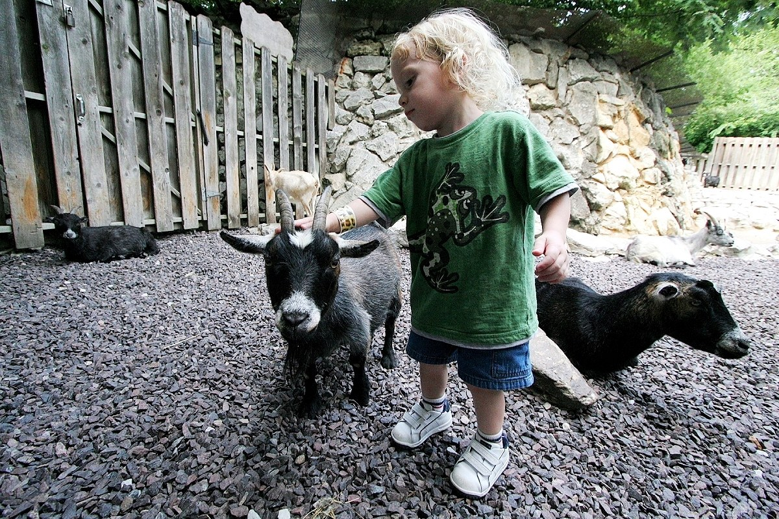
GRADE 7 · LESSON 8
Welcome to Amberton Farm
Amberton fermasiga xush kelibsiz
Unit 2. Reading: Welcome to Amberton Farm
Robert Lawton · CC BY-SA 2.5
sozlar.com

Slide 2
LESSON AIMS
Bugungi maqsad
1
Name eight baby and farm animals
2
Use seven farm-job phrases (welcome, milk, collect, brush, move, plant, pick)
3
Match each paragraph of an advert with its heading
4
Say what they would like to do at a farm: 'I'd like to…'

Slide 3
BOOK TASK · 10 MINUTES
Book tasks — Laser A1+, pp. 14–15
Open your books. Read the advert and do the tasks.
1
p.14 Match — the baby animals a–g with the photos. p.15 write one letter in each gap (8 definitions).
2
ex.1 Match each paragraph with a heading (six headings, six paragraphs).
3
ex.2 Complete the table: types of animal · types of people · names of people and animals.
4
ex.3 Short answers: Where do most people live? How many days is the farm open? What time do they start work?
5
ex.4 Say what you'd like to do at the farm: I'd like to feed the ducks.

Slide 4
VOCABULARY
A. Baby animals
🐥️
duckling
o‘rdakcha (o‘rdak bolasi)
Five little ducklings are swimming behind their mother.
🐑️
lamb
qo‘zichoq
The little lamb is only two weeks old.
🐄️
calf (calves)
buzoq (buzoqlar)
The cow and her calf are in the field.
🐣️
chick
jo‘ja
The yellow chicks follow the hen everywhere.
🐴️
pony (ponies)
poni (kichik ot)
The youngest children can ride the ponies.

Slide 5
VOCABULARY
B. Farm animals (1/2)
🥛️
cow
sigir
Our cow gives a lot of milk every day.
🐎️
horse
ot
My grandfather has got a beautiful brown horse.
🐏️
sheep
qo‘y
There are fifty sheep on the hill near our village.
🐐️
goat
echki
The goat is eating the leaves of the apple tree!

Slide 6
VOCABULARY
B. Farm animals (2/2)
🫏️
donkey
eshak
Ned the old donkey loves all the visitors.
🦆️
duck
o‘rdak
Some ducks are swimming on the pond.
🐔️
chicken
tovuq
Grandma has got ten chickens in her garden.
🐕️
sheepdog
cho‘pon iti
The sheepdog runs around the sheep and keeps them together.

Slide 7
VOCABULARY
C. Jobs on the farm (1/2)
👋️
welcome
kutib olmoq, qarshi olmoq
Mrs Collins welcomes the visitors at the gate.
🪣️
milk the cows
sigirlarni sog‘moq
The farmer milks the cows before breakfast.
🥚️
collect the eggs
tuxumlarni yig‘moq
After breakfast we collect the eggs from the hens.
🪮️
brush the horses
otlarni cho‘tka bilan tozalamoq
On Sunday mornings we brush the horses together.

Slide 8
VOCABULARY
C. Jobs on the farm (2/2)
➡️
move the sheep
qo‘ylarni boshqa joyga haydamoq
The dog helps the farmer move the sheep to the next field.
🌱️
plant
ekmoq
In spring we plant potatoes and onions.
🍒️
pick
uzmoq, termoq
In June we pick cherries in Grandma’s garden.

Slide 9
VOCABULARY
D. The farm and its visitors (1/2)
👩‍🌾
a farm worker
ferma ishchisi
My aunt is a farm worker and she gets up very early.
🏙️
a city farm
shahar ichidagi ferma
There’s a city farm near our school with cows and goats.
🚪️
open to the public
hamma uchun ochiq
The museum is open to the public on Saturdays.

Slide 10
VOCABULARY
D. The farm and its visitors (2/2)
🎟️
a visitor
tashrif buyuruvchi, mehmon
Every visitor can feed the ducks.
🌾️
a field
dala
The horses are in the field behind the house.
💧️
a duckpond
o‘rdaklar suzadigan hovuz
There are six white ducks on the duckpond.

Slide 11
VOCABULARY
E. A day at the farm (1/2)
🌅️
start early
erta boshlanmoq
On a farm the day starts early, at half past five.
🕖️
stay all day
kun bo‘yi qolmoq
On Sundays we stay all day at Grandpa’s farm.
🛋️
a lazy day
bekorchilik kuni
Sunday is my lazy day — I read and sleep a lot.
✋️
touch
tegmoq, ushlab ko‘rmoq
You can touch the lambs, but be gentle.

Slide 12
VOCABULARY
E. A day at the farm (2/2)
🤲️
stroke
silamoq
My little sister gently strokes the kitten.
🏇️
ride a horse
ot minmoq
My brother wants to ride a horse at the farm.
🎉️
have a great time
vaqtni maroqli o‘tkazmoq
The children have a great time on the farm.

Slide 13
TODAY'S WORDS IN CONTEXT
A school day at Amberton Farm (1/2)
Every spring our class goes to Amberton Farm. It's a city farm, and it's open to the public seven days a week. Mrs Collins welcomes us at the gate. Farm life starts early: the farm workers get up at half past five.
First we help with the jobs. We feed the animals, collect the eggs and watch a worker milk the cows. Then we brush the horses. A black and white sheepdog helps a farmer move the sheep to a different field. Nobody has a lazy day!
Cover the word list. Can you understand the words in bold from the sentence?

Slide 14
TODAY'S WORDS IN CONTEXT
A school day at Amberton Farm (2/2)
After lunch we pick strawberries and plant onions. The best part is the baby animals: lambs, a calf, yellow chicks, ducklings and a very noisy puppy. We can touch them and stroke them.
Some girls ride the ponies and the boys take the goats for a walk. Many families stay all day, but our class goes home at four o'clock.
Cover the word list. Can you understand the words in bold from the sentence?

Slide 15
TODAY'S WORDS IN CONTEXT
Read and answer
1
Amberton Farm is in a small village. True or false?
2
The farm workers get up at half past five. True or false?
3
The children milk the cows. True or false?
4
Who helps the farmer move the sheep?
5
Name three baby animals at the farm.
6
What time does the class go home?

Slide 16
PAIRS · ESDA QOLDIMI?
Memory check — cover the Uzbek column
Juftingiz inglizchasini o‘qiydi, siz o‘zbekchasini aytasiz. So‘ng almashinasiz.
1
Say the baby animal: cow · duck · sheep · chicken
2
Say the English: sigirlarni sog‘moq · tuxumlarni yig‘moq · silamoq · uzmoq · eshak
3
Tell your partner three jobs on a farm in one minute.
4
Write the three words you keep forgetting.

Slide 17
FOCUS
Reading an advert — how to find the heading
• Read the first and last sentence of each paragraph — the heading is usually there.
• Look for key words: open, every day → 'Open every day of the year!'
• Numbers and times help: 5.30 a.m., six o'clock, seven in the evening → the time to come and go.
• There is one heading for each paragraph — cross out the ones you have used.
• Plural of baby animals: calf → calves, pony → ponies, puppy → puppies.

Slide 18
STRATEGY
Reading for the main idea — three steps
1
Look at the photos and the title: what is the text about?
2
Read fast once — do not stop at new words.
3
Match each paragraph with a heading, then read again to check.

Slide 19
PRONUNCIATION
Say it — don’t just read it
Say the plurals — listen to the ending:
lambs /læmz/
chicks /tʃɪks/
calves /kɑːvz/
ponies /ˈpəʊniz/
ducklings /ˈdʌklɪŋz/
goats /ɡəʊts/
donkeys /ˈdɒŋkiz/
sheep /ʃiːp/
The b in lamb is silent, and the l in calf is silent too. One sheep, two sheep — no -s!

Slide 20
WHOLE CLASS
Practice — complete the sentence (1/2)
1
A baby duck is called a ________.
2
A baby cow is a ________, and two of them are calves.
3
The ________ has got long ears and says 'hee-haw'.
4
Every day the farm workers ________ ________ ________ before breakfast, so we have fresh milk.
5
The children ________ ________ ________ from the chickens.
6
In spring we ________ carrots, and in summer we ________ apples.

Slide 21
WHOLE CLASS
Practice — complete the sentence (2/2)
7
The farm is ________ ________ ________ ________ — everybody can come.
8
Every year our class visits the farm and we always ________ ________ ________ ________ there.
9
Farm life ________ ________: the workers get up at half past five.
10
Nobody has a ________ ________ on the farm — there are lots of jobs!
11
Move your hand gently along the donkey's back — ________ it like this. (silamoq)
12
The sheepdog helps the farmer ________ ________ ________ to a different field.

Slide 22
PAIRS · 4 MINUTES
Speaking
What would you like to do at Amberton Farm? Say three things: 'I'd like to brush the horses.'
Which baby animal would you like to stroke? Why?

Slide 23
PAIR / GROUP WORK · 8 MINUTES
Vocabulary activity
1
Match the beginnings (1-10) with the endings (a-j).
2
Read your complete sentences aloud.
3
Give the Uzbek meaning of the key word in each sentence.
4
When you finish, swap tables with the other group.

Slide 24
UZ
Qiyin joyi — o‘zbekcha
calf → calves, pony → ponies: ko‘plikda imlo o‘zgaradi — kitobdagi ex.2 jadvalida shu shakllar kerak.
pick — mevani daraxtdan uzish; plant — yerga ekish. Chalkashtirmang.
touch — tegmoq, qo‘l tekkizmoq; stroke — qo‘lni mayin yurgizib silamoq.
pony — kichik zotli ot, ot bolasi (toy) emas; kitob uni hayvon bolalari qatorida sanaydi.
open to the public — «hamma uchun ochiq», so‘zma-so‘z «xalqqa ochiq» emas.

Slide 25
HOMEWORK
Uy vazifasi
1
Laser A1+ Workbook pp. 10–11, ex. 1–3.
2
Learn the 33 items (sections A–E) with the flashcards: sozlar.com/vocab/cards/?set=grade7-lesson8
3
Write five sentences: What would you like to do at Amberton Farm?

Slide 26
IMAGE CREDITS
Rasmlar manbasi
cover
Robert Lawton · CC BY-SA 2.5 · https://commons.wikimedia.org/wiki/File:Little_kids.JPG

Slide 27
Uchta so‘z — ertaga ham esingizda qoladi
Juftingizga ayting, so‘ng daftaringizga yozib qo‘ying.
sozlar.com/vocab/cards/?set=grade7-lesson8

