Slide 1
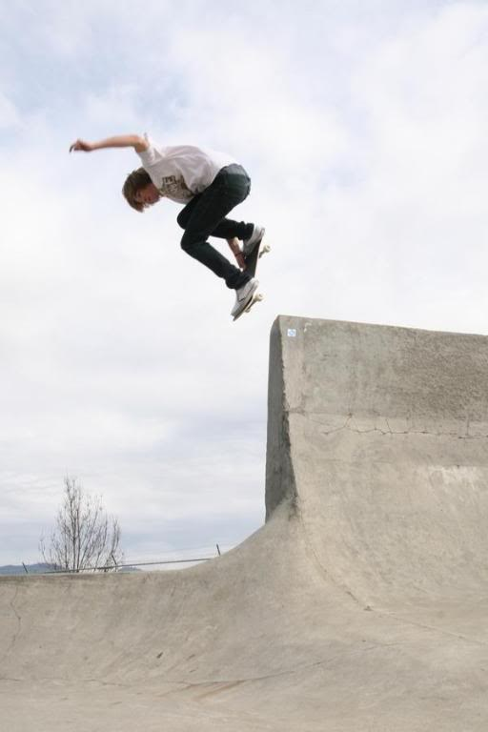
GRADE 8 · LESSON 8
Having Fun: Free Time
Bo‘sh vaqtni qiziqarli o‘tkazish
Unit 2. Having Fun. Zak and Matt talk (Reading)
Vlwisconsin (talk) · Public domain
sozlar.com

Slide 2
LESSON AIMS
Bugungi maqsad
1
Name twenty free-time activities and hobbies
2
Match the Wordpower definitions (free time, member, join, hang out, hobby, collect, beginner)
3
Find past time phrases in a dialogue (last night, a year ago, recently)
4
Suggest a hobby with Why not…? / How about…ing?

Slide 3
BOOK TASK · 10 MINUTES
Book tasks — Laser A2, pp. 14–15
Get ready!, the dialogue and Wordpower.
1
Get ready! Find the words in the letters (cinema, internet, photographs, concert…). Which activities do you like?
2
ex.1 Read quickly and tick the main thing Zak and Matt are talking about.
3
ex.2 Zak or Matt? Write the name next to each statement.
4
ex.3 When did these things happen? Write a word or short phrase.
5
Wordpower Write a word for each definition — the first letter is given.

Slide 4
VOCABULARY
A. Going out and staying in (1/2)
🍿️
see a film
film ko‘rmoq
We saw a film about a boy and his dog.
🏠️
stay at home
uyda qolmoq
It was cold and rainy, so I stayed at home all day.
🎮️
play video games
video o‘yin o‘ynamoq
My little brother played video games for two hours yesterday.
🌐️
surf the internet
internetda kezmoq
I surfed the internet and found some funny videos about cats.
🎤️
go to a concert
konsertga bormoq
Last summer our class went to a concert in the city park.

Slide 5
VOCABULARY
A. Going out and staying in (2/2)
📷️
take photographs
suratga olmoq
Dilnoza took photographs of the mountains on our trip.
🍽️
go out to a restaurant
restoranga borib ovqatlanmoq
For my mum’s birthday we went out to a restaurant in the centre.
📚️
have a lot of homework
uy vazifasi ko‘p bo‘lmoq
I couldn’t play football because I had a lot of homework.
🛋️
do nothing
hech narsa qilmay o‘tirmoq
On Sunday I was tired, so I stayed in bed and did nothing all morning.
👫️
have friends round
do‘stlarni uyga chaqirmoq
On Wednesday we had friends round and watched a football match.

Slide 6
VOCABULARY
B. Hobbies and free time (1/2)
🆓️
free time
bo‘sh vaqt
Last week I spent most of my free time in the park with my friends.
🪙️
collect coins
tanga yig‘moq
My uncle collects coins and keeps them in a special book.
🌍️
from all over the world
dunyoning turli burchaklaridan
Tourists from all over the world visit Samarkand every year.
🎻️
learn to play an instrument
cholg‘u chalishni o‘rganmoq
Last year Bekzod decided to learn to play an instrument.

Slide 7
VOCABULARY
B. Hobbies and free time (2/2)
💨️
disappear
g‘oyib bo‘lmoq
The weekend went so fast — it just disappeared!
🍳️
cooking
ovqat pishirish
My brother’s new hobby is cooking — last Sunday he made plov for us.
🌱️
gardening
bog‘dorchilik (bog‘da ishlash)
My grandmother loves gardening, and last spring she planted ten rose bushes.

Slide 8
VOCABULARY
C. Clubs and sport (1/2)
🪪️
be a member of a club
to‘garak a’zosi bo‘lmoq
Last year my brother was a member of a club for young chess players.
💻️
a computer club
kompyuter to‘garagi
In the computer club we learnt to make a simple website.
🎾️
play tennis
tennis o‘ynamoq
Nodira played tennis with her dad on Sunday morning.

Slide 9
VOCABULARY
C. Clubs and sport (2/2)
🛹️
go skateboarding
skeytbordda uchishga bormoq
Yesterday I went skateboarding in the park with my cousin.
🔰️
a beginner
yangi boshlovchi
I’m only a beginner, so I fell three times on my first day.
🕓️
be free
vaqti bo‘sh bo‘lmoq
I called Timur, but he wasn’t free on Saturday.

Slide 10
VOCABULARY
D. When did it happen? (1/2)
🌙️
last night
kecha kechqurun
Last night I read a comic until ten o’clock.
📅️
last week
o‘tgan hafta
Our teacher showed us a new board game last week.
🗓️
on Monday evening
dushanba kuni kechqurun
On Monday evening we had a family dinner at my grandmother’s house.

Slide 11
VOCABULARY
D. When did it happen? (2/2)
⏳️
in the past
ilgari, avvallari
In the past my dad played football for a team in Andijan.
🕰️
a year ago
bir yil oldin
We moved to Tashkent a year ago.
🆕️
recently
yaqinda
My aunt recently started a cooking class.

Slide 12
TODAY'S WORDS IN CONTEXT
Two friends, two weekends (1/2)
Aziz had a lot of homework last weekend, so he stayed at home. On Saturday he played video games and surfed the internet. 'I never know what to do in my free time,' he told his friend Timur on Monday.
Timur has the opposite problem — he has lots of hobbies. He plays the guitar, he collects coins from all over the world, and last week he went skateboarding for the first time. 'I'm a beginner,' he said, 'but it's a lot of fun.'
Cover the word list. Can you understand the words in bold from the sentence?

Slide 13
TODAY'S WORDS IN CONTEXT
Two friends, two weekends (2/2)
In the past Timur was a member of four school clubs, but they took too much time. Now he is only in the photography club. 'It sounds as if you need a hobby,' he told Aziz. 'Why not join a club? How about coming to the photography club with me? It meets once a week.' 'OK,' said Aziz. 'That sounds really interesting.'
Cover the word list. Can you understand the words in bold from the sentence?

Slide 14
TODAY'S WORDS IN CONTEXT
Read and answer
1
Why did Aziz stay at home last weekend?
2
What are Timur's hobbies?
3
Is Timur good at skateboarding?
4
Why did Timur leave some clubs?
5
What does Timur suggest?

Slide 15
PAIRS · ESDA QOLDIMI?
Memory check — Wordpower definitions
Juftingiz ta’rifni o‘qiydi, siz so‘zni aytasiz.
1
time when you can do what you want · someone who is in a club · get and keep coins, stamps …
2
someone who is starting to learn something · not busy, with time to do something · games you play on a screen
3
growing flowers and vegetables · making food · go away so nobody can see it

Slide 16
FOCUS
Reading a dialogue — who, what, when
• First read quickly for the main topic (ex.1) — what are Zak and Matt talking about?
• Then read for names: who did it — Zak or Matt? (ex.2)
• Then read for time phrases: last night · on Wednesday · on Thursday evening · in the past · a year ago · last week (ex.3).
• Most verbs are in the past simple: went, saw, stayed, played, came, had, gave.
• Suggestions: Why not + verb? · How about + -ing? — reply: That sounds really interesting.

Slide 17
STRATEGY
Reading for detail — three passes
1
Pass 1 (1 min): tick the main thing they talk about.
2
Pass 2: underline every name + action.
3
Pass 3: circle every time phrase and match it to an action.

Slide 18
PRONUNCIATION
Say it — don’t just read it
Past -ed endings and tricky words — repeat:
stayed at home /steɪd/
surfed the internet /sɜːft/
disappeared /ˌdɪsəˈpɪəd/
collected coins /kəˈlektɪd/
an instrument /ˈɪnstrəmənt/
gardening /ˈɡɑːdnɪŋ/
a beginner /bɪˈɡɪnə/
recently /ˈriːsntli/
Only verbs ending in t or d add a new syllable: col-lec-ted, de-ci-ded.

Slide 19
WHOLE CLASS
Practice — complete the sentence (1/2)
1
What do you do in your ________ ________? — I play the guitar.
2
I didn't go out last night. I ________ ________ ________ and watched TV.
3
Mum says I can ________ ________ ________ on Friday, so I've invited three classmates.
4
My brother ________ ________ from all over the world. (collect · coins)
5
Are you a ________ of the photography club?
6
Our school has a ________ ________ for students who like making websites.

Slide 20
WHOLE CLASS
Practice — complete the sentence (2/2)
7
I can't skate well yet — I'm a ________.
8
My dad gave me my first coin a ________ ________.
9
You're always bored. It ________ ________ ________ you need a hobby!
10
________ ________ learn to play an instrument?
11
Or how ________ ________ photographs?
12
It rained all Saturday, so I just sat on the sofa and ________ ________.

Slide 21
PAIRS · 6 MINUTES
Speaking
Tell your partner what you did in your free time last week — one thing for each day.
Your partner is bored. Suggest two hobbies: 'Why not…? How about…?'

Slide 22
PAIR / GROUP WORK · 8 MINUTES
Vocabulary activity
1
Match the beginnings (1-10) with the endings (a-j).
2
Read your complete sentences aloud.
3
Give the Uzbek meaning of the key word in each sentence.
4
When you finish, swap tables with the other group.

Slide 23
UZ
Qiyin joyi — o‘zbekcha
stay at home — uyda qolish; go out to a restaurant — restoranga borib ovqatlanish; have friends round — do‘stlarni uyga chaqirish.
take photographs — suratga olish; o‘tgan zamoni took photographs (taked emas).
be free — vaqti bo‘sh bo‘lish (I’m free on Saturday.); free time — bo‘sh vaqt (ot).
Taklif: Why not + fe’l (Why not join?), How about + -ing (How about joining?).

Slide 24
HOMEWORK
Uy vazifasi
1
Laser A2 Workbook pp. 10–11, ex. 1–3.
2
Learn the 29 items with the flashcards: sozlar.com/vocab/cards/?set=grade8-lesson8
3
Write six sentences: what did you do in your free time last week?

Slide 25
IMAGE CREDITS
Rasmlar manbasi
cover
Vlwisconsin (talk) · Public domain · https://commons.wikimedia.org/wiki/File:BackSmithGrind.jpg

Slide 26
Uchta so‘z — ertaga ham esingizda qoladi
Juftingizga ayting, so‘ng daftaringizga yozib qo‘ying.
sozlar.com/vocab/cards/?set=grade8-lesson8

