Slide 1
GRADE 7 · LESSON 7
Writing a Personal Profile
Shaxsiy profil yozish
Writing: personal profile (Unit 1)
A What I look like · B Me and my family · C My room · D My favourite things
sozlar.com

Slide 2
LESSON AIMS
Bugungi maqsad
1
Say which of the four paragraphs each piece of information belongs to
2
Use short forms and an exclamation mark in informal writing
3
Write the first two paragraphs of their own profile in class

Slide 3
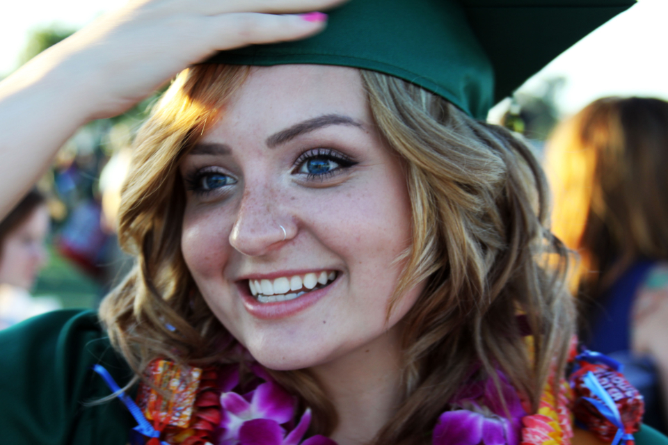
LOOK AND SAY
Bugungi mavzu
Candace McDaniel · CC0 1.0
What can you see? Say three sentences about the picture.

Slide 4
MODEL TEXT · 4 MINUTES
Zara's profile — Laser A1+, p. 12
Four paragraphs, one topic each. Read and find the short forms.
1
1 I'm Zara and I'm 13 years old. I'm quite tall. I've got long brown hair and blue eyes. And I've got a beautiful smile. That's what my friends say, anyway!
2
2 I've got a large family. I've got two brothers and two sisters, and we're very close. My sisters are my best friends, really. We don't have many cousins, so we spend a lot of time with each other.
3
3 I share a room with my sisters, but it's a large room so that's OK. I've got a desk, where I do my homework, and it's got my computer on it. Over the desk I've got pictures of my favourite bands!
4
4 My favourite film star is Jennifer Aniston because her films are always very funny! My favourite singer is called Adele. She has a fantastic voice. And my favourite book is the first Harry Potter book.

Slide 5
VOCABULARY
A. What I look like (1/2)
📏️
quite tall
ancha baland bo‘yli
Dilnoza is quite tall for a twelve-year-old.
👩️
brown hair
qo‘ng‘ir soch
I’ve got short brown hair like my dad.
👱‍♀️
blonde hair
sariq soch
The girl in this photo has got long blonde hair.
👁️
blue eyes
ko‘k ko‘zlar
My baby cousin has got big blue eyes.
😊️
a beautiful smile
chiroyli tabassum
Our teacher has got a beautiful smile.

Slide 6
VOCABULARY
A. What I look like (2/2)
😎️
good-looking
kelishgan, chiroyli
My uncle is tall and good-looking, like a film star.
🌸️
pretty
yoqimtoy, chiroyli
My little sister has got a pretty face and big brown eyes.
💚️
green eyes
yashil ko‘zlar
My cousin Malika has got big green eyes.
🧔️
a beard
soqol
My grandfather has got a long white beard.
👨️
a moustache
mo‘ylov
My dad has got a black moustache but no beard.

Slide 7
VOCABULARY
B. Me and my family
🔗️
have in common
o‘xshash jihatlari bor bo‘lmoq
Aziz and I have a lot in common — we both love football.
😤️
argue
tortishmoq, janjallashmoq
My brother and I sometimes argue about the TV.
👭️
help each other
bir-biriga yordam bermoq
My sister and I help each other with our homework.

Slide 8
VOCABULARY
C. My room
🗺️
over the desk
stol tepasida (devorda)
There’s a big map of Uzbekistan over the desk.
🖼️
a picture
rasm, surat
I’ve got a picture of my favourite football team on the wall.
📚️
a bookcase
kitob javoni
There’s a tall bookcase next to my bed.
🪟️
a window
deraza
My desk is next to the window, so it’s very light.
📷️
a photo frame
rasm ramkasi
There’s a photo frame with a picture of my family on my desk.

Slide 9
VOCABULARY
D. My favourite things (1/2)
🎬️
a film star
kino yulduzi
My mum’s favourite film star is from India.
🎭️
an actress
aktrisa
She’s an actress and she’s in a new film this year.
🎞️
an actor
aktyor
My uncle is an actor and he works in a theatre in Tashkent.
🎤️
a singer
xonanda, qo‘shiqchi
Sevara Nazarkhan is a famous Uzbek singer.
🎸️
a band
musiqa guruhi
My brother plays the guitar in a school band.

Slide 10
VOCABULARY
D. My favourite things (2/2)
🌟️
famous
mashhur
Amir Temur Square is a famous place in Tashkent.
🎶️
a fantastic voice
ajoyib ovoz
Listen to her — she’s got a fantastic voice!
🎢️
full of excitement
hayajonga to‘la
This adventure book is full of excitement from the first page.
🪄️
magic
sehr, sehrgarlik
Harry Potter books are full of magic.
🙋️
a fan
muxlis
I’m a big fan of this band — I know all their songs.

Slide 11
TODAY'S WORDS IN CONTEXT
About me! — Zara's profile (Laser A1+, p. 12) (1/2)
I'm Zara and I'm 13 years old. I'm quite tall. I've got long brown hair and blue eyes. And I've got a beautiful smile. That's what my friends say, anyway!
I've got a large family. I've got two brothers and two sisters, and we're very close. My sisters are my best friends, really. We don't have many cousins, so we spend a lot of time with each other. Of course, we've got our own friends as well.
Cover the word list. Can you understand the words in bold from the sentence?

Slide 12
TODAY'S WORDS IN CONTEXT
About me! — Zara's profile (Laser A1+, p. 12) (2/2)
I share a room with my sisters, but it's a large room so that's OK. I've got a desk, where I do my homework, and it's got my computer on it. Over the desk I've got pictures of my favourite bands and film stars! I've also got lots of photos of me and my sisters!
My favourite film star is Jennifer Aniston because her films are always very funny! My favourite singer is called Adele. She has a fantastic voice. And my favourite book is the first Harry Potter book. It's full of excitement and magic!
Cover the word list. Can you understand the words in bold from the sentence?

Slide 13
TODAY'S WORDS IN CONTEXT
Read and answer
1
Zara has long hair and brown eyes. True or false?
2
Zara has lots of cousins. True or false?
3
Zara and her sisters' room is quite small. True or false?
4
Zara has pictures of famous people in her room. True or false?

Slide 14
PAIRS · ESDA QOLDIMI?
Memory check — cover the Uzbek column
Juftingiz inglizchasini o‘qiydi, siz o‘zbekchasini aytasiz. So‘ng almashinasiz.
1
Say the Uzbek meaning: a beard · a bookcase · full of excitement
2
Say the English: ancha baland bo‘yli · mo‘ylov · muxlis · tortishmoq
3
Name the four paragraphs of Zara’s profile without looking.
4
Say three sentences about yourself using short forms only.
5
Write down the three phrases you keep forgetting.

Slide 15
FOCUS
Language Lab — four rules from p. 12
• Short forms: I'm · I've got · we're · it's · don't — a profile is informal writing.
• Introduce yourself with your first name: I'm Zara and I'm 13 years old.
• Exclamation marks show emotion — but two or three in the whole text, not in every line.
• A new topic → a new paragraph. Zara has four: how she looks · her family · her room · her favourites.
• Give a reason with because: …because her films are always very funny!

Slide 16
STRATEGY
Writing a profile — four paragraphs
1
Paragraph 1 — me: name, age, height, hair and eyes.
2
Paragraph 2 — my family: how many, how close, who your best friend is.
3
Paragraph 3 — my room: alone or shared, what is on the desk and on the wall.
4
Paragraph 4 — my favourites: a film star, a singer, a book — and why.

Slide 17
PRONUNCIATION
Say it — don’t just read it
These words are hard to say. Listen and repeat, then read Zara's first paragraph aloud:
a moustache /ə məˈstɑːʃ/
a beard /ə bɪəd/
blonde hair /blɒnd heə/
argue /ˈɑːɡjuː/
a bookcase /ə ˈbʊkkeɪs/
an actress /ən ˈæktrəs/
a fantastic voice /ə fænˈtæstɪk vɔɪs/
full of excitement /fʊl əv ɪkˈsaɪtmənt/
Now say: My uncle has got a beard and a moustache, and he's an actor.

Slide 18
BOOK TASK · 7 MINUTES
Book tasks — Laser A1+, p. 12, ex. 1 and ex. 3
First true or false, then match each paragraph with a statement.
1
ex.1 1 Zara has long hair and brown eyes. T / F
2
2 Zara has lots of cousins. T / F · 3 Their room is quite small. T / F
3
4 Zara has pictures of famous people in her room. T / F
4
ex.3 Paragraph 1 · 2 · 3 · 4 — match with a, b, c, d:
5
a) Zara's room and the things that are important to her · b) Zara and what she looks like
6
c) Zara's family and friends · d) some things that Zara likes a lot

Slide 19
WHOLE CLASS
Practice — complete the sentence (1/2)
1
My uncle shaves his chin but not his top lip, so he's got a ________.
2
I'm ________ ________ for my age, like my father.
3
Her hair is not black and not blonde: she's got long ________ ________.
4
Malika and I like the same books and the same songs, so we have a lot ________ ________.
5
My brother and I ________ about the computer every evening — he wants it and I want it!
6
I'm good at maths and Aziz is good at English, so we ________ ________ ________ before tests.

Slide 20
WHOLE CLASS
Practice — complete the sentence (2/2)
7
All my books are on the ________ in the corner of my room.
8
________ ________ ________ I've got a poster of my favourite team.
9
Everybody stops talking when she sings: she has ________ ________ ________.
10
The last Harry Potter book is ________ ________ ________ and magic!
11
When you write about a new topic, ________ ________ ________ ________.
12
We use an ________ ________ to show emotion: What a day!

Slide 21
PAIRS
Speaking
Read Zara's profile and say what you and Zara have in common: 'Zara's got blue eyes and I've got blue eyes too.'
Tell your partner your four paragraph headings and one sentence for each.
Candace McDaniel · CC0 1.0

Slide 22
PAIR / GROUP WORK · 8 MINUTES
Vocabulary activity
1
Match the beginnings (1-10) with the endings (a-j).
2
Read your complete sentences aloud.
3
Give the Uzbek meaning of the key word in each sentence.
4
When you finish, swap tables with the other group.

Slide 23
UZ
Qiyin joyi — o‘zbekcha
Har bir yangi mavzu — yangi xatboshi. Zarada to‘rtta: tashqi ko‘rinish, oila, xona, sevimlilari.
Norasmiy yozuvda qisqartma ishlatiladi: I've got, we’re, it's — to‘liq shakl quruq eshitiladi.
quite tall — «ancha baland», very tall emas: quite darajani biroz pasaytiradi.
Undov belgisi hissiyot uchun, lekin har gapda emas — butun matnda uch-to‘rttasi yetadi.
Sababni because bilan ayting: …because her films are always very funny.

Slide 24
HOMEWORK
Uy vazifasi
1
Finish your personal profile: paragraphs 3 (my room) and 4 (my favourites), with a reason for each favourite.
2
Learn the 28 items (sections A-D) with the flashcards: sozlar.com/vocab/cards/?set=grade7-lesson7
3
Laser A1+ Workbook p. 9.

Slide 25
IMAGE CREDITS
Rasmlar manbasi
profile
Candace McDaniel · CC0 1.0 · https://stocksnap.io/photo/education-graduation-XAL3MIM3OC

Slide 26
Uchta so‘z — ertaga ham esingizda qoladi
Juftingizga ayting, so‘ng daftaringizga yozib qo‘ying.
sozlar.com/vocab/cards/?set=grade7-lesson7

