Slide 1
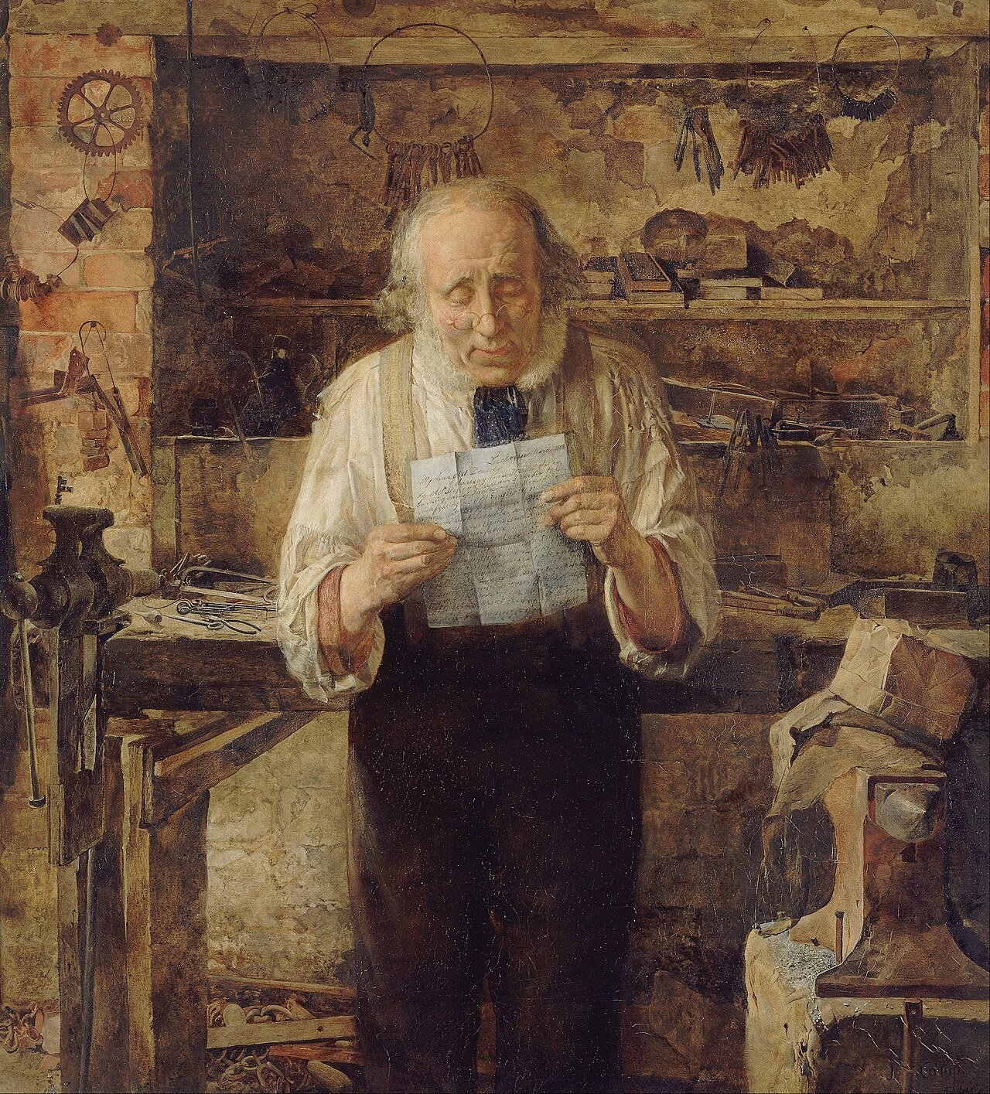
GRADE 10 · LESSON 7
Writing: An Informal Letter
Norasmiy xat yozish
Writing: An informal letter/email (Unit 1)
James Campbell (1828–1893) · Public domain
sozlar.com

Slide 2
LESSON AIMS
Bugungi maqsad
1
Swap five formal expressions for informal ones
2
Use six news phrases from Martina's letter (Anyway, The big news is…, Oh, and another thing!…)
3
Name five features of informal writing
4
Plan and start the letter to Dean (Laser p. 13 ex. 6–8)

Slide 3
VOCABULARY
A. Letters and emails (1/2)
✉️
an informal letter
norasmiy xat
My cousin wrote me a long informal letter full of family news.
📜️
a formal letter
rasmiy xat
You send a formal letter to a company or a school director.
🌍️
a pen-friend
yozishma do‘sti
My pen-friend in Canada writes to me every month.
🧳️
live abroad
chet elda yashamoq
My aunt has lived abroad for ten years, in Germany.
👨‍👩‍👧
the family news
oilaviy yangiliklar
Grandma always wants to hear the family news when she phones.

Slide 4
VOCABULARY
A. Letters and emails (2/2)
↩️
reply to a letter
xatga javob yozmoq
I’m sorry I didn’t reply to your letter earlier — I was ill.
✍️
write back
javob yozmoq
Please write back soon and tell me about your new school.
📄️
a paragraph
xatboshi
Each paragraph of your letter should have one main piece of news.
🏠️
an address
manzil
Don’t put your address at the top of an email.
🖊️
sign a letter
xatga imzo qo‘ymoq
Martina signed her letter with just her first name.

Slide 5
VOCABULARY
B. Starting and ending a letter (1/2)
🎩️
Dear Sir or Madam
Hurmatli janob yoki xonim (ismini bilmaganda)
The letter to the hotel began with Dear Sir or Madam.
🤝️
Yours faithfully
Hurmat bilan (rasmiy; ismini bilmaganda)
He finished his letter to the bank with Yours faithfully.
📨️
Yours sincerely
Hurmat bilan (rasmiy; ismini bilganda)
I wrote ’Dear Mrs Karimova’ at the top and ’Yours sincerely’ at the end.
❤️
All my love
Butun mehrim bilan (yaqinlarga xat oxirida)
Martina ended her letter to her cousin with ’All my love’.

Slide 6
VOCABULARY
B. Starting and ending a letter (2/2)
💕️
Lots of love
Ko‘p-ko‘p mehr bilan (yaqinlarga)
Mum’s messages always finish with ’Lots of love’ and a heart.
🌟️
Best wishes
Eng yaxshi tilaklar bilan
To my old teacher I wrote ’Best wishes, Aziz’.
👋️
Bye for now
Hozircha xayr
That’s all my news. Bye for now!

Slide 7
VOCABULARY
C. Informal style (1/2)
👔️
formal language
rasmiy til
Formal language sounds strange in a letter to your brother.
👕️
informal language
norasmiy til, so‘zlashuv tili
Use informal language when you write to friends and family.
🗣️
a conversational tone
so‘zlashuv ohangi (gaplashayotgandek)
Her email has a conversational tone, as if she is sitting next to me.
✂️
a contraction
qisqartirilgan shakl (it’s, we’re)
"Can’t" is a contraction of "cannot".

Slide 8
VOCABULARY
C. Informal style (2/2)
❗️
an exclamation mark
undov belgisi (!)
Don’t put an exclamation mark after every sentence!
🧩️
an incomplete sentence
to‘liqsiz gap
"Good luck!" is an incomplete sentence, but it’s fine in a letter to a friend.
💬️
everyday vocabulary
kundalik so‘zlar
Choose everyday vocabulary: "get" sounds friendlier than "receive".

Slide 9
VOCABULARY
D. Linking words and family news (1/2)
↪️
anyway
xullas, nima bo‘lsa ham (mavzuga o‘tish)
Anyway, that’s enough about my exams — how’s your new flat?
☝️
one last thing
oxirgi bir gap
One last thing — do you still have my blue scarf?
💡️
actually
aslida
I thought the party was on Friday, but actually it’s on Saturday.
📰️
the big news
eng katta yangilik
The big news is that we’re moving to Samarkand!

Slide 10
VOCABULARY
D. Linking words and family news (2/2)
📬️
hear from someone
kimdandir xabar olmoq
I haven’t heard from my pen-friend in Canada for two months.
💍️
a wedding
to‘y
The whole family came to my sister’s wedding in Namangan.
🎉️
have a wonderful time
ajoyib vaqt o‘tkazmoq
We had a wonderful time at my cousin’s wedding.

Slide 11
TODAY'S WORDS IN CONTEXT
A model answer — Dear Dean, (Laser B1+ p. 13, ex. 6) (1/2)
Dear Dean,
How are you? Sorry I didn't reply to your letter sooner — life here is so busy! Anyway, you asked me about the family I'm staying with, so here's all the news.
I'm staying with the Carters in York, and I love it! It's a beautiful old town with a river. Mr Carter is a doctor and he's really funny — he tells jokes at every meal. Mrs Carter teaches music, so there's always somebody playing the piano.
Cover the word list. Can you understand the words in bold from the sentence?

Slide 12
TODAY'S WORDS IN CONTEXT
A model answer — Dear Dean, (Laser B1+ p. 13, ex. 6) (2/2)
Oh, and another thing! Their son Tom is my age. He's crazy about football, and last Saturday we went to a real match. We lost, but we had a wonderful time. Their daughter Amy is only six, but she's teaching me English songs. Can you believe it?
One last thing. How's Mum's new job? Actually, I haven't heard from her for two weeks. And did you pass your driving test? Please write back soon — tell me all your news!
That's all for now. Everybody sends their love.
Love,
Aziz
Cover the word list. Can you understand the words in bold from the sentence?

Slide 13
TODAY'S WORDS IN CONTEXT
Read and answer
1
Who is Aziz writing to, and why is the letter informal?
2
Which phrase does Aziz use to go back to the main topic?
3
What do Mr and Mrs Carter do?
4
Find three contractions in the letter.
5
How many paragraphs are there between 'Dear Dean' and 'Love'?

Slide 14
PAIRS · ESDA QOLDIMI?
Memory check — formal → informal
Juftingiz rasmiy iborani aytadi, siz norasmiysini aytasiz.
1
Dear Sir or Madam → … · Yours faithfully → … · I look forward to hearing from you → …
2
a formal letter → … · formal language → … · Yours sincerely → …
3
Give three ways to end a letter to a friend.

Slide 15
FOCUS
Informal letter — the shape
• Start: Dear + first name, → a friendly opening line: It was great to hear from you! / Sorry I didn't reply sooner.
• Middle: one topic per paragraph; move on with Anyway, … · Oh, and another thing! · One last thing.
• Style: contractions, everyday words, a few exclamation marks, questions to the reader.
• End: a short closing line (That's all for now. · Write again soon.) + Love, / All my love, / Best wishes, + first name.
• Never in an informal letter: Dear Sir / Madam, Yours faithfully, I look forward to hearing from you.

Slide 16
STRATEGY
Writing an informal letter — four steps
1
Read the task: who to, why, how many words?
2
Plan the paragraphs (Laser p.13 ex.7 questions).
3
Write — Dear…, opening line, 3 paragraphs, closing line.
4
Check it out! (p.13): contractions, no formal phrases, 120–180 words.

Slide 17
BOOK TASK · 10 MINUTES
Book tasks — Laser B1+, pp. 12–13
From Martina's letter to your own plan.
1
ex.1 Read the task — why should the letter be informal?
2
ex.2 Match the formal language (1–7) with the informal language (a–g).
3
ex.4 Find the informal words and phrases in Martina's letter.
4
ex.5 True or false: five statements about informal writing.
5
ex.6–7 The letter to Dean — make a plan with the questions; then Writing Planner 1 (p. 155).

Slide 18
PRONUNCIATION
Say it — don’t just read it
Stress and tricky sounds in the new words:
faithfully /ˈfeɪθfəli/
sincerely /sɪnˈsɪəli/
abroad /əˈbrɔːd/
a paragraph /ə ˈpærəɡrɑːf/
a contraction /ə kənˈtrækʃn/
an exclamation mark /ən ˌekskləˈmeɪʃn mɑːk/
conversational /ˌkɒnvəˈseɪʃənl/
vocabulary /vəˈkæbjələri/
Read Martina's first paragraph aloud — no full forms!

Slide 19
WHOLE CLASS
Practice — complete the sentence (1/2)
1
A letter to a company starts with 'Dear ________ or ________'.
2
I ________ ________ ________ hearing from you. (formal)
3
It was ________ to ________ from you! (g… · h…)
4
Hope ________ ________. (informal: hammasi joyida)
5
The ________ ________ is that my sister got engaged! (b… n…)
6
My cousin got married last week — the ________ was in Bukhara and 300 guests came. (w…)

Slide 20
WHOLE CLASS
Practice — complete the sentence (2/2)
7
Grandma and Grandpa say hello. Everybody ________ ________ ________.
8
In informal letters we use ________: it's, we're, can't.
9
Sorry I didn't ________ ________ — I had exams. (r… sooner)
10
My uncle works in Korea now — he ________ ________ with his whole family. (l… a…)
11
Write to a friend in a ________ ________, as if you are chatting face to face. (c… t…)
12
You don't know the name, so you end the letter with 'Yours ________'. (f…)

Slide 21
PAIR / GROUP WORK · 6 MINUTES
Vocabulary activity
1
Match the beginnings (1-10) with the endings (a-j).
2
Read your complete sentences aloud.
3
Give the Uzbek meaning of the key word in each sentence.
4
When you finish, swap tables with the other group.

Slide 22
PAIRS · 3 MINUTES
Speaking
Tell your partner the big news from last month — then say 'Anyway, …' and add one more piece of news.
Do you have a pen-friend or a relative who lives abroad? How often do you hear from them?

Slide 23
UZ
Qiyin joyi — o‘zbekcha
Yours faithfully — kimga yozayotganingizni (ismini) bilmasangiz (Dear Sir or Madam); Yours sincerely — ismini bilsangiz (Dear Mr Brown).
Norasmiy xatda qisqartmalar tabiiy: it's, we're, I'd; to‘liq shakl sovuq eshitiladi.
Anyway — mavzuga qaytish yoki yangi mavzuga o‘tish; o‘zbekcha «xullas».
Love, / All my love, — oila va yaqin do‘stga; Best wishes, — do‘stona, ammo biroz betaraf.
hear from someone — «kimdandir xabar olmoq»: I haven’t heard from him for a month. hear about — biror narsa haqida eshitmoq.

Slide 24
HOMEWORK
Uy vazifasi
1
Finish the letter to Dean (120–180 words) and tick the Check it out! list on p. 13.
2
Learn the 31 items with the flashcards: sozlar.com/vocab/cards/?set=grade10-lesson7
3
Plan homework: write the informal letter (Laser B1+ p. 13, ex. 8).

Slide 25
IMAGE CREDITS
Rasmlar manbasi
cover
James Campbell (1828–1893) · Public domain · https://commons.wikimedia.org/wiki/File:James_Campbell_-_News_from_My_Lad_-_Google_Art_Project.jpg

Slide 26
Uchta so‘z — ertaga ham esingizda qoladi
Juftingizga ayting, so‘ng daftaringizga yozib qo‘ying.
sozlar.com/vocab/cards/?set=grade10-lesson7

