Slide 1
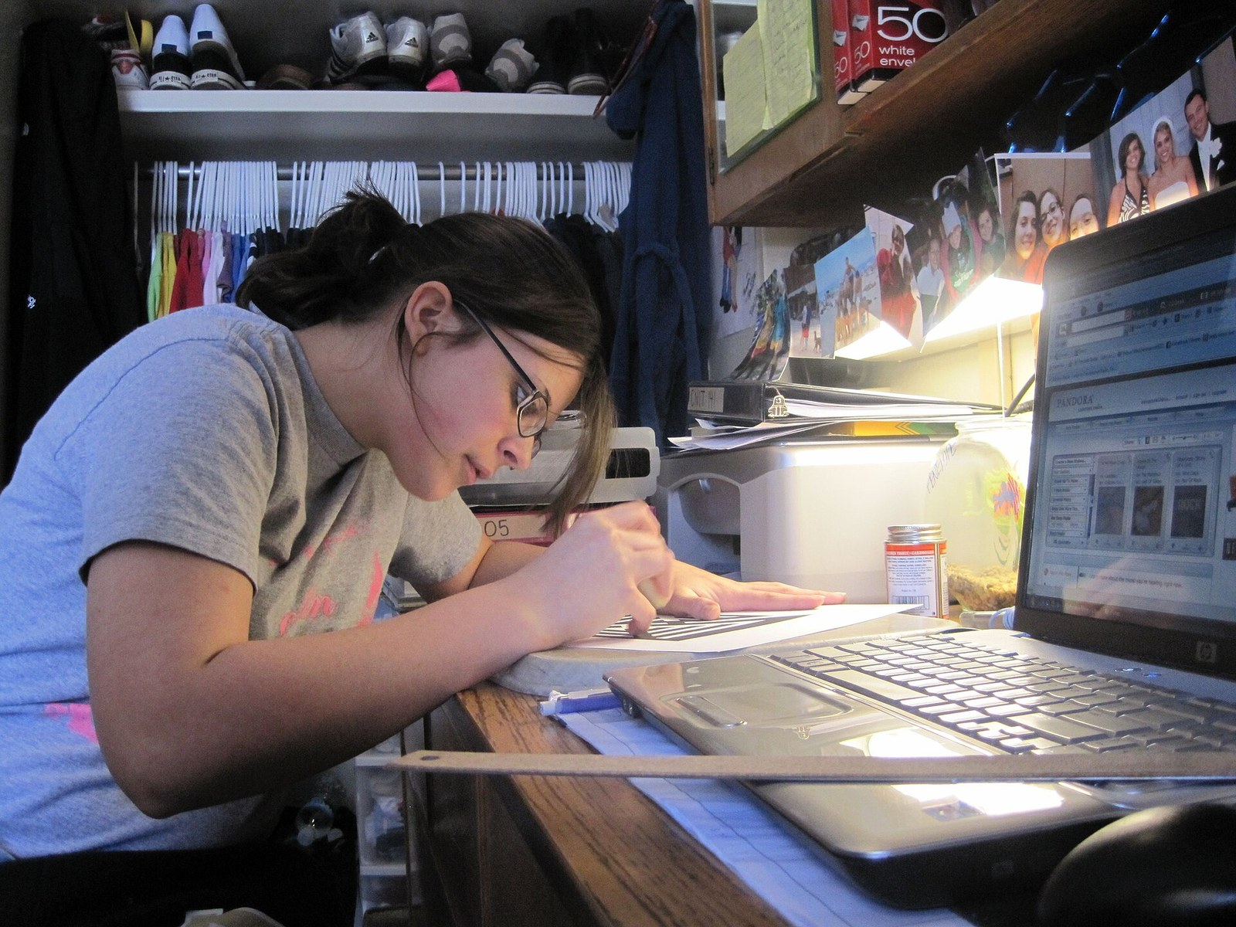
GRADE 8 · LESSON 7
Unit 1 Revision
1-bo‘lim takrori
Revision (Unit 1)
English106 · CC BY 2.0
sozlar.com

Slide 2
LESSON AIMS
Bugungi maqsad
1
Recall thirty-two Unit 1 words and phrases in context
2
Describe a person's appearance in three sentences
3
Complete a mixed revision test with at least 14/20
4
Name the words they still need to learn

Slide 3
VOCABULARY
A. Daily routine and housework (lesson 2) (1/2)
🌅️
wake up
uyg‘onmoq
On school days I wake up before my alarm clock rings.
😴️
have a lie-in
ertalab kechroq turmoq, to‘yib uxlamoq
There are no lessons tomorrow, so I can have a lie-in.
🛏️
make your bed
o‘rin-ko‘rpani yig‘ishtirmoq
Mum asks me to make my bed every morning before school.
🙆️
get up
o‘rnidan turmoq (yotoqdan)
My grandfather gets up at five and goes for a walk.

Slide 4
VOCABULARY
A. Daily routine and housework (lesson 2) (2/2)
🏠️
get back
(uyga) qaytib kelmoq
Dad gets back from work at about seven every evening.
🚪️
go out
ko‘chaga chiqmoq, (uydan) tashqariga chiqmoq
We go out with our friends after lunch on Saturdays.
🧹️
housework
uy ishlari
Everyone in our family helps with the housework at the weekend.
🛒️
do the shopping
bozor-o‘char qilmoq
On Sundays Dad does the shopping at the bazaar near our house.

Slide 5
VOCABULARY
B. Free time and opinions (lesson 3) (1/2)
🧑‍🤝‍🧑
hang out with friends
do‘stlar bilan vaqt o‘tkazmoq
On Saturdays I hang out with friends in the park.
🤝️
meet up
(kelishib) uchrashmoq
We meet up near the school gate at four o’clock.
🎶️
relax
dam olmoq, hordiq chiqarmoq
After lessons I relax and listen to music for an hour.
🌃️
stay up late
kech tungacha uxlamay o‘tirmoq
On Saturdays I stay up late and watch films with my family.

Slide 6
VOCABULARY
B. Free time and opinions (lesson 3) (2/2)
⚽️
be a fan of
…ning muxlisi bo‘lmoq
My brother is a fan of Pakhtakor and never misses a match.
😍️
be keen on
…ga qiziqmoq, …ni yoqtirmoq
Dilshod is keen on photography and takes his camera everywhere.
😖️
can’t stand
…ni juda yomon ko‘rmoq, …ga toqat qilolmaslik
I can’t stand getting up early in winter.
👍️
prefer
afzal ko‘rmoq
I prefer reading to watching TV in the evening.

Slide 7
VOCABULARY
C. Describing people (lesson 4) (1/2)
👀️
look like
tashqi ko‘rinishi qanday bo‘lmoq
What does your brother look like? — He’s tall with fair hair.
↕️
of medium height
o‘rta bo‘yli
He isn’t tall or short — he’s of medium height.
😎️
good-looking
kelishgan, chiroyli
The new boy is good-looking and very friendly.
➖️
straight hair
tekis (to‘g‘ri) soch
My mother has got long straight hair.

Slide 8
VOCABULARY
C. Describing people (lesson 4) (2/2)
➰️
curly hair
jingalak soch
Our goalkeeper is the boy with curly hair.
🧓️
a beard
soqol
My grandfather has got a long white beard.
👨️
a moustache
mo‘ylov
Our maths teacher has got a moustache but no beard.
👓️
wear glasses
ko‘zoynak taqmoq
Dilshod wears glasses when he reads.

Slide 9
VOCABULARY
D. Profiles and projects (lessons 5–6) (1/2)
🪪️
a profile
profil (shaxsiy sahifa)
I’m writing a profile for our class website.
🔖️
a heading
sarlavha (bo‘lim nomi)
Each part of my profile has a heading, like My family or My interests.
💬️
informal
norasmiy
A profile is informal, so I write I’m and she’s.
🎯️
an ambition
orzu, hayotiy maqsad
My ambition is to become an engineer.

Slide 10
VOCABULARY
D. Profiles and projects (lessons 5–6) (2/2)
🗂️
a section
bo‘lim
My page has six sections, and each one has a heading.
💡️
come up with
o‘ylab topmoq
Can you come up with a name for our class blog?
🏷️
a caption
surat ostidagi yozuv
The caption under the photo says: Me and my dog.
✔️
check your spelling
imloni tekshirmoq
Always check your spelling before you give your work to the teacher.

Slide 11
TODAY'S WORDS IN CONTEXT
Madina's week (1/2)
Madina is thirteen. On weekdays she wakes up at half past six, gets dressed quickly and catches the bus at seven. She hardly ever skips breakfast, but on Monday she overslept and left home in a hurry. On Sundays she has a lie-in and then she helps with the housework.
She is a fan of basketball, so last month she joined a club — the school basketball club. She is good at maths and she is keen on photography, but she can't stand staying up late.
Cover the word list. Can you understand the words in bold from the sentence?

Slide 12
TODAY'S WORDS IN CONTEXT
Madina's week (2/2)
Her best friend, Zarina, is of medium height and has got long straight hair. She wears glasses and she's always smiling. 'She's really nice,' Madina says. 'We get on very well.'
This week the class is making a profile page. Madina has decided who to write about — herself — and she has come up with a new section: 'My favourite places'. She has written a caption under each photo, checked her spelling twice and she is proud of her page.
Cover the word list. Can you understand the words in bold from the sentence?

Slide 13
TODAY'S WORDS IN CONTEXT
Read and answer
1
What time does Madina catch the bus?
2
Why did she leave home in a hurry on Monday?
3
Which club did she join?
4
What does Zarina look like?
5
What new section has Madina come up with?

Slide 14
PAIRS · ESDA QOLDIMI?
Memory check — one minute per section
Juftingiz bo‘lim harfini aytadi (A, B, C yoki D), siz bir daqiqada iloji boricha ko‘p so‘z aytasiz.
1
A: routine and housework (wake up, do the shopping …) · B: free time (meet up, prefer …)
2
C: describing people (curly hair, a beard …) · D: profiles and projects (a heading, a caption …)
3
Which three words do you still forget? Write them on a sticky note.

Slide 15
FOCUS
How to revise words — four tips
• Say it in a sentence, not alone: On Sundays I have a lie-in.
• Group words: routine · free time · people · writing.
• Test yourself: cover the English, say it from the Uzbek.
• Mark the difficult ones and revise them again tomorrow — that is how memory works.

Slide 16
TEST · 8 MINUTES
Revision test — part 1 (vocabulary) (1/2)
Choose A, B or C. Write only the letter.
1
Every morning I ___ my bed before school. A make B do C tidy
2
After school I get ___ home at three and have lunch. A back B up C out
3
On Sundays I have a ___ until ten. A sleep-up B lie-in C lie-down
4
I ___ reading to watching TV. A prefer B like C want
5
I ___ stand horror films. A don't B can't C am not
6
He isn't tall or short — he's of ___ height. A half B medium C normal

Slide 17
TEST · 8 MINUTES
Revision test — part 1 (vocabulary) (2/2)
7
My grandfather has got a beard and a ___. A moustache B mustard C mouth
8
Let's ___ up after school — at the gate at four? A hang B meet C make
9
Write a short ___ under each photo. A heading B caption C chapter
10
___ your spelling before you hand it in. A Look B Control C Check

Slide 18
TEST · 7 MINUTES
Revision test — part 2 (grammar and phrases) (1/2)
Complete with one or two words.
11
Right now my brother ___ ___ (play) football.
12
My mum ___ (be) a nurse. She works at night.
13
'___ your name?' 'I'm Aziz.'
14
'___ ___ he look like?' 'He's tall with short hair.'
15
I hardly ___ go to the cinema.
16
She's keen ___ photography.

Slide 19
TEST · 7 MINUTES
Revision test — part 2 (grammar and phrases) (2/2)
17
A profile is ___, so you can write I'm and she's.
18
'— This is my cousin Sardor.' '— Nice to ___ you!'
19
Can you come ___ ___ a good heading for my profile?
20
At the moment I ___ ___ (learn) the guitar.

Slide 20
PRONUNCIATION
Say it — don’t just read it
Stress in revision phrases — repeat:
have a lie-in /ˌhæv ə ˈlaɪ ɪn/
housework /ˈhaʊswɜːk/
of medium height /əv ˈmiːdiəm haɪt/
good-looking /ˌɡʊd ˈlʊkɪŋ/
a beard /bɪəd/
a moustache /məˈstɑːʃ/
an ambition /æmˈbɪʃn/
a caption /ˈkæpʃn/
British English: mouSTACHE /məˈstɑːʃ/; American English: MUStache /ˈmʌstæʃ/.

Slide 21
WHOLE CLASS
Practice — complete the sentence (1/2)
1
On Sunday I don't get up early — I ________ ________ ________ until ten.
2
My parents work late, so they ________ ________ home after eight.
3
Before I go to school, I ________ ________ ________ and open the window.
4
There's no bread or milk, so Mum asks me to ________ ________ ________.
5
I'm a big ________ ________ Real Madrid — I watch all their matches.
6
I ________ ________ cold showers in the morning. I hate them!

Slide 22
WHOLE CLASS
Practice — complete the sentence (2/2)
7
'What does your cousin ________ ________?' 'He's tall and he's got curly hair.'
8
My uncle isn't very tall, but he isn't short either — he's ________ ________ ________.
9
My grandfather has got ________ ________ and ________ ________.
10
Write a short ________ under each photo: 'Me and my sister.'
11
Before you hand in the project, ________ ________ ________.
12
We use the ________ ________ for things that are happening now: 'Anek is watching TV.'

Slide 23
PAIRS
Speaking
Describe a famous person — your partner guesses who it is (hair, height, glasses, beard).
Tell your partner about your typical Saturday in five sentences using words from section A.

Slide 24
PAIR / GROUP WORK · 8 MINUTES
Vocabulary activity
1
Match the beginnings (1-10) with the endings (a-j).
2
Read your complete sentences aloud.
3
Give the Uzbek meaning of the key word in each sentence.
4
When you finish, swap tables with the other group.

Slide 25
UZ
Qiyin joyi — o‘zbekcha
wake up — uyg‘onish (ko‘zni ochish); get up — o‘rindan turish; have a lie-in — dam olish kuni atayin kech turish.
can't stand + odatda -ing: I can't stand getting up early.
be keen on / be a fan of / prefer … to … — predlogni so‘z bilan birga yodlang.

Slide 26
HOMEWORK
Uy vazifasi
1
Revise all Unit 1 words for the next check (plan: Revising).
2
Learn the 32 items with the flashcards: sozlar.com/vocab/cards/?set=grade8-lesson7
3
Revise the two words you circled in the test — write a sentence with each.

Slide 27
IMAGE CREDITS
Rasmlar manbasi
cover
English106 · CC BY 2.0 · https://commons.wikimedia.org/wiki/File:Female_student_writing_and_studying_at_dorm_room_desk.jpg

Slide 28
Uchta so‘z — ertaga ham esingizda qoladi
Juftingizga ayting, so‘ng daftaringizga yozib qo‘ying.
sozlar.com/vocab/cards/?set=grade8-lesson7

