Slide 1
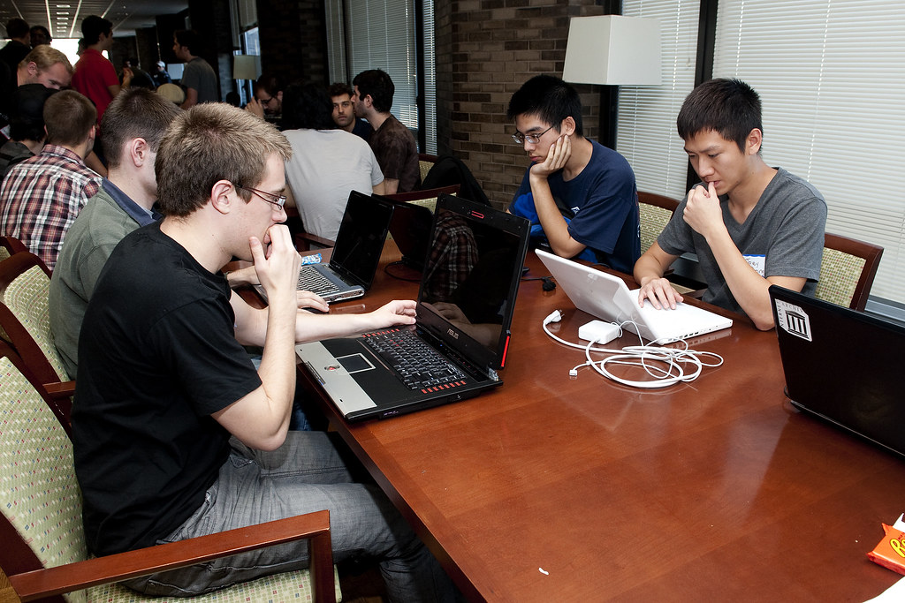
GRADE 8 · LESSON 6
Project: My Website Page
Loyiha: o‘z veb-sahifam
Project work: Creating a website profile (Unit 1)
hackNY · CC BY-SA 2.0
sozlar.com

Slide 2
LESSON AIMS
Bugungi maqsad
1
Fill in the seven rows of the book's planner about themselves or a friend
2
Invent a website address, a welcome message and one section of their own
3
Write three sentences about what their friends are doing right now

Slide 3
BOOK TASK · 8 MINUTES
The planner — Laser A2, p. 13, ex. 2 (1/2)
Eight rows. Fill them with notes first, sentences later.
1
Website address — invent one: www.MyTeenSite.org/…
2
Welcome message — Welcome to …'s page!
3
About me — name · age · where you live
4
My family — parents' names and jobs · brothers and sisters · other members · pets
5
My interests — hobbies and things you love doing
6
My best friends — three names + what each is doing now

Slide 4
BOOK TASK · 8 MINUTES
The planner — Laser A2, p. 13, ex. 2 (2/2)
7
My photos — two pictures with a caption each
8
At the moment I'm … and Other — one more heading of your own

Slide 5
VOCABULARY
A. Planning a project (1/2)
📁️
a project
loyiha
Our class is making a project about our families.
🗓️
plan
rejalashtirmoq
We plan every section before we start writing.
🤔️
decide
qaror qilmoq, hal qilmoq
I can’t decide which photo to put on my page.
📋️
a planner
reja jadvali
Fill in the planner first, then write your page.

Slide 6
VOCABULARY
A. Planning a project (2/2)
🗂️
a section
bo‘lim
My page has six sections, and each one has a heading.
💭️
use your imagination
tasavvurni ishga solmoq
The address isn’t real, so use your imagination.
💡️
come up with
o‘ylab topmoq
Can you come up with a name for our class blog?
🛠️
create
yaratmoq
Our group wants to create a website about our town.

Slide 7
VOCABULARY
B. On a website page (1/2)
🔗️
a website address
sayt manzili
Type the website address carefully — one wrong letter and it doesn’t work.
👋️
a welcome message
salomlashuv xabari
Her welcome message says: Hi, I’m Zarina!
✏️
a drawing
qo‘lda chizilgan rasm
I haven’t got a photo of my cat, so I’m using a drawing.
🏷️
a caption
surat ostidagi yozuv
The caption under the photo says: Me and my dog.
⛓️
a link
havola
Click on the link to see my class page.

Slide 8
VOCABULARY
B. On a website page (2/2)
🖱️
click on
…ni bosmoq (sichqoncha bilan)
Click on a photo to see it bigger.
⬆️
upload
internetga yuklamoq (joylamoq)
Sardor uploads new photos to his page every week.
👤️
a username
foydalanuvchi nomi
My username is kamron_fergana.
🔑️
a password
parol
Never tell anybody your password.

Slide 9
VOCABULARY
C. People and favourite things (1/2)
👨‍👩‍👧
a family member
oila a’zosi
Every family member helps at home on Saturdays.
🧒️
a cousin
amakivachcha, xolavachcha
My cousin Rustam is staying with us this week.
👩️
an aunt
xola, amma
My aunt lives next door and often visits us.
👨‍🦱
an uncle
amaki, tog‘a
My uncle lives in Samarkand and visits us every spring.
🪁️
a hobby
sevimli mashg‘ulot (hobbi)
Her favourite hobby is taking photos of birds.

Slide 10
VOCABULARY
C. People and favourite things (2/2)
🫂️
a best friend
eng yaqin do‘st
My best friend is learning Korean at the moment.
📡️
a TV programme
teleko‘rsatuv
My favourite TV programme is about wild animals.
🎬️
a film
film, kino
We’re watching a funny film about a dog tonight.
🐭️
a cartoon
multfilm
My little brother watches cartoons every morning.

Slide 11
VOCABULARY
D. Finishing the project
📃️
a sheet of paper
bir varaq qog‘oz
Make your page on a big sheet of paper.
🧷️
stick
yopishtirmoq
Stick your photos next to each section.
✔️
check your spelling
imloni tekshirmoq
Always check your spelling before you give your work to the teacher.
🖼️
display
ko‘rgazmaga qo‘ymoq, osib qo‘ymoq
Our teacher displays the best projects on the classroom wall.

Slide 12
TODAY'S WORDS IN CONTEXT
Making my website page (1/3)
Our teacher said: “Plan your project!” First we had to decide who to write about — me, a friend, or your own idea. I chose myself, and I invented a website address: www.MyTeenSite.org/kamron-fergana. “Use your imagination!” the book says, so I did.
Then we filled in a planner with eight rows. Each row becomes a section of the page with its own heading. Under “About me” I wrote my name, my age and where I live. Under “My family” I put my parents' names, their jobs — a nurse and a driver — my brothers and sisters, the other family members (my aunt, my uncle and two cousins) and our pets.
Cover the word list. Can you understand the words in bold from the sentence?

Slide 13
TODAY'S WORDS IN CONTEXT
Making my website page (2/3)
Under “My interests” I listed my hobbies and two things you love doing — the row asks it that way. In “My best friends” I wrote three names and what they are doing now: Sardor is studying for a test, Malika is helping at home and Jasur is playing football.
Cover the word list. Can you understand the words in bold from the sentence?

Slide 14
TODAY'S WORDS IN CONTEXT
Making my website page (3/3)
The last rows were the best. Under “My photos” I stuck two pictures on a sheet of paper with a caption under each, and one drawing, because I had no photo of my cat. Under “At the moment I'm …” I wrote: learning to swim. Then I had to come up with one more section of my own, and I chose “My favourite films!” Before I handed it in I had to “check your spelling” — that is what the checklist says, and our teacher repeats it twice. Tomorrow I show it to the class, and then our teacher will display it on the wall. “This is your page!” she told us — and now I'm proud of my page.
Cover the word list. Can you understand the words in bold from the sentence?

Slide 15
TODAY'S WORDS IN CONTEXT
Read and answer
1
What was the first decision to make?
2
How many rows has the planner got?
3
Why did the writer use a drawing?
4
Which extra section did he invent?

Slide 16
PAIRS · ESDA QOLDIMI?
Memory check — cover the Uzbek column
Juftingiz inglizchasini o‘qiydi, siz o‘zbekchasini aytasiz. So‘ng almashinasiz.
1
Say the Uzbek meaning: a caption · come up with · a planner · upload
2
Say the English word: imloni tekshirmoq · bir varaq qog‘oz · parol · amakivachcha
3
Name the eight rows of the planner without looking.
4
Give one present simple and one present continuous sentence from your own page.
5
Write down the three words you keep forgetting.

Slide 17
FOCUS
Language focus — the two tenses on your page
• Present simple for the facts of the page: I live in Nukus. My mum's a nurse. I play chess.
• Present continuous for the 'My best friends' and 'At the moment' rows: Anek is watching TV.
• Short forms everywhere — the page is informal writing: I'm, she's, they're, I've got.
• Each row of the planner becomes a heading on the page: About me · My family · My interests …
• The 'Other' row is yours to invent — one more heading nobody else has.
• Each heading = one paragraph of two or three sentences (Solutions Elementary p. 18, Writing Strategy 2).

Slide 18
STRATEGY
From planner to page — four steps
1
Choose: me, a friend, or your own idea. Write the website address and welcome message.
2
Fill the planner: notes only — names, ages, jobs, hobbies. Not full sentences yet.
3
Write the sections: turn each note into one or two short sentences with short forms.
4
Add photos and a caption, invent your extra section, then check the spelling.

Slide 19
PRONUNCIATION
Say it — don’t just read it
Words for your page — watch the stress and the silent letters:
imagination /ɪˌmædʒɪˈneɪʃn/
caption /ˈkæpʃn/
drawing /ˈdrɔːɪŋ/
programme /ˈprəʊɡræm/
cousin /ˈkʌzn/
aunt /ɑːnt/
username /ˈjuːzəneɪm/
display /dɪˈspleɪ/
Now read your welcome message aloud twice — the second time smiling.

Slide 20
WHOLE CLASS
Practice — complete the sentence (1/2)
1
Before you write anything you must ________ who to write about — yourself or somebody you know well.
2
Nobody will check the address, so ________ ________ ________ and invent one.
3
Our teacher gave everybody a ________ with eight empty rows.
4
The last row is empty on purpose: you have to ________ ________ ________ a heading of your own.
5
My mum's sister is my ________, and her son Bobur is my cousin.
6
Malika cut out her photos and ________ them on the page with glue.

Slide 21
WHOLE CLASS
Practice — complete the sentence (2/2)
7
An aunt, a grandfather, a cousin — each of them is a ________ ________.
8
Never tell anybody your ________ — it keeps your page safe.
9
Don't phone Sardor now — he ________ ________ for tomorrow's test.
10
Under the second photo Malika wrote a short ________: 'My cat Oq'.
11
Ask your teacher before you ________ a photo of a classmate to the school website.
12
Read your page twice and ________ ________ ________ before you hand it in.

Slide 22
PAIRS
Speaking
Swap planners with your partner and ask two questions about a row you find interesting.
Say three sentences about what three people you know are doing right now.

Slide 23
PAIR / GROUP WORK · 5 MINUTES
Vocabulary activity
1
Match the beginnings (1-10) with the endings (a-j).
2
Read your complete sentences aloud.
3
Give the Uzbek meaning of the key word in each sentence.
4
When you finish, swap tables with the other group.

Slide 24
UZ
Qiyin joyi — o‘zbekcha
Rejalashtiruvchi jadvalga qayd yoziladi, to‘liq gap emas — gaplar keyingi bosqichda.
My best friends va At the moment qatorlari — Present Continuous; qolgani Present Simple.
Come up with — «o‘ylab topmoq»; come up yakka holda «paydo bo‘lmoq» degani.
Sayt manzili haqiqiy bo‘lishi shart emas — kitob «use your imagination» deydi.
Har bir bo‘limga sarlavha qo‘ying: o‘quvchi kerakli joyni tez topadi.

Slide 25
HOMEWORK
Uy vazifasi
1
Finish your website page on one sheet of A4: eight rows, photos or drawings, and your own extra section.
2
Learn the 30 words (sections A-D) with the flashcards: sozlar.com/vocab/cards/?set=grade8-lesson6
3
Laser A2 Workbook p. 10, exercises 1-2.

Slide 26
IMAGE CREDITS
Rasmlar manbasi
cover
hackNY · CC BY-SA 2.0 · https://www.flickr.com/photos/61623410@N08/5685379731

Slide 27
Uchta so‘z — ertaga ham esingizda qoladi
Juftingizga ayting, so‘ng daftaringizga yozib qo‘ying.
sozlar.com/vocab/cards/?set=grade8-lesson6

