Slide 1
GRADE 7 · LESSON 6
Possessives
Egalik shakllari
Grammar: possessives (Unit 1)
A School things · B Personal things · C Clothes · D Whose is it?
sozlar.com

Slide 2
LESSON AIMS
Bugungi maqsad
1
Complete six sentences with my / your / his / her / our / their
2
Replace a noun with mine / yours / his / hers / ours / theirs
3
Write 's after a singular noun and s' after a regular plural

Slide 3
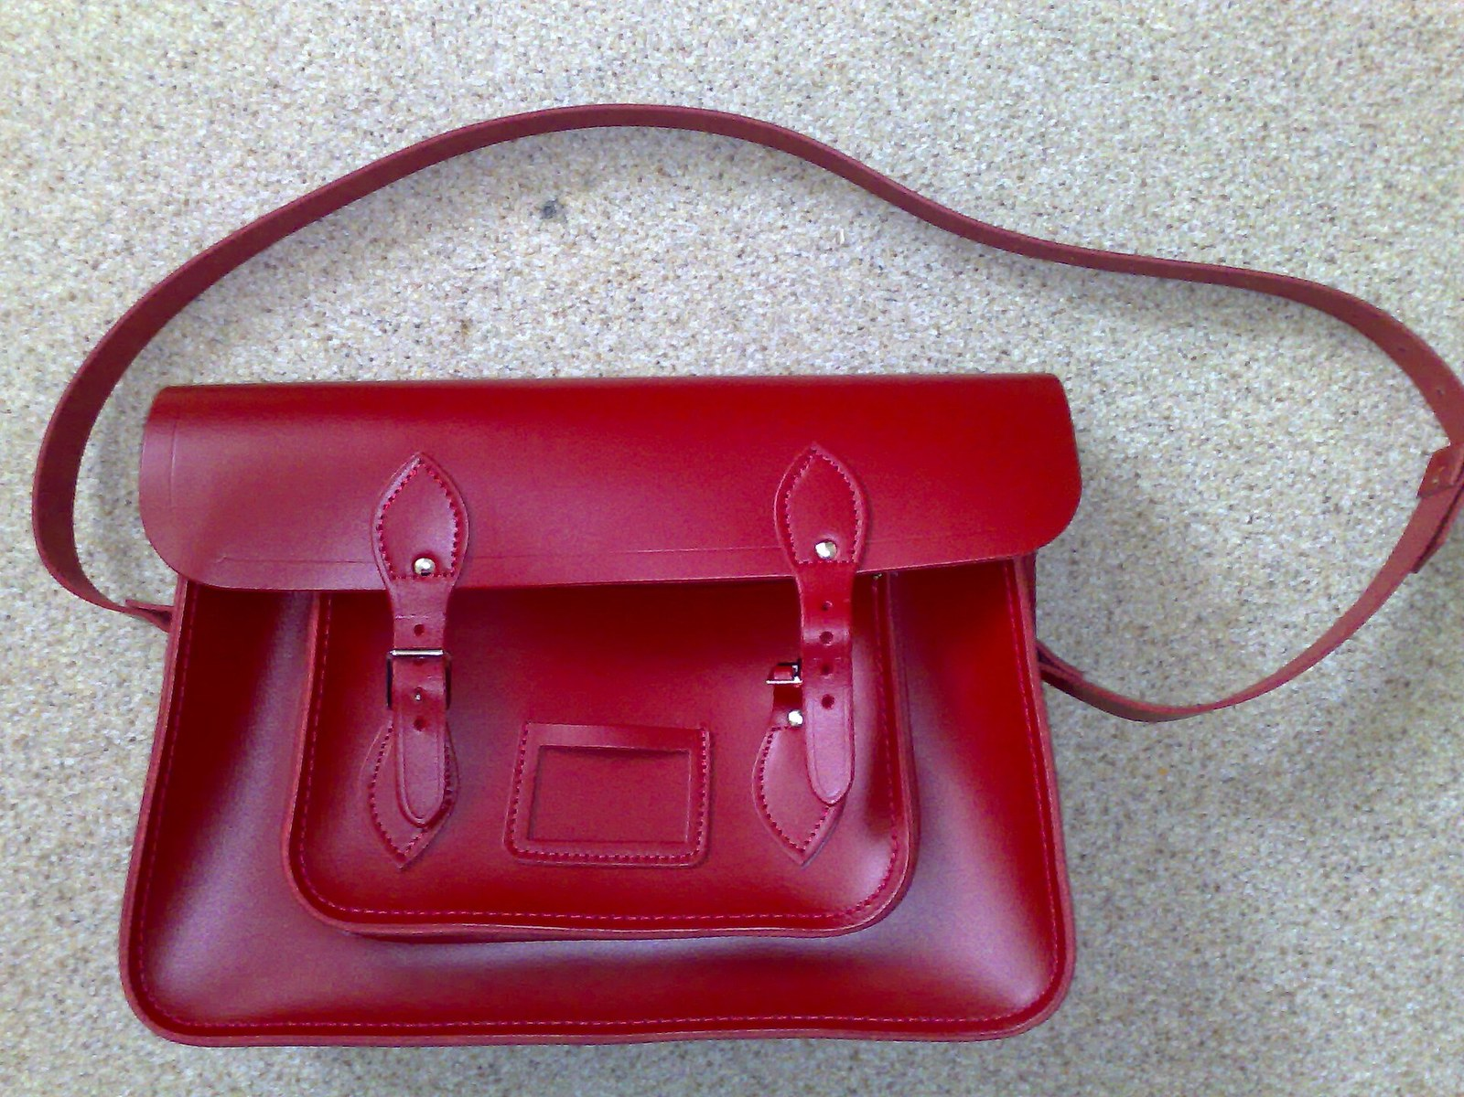
LOOK AND SAY
Bugungi mavzu
Mark Hillary · CC BY 2.0
What can you see? Say three sentences about the picture.

Slide 4
GRAMMAR
Form — possessive adjective or possessive pronoun?
BEFORE A NOUN (adjective)
INSTEAD OF A NOUN (pronoun)
I
This is my phone.
This phone is mine.
you
That's your bag.
That bag is yours.
he / she
his room · her book
It's his. · It's hers.
we / they
our class · their room
It's ours. · It's theirs.
Egalik olmoshidan keyin ot kelmaydi: This is mine — this is mine phone emas. Apostrof ham qo‘yilmaydi: yours, hers, ours, theirs (your's — xato).

Slide 5
FOCUS
Language focus — where does the apostrophe go?
QOIDA
QOIDA
One person or thing → 's: Finlay's dad · George's phone · my sister's room
Regular plural (already ends in s) → s': the twins' room · my parents' car
Irregular plural → 's: the children's books · the men's team
Name ending in s → both are used: James's book or James' book.
its = egalik (its bowl), it's = it is. Bu ikkisi butunlay boshqa.

Slide 6
VOCABULARY
A. School things (1/2)
🧽️
rubber
o‘chirg‘ich
Is this rubber yours or Aziz’s?
✏️
pencil sharpener
qalamtarosh (qalam ochgich)
My pencil sharpener is blue, and hers is pink.
📏️
ruler
chizg‘ich
Can I use your ruler? Mine is at home.
📓️
notebook
daftar
Write your name on your notebook, please.

Slide 7
VOCABULARY
A. School things (2/2)
✂️
scissors
qaychi
These scissors are our teacher’s, so be careful with them.
🧮️
calculator
kalkulyator
Malika forgot her calculator, so I gave her mine.
🥤️
water bottle
suv idishi (butilka)
Whose water bottle is this? It isn’t mine.
📝️
homework
uy vazifasi
My sister did her homework, and I did mine.

Slide 8
VOCABULARY
B. Personal things (1/2)
🔑️
keys
kalitlar
Are these your keys? — No, mine are in my bag.
👛️
wallet
hamyon
Dad can’t find his wallet anywhere.
☂️
umbrella
soyabon
Take my umbrella — it’s raining and yours is at home.
🪮️
hairbrush
soch cho‘tkasi
This hairbrush is my sister’s, not mine.

Slide 9
VOCABULARY
B. Personal things (2/2)
🕶️
sunglasses
quyosh ko‘zoynagi
Mum, are these sunglasses yours?
🔌️
charger
quvvatlagich (zaryadlovchi)
My phone is dead. Can I use your charger?
🍱️
lunch box
tushlik qutisi
Your lunch box is green and mine is yellow.
💍️
ring
uzuk
Is that your grandmother’s old ring?

Slide 10
VOCABULARY
C. Clothes (1/2)
👕️
T-shirt
futbolka
That red T-shirt is my brother’s, not mine.
🧥️
jacket
kurtka
Whose jacket is this on my chair?
👟️
trainers
krossovka
Are these your trainers? Ours are by the door.

Slide 11
VOCABULARY
C. Clothes (2/2)
🧣️
scarf
sharf
Is this scarf yours? — Yes, it’s mine. Thanks!
🧤️
gloves
qo‘lqop
I can’t find my gloves. Can I wear yours?
🧶️
sweater
sviter
My grandmother made this sweater for my birthday.

Slide 12
VOCABULARY
D. Whose is it? (1/2)
🏷️
belong to
(biror kishiga) tegishli bo‘lmoq
This phone belongs to my sister — it isn’t mine.
↩️
give back
qaytarib bermoq
Please give back my ruler after the lesson.
🤲️
borrow
qarzga olmoq, vaqtincha olib turmoq
Can I borrow your pen? I can’t find mine.
🚲️
lend
qarzga bermoq, vaqtincha berib turmoq
I can lend you my bike on Saturday.

Slide 13
VOCABULARY
D. Whose is it? (2/2)
😟️
lose
yo‘qotmoq
My little brother always loses his gloves.
🔍️
find
topmoq
Can you help me find my keys?
👤️
the owner
egasi
Who is the owner of this bike? Is it yours?
📦️
lost property
topilmalar (yo‘qolgan buyumlar joyi)
Look for your scarf in the lost property box.

Slide 14
TODAY'S WORDS IN CONTEXT
Whose is it? (1/2)
This morning there was a bag on my desk. “Whose bag is this?” asked our teacher. “It isn't mine,” I said. “Mine is black and it's under my chair.”
“It isn't hers either,” said Aziz. “Her bag is next to the window. And it isn't ours — our bags are by the door. Maybe it's theirs?” He looked at the twins' room across the corridor.
Then Malika came in. “That's my sister's bag,” she said. “It belongs to her. She left it here before the lesson — my sister's room is on this floor. I'll give it back to her at break.”
Cover the word list. Can you understand the words in bold from the sentence?

Slide 15
TODAY'S WORDS IN CONTEXT
Whose is it? (2/2)
Things get lost in our school every day: the children's books, somebody's ruler, a water bottle, even George's charger last week. What's the problem? Our teacher has a simple rule: if it isn't yours, put it in the lost property box, and the owner will find it there.
Cover the word list. Can you understand the words in bold from the sentence?

Slide 16
TODAY'S WORDS IN CONTEXT
Read and answer
1
Whose bag was on the desk?
2
Where is the girl's bag?
3
How does the writer know the bag is not his?
4
What is the teacher's rule?

Slide 17
PAIRS · ESDA QOLDIMI?
Memory check — cover the Uzbek column
Juftingiz inglizchasini o‘qiydi, siz o‘zbekchasini aytasiz. So‘ng almashinasiz.
1
Say the Uzbek meaning: pencil sharpener · belong to · lost property
2
Say the English word: qaychi · soyabon · qarzga olmoq
3
Change to a pronoun: This is my bag → This bag is … (five sentences)
4
Where does the apostrophe go: my parents car · the children books?
5
Write down the three items you keep forgetting.

Slide 18
BOOK TASK · 4 MINUTES
Reorder the words — Laser A1+, p. 11, ex. 2
Make sentences and use 's or s'.
1
sister – pet rabbit – My – got – hasn't – name – a
2
are – families – interesting – Other – people
3
brothers – hasn't – mum – sisters – or – Theo – got
4
Namuna: you – Have – got – mobile phone – George → Have you got George's mobile phone?

Slide 19
PRONUNCIATION
Say it — don’t just read it
The possessive 's has three sounds. Listen and repeat:
Pat's book
Jack's bag
Finlay's dad
Imogen's family
Theo's brother
Alex's homework
George's phone
Ross's room
After s, z, ch, sh and j /dʒ/ we say an extra syllable: /ɪz/.

Slide 20
BOOK TASK · 6 MINUTES
Correct the mistakes — Laser A1+, p. 11, ex. 3
Ten mistakes in one short dialogue. Correct them, then read it in pairs.
1
David: Give it back! It's (1) my!
2
Daisy: No, it isn't! It's (2) mine T-shirt!
3
Mum: Hey, you two! What's the problem?
4
Daisy: David says this T-shirt is (3) him, but it isn't. It's (4) me! — David: It isn't (5) her! She gave it to me!
5
Mum: That means it's (6) Davids' T-shirt, not (7) your. — Daisy: I only gave it to him because he did (8) mine homework for me!
6
Mum: But it's still (9) he's T-shirt. — Daisy: But (10) us teacher gave me an F for that homework!

Slide 21
WHOLE CLASS
Practice — complete the sentence (1/2)
1
What's ________ family like? (you)
2
My sisters have lots of things in ________ room. (they)
3
We aren't very close to ________ cousins. (we)
4
Does Alex see ________ great-grandfather every week? (he)
5
I don't know where ________ MP3 player is. (I)
6
Tell Jan that I've got ________ book. (she)

Slide 22
WHOLE CLASS
Practice — complete the sentence (2/2)
7
This phone is ________ — the other one is yours. (I)
8
The two bikes near the gate are ________. (they)
9
The laptop is in the ________ room. (the twins)
10
Is that ________ dad in the car? (Finlay)
11
________ T-shirt is this — yours or his?
12
I haven't got a ruler today. Can you ________ me yours?

Slide 23
PAIRS
Speaking
Put five objects on the desk (a ruler, a rubber, keys …). Ask and answer: Whose is this? — It's hers / It's Aziz's.
Describe three things in your classroom using 's or s': the teacher's desk, the girls' bags …
Mark Hillary · CC BY 2.0

Slide 24
PAIR / GROUP WORK · 6 MINUTES
Vocabulary activity
1
Match the beginnings (1-10) with the endings (a-j).
2
Read your complete sentences aloud.
3
Give the Uzbek meaning of the key word in each sentence.
4
When you finish, swap tables with the other group.

Slide 25
UZ
Qiyin joyi — o‘zbekcha
my / your / his — otdan OLDIN; mine / yours / his — ot O‘RNIGA keladi.
Egalik olmoshlarida apostrof YO‘Q: yours, hers, ours, theirs (your's — xato).
Bitta odam → 's: Finlay's dad. Ko‘plik (s bilan tugasa) → s': the twins' room.
Qoidasiz ko‘plik yana 's oladi: children's, men's, women's.
its = uning (narsa); it's = it is. Yozuvda eng ko‘p uchraydigan xato shu.

Slide 26
HOMEWORK
Uy vazifasi
1
Write ten sentences about things in your house: five with 's or s' and five with a possessive pronoun.
2
Learn the 30 items (sections A-D) with the flashcards: sozlar.com/vocab/cards/?set=grade7-lesson6
3
Laser A1+ Workbook pp. 8-9.

Slide 27
IMAGE CREDITS
Rasmlar manbasi
things
Mark Hillary · CC BY 2.0 · https://commons.wikimedia.org/wiki/File:Red_satchel_by_Cambridge_Satchel_Company.jpg

Slide 28
Uchta so‘z — ertaga ham esingizda qoladi
Juftingizga ayting, so‘ng daftaringizga yozib qo‘ying.
sozlar.com/vocab/cards/?set=grade7-lesson6

