Slide 1

GRADE 8 · LESSON 5
Writing a Profile
Shaxsiy sahifa (profil) yozish
Writing a profile (Unit 1)
Green Chameleon · CC0 1.0
sozlar.com

Slide 2
LESSON AIMS
Bugungi maqsad
1
Name the six parts of a profile and say what information goes in each
2
Choose present simple for general situations and present continuous for right now
3
Use short forms and an exclamation mark in informal writing

Slide 3
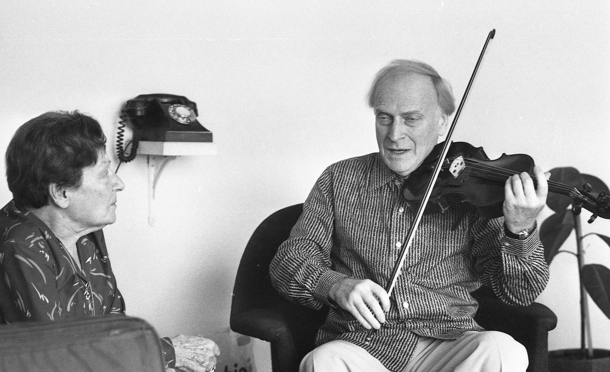
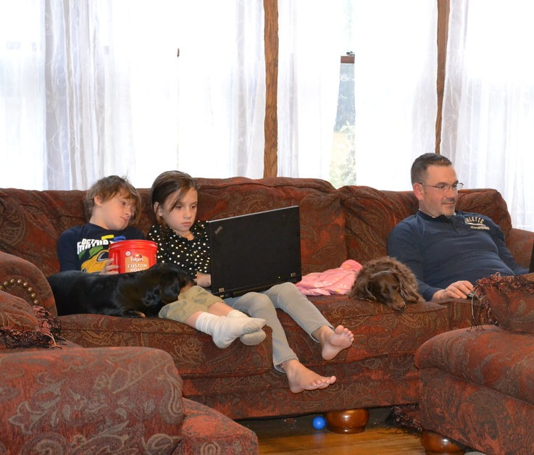
LOOK AND SAY
Bugungi mavzu
Dan Hadani · CC BY 4.0
Tobyotter · CC BY 2.0
What can you see? Say three sentences about each picture.

Slide 4
MODEL TEXT · 4 MINUTES
Bandhu's page — Laser A2, p. 12
Read the profile. Where do you see pages like this?
1
About me: My name's Bandhu and I'm 14 years old. I live in Mumbai, India.
2
My family: My mum's called Gitanjali. She's a doctor. My dad's called Lav and he's a pilot. I've got two sisters, Eta and Ela. They're twins.
3
My interests: I play the violin in the school orchestra. I also play the piano, and at the moment I'm learning to play the guitar!
4
My best friends: Anek is watching TV. Phani is online. Malina is having lunch.
5
At the moment, I'm playing basketball with friends.
6
My photos: me · Colin (my kitten — he's black and white and very funny!)

Slide 5
VOCABULARY
A. Writing a profile (1/2)
🪪️
a profile
profil (shaxsiy sahifa)
I’m writing a profile for our class website.
🌐️
a website
veb-sayt
Our school website has a page for every class.
🔖️
a heading
sarlavha (bo‘lim nomi)
Each part of my profile has a heading, like My family or My interests.

Slide 6
VOCABULARY
A. Writing a profile (2/2)
📄️
a paragraph
xatboshi
I write one paragraph about my family and one about my hobbies.
💬️
informal
norasmiy
A profile is informal, so I write I’m and she’s.
❗️
an exclamation mark
undov belgisi
I put an exclamation mark at the end: My kitten is so funny!

Slide 7
VOCABULARY
B. About me and my family (1/3)
📛️
be called
ismi … bo‘lmoq, …deb atalmoq
My mum is called Nilufar and she works at a bank.
👯️
twins
egizaklar
My little sisters are twins — they have the same birthday.
🐱️
a kitten
mushukcha
We’ve got a black and white kitten called Oq.
✈️
a pilot
uchuvchi
My uncle is a pilot — he flies to Istanbul every week.

Slide 8
VOCABULARY
B. About me and my family (2/3)
🐶️
a vet
veterinar (hayvonlar shifokori)
My aunt is a vet, so she helps sick animals every day.
👭️
a stepsister
o‘gay opa-singil
My stepsister is at university in Tashkent.
🎯️
an ambition
orzu, hayotiy maqsad
My ambition is to become an engineer.
🎨️
creative
ijodkor
I’m creative — I draw and write stories.

Slide 9
VOCABULARY
B. About me and my family (3/3)
💪️
hard-working
mehnatkash
Sevara is hard-working and always does her homework.
😊️
friendly
do‘stona, samimiy
Our new neighbours are very friendly.
✅️
honest
rostgo‘y, halol
Dilnoza is honest — she always tells the truth.
🎩️
polite
odobli, xushmuomala
Our new classmate is very polite and always says thank you.

Slide 10
VOCABULARY
C. My interests (1/2)
⭐️
an interest
qiziqish
Music is my biggest interest.
🤖️
be interested in
…ga qiziqmoq
My brother is interested in robots and computers.
🎻️
play the violin
skripka chalmoq
Lola plays the violin after school every Tuesday.
🎼️
the school orchestra
maktab orkestri
Twenty pupils play in the school orchestra.
🎹️
play the piano
pianino chalmoq
My grandmother plays the piano very well.

Slide 11
VOCABULARY
C. My interests (2/2)
🎸️
play the guitar
gitara chalmoq
I play the guitar and sing with my friends.
♟️
play chess
shaxmat o‘ynamoq
On Sundays I play chess with my grandfather.
🎲️
backgammon
nard (o‘yin)
My dad and my uncle love backgammon.
📚️
a school subject
maktab fani
My favourite school subject is biology.

Slide 12
VOCABULARY
D. What my friends are doing now
🎧️
listen to music
musiqa tinglamoq
Right now my sister is listening to music in her room.
🍲️
have lunch
tushlik qilmoq
Malika is having lunch with her cousins at the moment.
🏀️
play basketball
basketbol o‘ynamoq
Jasur is playing basketball in the school yard now.
⏳️
at the moment
ayni paytda, hozir
At the moment I’m learning to swim.
⏱️
right now
hozirning o‘zida
Don’t call Aziza — she’s doing her homework right now.

Slide 13
TODAY'S WORDS IN CONTEXT
Welcome to my page! (1/2)
Welcome to my page! My name's Kamron. I live in Fergana. This is my profile for our school website — every part has a heading, because that is how informal writing works on the internet.
My family: my mum's called Nilufar. She's a doctor at the city hospital. My dad is a driver, not a pilot — but my uncle is a pilot, and that is much more interesting! I've got two sisters; they're twins and they are nine. We've also got a kitten called Oq: he is black and white and very funny!
Cover the word list. Can you understand the words in bold from the sentence?

Slide 14
TODAY'S WORDS IN CONTEXT
Welcome to my page! (2/2)
My interests: I play the violin in the school orchestra and I also play the piano. At the moment, I'm learning to play the guitar. I love playing chess with my grandfather, my favourite school subjects are biology and English, and I'm interested in languages too. I listen to music when I do my homework and I watch DVDs with my friends at the weekend.
My best friends: right now Jasur is watching TV, Aziza is online and Bekzod is having lunch. And me? Right now I am playing basketball — well, almost: I'm writing this first!
Cover the word list. Can you understand the words in bold from the sentence?

Slide 15
TODAY'S WORDS IN CONTEXT
Read and answer
1
Which part of the page tells us Kamron's city?
2
Who is a pilot?
3
What is Kamron learning at the moment?
4
Which tense does he use for his friends, and why?

Slide 16
PAIRS · ESDA QOLDIMI?
Memory check — cover the Uzbek column
Juftingiz inglizchasini o‘qiydi, siz o‘zbekchasini aytasiz. So‘ng almashinasiz.
1
Say the Uzbek meaning: a heading · informal · an ambition · hard-working
2
Say the English word: egizaklar · skripka chalmoq · undov belgisi · rostgo‘y
3
Name the six parts of a profile without looking.
4
Give one present simple sentence and one present continuous sentence about yourself.
5
Write down the three words you keep forgetting.

Slide 17
FOCUS
Language Lab — how a profile is written
• Short forms: I'm, she's, he's, they're, I've got — informal writing only.
• Present simple for what is always true: I play the violin. My mum's a doctor.
• Present continuous for now or around now: At the moment I'm learning the guitar.
• Exclamation mark makes a sentence exciting: He's black and white and very funny!
• Headings break the page into parts so the reader finds things quickly.

Slide 18
STRATEGY
Writing a profile — four steps
1
Plan the headings: About me · My family · My interests · At the moment.
2
About me: name, age, where you live — two or three short sentences.
3
Family and interests: present simple — My mum's a teacher. I play chess.
4
At the moment: present continuous — Right now I'm learning to swim!

Slide 19
PRONUNCIATION
Say it — don’t just read it
Hard words from today's cards — stress and silent letters. Repeat after me:
orchestra /ˈɔːkɪstrə/
violin /ˌvaɪəˈlɪn/
guitar /ɡɪˈtɑː/
ambition /æmˈbɪʃn/
honest /ˈɒnɪst/
exclamation mark /ˌekskləˈmeɪʃn mɑːk/
paragraph /ˈpærəɡrɑːf/
backgammon /ˈbækɡæmən/
Now read Bandhu's profile aloud — say the short forms I'm, she's, they're as one sound group.

Slide 20
BOOK TASK · 6 MINUTES
Match the part with what it tells us — Laser A2, p. 12, ex. 2
Match each part of the profile (1-6) with a statement (a-f).
1
1 About me · 2 My family · 3 My interests
2
4 My best friends · 5 My photos · 6 At the moment, I'm …
3
a) This tells us what you're doing right now.
4
b) This tells us your name, age and where you live.
5
c) This tells us about your parents, brothers, sisters and pets.
6
d) This tells us what other people are doing right now. · e) This shows us your pictures. · f) This tells us what you like doing.

Slide 21
WHOLE CLASS
Practice — complete the sentence (1/2)
1
My dad married again, and his new wife's daughter is now my ________.
2
Aziza loves animals and wants to help sick cats and dogs — she wants to be a ________.
3
My father ________ ________ ________ — he flies to Dubai twice a week.
4
My two little sisters were born on the same day: ________ ________.
5
I ________ ________ ________ in the school orchestra every Thursday.
6
He can already play the piano, and this year he is learning to ________ ________ ________ too.

Slide 22
WHOLE CLASS
Practice — complete the sentence (2/2)
7
Do not phone him now — he ________ ________ his homework.
8
Bekzod is not in the classroom — he ________ ________ ________ in the school canteen.
9
Give every part of your page a ________: About me, My family, My interests.
10
A message to a friend is ________ — short forms, no long sentences.
11
Kamol never tells lies, even when the truth is difficult — he is ________.
12
Put an ________ ________ at the end of 'He's so funny' — it shows you are excited.

Slide 23
PAIRS · 5 MINUTES
Speaking
In pairs, read your partner's plan and ask two questions about it.
Say three sentences about what people in your family are doing right now.
Tobyotter · CC BY 2.0

Slide 24
PAIR / GROUP WORK · 5 MINUTES
Vocabulary activity
1
Match the beginnings (1-10) with the endings (a-j).
2
Read your complete sentences aloud.
3
Give the Uzbek meaning of the key word in each sentence.
4
When you finish, swap tables with the other group.

Slide 25
UZ
Qiyin joyi — o‘zbekcha
Present Simple — doimiy holat: I play the violin. Present Continuous — hozir: I'm learning the guitar.
Qisqartmada apostrof tushib qolgan harf o‘rniga qo‘yiladi: I am → I'm, she is → she's.
My mum's called Gitanjali = My mum is called… — bu yerda 's = is, egalik emas.
Undov belgisi (!) gapga hayajon qo‘shadi — rasmiy xatda ishlatilmaydi.
Har bir bo‘limga sarlavha qo‘ying: o‘quvchi kerakli joyni tez topadi.

Slide 26
HOMEWORK
Uy vazifasi
1
Write your own profile (80-100 words) with four headings: About me, My family, My interests, At the moment.
2
Learn the 32 words (sections A-D) with the flashcards: sozlar.com/vocab/cards/?set=grade8-lesson5
3
Laser A2 Workbook p. 9, exercises 1-2.

Slide 27
IMAGE CREDITS
Rasmlar manbasi
cover
Green Chameleon · CC0 1.0 · https://stocksnap.io/photo/writing-drawing-8Y0EDX4VP9
hobby
Dan Hadani · CC BY 4.0 · https://commons.wikimedia.org/w/index.php?curid=142349439
family
Tobyotter · CC BY 2.0 · https://www.flickr.com/photos/78428166@N00/10479957884

Slide 28
Uchta so‘z — ertaga ham esingizda qoladi
Juftingizga ayting, so‘ng daftaringizga yozib qo‘ying.
sozlar.com/vocab/cards/?set=grade8-lesson5

