Slide 1
GRADE 7 · LESSON 5
Talking about Yourself
O‘zing haqingda gapirish
Speaking: talking about yourself (Unit 1)
A Height and build · B Hair and glasses · C My family · D My room
sozlar.com

Slide 2
LESSON AIMS
Bugungi maqsad
1
Describe height and hair with eight phrases from the book
2
Make notes about Me / My family / My room and speak from the notes
3
Hear and say the two sounds of the letter s (/s/ and /z/)

Slide 3
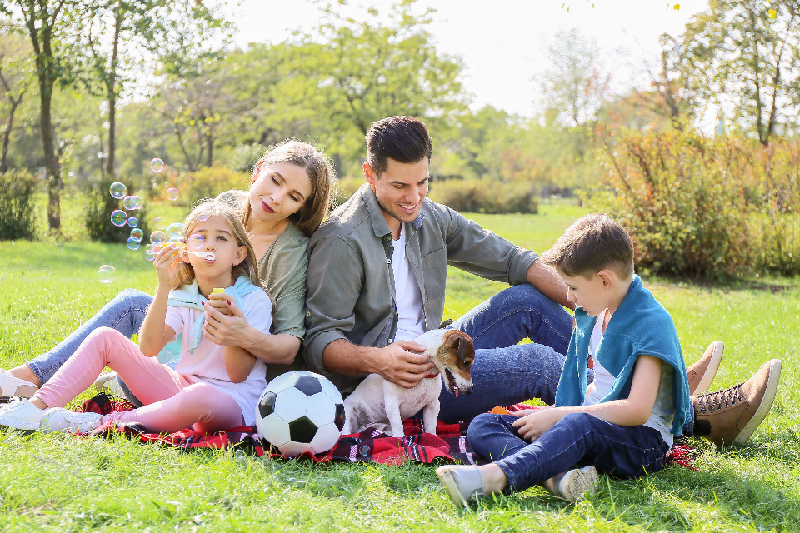
LOOK AND SAY
Bugungi mavzu
Family Moments · CC0 1.0
What can you see? Say three sentences about the picture.

Slide 4
VOCABULARY
A. Height and build
🦒️
tall
baland bo‘yli
I’m tall for my age, like my dad.
🧒️
short
past bo‘yli
My little sister is short, so she sits in the front row.
🧍️
medium height
o‘rta bo‘yli
My best friend is medium height and very fast.
🤸️
slim
xipcha, nozik qomatli
My mum is slim and she’s got dark hair.
📏️
height
bo‘y (balandlik)
The school nurse checked my height: one metre fifty-five.

Slide 5
VOCABULARY
B. Hair and glasses (1/2)
💇‍♀️
long hair
uzun soch
I’ve got long hair, like my mum.
💇‍♂️
short hair
kalta soch
My brother has got very short hair in summer.
💁‍♀️
medium-length hair
o‘rtacha uzunlikdagi soch
My cousin has got medium-length hair and green eyes.
➰️
curly hair
jingalak soch
Aziz has got curly hair, like his grandfather.
🪮️
straight hair
tekis (to‘g‘ri) soch
I’ve got straight hair, but my sister’s hair is curly.

Slide 6
VOCABULARY
B. Hair and glasses (2/2)
🌑️
dark hair
to‘q rangli (qoramtir) soch
Everybody in my family has got dark hair.
🌼️
fair hair
och rangli (sariq) soch
The new girl in our class has got fair hair.
👴️
grey hair
oqargan soch, oq soch
My grandfather has got grey hair and a beard.
👓️
wear glasses
ko‘zoynak taqmoq
I’m short and I wear glasses.

Slide 7
VOCABULARY
C. My family (1/2)
👨‍👩‍👧‍👦
a large family
katta oila
I’ve got a large family — four brothers and two sisters.
👨‍👩‍👦
a small family
kichik oila
Lola has got a small family: just her parents and her.
👦️
an older brother
aka
I’ve got an older brother — he’s sixteen.
👧️
a younger sister
singil
I’ve got a younger sister and she’s six.
🥇️
the oldest
eng kattasi (to‘ng‘ich)
I’m the oldest of four children.

Slide 8
VOCABULARY
C. My family (2/2)
🍼️
the youngest
eng kichigi (kenja)
My brother Sardor is the youngest in our family.
🥈️
the middle child
o‘rtancha farzand
I’ve got an older sister and a younger brother, so I’m the middle child.
🤝️
the same age
tengdosh, yoshi bir xil
My cousin and I are the same age — we’re both thirteen.
🎂️
birthday
tug‘ilgan kun
My birthday is in May, at the end of spring.

Slide 9
VOCABULARY
D. My room (1/2)
🧸️
a lot of things
ko‘p narsa
There are a lot of things in my room: books, games and a guitar.
🪑️
not many things
oz narsa (ko‘p emas)
My room is small, so there are not many things in it.
🛌️
a bunk bed
ikki qavatli karavot
My brother and I sleep in a bunk bed — I’m on top!
🛋️
furniture
mebel
There isn’t much furniture in my room: a bed, a desk and a chair.

Slide 10
VOCABULARY
D. My room (2/2)
📐️
space
bo‘sh joy
There’s no space for a big desk in my room.
🕯️
cosy
shinam
My room is small but very cosy.
🪜️
upstairs
yuqori qavatda
My room is upstairs, next to the bathroom.

Slide 11
TODAY'S WORDS IN CONTEXT
Meet Kamola (1/2)
Hi! My name is Kamola. I'm thirteen years old and my birthday is in January. I am tall for my age and I have long hair. My little brother is still very short, but he says he will be very tall one day.
I've got a large family. I've got two brothers and one sister, so we are five children. My mother has three sisters, so I have aunts and uncles in every part of the city. — Who else is in your family? — My grandmother lives with us. — Any pets? — Yes, a cat called Oq.
Cover the word list. Can you understand the words in bold from the sentence?

Slide 12
TODAY'S WORDS IN CONTEXT
Meet Kamola (2/2)
I don't have my own room: I share a room with my sister. It isn't very big, but it isn't small either, and there are a lot of things in it — books, photos and my sister's guitar.
My cousin Aziz lives in a very small family: just his mother and him. His room is very small and there are not many things in it. He says that is why it is always tidy!
Cover the word list. Can you understand the words in bold from the sentence?

Slide 13
TODAY'S WORDS IN CONTEXT
Read and answer
1
When is Kamola's birthday?
2
Who else lives with her family?
3
Does she have her own room?
4
Why is Aziz's room always tidy?

Slide 14
PAIRS · ESDA QOLDIMI?
Memory check — cover the Uzbek column
Juftingiz inglizchasini o‘qiydi, siz o‘zbekchasini aytasiz. So‘ng almashinasiz.
1
Say the Uzbek meaning: curly hair · the middle child · a bunk bed
2
Say the English phrase: o‘rta bo‘yli · ko‘zoynak taqmoq · shinam
3
Describe yourself in three sentences without looking at the sheet.
4
Ask your partner two questions about their room.
5
Write down the three words you keep forgetting.

Slide 15
FOCUS
Language focus — I am and I have got
• Age and height use be: I am thirteen. I am tall.
• Family and hair use have got: I've got two brothers. I've got long hair.
• Short forms in speaking: I'm = I am, I've got = I have got.
• Months take in: My birthday is in January.
• Say a large family, not a big family — the book uses large / small.

Slide 16
STRATEGY
Talking about yourself — four steps
1
Start: My name is … and I'm thirteen years old.
2
Family: I've got a large family — two brothers and one sister.
3
Yourself: I am tall and I have short hair. My birthday is in May.
4
My room: I share a room with my brother. It is small but there are a lot of things in it.

Slide 17
PRONUNCIATION
Say it — don’t just read it
SoundSpot (Laser A1+, p. 10) — tick the sound of the letter s: /s/ or /z/?
aunts
pets
uncles
brothers
sisters
cousins
friends
Listen and check. Then say: “I've got lots of uncles but very few aunts.”

Slide 18
BOOK TASK · 6 MINUTES
Your notes — Laser A1+, p. 10, ex. 2
Write notes (not sentences). You will speak from these notes.
1
Me: name · age · birthday · tall / short · hair
2
My family: very large / large / small / very small
3
Numbers: brothers ___ sisters ___ aunts and uncles ___
4
Who else is in your family? Any pets?
5
My room: my own room / share a room with ___
6
What is it like? big / small · a lot of things / not many things

Slide 19
WHOLE CLASS
Practice — complete the sentence (1/2)
1
________ ________ ________ Malika and I am from Andijan.
2
I'm thirteen ________ ________ and I am in Year 7.
3
My ________ is in April, so we always celebrate it in spring.
4
I ________ ________ one brother and two sisters.
5
Our basketball coach can touch the ceiling — he is very ________.
6
Her hair reaches down to her waist — she has got ________ ________.

Slide 20
WHOLE CLASS
Practice — complete the sentence (2/2)
7
Nine children and their parents live in that house — they are ________ ________ ________.
8
My grandfather is seventy and he has got ________ ________ now.
9
Dilnoza is not the oldest or the youngest of the three children — she is ________ ________ ________.
10
My brother sleeps at the top of our ________ ________, and I sleep at the bottom.
11
There is only a bed and a desk in my room, so there are ________ ________ ________ in it.
12
________ ________ ________ ________ ________ ________? — My grandmother lives with us too.

Slide 21
PAIRS
Speaking
Make notes in the table: Me · My family · My room. Write words, not sentences.
Tell the class about yourself from your notes. Try to talk for one minute without stopping.
Family Moments · CC0 1.0

Slide 22
PAIR / GROUP WORK · 8 MINUTES
Vocabulary activity
1
Match the beginnings (1-10) with the endings (a-j).
2
Read your complete sentences aloud.
3
Give the Uzbek meaning of the key word in each sentence.
4
When you finish, swap tables with the other group.

Slide 23
UZ
Qiyin joyi — o‘zbekcha
Yosh va bo‘y — am bilan: I am thirteen. I am tall.
Oila va soch — have got bilan: I've got two brothers. I've got long hair.
a large family deyiladi, a big family emas (kitobda shunday).
Oy nomidan oldin in: My birthday is in January.
s harfi ikki xil o‘qiladi: aunts /s/, lekin uncles, brothers, sisters /z/.

Slide 24
HOMEWORK
Uy vazifasi
1
Write eight sentences about yourself using the Phrase Bank and the new words (name, age, birthday, height, hair, family, room), then finish gap fill 1-6 on the sheet.
2
Learn the 30 words and phrases (sections A-D) with the flashcards: sozlar.com/vocab/cards/?set=grade7-lesson5
3
Laser A1+ Workbook p. 6, exercises 1-3.

Slide 25
IMAGE CREDITS
Rasmlar manbasi
family
Family Moments · CC0 1.0 · https://stocksnap.io/photo/family-portrait-R0P6STPFE0

Slide 26
Uchta so‘z — ertaga ham esingizda qoladi
Juftingizga ayting, so‘ng daftaringizga yozib qo‘ying.
sozlar.com/vocab/cards/?set=grade7-lesson5

