Slide 1
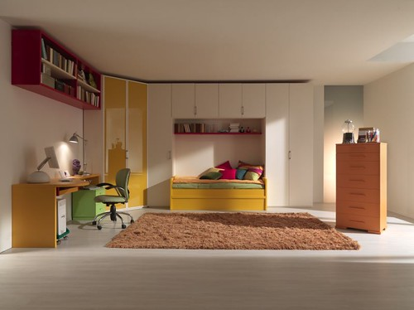
GRADE 7 · LESSON 4
My Room, My Pets, My Family
Xonam, uy hayvonlarim, oilam
Listening for gist / specific information (Unit 1)
MAZZALI bespoke italian furniture · CC BY-SA 2.0
sozlar.com

Slide 2
LESSON AIMS
Bugungi maqsad
1
Students will be able to decide if six statements about a recording are true or false (gist)
2
Students will be able to complete six sentences with one word while listening (specific information)
3
Students will be able to describe their own room, pets and family in five sentences

Slide 3
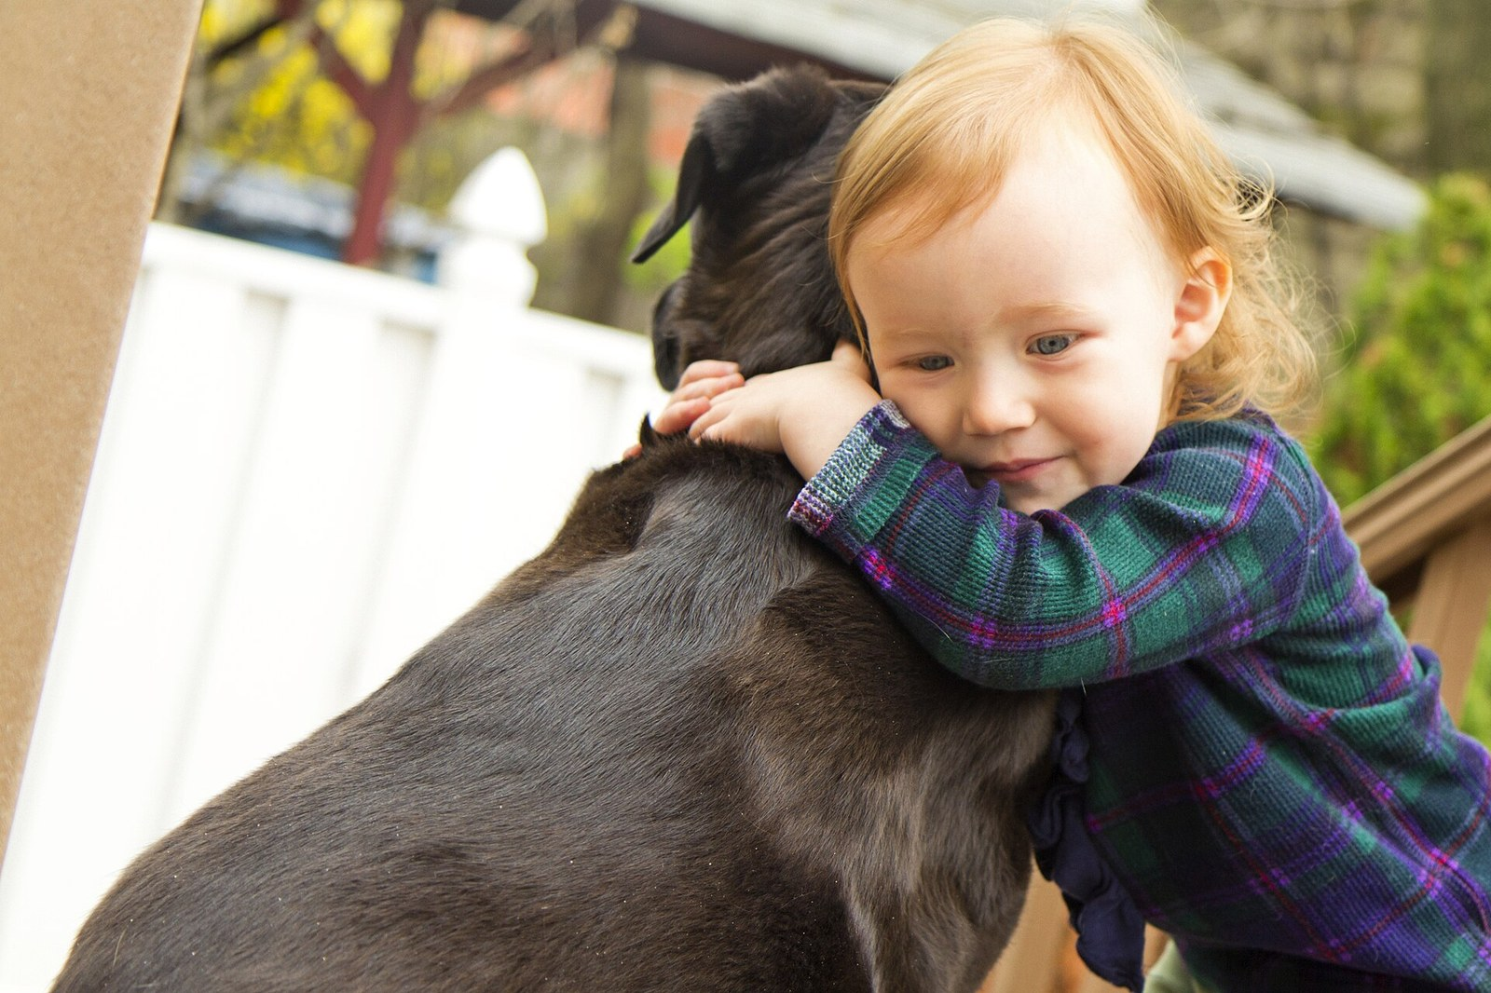
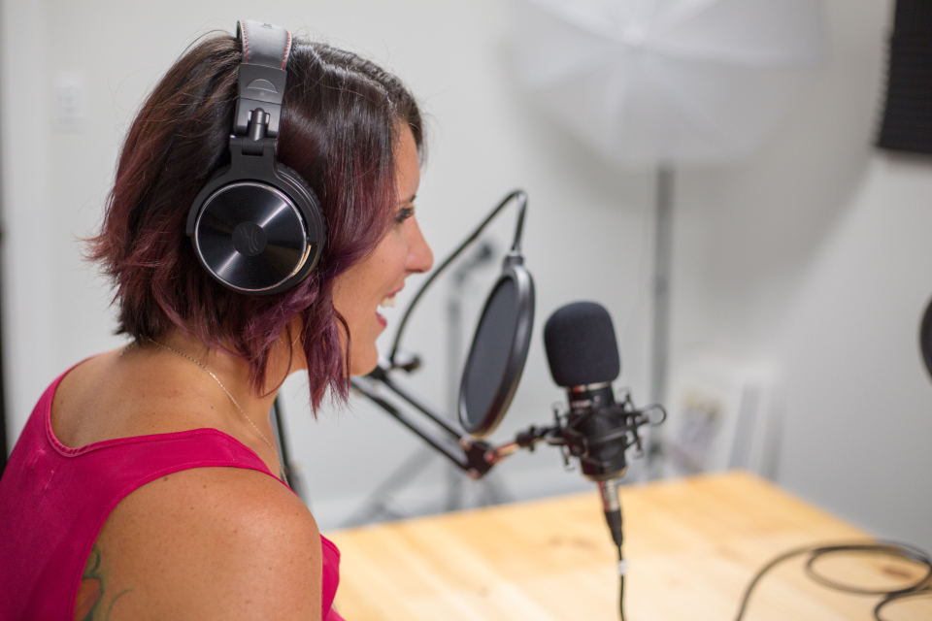
LOOK AND SAY
Bugungi mavzu
Dave Buchwald · CC BY-SA 3.0
Kristin Hardwick · CC0 1.0
What can you see? Say three sentences about each picture.

Slide 4
VOCABULARY
A. Family life
🍀️
lucky
omadli
I’m lucky — I’ve got two brothers and a big garden.
🏠️
live with
… bilan birga yashamoq
My grandmother lives with us in Samarkand.
🐈️
a family pet
oilaning uy hayvoni
Our cat Mosh is a family pet — everybody in our house loves her.

Slide 5
VOCABULARY
B. In my bedroom (1/3)
🚪️
bedroom
yotoqxona
My bedroom is next to the kitchen.
🛏️
bed
karavot
Our cat always sleeps on my bed.
🧥️
wardrobe
kiyim javoni (shkaf)
All my clothes are in the wardrobe in the corner.
✏️
desk
yozuv stoli
I do my homework at the desk near the window.

Slide 6
VOCABULARY
B. In my bedroom (2/3)
📚️
shelf
javon, tokcha
My books and games are on the shelf above the bed.
🗄️
chest of drawers
tortmali javon (komod)
My socks and T-shirts are in the chest of drawers.
💡️
lamp
chiroq (stol chirog‘i)
I read in bed with the small lamp on.
🪞️
mirror
ko‘zgu
There’s a big mirror on the wardrobe door.

Slide 7
VOCABULARY
B. In my bedroom (3/3)
🖼️
poster
plakat
I’ve got a poster of my favourite team on the wall.
🪟️
curtains
pardalar
The curtains in my room are blue, like the walls.
🟥️
carpet
gilam
There’s a soft red carpet on the floor of my room.

Slide 8
VOCABULARY
C. Describing a room
✨️
tidy
tartibli, saranjom
My sister’s room is always tidy — everything is in its place.
🌀️
messy
tartibsiz, sochilib yotgan
My brother’s side of the room is very messy.
📦️
be full of things
narsalarga to‘la bo‘lmoq
My little brother’s room is full of things: toys, books and a big drum.
🛋️
comfortable
qulay
My new bed is big and very comfortable.
🧹️
tidy up
yig‘ishtirmoq, tartibga keltirmoq
I tidy up my room every Saturday morning.

Slide 9
VOCABULARY
D. Pets (1/3)
🦜️
parrot
to‘tiqush
Our parrot can say three words in English.
🐹️
hamster
xomyak
My hamster sleeps all day and runs all night.
🐠️
goldfish
oltin baliqcha
My sister has got two goldfish in a bowl.
🐢️
tortoise
toshbaqa
Our tortoise is very old — older than my dad!

Slide 10
VOCABULARY
D. Pets (2/3)
🐱️
kitten
mushukcha
Our neighbours gave us a little black kitten.
🐶️
puppy
kuchukcha
My uncle has got a puppy — it’s only two months old.
🐾️
cage
qafas
My hamster’s cage is on the shelf in my room.
🩺️
vet
veterinar (hayvonlar shifokori)
We take our dog to the vet once a year.

Slide 11
VOCABULARY
D. Pets (3/3)
🥣️
feed
ovqat bermoq (boqmoq)
I feed my hamster every morning before school.
🤗️
look after
qaramoq, parvarish qilmoq
My sister and I look after our tortoise.
🦮️
take the dog for a walk
itni sayrga olib chiqmoq
I take the dog for a walk after school.

Slide 12
TODAY'S WORDS IN CONTEXT
Rustam's room (1/2)
Rustam has my own room written on his door, but the room is small. Before this year he had to share a room with his cousin. In his bedroom there is a wardrobe for his clothes, a desk under the window and a shelf with a lot of books on it.
Over the desk there is a poster of his favourite team, and there is a mirror near the door. On Monday the room is tidy; by Friday it is always messy. Nobody helps him, so he cleans it himself.
Cover the word list. Can you understand the words in bold from the sentence?

Slide 13
TODAY'S WORDS IN CONTEXT
Rustam's room (2/2)
Rustam has a couple of pets: a hamster called Bo‘ta and a parrot. He feeds them every morning before school. His neighbour has a dog, and Rustam sometimes takes the dog for a walk in the evening.
After that he listens to a radio show for teenagers. He listens carefully, but he cannot always catch every word. Then he guesses from the other words, and if he still does not understand, he asks his father to repeat it.
Cover the word list. Can you understand the words in bold from the sentence?

Slide 14
TODAY'S WORDS IN CONTEXT
Read and answer
1
Who did Rustam share a room with before this year?
2
When is his room messy?
3
How many pets has Rustam got?
4
What does he do when he cannot catch a word?

Slide 15
FOCUS
Language focus — have got for possessions
• I have got my own room. / She has got a couple of pets.
• Have you got a pet? — Yes, I have. / No, I haven't.
• a lot of + plural: a lot of posters; not many + plural: not many relatives.

Slide 16
STRATEGY
Listening — how we do it
1
Read the six statements first and underline the key word in each one.
2
First listening: catch the general idea — do not stop at an unknown word.
3
Second listening: catch the details — numbers, names, how many.
4
Compare with your partner and say which word gave you the answer.

Slide 17
TASK 1 · GIST
First listening — true or false?
Listen once. Write T or F. Do not stop at an unknown word.
1
Paula has a large family.
T / F
2
Paula shares a room with her brother.
T / F
3
Seb has his own room.
T / F
4
Seb has three pets.
T / F
5
Sienna has a pet at home.
T / F
6
Sienna's neighbour has a parrot.
T / F

Slide 18
TASK 2 · DETAILS
Second listening — complete the sentences
Listen again. Write a word, number or short phrase in each gap.
1
Paula has ________ one cousin.
2
There are a lot of books on Paula's ________.
3
Seb's room is often ________.
4
Seb ________ his pets every morning.
5
Sienna lives with her parents and her ________.
6
Sienna does her homework at the ________ near the window.

Slide 19
PRONUNCIATION
Say it — don’t just read it
Repeat after me, then clap on the stressed syllable:
wardrobe /ˈwɔːdrəʊb/
chest of drawers /ˌtʃest əv ˈdrɔːz/
curtains /ˈkɜːtnz/
comfortable /ˈkʌmftəbl/
mirror /ˈmɪrə/
parrot /ˈpærət/
tortoise /ˈtɔːtəs/
hamster /ˈhæmstə/
Now cover the Uzbek column and say the meaning of each word.

Slide 20
WHOLE CLASS
Practice — complete the sentence (1/2)
1
My grandparents ________ ________ us, so our house is never quiet.
2
Put your clothes in the ________, not on the chair.
3
My room is very ________: everything is in its place.
4
Their ________ can say hello in two languages.
5
Don't forget to ________ the cat before you go to school.
6
A ________ walks very slowly and can live for a hundred years.

Slide 21
WHOLE CLASS
Practice — complete the sentence (2/2)
7
Tom does not have ________ relatives — just his parents and one uncle.
8
There are ________ ________ ________ posters on my bedroom wall.
9
Please ________ ________ your room before Grandma comes — there are clothes everywhere!
10
Our puppy is ill, so we are taking him to the ________ today.
11
My T-shirts are in the top drawer of the ________ ________ ________.
12
Close the ________, please — the sun is in my eyes.

Slide 22
PAIR / GROUP WORK · 9 MINUTES
Vocabulary activity
1
Match the beginnings (1-10) with the endings (a-j).
2
Read your complete sentences aloud.
3
Give the Uzbek meaning of the key word in each sentence.
4
When you finish, swap tables with the other group.

Slide 23
PAIRS
Speaking
Tell your partner about your room: what furniture is in it (a bed, a wardrobe, a desk …)? Is it tidy or messy?
Ask three questions about your partner's pets: Who feeds it? Who looks after it? Do you take it to the vet?
Kristin Hardwick · CC0 1.0

Slide 24
UZ
Qiyin joyi — o‘zbekcha
a lot of — ko‘p, not many — kam. Ikkalasidan keyin ko‘plik ot keladi.
a couple of — “ikkitacha” degani, “er-xotin” emas. Kontekstga qarang.
Tinglashda hamma so‘zni tushunish shart emas: birinchi tinglashda umumiy ma’no, ikkinchisida tafsilot.
own — “o‘zimning”: my own room = faqat menga tegishli xona.
Savolga javob berishdan oldin savoldagi kalit so‘zning tagiga chizing — javob shu atrofda bo‘ladi.

Slide 25
HOMEWORK
Uy vazifasi
1
Learn the 30 words (sections A-D).
2
sozlar.com/vocab/cards/?set=grade7-lesson4 — listen to each word and test yourself.
3
Write 8 sentences about your room and your pets (furniture, tidy or messy, who looks after the pet), underline the new words.
4
Workbook exercises 1 and 2 on page 7.

Slide 26
IMAGE CREDITS
Rasmlar manbasi
cover
MAZZALI bespoke italian furniture · CC BY-SA 2.0 · https://www.flickr.com/photos/26098878@N06/2658587012
pets
Dave Buchwald · CC BY-SA 3.0 · https://commons.wikimedia.org/wiki/File:A_girl_and_her_dog.jpg
radio
Kristin Hardwick · CC0 1.0 · https://stocksnap.io/photo/recording-studio-YA3HZPUFYL

Slide 27
Uchta so‘z — ertaga ham esingizda qoladi
Juftingizga ayting, so‘ng daftaringizga yozib qo‘ying.
sozlar.com/vocab/cards/?set=grade7-lesson4

