Slide 1

GRADE 8 · LESSON 4
Introducing and Describing People
Tanishtirish va odamni tasvirlash
Speaking: Introducing and describing other people (Unit 1)
Michelle_Maria · CC0 1.0
sozlar.com

Slide 2
LESSON AIMS
Bugungi maqsad
1
Put the words of eleven personal questions in the correct order and ask them
2
Introduce a person with 'This is …' plus three facts (age, place, family)
3
Answer 'What does he look like?' with height, hair and one more detail

Slide 3
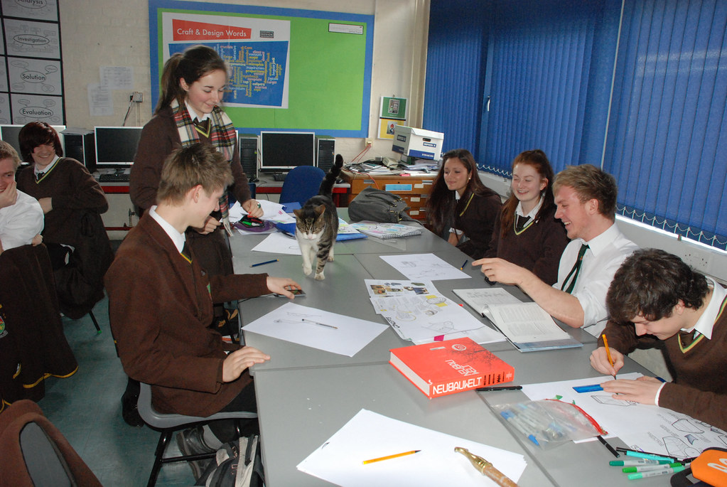
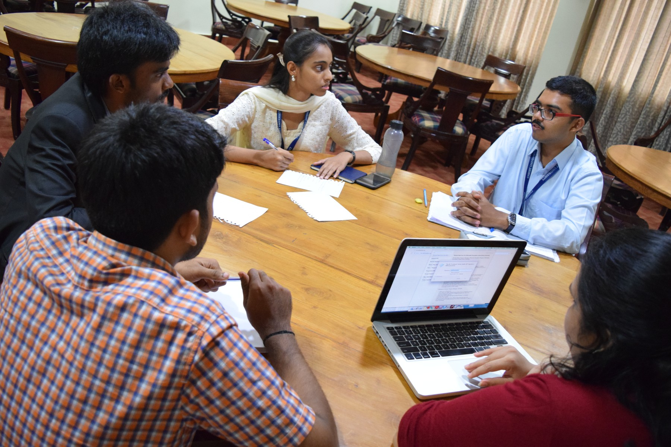
LOOK AND SAY
Bugungi mavzu
Jordanhill School D&T Dept · CC BY 2.0
NSaad (WMF) · CC BY-SA 4.0
What can you see? Say three sentences about each picture.

Slide 4
VOCABULARY
A. Personal details (1/2)
🤝️
introduce
tanishtirmoq
Let me introduce my friend Behruz — he’s new in our class.
🎂️
age
yosh (necha yoshdaligi)
Behruz and I are the same age — we’re both thirteen.
🏠️
live in
…da yashamoq
My cousin lives in Bukhara with his grandparents.
👫️
brothers and sisters
aka-uka va opa-singillar
Has she got any brothers and sisters? — Yes, one brother.
👷️
an engineer
muhandis
Her dad is an engineer — he builds bridges.

Slide 5
VOCABULARY
A. Personal details (2/2)
👪️
parents
ota-ona
His parents are both teachers at our school.
💼️
a job
kasb, ish
What’s her mum’s job? — She’s a nurse.
🩺️
a doctor
shifokor
His mum is a doctor at the children’s hospital.
🎭️
an actor
aktyor
Her dad is an actor — he works in the city theatre.
🏫️
a classmate
sinfdosh
This is Dilshod, my classmate — we sit at the same desk.

Slide 6
VOCABULARY
B. Height and looks (1/2)
👀️
look like
tashqi ko‘rinishi qanday bo‘lmoq
What does your brother look like? — He’s tall with fair hair.
🦒️
tall
baland bo‘yli
My cousin is very tall, so he plays basketball.
📏️
short
past bo‘yli
My little sister is short, so she sits at the front.
↕️
of medium height
o‘rta bo‘yli
He isn’t tall or short — he’s of medium height.

Slide 7
VOCABULARY
B. Height and looks (2/2)
🏃️
slim
xipcha, qaddi-qomati kelishgan
Our PE teacher is slim and runs very fast.
😎️
good-looking
kelishgan, chiroyli
The new boy is good-looking and very friendly.
🌸️
pretty
yoqimtoy, chiroyli (qizlar haqida)
Nodira has got a pretty smile and long dark hair.
🧔️
middle-aged
o‘rta yoshli
Our neighbour is middle-aged — he’s about fifty.

Slide 8
VOCABULARY
C. Hair and face (1/3)
🖤️
dark hair
qora (qoramtir) soch
Aziz has got short dark hair and brown eyes.
👱️
fair hair
och rangli (sarg‘ish) soch
Both twins have got fair hair and green eyes.
👩‍🦰
red hair
malla (qizg‘ish) soch
The girl with red hair is Lucy’s sister.
💇️
medium-length hair
o‘rtacha uzunlikdagi soch
He’s got medium-length hair — not long and not short.

Slide 9
VOCABULARY
C. Hair and face (2/3)
➖️
straight hair
tekis (to‘g‘ri) soch
My mother has got long straight hair.
🌊️
wavy hair
to‘lqinsimon soch
Lola has got wavy hair, just like her mother.
➰️
curly hair
jingalak soch
Our goalkeeper is the boy with curly hair.
👁️
blue eyes
ko‘k ko‘zlar
The baby has got big blue eyes.

Slide 10
VOCABULARY
C. Hair and face (3/3)
🧓️
a beard
soqol
My grandfather has got a long white beard.
👨️
a moustache
mo‘ylov
Our maths teacher has got a moustache but no beard.
👓️
wear glasses
ko‘zoynak taqmoq
Dilshod wears glasses when he reads.

Slide 11
VOCABULARY
D. Clothes
👕️
a T-shirt
futbolka
Tom is the boy in the white T-shirt.
🧥️
a jacket
kurtka
Bobur has got a new red jacket for the winter.
👖️
trousers
shim
He’s wearing a white shirt and grey trousers.
👗️
a dress
ko‘ylak (ayollar ko‘ylagi)
Madina has got a beautiful green dress for the party.

Slide 12
TODAY'S WORDS IN CONTEXT
A new student in 8-A (1/2)
“Do you know the new boy?” Dilshod asked me at break. “Is he here?” I said. “Yes, he's over there, next to the window.”
“What does he look like?” — “He's tall and he's got short fair hair. He wears glasses and today he's got a white T-shirt. He isn't short and he isn't of medium height — he's the tallest boy in our class.”
So we walked over to introduce ourselves. “Hello! This is Dilshod, and I'm Sardor.” — “Nice to meet you. I'm Behruz.” — “What's your name? Sorry, I mean — how old are you?” we laughed. “I'm thirteen,” he said. “Where do you live?” — “Near the bazaar.”
Cover the word list. Can you understand the words in bold from the sentence?

Slide 13
TODAY'S WORDS IN CONTEXT
A new student in 8-A (2/2)
Behruz told us that he's got two brothers and that he hasn't got a sister. His parents both work: his mum is a doctor and his dad is an engineer. Now he is my classmate and, after two weeks, also a good friend of mine. He's really nice.
Cover the word list. Can you understand the words in bold from the sentence?

Slide 14
TODAY'S WORDS IN CONTEXT
Read and answer
1
Where was the new boy standing?
2
What does Behruz look like?
3
How many brothers and sisters has he got?
4
What do his parents do?

Slide 15
PAIRS · ESDA QOLDIMI?
Memory check — cover the Uzbek column
Juftingiz inglizchasini o‘qiydi, siz o‘zbekchasini aytasiz. So‘ng almashinasiz.
1
Say the Uzbek meaning: of medium height · wavy hair · good-looking · middle-aged
2
Say the English word: mo‘ylov · ko‘zoynak taqmoq · kurtka · sinfdosh
3
Ask your partner three questions about age, family and parents' jobs without looking at the sheet.
4
Describe the student sitting behind you in two sentences: height, hair and clothes.
5
Write down the three words you keep forgetting.

Slide 16
FOCUS
Language focus — has got and look like
• He's got = He has got. In speaking we almost always use the short form: He's got two brothers.
• Negative: He hasn't got a sister. Question: Has he got a bike?
• What does he look like? asks about appearance: He's tall with short dark hair.
• Age uses be: He is eleven years old — never he has eleven years.
• Speaking Strategy (Solutions p.16): speak in a loud, clear voice · look at the other person · listen carefully so that you can reply.

Slide 17
STRATEGY
Introducing someone — four steps
1
Introduce: This is my friend Giorgi. Do you know him?
2
Ask: What does he look like? How old is he? Where does he live?
3
Describe: He's tall and he's got short dark hair. He's got a white T-shirt.
4
React and close: Nice to meet you. He's really nice — let's go and talk to him.

Slide 18
PRONUNCIATION
Say it — don’t just read it
SoundSpot (Laser A2, p. 10) — how many syllables do we really say? Now the new words:
moustache /məˈstɑːʃ/
beard /bɪəd/
engineer /ˌendʒɪˈnɪə/
middle-aged /ˌmɪdlˈeɪdʒd/
of medium height /əv ˈmiːdiəm haɪt/
straight hair /streɪt heə/
wavy hair /ˈweɪvi heə/
trousers /ˈtraʊzəz/
Book words: evening (2), different (2), favourite (2), generally (3). Say each word again with ONE strong stress.

Slide 19
BOOK TASK · 6 MINUTES
Question order — Laser A2, p. 10, ex. 1
Reorder the words to make the questions. Then ask your partner.
1
name – your – what's
2
how – you – old – are
3
do – where – you – live
4
brothers – do – have – you – any – sisters – and
5
parents – what – do – do – your
6
what – bed – you – do – time – to – go

Slide 20
WHOLE CLASS
Practice — complete the sentence (1/2)
1
Grandpa shaves his chin every morning, but he keeps the hair above his lip — he's proud of his ________.
2
Sardor and I are the same ________ — we were both born in 2013.
3
— Where ________ you live? — In Nukus.
4
— What does she ________ ________? — She's short and has wavy hair.
5
Let me ________ my cousin Rustam. He is in Grade 9.
6
It's cold and windy today, so put on your ________ before you go out.

Slide 21
WHOLE CLASS
Practice — complete the sentence (2/2)
7
He is not tall and not short — he is ________ ________ ________.
8
My sister's hair is not straight and not wavy — it goes round in small circles, so it is ________.
9
My grandfather cannot read the newspaper unless he ________ ________.
10
He ________ ________ two brothers, so their room is always busy.
11
There are three boys in the family and no girls, so he ________ ________ a sister.
12
Nodira sits behind me in every lesson — she is my ________.

Slide 22
PAIRS · 7 MINUTES
Speaking
In pairs, ask your partner the eleven questions from Laser p. 10 ex. 1 and write short notes.
Choose someone in the class. Describe him or her without saying the name — can your partner guess who it is?
NSaad (WMF) · CC BY-SA 4.0

Slide 23
PAIR / GROUP WORK · 8 MINUTES
Vocabulary activity
1
Match the beginnings (1-10) with the endings (a-j).
2
Read your complete sentences aloud.
3
Give the Uzbek meaning of the key word in each sentence.
4
When you finish, swap tables with the other group.

Slide 24
UZ
Qiyin joyi — o‘zbekcha
He's got = He has got — gapirganda deyarli har doim qisqartma ishlatiladi.
Yosh to be bilan: He is thirteen. He has thirteen years — xato.
What does he look like? — tashqi ko‘rinish; What is he like? — xarakter.
Sochni tasvirlash tartibi: uzunlik + rang + hair — long dark hair, short fair hair.
Nice to meet you — faqat birinchi tanishuvda; keyingi uchrashuvda Nice to see you.

Slide 25
HOMEWORK
Uy vazifasi
1
Write a 60-word profile of your partner: name, age, where they live, family, and what they look like.
2
Learn the 33 words (sections A-D) with the flashcards: sozlar.com/vocab/cards/?set=grade8-lesson4
3
Laser A2 Workbook p. 8, exercises 1-2.

Slide 26
IMAGE CREDITS
Rasmlar manbasi
people
Jordanhill School D&T Dept · CC BY 2.0 · https://www.flickr.com/photos/42042252@N02/4436429164
talk
NSaad (WMF) · CC BY-SA 4.0 · https://commons.wikimedia.org/w/index.php?curid=67092238
cover
Michelle_Maria · CC0 1.0 · https://commons.wikimedia.org/w/index.php?curid=123427751

Slide 27
Uchta so‘z — ertaga ham esingizda qoladi
Juftingizga ayting, so‘ng daftaringizga yozib qo‘ying.
sozlar.com/vocab/cards/?set=grade8-lesson4

