Slide 1
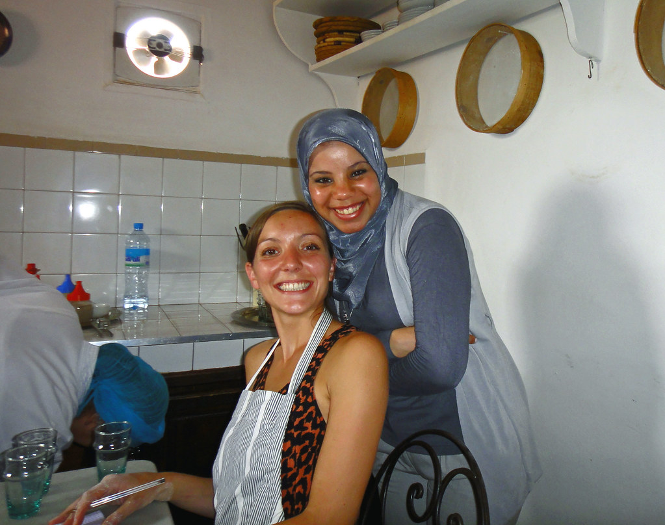
GRADE 10 · LESSON 4
Adjectives to Describe People
Odamni tasvirlaydigan sifatlar
Vocabulary builder: Adjectives to describe people (Unit 1)
Gareth1953 All Right Now · CC BY 2.0
sozlar.com

Slide 2
LESSON AIMS
Bugungi maqsad
1
Choose the right adjective for a described behaviour (twenty-five adjectives)
2
Form negatives with un-, im-, in-, ir-, il- and dis- and explain which letter decides the prefix
3
Use five phrasal verbs with 'up' and five temperature metaphors about people

Slide 3
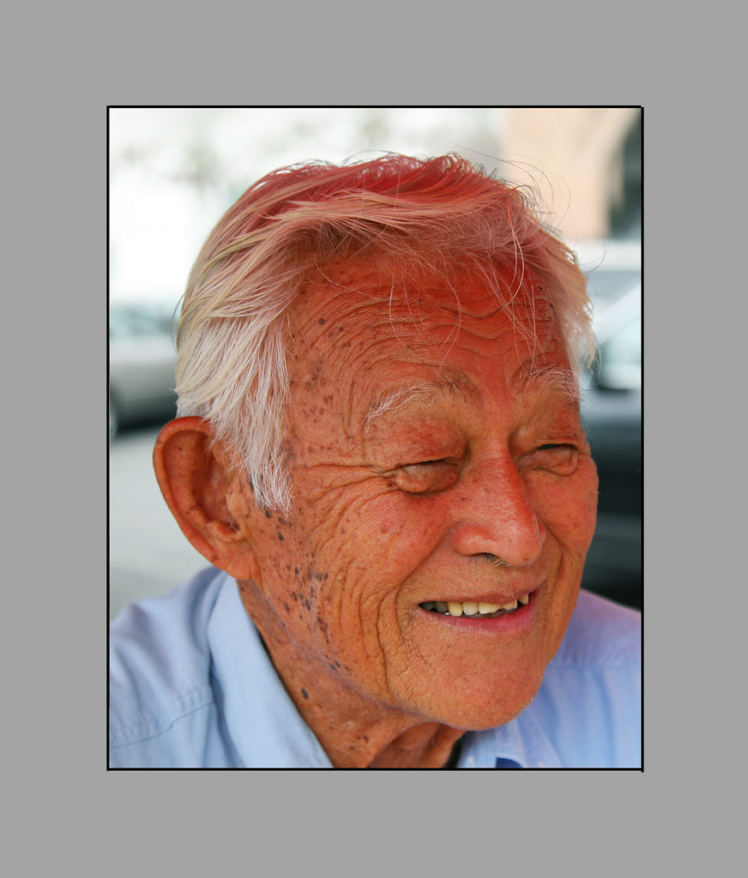
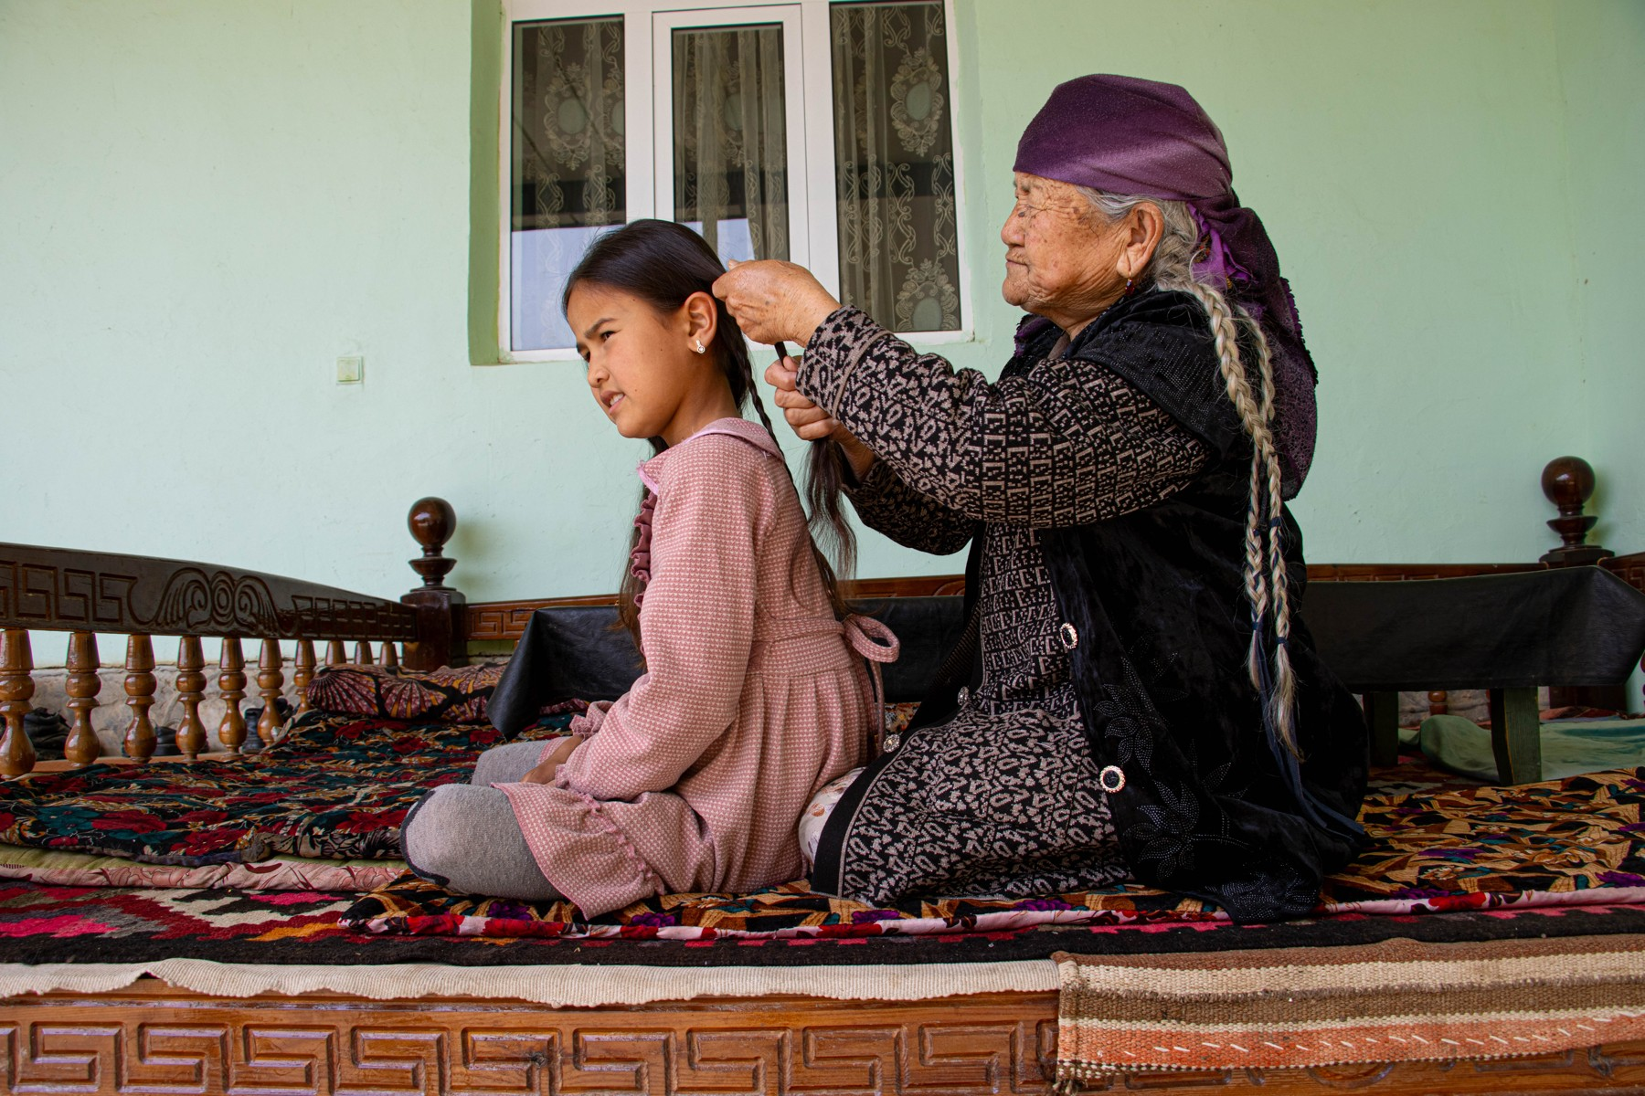
LOOK AND SAY
Bugungi mavzu
Sinchalak Musulmon · CC BY-SA 4.0
jitze · CC BY 2.0
What can you see? Say three sentences about each picture.

Slide 4
VOCABULARY
A. Positive character (1/2)
🚀️
ambitious
katta maqsadli, intiluvchan
She is ambitious and wants to run her own clinic one day.
🥳️
sociable
kirishimli, odamoxun
He is very sociable — he has friends in every group.
🎁️
generous
saxovatli, qo‘li ochiq
She is generous with her time as well as her money.
🌈️
optimistic
nikbin, kelajakka umid bilan qaraydigan
He stayed optimistic even after two bad results.
😌️
modest
kamtar
She won the olympiad, but she is too modest to talk about it.

Slide 5
VOCABULARY
A. Positive character (2/2)
🤝️
considerate
o‘zgalarni o‘ylaydigan, e’tiborli
It was considerate of him to carry her bag upstairs.
😂️
funny
hazilkash, kulgili
He is the funny one in our group — he makes everybody laugh.
👋️
outgoing
dilkash, odamlar bilan tez til topishadigan
New students like her because she is so outgoing.
🎨️
creative
ijodkor
Our art teacher is the most creative person I know.
💞️
sympathetic
hamdard, dardkash
My teacher was sympathetic when I explained the problem.

Slide 6
VOCABULARY
B. Difficult character (1/2)
🌧️
pessimistic
badbin, hamma narsaga yomon ko‘z bilan qaraydigan
Don’t be so pessimistic — we still have two weeks.
🍰️
selfish
xudbin, faqat o‘zini o‘ylaydigan
It is selfish to take the last piece of cake without asking.
👑️
arrogant
takabbur, manman
He became arrogant after winning the competition.
🥺️
sensitive
ta’sirchan, tez xafa bo‘ladigan
She is very sensitive — one sharp word can upset her for a whole day.

Slide 7
VOCABULARY
B. Difficult character (2/2)
🐂️
stubborn
qaysar, o‘jar
She is stubborn — once she decides, nobody can change her mind.
📢️
bossy
hammaga buyruq beradigan
My older sister is bossy — she tells everybody what to do.
😠️
bad-tempered
badjahl, jahldor
He is bad-tempered in the morning until he has his tea.

Slide 8
VOCABULARY
C. Negative prefixes (1/2)
💔️
unkind
mehrsiz, qo‘pol
That was an unkind thing to say to a new student.
🙊️
impolite
odobsiz, beadab
It is impolite to interrupt when somebody is answering.
👓️
unattractive
ko‘rimsiz, jozibasiz
He felt unattractive in his old glasses, but his friends said he looked fine.
⚖️
unfair
adolatsiz, nohaq
It is unfair to blame the whole team for one mistake.

Slide 9
VOCABULARY
C. Negative prefixes (2/2)
🤥️
dishonest
insofsiz, rostgo‘y emas
It is dishonest to copy an answer and call it your own.
🚫️
incapable
qodir emas, qo‘lidan kelmaydigan
My grandfather is incapable of saying no to his grandchildren.
🚔️
illegal
noqonuniy, qonunga xilof
Selling these tickets outside the stadium is illegal.
🗑️
irrelevant
mavzuga aloqasiz
His answer was interesting but completely irrelevant to the question.

Slide 10
VOCABULARY
D. Phrasal verbs with up
🚪️
turn up
kelib qolmoq, (ko‘pincha kutilmaganda) paydo bo‘lmoq
She turned up an hour late and said nothing.
❗️
come up
(muammo, savol) kutilmaganda chiqib qolmoq
A problem came up, and we had to change the plan.
💡️
think up
o‘ylab topmoq
They thought up a new game for the school party.
📖️
make up a story
hikoya to‘qib chiqarmoq
He made up a story about a lost dog to explain why he was late.
💬️
bring up a subject
(suhbatda) mavzuni ko‘tarmoq, gap ochmoq
At dinner my uncle brought up the subject of money again.

Slide 11
VOCABULARY
E. Temperature metaphors
☀️
a warm person
mehri issiq, samimiy odam
She is a warm person — everybody feels welcome in her house.
😎️
cool
vazmin, sovuqqon (hech narsadan hovliqmaydigan)
Our captain stays cool even in the last minute of a match.
🧊️
an icy look
muzdek (sovuq) nigoh
When I asked about her marks, she gave me an icy look and left the room.
🌋️
hot-tempered
tez qizishadigan, jizzaki
Our coach is hot-tempered, but he forgets his anger in five minutes.
🥶️
cold-hearted
toshbag‘ir, berahm
Only a cold-hearted person could walk past a crying child.

Slide 12
TODAY'S WORDS IN CONTEXT
Two brothers (1/4)
Timur and Anvar grew up in the same house, but nobody would call them alike. Timur is ambitious, sociable and outgoing: he knows everybody's name and is passionate about everything he starts. He is also generous and considerate — and, when it matters, modest about his own results.
Anvar is quieter. He is intelligent and shrewd, sometimes sensitive, and his teachers call him creative. He can be stubborn, though, and after a bad week he becomes pessimistic and even a little bad-tempered. He is never selfish or cruel, but he is not gullible either.
Cover the word list. Can you understand the words in bold from the sentence?

Slide 13
TODAY'S WORDS IN CONTEXT
Two brothers (2/4)
Their grandmother, who brought them up, says the difference is simple. Timur turns up when something is happening; Anvar thinks up the thing that happens. When a problem comes up, Timur makes up a plan in a minute; Anvar reads it twice, then improves it.
She is a warm person and she never lets them give up. “Be funny if you like,” she says, “but never arrogant, never untrustworthy, never cold-hearted. If you look up to somebody, learn from them; if somebody is hot-tempered, stay cool and put up with it for one day. And when a friend is sad — cheer them up.”
Cover the word list. Can you understand the words in bold from the sentence?

Slide 14
TODAY'S WORDS IN CONTEXT
Two brothers (3/4)
Their grandmother has a shorter list of what a person must never be. “Don't be unkind, don't be unfair, and never be dishonest or disloyal,” she says. “Being impolite costs you nothing today and everything tomorrow. An impatient man is only immature; an inconsiderate one is worse. And a person who is unreliable — who says yes and then disappears — is the hardest to forgive.”
Cover the word list. Can you understand the words in bold from the sentence?

Slide 15
TODAY'S WORDS IN CONTEXT
Two brothers (4/4)
She is not judgemental about small things. A jacket can be unattractive, an answer can be irrelevant, a neighbour can be unfriendly on a bad morning. But she has no patience for anything illegal, for people who are incapable of saying sorry, or for irresponsible promises. “Be stingy with your words if you like,” she smiles, “but never with your help.”
Cover the word list. Can you understand the words in bold from the sentence?

Slide 16
TODAY'S WORDS IN CONTEXT
Read and answer
1
Which three adjectives describe Timur best?
2
What happens to Anvar after a bad week?
3
How does the grandmother explain the difference between them?
4
What does she tell them never to be?

Slide 17
PAIRS · ESDA QOLDIMI?
Memory check — cover the Uzbek column
Juftingiz inglizchasini o‘qiydi, siz o‘zbekchasini aytasiz. So‘ng almashinasiz.
1
Say the Uzbek meaning: ambitious · bossy · sympathetic · arrogant
2
Say the English adjective: kamtar · qaysar · saxovatli · jahldor
3
Give the opposite with a prefix: kind · polite · honest · fair
4
Which five adjectives from A would you use about a good teacher?
5
Write down the five words you keep forgetting.

Slide 18
FOCUS
Word formation — negative prefixes
• un- is the most common: unhappy, untidy, unusual
• im- before m and p: imperfect, immature, impossible
• in- before most other letters: invisible, incorrect, informal
• ir- before r, il- before l: irregular, illogical
• dis- often with honesty and agreement words: disagree, dislike, disobey
• No rule is 100 %: check the dictionary — but the stress never moves to the prefix.

Slide 19
PRONUNCIATION
Say it — don’t just read it
Repeat after me, then mark the stress. Long adjectives keep one strong syllable:
con-SI-de-rate
am-BI-tious
sym-pa-THE-tic
op-ti-MIS-tic
ir-RE-le-vant
AR-ro-gant
hot-TEM-pered
cold-HEAR-ted
Now say: polite - imPOLITE, honest - disHONEST. The stress stays on the root.

Slide 20
WHOLE CLASS
Practice — complete the sentence (1/2)
1
She is ________ and already knows which university she wants.
2
He knows everybody's name and hates being on his own; the word for that is ________ (not “outgoing”).
3
She won first place but she is too ________ to mention it.
4
Whatever the news is, he expects the worst — he is very ________.
5
We argued for an hour, but he would not change his mind: he is ________.
6
Nobody dares to choose the film when she is there — she is so ________.

Slide 21
WHOLE CLASS
Practice — complete the sentence (2/2)
7
When I told her about my grandfather’s illness, she was very ________ and listened for an hour.
8
During dinner my brother ________ ________ the subject of his exam results, and everybody went quiet.
9
A problem ________ ________ at the last minute and we changed the plan.
10
When the teacher asked about his homework, he ________ ________ a story about a broken printer.
11
The bus broke down in the rain, but she stayed ________ and found a taxi.
12
She said nothing, gave me ________ ________ ________ and walked past.

Slide 22
PAIR / GROUP WORK · 8 MINUTES
Vocabulary activity
1
Part A — write the correct form of the word in CAPITALS (10 items).
2
Part B — complete each phrase with ONE verb from the box; each verb is used once.
3
Work alone first (6 min), then compare with your partner and say which prefix rule you used.
4
Part C (speaking) comes on the next slide — keep your notes open.

Slide 23
GROUPS OF THREE · 6 MINUTES
Speaking
In groups of three, answer the five questions in Part C of the worksheet.
Describe a person you admire without naming them; the group guesses who it is.
Sinchalak Musulmon · CC BY-SA 4.0

Slide 24
UZ
Qiyin joyi — o‘zbekcha
Prefiks urg‘uni ko‘chirmaydi: poLITE → imPOLITE, HONest → disHONest.
im- faqat m va p oldidan keladi: impolite, impossible, imperfect.
sympathetic — «simpatik, yoqimtoy» emas, «hamdard, dardkash» degani.
cool odam haqida — «sovuq» emas, «vazmin»; cold-hearted esa «toshbag‘ir».
bring up a subject — suhbatda mavzuni ko‘tarmoq; make up a story — hikoya to‘qib chiqarmoq (ko‘pincha yolg‘on).

Slide 25
HOMEWORK
Uy vazifasi
1
Write a 100-word description of a person you admire, using at least six adjectives from today's list and one phrasal verb with 'up'.
2
Learn the 35 words (sections A-E) with the flashcards: sozlar.com/vocab/cards/?set=grade10-lesson4
3
Laser B1+ Workbook, Vocabulary builder 1, exercises 1-3.

Slide 26
IMAGE CREDITS
Rasmlar manbasi
cover
Gareth1953 All Right Now · CC BY 2.0 · https://www.flickr.com/photos/40837632@N05/5918589727
team
jitze · CC BY 2.0 · https://www.flickr.com/photos/40648743@N00/7771937390
family
Sinchalak Musulmon · CC BY-SA 4.0 · https://commons.wikimedia.org/w/index.php?curid=187483258

Slide 27
Uchta so‘z — ertaga ham esingizda qoladi
Juftingizga ayting, so‘ng daftaringizga yozib qo‘ying.
sozlar.com/vocab/cards/?set=grade10-lesson4

