Slide 1
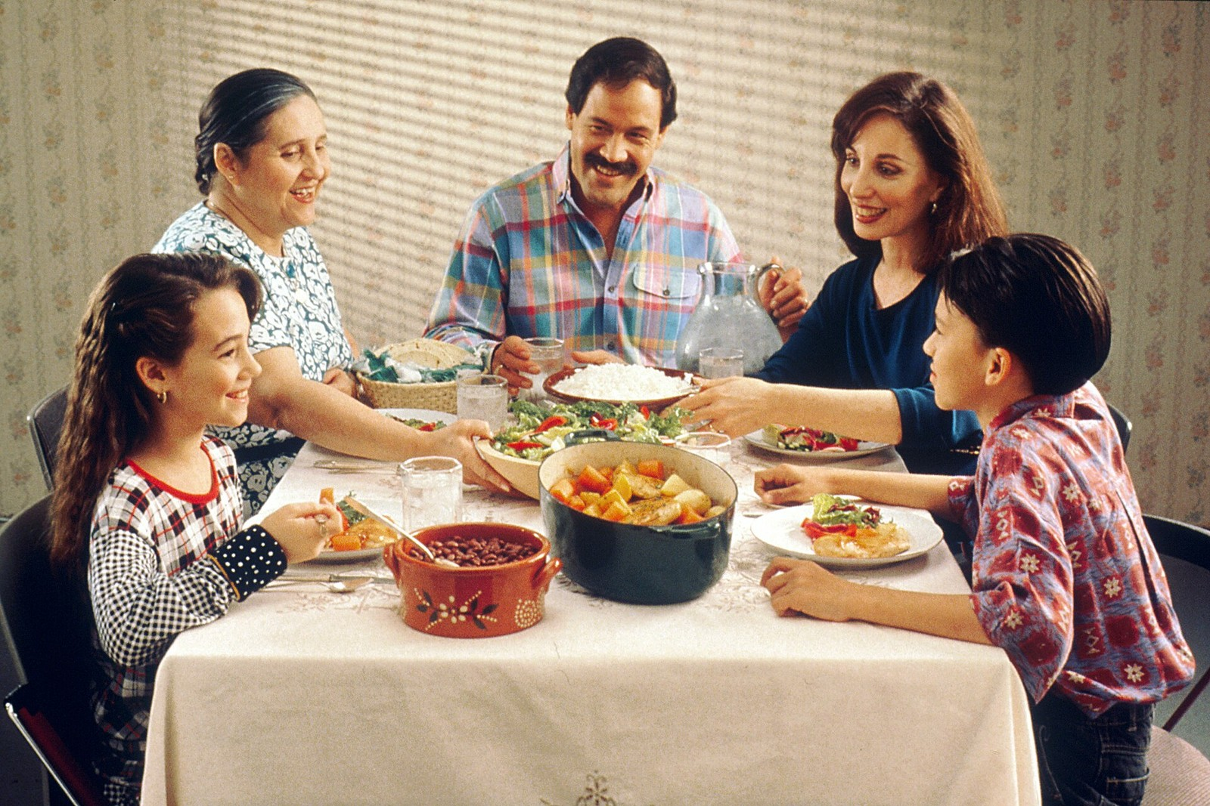
GRADE 10 · LESSON 3
Present Tenses: How Families Live
Hozirgi zamon: oila hayoti
Grammar clinic: Present tense review (Unit 1)
National Cancer Institute · Public domain
sozlar.com

Slide 2
LESSON AIMS
Bugungi maqsad
1
Students will be able to explain when to use present simple and when to use present continuous
2
Students will be able to use fifteen stative verbs correctly (not in the continuous form)
3
Students will be able to describe their own family's habits in eight sentences with the new time expressions

Slide 3
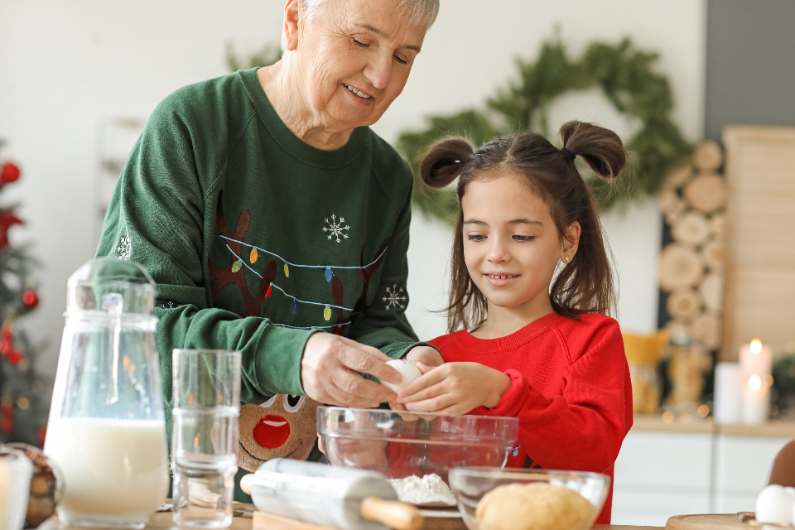
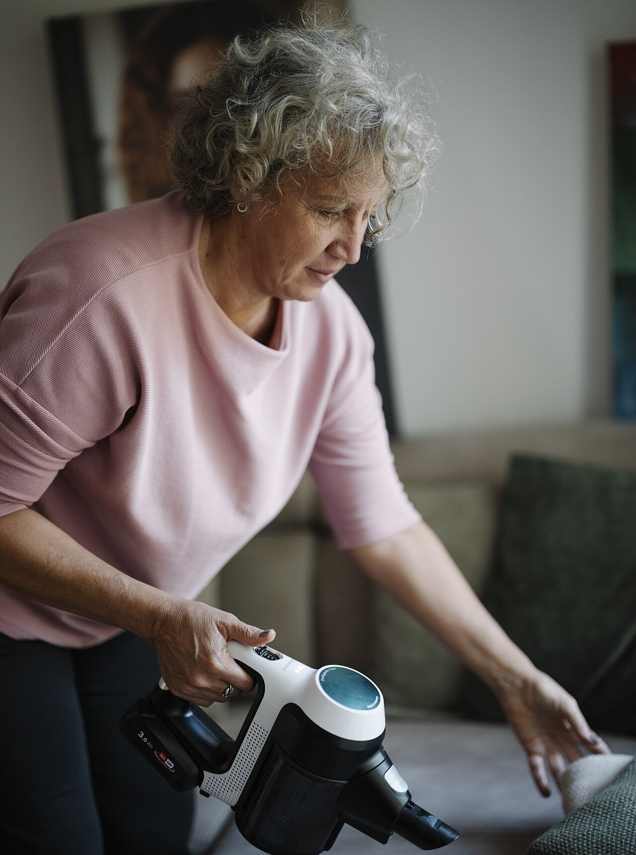
LOOK AND SAY
Bugungi mavzu
PS Imaging · CC0 1.0
Shixart1985 · CC BY 2.0
What can you see? Say three sentences about each picture.

Slide 4
GRAMMAR
Form — present simple and present continuous
PRESENT SIMPLE
PRESENT CONTINUOUS
+
I/you/we/they work · he/she works
I am working · he is working · they are working
−
I don't work · he doesn't work
I am not working · he isn't working
?
Do you work? · Does he work?
Are you working? · Is he working?
⏱
every day, as a rule, hardly ever, from time to time, these days
at the moment, right now, currently, these days
Stative verbs (believe, belong to, own, prefer, seem, mean, contain, consist of, deserve, matter, involve, recognise, understand, realise, depend on) are not normally used in the continuous — even when we talk about now.

Slide 5
FOCUS
Language focus — present simple vs present continuous
QOIDA
QOIDA
Present simple: habits, rules, permanent situations. We have dinner together on Fridays.
Present continuous: now, around now, a changing situation. My cousins are staying with us this month.
These days / nowadays can take both tenses — the continuous shows that the situation is changing.
always + continuous = a habit that annoys you: He is always losing his keys.
Stative verbs stay simple: I believe you (not: I am believing you).
Stative verbs (believe, own, belong to, prefer…) — keep the list on the board during the lesson.

Slide 6
VOCABULARY
A. Family routines and habits (1/3)
🏖️
go on holiday
dam olishga (ta’tilga) bormoq
Our family goes on holiday to Chimgan every summer.
🍽️
have dinner together
birga kechki ovqatlanmoq
On Fridays we always have dinner together at Grandma’s house.
🚶️
walk to school
maktabga piyoda bormoq
Jasur usually walks to school with his best friend.
🏢️
work in an office
ofisda ishlamoq
My dad works in an office in the city centre.

Slide 7
VOCABULARY
A. Family routines and habits (2/3)
📰️
a newsreader
yangiliklar boshlovchisi
My aunt is a newsreader and reads the evening news on local TV.
🎹️
play the piano
pianino chalmoq
Madina plays the piano every evening after dinner.
🚪️
come to visit
mehmonga kelmoq
My grandparents often come to visit us on Sundays.
🎤️
sing in the school choir
maktab xorida qo‘shiq aytmoq
My sister sings in the school choir and practises every Tuesday.

Slide 8
VOCABULARY
A. Family routines and habits (3/3)
🧹️
do the chores
uy yumushlarini qilmoq
In our house everyone does the chores on Saturday morning.
🧽️
do the washing-up
idish-tovoq yuvmoq
Dad usually does the washing-up after dinner.
🧺️
keep your room tidy
xonangni ozoda tutmoq
My little brother never keeps his room tidy.

Slide 9
VOCABULARY
B. Happening now or for now (1/2)
🛌️
stay with somebody
birovnikida vaqtincha yashamoq
My cousins from Fergana are staying with us this week.
📖️
study for exams
imtihonlarga tayyorlanmoq
My sister can’t come to the party because she is studying for her exams.
🎭️
act in the school play
maktab spektaklida rol o‘ynamoq
Zarina is acting in the school play next week, so she’s very nervous.
🌙️
sleep over
do‘stinikida tunab qolmoq
Tonight I am sleeping over at my friend’s house.
🦉️
stay up late
kechgacha uxlamay o‘tirmoq
We are staying up late tonight to watch the football final.

Slide 10
VOCABULARY
B. Happening now or for now (2/2)
📞️
talk on the phone
telefonda gaplashmoq
Not now — Mum is talking on the phone with Grandma.
🚿️
have a shower
dush qabul qilmoq, dushga tushmoq
Can you call back later? Dad is having a shower.
📈️
get better
yaxshilanmoq, tuzalmoq
Grandma was ill last week, but she is getting better now.
🚗️
wash the car
mashinani yuvmoq
Look! Dad is washing the car in the rain!
🐕️
take the dog to the vet
itni veterinarga olib bormoq
On Monday my sister is taking the dog to the vet.

Slide 11
VOCABULARY
C. Arguments and annoying habits (1/2)
📺️
argue about
…haqida tortishmoq
My brother and I argue about the TV remote every evening.
🗯️
have an argument
janjallashib qolmoq, urishib qolmoq
Shh, my parents are having an argument about money.
🃏️
play tricks on
…ni laqillatmoq, …ga hazil qilmoq
My cousins are always playing tricks on me.
🔊️
play music loud
musiqani baland qo‘ymoq
My neighbour plays music loud every night.

Slide 12
VOCABULARY
C. Arguments and annoying habits (2/2)
🔉️
turn the music down
musiqa ovozini pasaytirmoq
Mum is always telling me to turn the music down.
🌃️
stay out late
uyga kech qaytmoq
My parents don’t like it when I stay out late.
💻️
share a family computer
oilaviy kompyuterdan birga foydalanmoq
We share a family computer, so we often argue about whose turn it is.
🙄️
an annoying habit
asabga tegadigan odat
Leaving dirty cups everywhere is my brother’s most annoying habit.

Slide 13
TODAY'S WORDS IN CONTEXT
How families keep in touch (1/4)
As a rule, our family eats together on Fridays. From time to time somebody is missing — my brother currently studies in Tashkent and at the moment he is studying for his exams — but these days we all appear on one screen anyway.
Right now my mother is cooking and my father is washing the car outside. My grandmother, who hardly ever uses a phone, prefers letters, and believe me, she still writes them.
I understand her. A letter means more than a message: it contains the handwriting, the paper, the time somebody spent. I realise that this seems old-fashioned, but I recognise the value of it.
Cover the word list. Can you understand the words in bold from the sentence?

Slide 14
TODAY'S WORDS IN CONTEXT
How families keep in touch (2/4)
Every family deserves that kind of attention. It matters who you call and how often; it depends on you, not on the technology. Whatever belongs to the past, one thing involves no screen at all — sitting down and listening.
The housework is another kind of contact. We take turns: my sister and I share the housework, and every now and then our cousins drop by and help out. Someone has to do the chores, someone has to do the washing-up, and whoever finishes first gives the other a hand.
Cover the word list. Can you understand the words in bold from the sentence?

Slide 15
TODAY'S WORDS IN CONTEXT
How families keep in touch (3/4)
My father commutes to the factory and on a regular basis he gives my aunt a lift or drops her off at the clinic. Once in a while we all have dinner together at my grandmother's house, catch up with each other and keep in touch for another month.
Cover the word list. Can you understand the words in bold from the sentence?

Slide 16
TODAY'S WORDS IN CONTEXT
How families keep in touch (4/4)
Families are also made of small habits. My parents support us and respect our choices; they trust us, so we rely on them. They encourage more than they criticise, and they forgive quickly. My uncle plays tricks on everybody and my grandmother spoils the youngest, but nobody argues for long. I take after my mother and I look up to my father, who was brought up in a village and still gets on with everyone he meets.
Cover the word list. Can you understand the words in bold from the sentence?

Slide 17
TODAY'S WORDS IN CONTEXT
Read and answer
1
When does the family usually eat together?
2
Why is the brother not there?
3
What does the grandmother prefer?
4
According to the writer, what does keeping in touch depend on?

Slide 18
PRONUNCIATION
Say it — don’t just read it
Repeat after me, then mark the stress:
NEWS-read-er /ˈnjuːzriːdə/
pi-AN-o /piˈænəʊ/
CHOIR /ˈkwaɪə/
TI-dy /ˈtaɪdi/
wash-ing-UP /ˌwɒʃɪŋ ˈʌp/
AR-gu-ment /ˈɑːɡjumənt/
an-NOY-ing /əˈnɔɪɪŋ/
com-PU-ter /kəmˈpjuːtə/
Now cover the Uzbek column and say the meaning of each word.

Slide 19
WHOLE CLASS
Practice — complete the sentence (1/2)
1
Quiet! My brother ________ ________ his homework right now.
2
We ________ dinner together every evening — it is our rule.
3
This house ________ ________ my grandparents; they built it in 1970.
4
Please be quiet — Grandma ________ ________ on the phone to Aunt Lola.
5
Today Dad ________ ________ the car himself, but usually my brother washes it.
6
My brother ________ ________ for his exams this week, so he can’t play football with us.

Slide 20
WHOLE CLASS
Practice — complete the sentence (2/2)
7
My sister ________ her room tidy, but my room is always a mess!
8
I ________ living with my family ________ living alone.
9
My uncle ________ a small shop; he opens it at seven every morning.
10
________ ________ ________ ________ we argue about the television, but not often.
11
He ________ that family is more important than money.
12
My cousins ________ ________ in Tashkent this month — they usually live in Bukhara.

Slide 21
PAIR / GROUP WORK · 8 MINUTES
Vocabulary activity
1
Part A — write the correct form of the word in CAPITALS (10 items).
2
Part B — complete each phrase with one word from the box; some words are used more than once.
3
Work alone first (6 min), then check with your partner (2 min).
4
Part C (speaking) comes next — keep your notes open.

Slide 22
GROUPS OF THREE · 7 MINUTES
Speaking
In groups of three, answer the five discussion questions on the worksheet.
Describe a family member's annoying habit without saying who it is (He is always playing music loud…); the group guesses who it is.
Shixart1985 · CC BY 2.0

Slide 23
UZ
Qiyin joyi — o‘zbekcha
Present Simple — odat va doimiy holat; Present Continuous — hozir yoki shu kunlarda o‘zgarayotgan holat.
Stative fe’llar (believe, belong, own, prefer, seem, mean) Continuous da ishlatilmaydi: I am believing — xato.
these days / nowadays — o‘zgarayotgan holatni bildirsa, Continuous bilan ham keladi.
always + Continuous — asabga tegadigan takroriy odat: He is always losing his keys.
Word formation da bo‘sh joyning oldingi va keyingi so‘ziga qarang — ot kerakmi, sifatmi, shundan aniqlanadi.

Slide 24
HOMEWORK
Uy vazifasi
1
Learn the 29 words (sections A–C).
2
sozlar.com/vocab/cards/?set=grade10-lesson3 — listen to each word and test yourself.
3
Write a 100-120 word paragraph: 'How my family lives these days', using both present tenses and six new words.
4
Workbook: present tense review exercises.

Slide 25
IMAGE CREDITS
Rasmlar manbasi
cover
National Cancer Institute · Public domain · https://commons.wikimedia.org/wiki/File:Family_eating_meal.jpg
generations
PS Imaging · CC0 1.0 · https://stocksnap.io/photo/grandmother-children-YN7HDBKGZH
home
Shixart1985 · CC BY 2.0 · https://commons.wikimedia.org/wiki/File:Middle-aged_woman_cleaning_a_couch_with_a_handheld_vacuum_in_a_living_room_during_the_day.jpg

Slide 26
Uchta so‘z — ertaga ham esingizda qoladi
Juftingizga ayting, so‘ng daftaringizga yozib qo‘ying.
sozlar.com/vocab/cards/?set=grade10-lesson3

