Slide 1
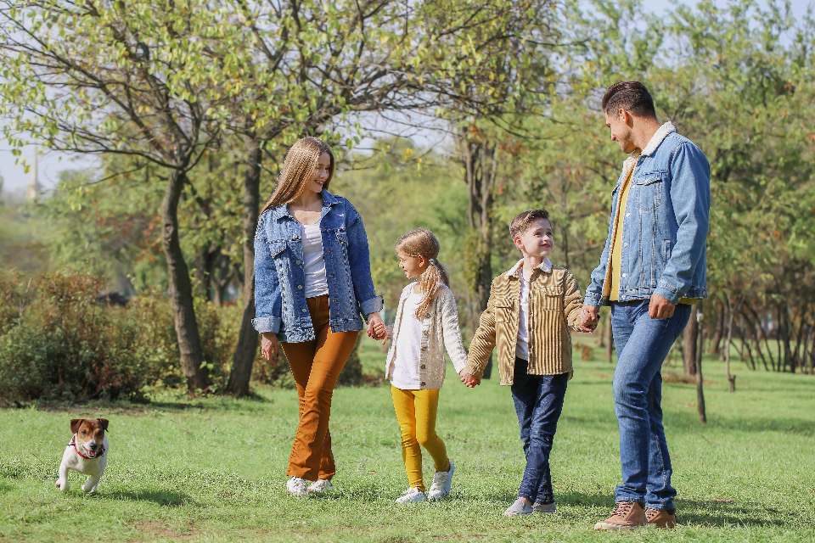
GRADE 7 · LESSON 3
Family and Friends
Oila va do‘stlar
General basic vocabulary (family members)
Family Moments · CC0 1.0
sozlar.com

Slide 2
LESSON AIMS
Bugungi maqsad
1
Students will be able to name 25 family members, including aunt, nephew, niece, grandson and great-grandparents
2
Students will be able to say how people are related with be married to, look like and on my dad's side
3
Students will be able to ask and answer three questions about a partner's family

Slide 3
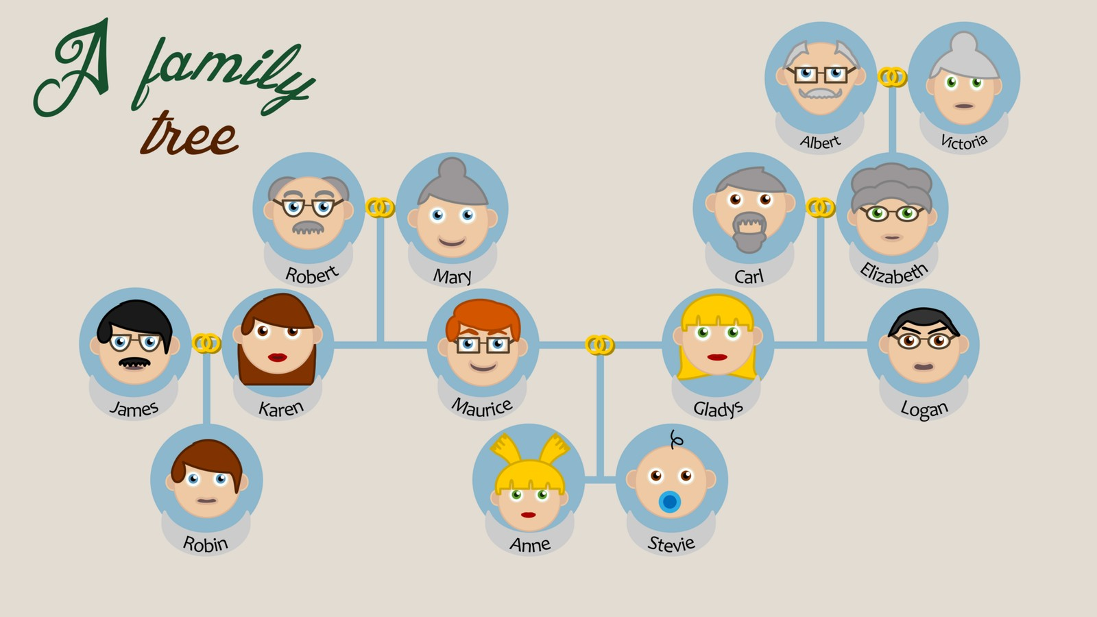
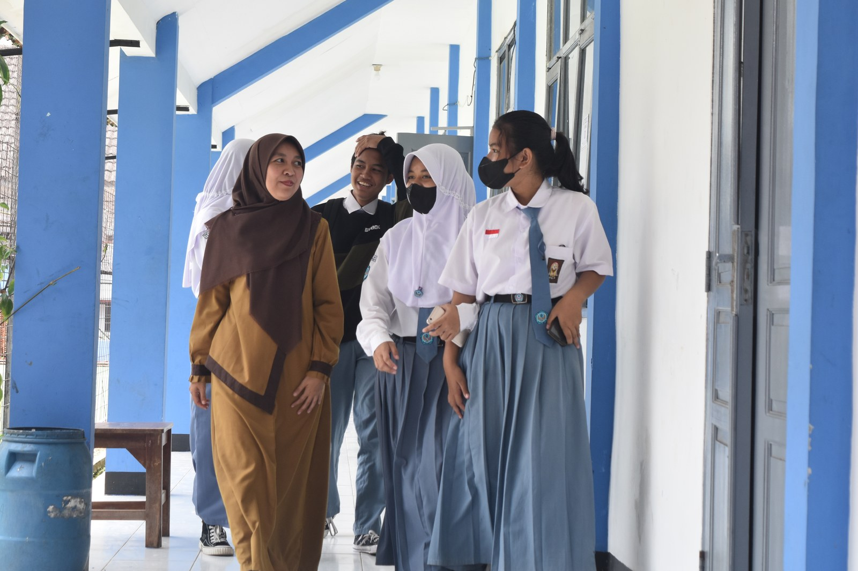
LOOK AND SAY
Bugungi mavzu
Chrkl · CC BY-SA 4.0
Randy Novian R · CC BY-SA 4.0
What can you see? Say three sentences about each picture.

Slide 4
VOCABULARY
A. Parents and grandparents (1/2)
👩️
mother
ona
My mother is a nurse at the city hospital.
👨️
father
ota
My father works in a bank in Tashkent.
👪️
parents
ota-ona
My parents are both teachers.
👴️
grandfather
bobo
My grandfather is seventy, but he still drives a car.
👵️
grandmother
buvi
My grandmother makes the best somsa in the family.

Slide 5
VOCABULARY
A. Parents and grandparents (2/2)
🏡️
grandparents
bobo va buvi
On my mum’s side, my grandparents live in Andijan.
🎩️
great-grandfather
katta bobo, bobokalon (bobo yoki buvining otasi)
My great-grandfather was a farmer in a small village.
🧶️
great-grandmother
katta buvi (bobo yoki buvining onasi)
My great-grandmother is ninety and still tells us stories.
🎣️
grandson
nevara (o‘g‘il bola)
Grandpa takes his grandson fishing every summer.
🍲️
granddaughter
nevara (qiz bola)
Grandma teaches her granddaughter to make plov.

Slide 6
VOCABULARY
B. Brothers, sisters and children (1/2)
👦️
brother
aka, uka
My older brother is a student in Samarkand.
👧️
sister
opa, singil
My little sister is only five years old.
🧒️
son
o‘g‘il (farzand)
My aunt has got one son and two daughters.
🎀️
daughter
qiz (farzand)
Their daughter Madina is in Year 5.
🧸️
children
bolalar, farzandlar
How many children have your grandparents got?

Slide 7
VOCABULARY
B. Brothers, sisters and children (2/2)
🤵️
husband
er (turmush o‘rtog‘i)
Aunt Nilufar’s husband is a doctor.
👰️
wife
xotin, rafiqa
My uncle’s wife teaches music at our school.
🤝️
stepbrother
o‘gay aka yoki uka
Timur is my stepbrother — he is my stepfather’s son.
💞️
stepsister
o‘gay opa yoki singil
My stepsister and I go to the same school.

Slide 8
VOCABULARY
C. Aunts, uncles and cousins (1/2)
🌷️
aunt
xola, amma
My aunt, my mum’s sister, lives in Tashkent.
🚕️
uncle
amaki, tog‘a
My uncle, my dad’s brother, is a taxi driver.
🤸️
cousin
amakivachcha, xolavachcha, tog‘avachcha
My cousin and I are in the same class.

Slide 9
VOCABULARY
C. Aunts, uncles and cousins (2/2)
🍼️
nephew
jiyan (o‘g‘il)
My big sister has got a baby boy, so I’ve got a nephew!
🎈️
niece
jiyan (qiz)
My brother’s little girl is my niece, and she is three.
🎊️
relatives
qarindoshlar
All our relatives come to our house for Navruz.

Slide 10
VOCABULARY
D. Talking about your family
🌳️
a family tree
shajara (oila daraxti)
We drew a family tree in our English lesson.
💍️
be married to
…bilan turmush qurgan bo‘lmoq
My uncle is married to a doctor from Bukhara.
🫂️
be close
bir-biriga yaqin bo‘lmoq
My cousins and I are close — we talk every day.
🧭️
on my dad’s side
ota tomonidan
On my dad’s side, I have got four cousins.
👀️
look like
…ga o‘xshamoq
Everybody says I look like my grandfather.

Slide 11
TODAY'S WORDS IN CONTEXT
My family tree (1/2)
Last week we drew a family tree at school. I put my grandparents at the top. My grandmother is very kind, and she takes care of us when our parents are at work. My grandfather tells us stories about his village.
I have one aunt and two uncles. My cousin Nodira and I are the same age, so we are close to each other. Her brothers are twins, and everybody says they look like their father.
My best friend Jasur is not a relative — he is our neighbour. He is funny and generous, but in class he is quiet and very hard-working. I get on well with him because he is friendly to everybody.
Cover the word list. Can you understand the words in bold from the sentence?

Slide 12
TODAY'S WORDS IN CONTEXT
My family tree (2/2)
Aziza sits behind me. She is an only child, so she often comes to our house at the weekend. My mother says our house is never quiet, and she is right!
Cover the word list. Can you understand the words in bold from the sentence?

Slide 13
TODAY'S WORDS IN CONTEXT
Read and answer
1
Who is at the top of the family tree?
2
Why are the writer and Nodira close?
3
Is Jasur a relative?
4
What is Jasur like in class?

Slide 14
PAIRS · ESDA QOLDIMI?
Memory check — cover the Uzbek column
Juftingiz inglizcha so‘zni o‘qiydi, siz o‘zbekchasini aytasiz. So‘ng almashinasiz.
1
Say the Uzbek meaning: relatives · nephew · stepsister · granddaughter
2
Say the English word: amaki · buvi · rafiqa · jiyan (qiz)
3
Draw a quick family tree with five people and label them in English.
4
Tell your partner about one relative on your tree: Who is he or she married to? Who does he or she look like?
5
Write in your notebook the three words you keep forgetting.

Slide 15
FOCUS
Language focus — have got
• I have got two cousins. / She has got a big family.
• Have you got any cousins? — Yes, I have. / No, I haven't.
• We say my father's brother (possessive 's) — this comes back in lesson 6.

Slide 16
PRONUNCIATION
Say it — don’t just read it
Repeat after me, then clap on the stressed syllable:
REL-a-tives
GRAND-pa-rents
great-GRAND-mo-ther
NEPH-ew
DAUGH-ter
STEP-bro-ther
FA-mi-ly tree
COU-sin
Now cover the Uzbek column and say the meaning of each word.

Slide 17
WHOLE CLASS
Practice — complete the sentence (1/2)
1
My mother's sister is my ________.
2
My father's brother is my ________.
3
My father's brother's son is my ________.
4
My brother has a baby girl, so I have a new ________.
5
My grandmother's mother is my ________.
6
Grandma calls my brother her ________ and me her granddaughter.

Slide 18
WHOLE CLASS
Practice — complete the sentence (2/2)
7
My mother and father are my ________.
8
My uncle's ________ is my aunt.
9
We drew a ________ ________ and put photos of everybody on it.
10
Lola ________ ________ ________ my dad's brother, so she is my aunt.
11
My father's parents are my grandparents ________ ________ ________ ________.
12
People say I ________ ________ my grandfather.

Slide 19
PAIR / GROUP WORK · 9 MINUTES
Vocabulary activity
1
Match the beginnings (1-10) with the endings (a-j).
2
Read your complete sentences aloud.
3
Give the Uzbek meaning of the key word in each sentence.
4
When you finish, swap tables with the other group.

Slide 20
PAIRS · 6 MINUTES
Speaking
Draw your family tree and describe five people to your partner.
Ask your partner three questions: Have you got any cousins? Who do you look like? Who are you close to?
Randy Novian R · CC BY-SA 4.0

Slide 21
UZ
Qiyin joyi — o‘zbekcha
Inglizchada cousin bitta so‘z: amakivachcha ham, xolavachcha ham, jinsidan qat’i nazar.
nephew — jiyan (o‘g‘il bola), niece — jiyan (qiz bola). Adashmang.
Qarindoshlikni ’s bilan aytamiz: my father’s brother = amakim.
have got = bor: I have got two cousins — mening ikkita amakivachcham bor.
So‘z oldiga great- qo‘shilsa bitta avlod yuqoriga chiqadi: grandmother → great-grandmother (katta buvi).

Slide 22
HOMEWORK
Uy vazifasi
1
Learn the 30 words (sections A-D).
2
sozlar.com/vocab/cards/?set=grade7-lesson3 — listen to each word and test yourself.
3
Write 8 true sentences about your family, underline the new words.
4
Draw your family tree and label everybody in English.

Slide 23
IMAGE CREDITS
Rasmlar manbasi
cover
Family Moments · CC0 1.0 · https://stocksnap.io/photo/family-outside-1AGOGNKPXF
tree
Chrkl · CC BY-SA 4.0 · https://commons.wikimedia.org/wiki/File:A_family_tree_(neutral_background).png
friends
Randy Novian R · CC BY-SA 4.0 · https://commons.wikimedia.org/w/index.php?curid=113811669

Slide 24
Uchta so‘z — ertaga ham esingizda qoladi
Juftingizga ayting, so‘ng daftaringizga yozib qo‘ying.
sozlar.com/vocab/cards/?set=grade7-lesson3

