Slide 1
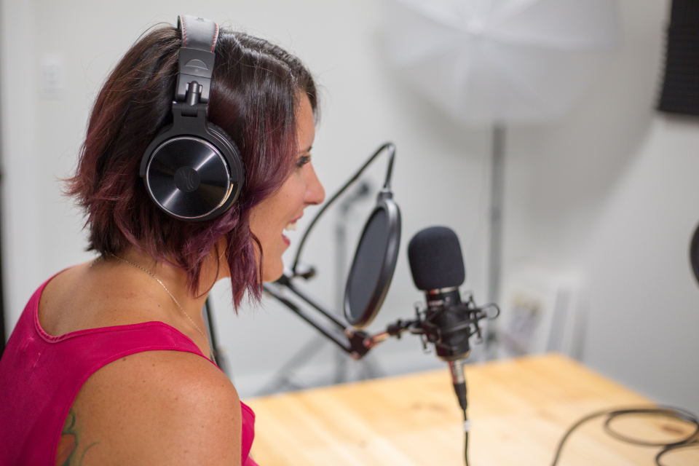
GRADE 8 · LESSON 3
Calling the Radio Station
Radioga qo‘ng‘iroq: hayotim haqida
Listening: Radio station conversation (Unit 1)
Kristin Hardwick · CC0 1.0
sozlar.com

Slide 2
LESSON AIMS
Bugungi maqsad
1
Students will be able to tick the ten topics a speaker mentions while listening once
2
Students will be able to complete eight sentences with details on a second listening
3
Students will be able to describe their own free time and school routine in six sentences

Slide 3
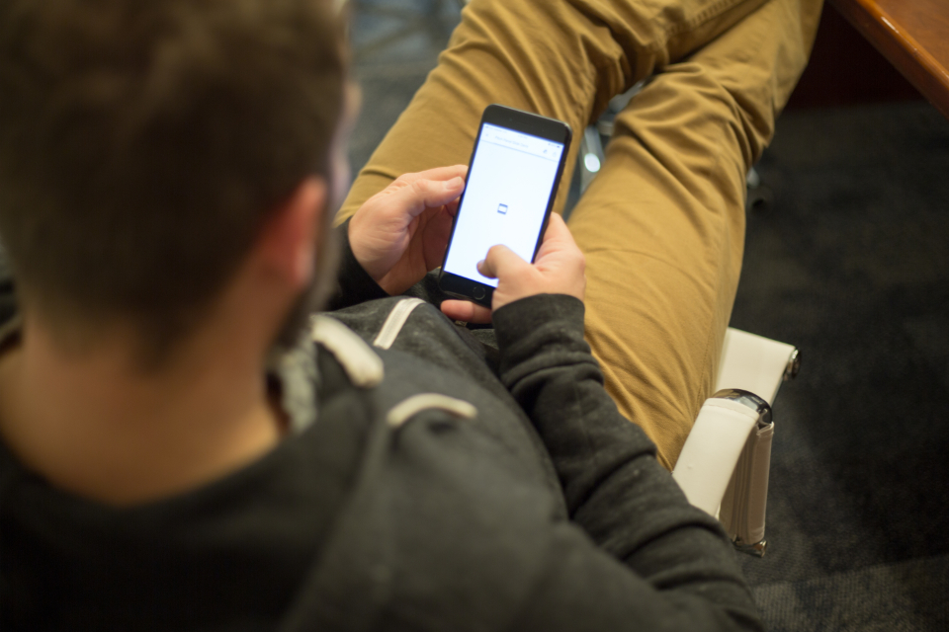
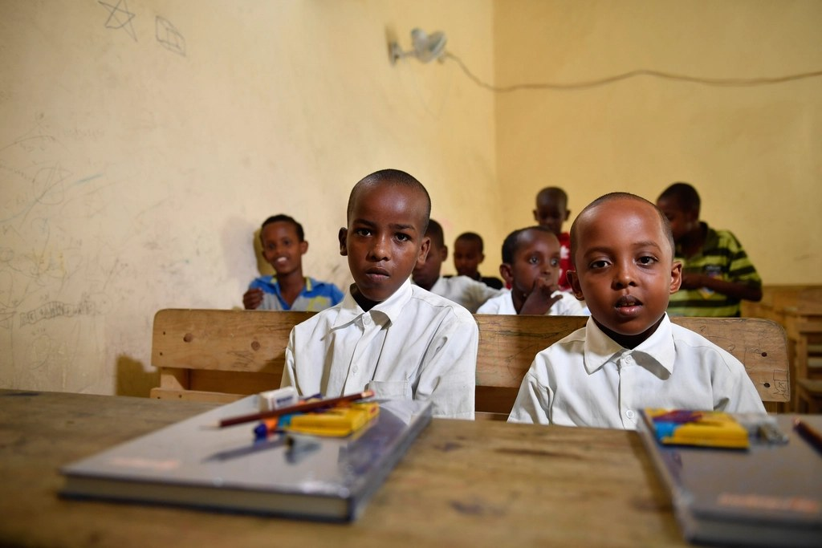
LOOK AND SAY
Bugungi mavzu
Kristin Hardwick · CC0 1.0
The African Union Mission in Somalia · CC0 1.0
What can you see? Say three sentences about each picture.

Slide 4
VOCABULARY
A. On the radio (1/2)
📻️
a radio station
radiostansiya
Adam calls a radio station to talk about his week.
📞️
call
qo‘ng‘iroq qilmoq
Many teenagers call the programme on Saturday mornings.
🙋️
a caller
qo‘ng‘iroq qiluvchi
The first caller today is a boy from Fergana.
🎙️
a presenter
boshlovchi (radio, televideniye)
The presenter of our favourite radio show has a lovely voice.

Slide 5
VOCABULARY
A. On the radio (2/2)
🎧️
a listener
tinglovchi
Thousands of listeners hear the programme every morning.
📡️
a radio programme
radioeshittirish
This radio programme is for teenagers and their parents.
🔴️
on air
efirda
When the red light is on, the programme is on air.
🚙️
listen to the radio
radio tinglamoq
Grandpa likes to listen to the radio in the car.

Slide 6
VOCABULARY
B. Adam’s life (1/2)
🐾️
a pet
uy hayvoni
My cousin has a pet — a small grey cat called Mosh.
🎒️
life at school
maktabdagi hayot
My grandmother always asks me about my life at school.
♟️
afternoon activities
tushdan keyingi mashg‘ulotlar
Our afternoon activities include chess, art and basketball.
🗓️
at the weekend
dam olish kunlari
At the weekend I visit my grandparents in the village.

Slide 7
VOCABULARY
B. Adam’s life (2/2)
🎬️
go to the cinema
kinoga (kinoteatrga) bormoq
We sometimes go to the cinema on Saturday afternoons.
🏡️
return home
uyga qaytmoq
My parents return home from work at about six o’clock.
📺️
watch TV
televizor ko‘rmoq
We watch TV together after supper on Friday evenings.
🕛️
midnight
yarim tun (tungi soat 12)
On New Year’s Eve we stay awake until midnight.

Slide 8
VOCABULARY
C. Phones and computers (1/2)
📲️
a mobile phone
mobil telefon
Aziz got a new mobile phone for his birthday.
🖥️
a computer
kompyuter
We have one computer at home, so I share it with my sister.
🎮️
play computer games
kompyuter o‘yinlari o‘ynamoq
My brother plays computer games for an hour after his homework.

Slide 9
VOCABULARY
C. Phones and computers (2/2)
🔋️
a battery
batareya, akkumulyator
The battery on my phone is nearly dead again.
🔌️
a charger
quvvatlagich (zaryadlovchi)
I always forget my phone charger at my grandma’s house.
📥️
an app
ilova (dastur)
This app helps me learn ten new words a day.

Slide 10
VOCABULARY
D. Free time and opinions (1/3)
🧑‍🤝‍🧑
hang out with friends
do‘stlar bilan vaqt o‘tkazmoq
On Saturdays I hang out with friends in the park.
🤝️
meet up
(kelishib) uchrashmoq
We meet up near the school gate at four o’clock.
🚴️
go cycling
velosipedda sayr qilmoq
In summer we go cycling along the river every Sunday.
🎶️
relax
dam olmoq, hordiq chiqarmoq
After lessons I relax and listen to music for an hour.

Slide 11
VOCABULARY
D. Free time and opinions (2/3)
🌃️
stay up late
kech tungacha uxlamay o‘tirmoq
On Saturdays I stay up late and watch films with my family.
⚽️
be a fan of
…ning muxlisi bo‘lmoq
My brother is a fan of Pakhtakor and never misses a match.
😍️
be keen on
…ga qiziqmoq, …ni yoqtirmoq
Dilshod is keen on photography and takes his camera everywhere.
😖️
can’t stand
…ni juda yomon ko‘rmoq, …ga toqat qilolmaslik
I can’t stand getting up early in winter.

Slide 12
VOCABULARY
D. Free time and opinions (3/3)
👍️
prefer
afzal ko‘rmoq
I prefer reading to watching TV in the evening.
😐️
boring
zerikarli
Monday is the most boring day of the week — six lessons!
🤩️
exciting
hayajonli, qiziqarli
The last ten minutes of the match were really exciting.

Slide 13
TODAY'S WORDS IN CONTEXT
Aziz's week (1/4)
Aziz is fourteen. On weekdays he gets up at half past six and walks home after school, because the bus is always full. On Tuesdays he goes to an after-school club — he decided to join a club in September and now he plays chess there.
He is a fan of chess, and he is also good at maths. In his free time he likes to relax with a book or meet up with friends near the library. At the weekend he hangs out with them and they spend time in the park.
Cover the word list. Can you understand the words in bold from the sentence?

Slide 14
TODAY'S WORDS IN CONTEXT
Aziz's week (2/4)
His mobile phone is always a problem. The battery is nearly always low and he often leaves his charger at home. His mother says he must switch off his phone at ten, and he agrees — but first he answers every text message.
Saturday is the most exciting day of his week and Monday is the most boring one — six lessons! At home he looks after his little sister and does the washing-up. He can't stand tidying his room, but he does it anyway.
Cover the word list. Can you understand the words in bold from the sentence?

Slide 15
TODAY'S WORDS IN CONTEXT
Aziz's week (3/4)
In the afternoon Aziz likes to go cycling or hang out with friends. Last September he decided to take up photography, and now he takes his camera on every class trip. His favourite day is Saturday, because he can go to the cinema with his friends.
At school he is good at maths and gets on with everybody. During break time he checks one app on his phone, then puts the screen away — his teacher does not allow phones in class. Next week he has to take an exam, so he will not stay up late.
Cover the word list. Can you understand the words in bold from the sentence?

Slide 16
TODAY'S WORDS IN CONTEXT
Aziz's week (4/4)
In the evening he likes to listen to the radio. His favourite radio station has a radio programme for teenagers: listeners call and talk about their life at school, and when a caller asks a question, Aziz tries to answer it before the presenter does. He is keen on music, but he prefers the talking parts — they are never boring.
Cover the word list. Can you understand the words in bold from the sentence?

Slide 17
TODAY'S WORDS IN CONTEXT
Read and answer
1
Why does Aziz walk home after school?
2
What does he do at the after-school club?
3
What two problems does he have with his phone?
4
Which job at home does he dislike?

Slide 18
FOCUS
Focus — frequency adverbs
• I usually hang out with friends at the weekend.
• He never switches off his phone at night.
• Adverb before the main verb, but after 'be': She is always late.

Slide 19
STRATEGY
Listening — how we do it
1
Look at the ten topics and the eight sentences before the recording starts.
2
First listening: tick the topics the caller talks about.
3
Second listening: write the details — age, place, times.
4
Make short notes, never full sentences, while you listen.

Slide 20
TASK 1 · GIST
First listening — tick the topics
Listen once. Which topics does the caller talk about?
1
his age
6
his favourite day
2
where he lives
7
his holidays
3
his pets
8
helping at home
4
his after-school club
9
his brother
5
his mobile phone
10
tidying his room

Slide 21
TASK 2 · DETAILS
Second listening — complete the sentences
Listen again. Write a word, number or short phrase in each gap.
1
Adam is ________ years old.
2
He lives in ________.
3
On weekdays he gets up at ________ past six.
4
He goes to a ________ club on Tuesdays.
5
He must switch off his phone at ________.
6
His favourite day is ________.
7
He thinks ________ is the most boring day.
8
He looks after his little ________.

Slide 22
PRONUNCIATION
Say it — don’t just read it
Repeat after me, then clap on the stressed syllable (ˈ shows the stress):
battery /ˈbætəri/
charger /ˈtʃɑːdʒə/
mobile phone /ˈməʊbaɪl fəʊn/
presenter /prɪˈzentə/
midnight /ˈmɪdnaɪt/
exciting /ɪkˈsaɪtɪŋ/
relax /rɪˈlæks/
prefer /prɪˈfɜː/
Now cover the Uzbek column and say the meaning of each word.

Slide 23
WHOLE CLASS
Practice — complete the sentence (1/2)
1
At the weekend I ________ ________ ________ ________ in the park until it gets dark.
2
My brother ________ ________ ________ computer games — he plays every evening.
3
My grandma never misses her favourite ________ ________ — it is on every morning at nine.
4
Speak clearly, please — you are ________ ________ now and thousands of people can hear you.
5
Let’s ________ ________ outside the cinema at five and buy the tickets together.
6
My phone does not work: the ________ is dead and I have no charger.

Slide 24
WHOLE CLASS
Practice — complete the sentence (2/2)
7
I downloaded a weather ________ on my phone yesterday.
8
The ________ told the presenter that he was thirteen years old.
9
Most ________ of this evening show are teenagers.
10
Don’t ________ ________ ________ tonight — you have a test tomorrow morning.
11
I ________ ________ people who talk during a film.
12
I ________ tea to coffee in the morning.

Slide 25
PAIR / GROUP WORK · 9 MINUTES
Vocabulary activity
1
Match the beginnings (1-10) with the endings (a-j).
2
Read your complete sentences aloud.
3
Give the Uzbek meaning of the key word in each sentence.
4
When you finish, swap tables with the other group.

Slide 26
PAIRS
Speaking
Tell your partner what you do on your favourite day, using six words from today's list.
Role-play: one of you calls the radio station, the other is the presenter and asks four questions.
The African Union Mission in Somalia · CC0 1.0

Slide 27
UZ
Qiyin joyi — o‘zbekcha
be a fan of — …ning muxlisi bo‘lmoq (jamoa, qo‘shiqchi); be keen on — …ga qiziqmoq (mashg‘ulot): I’m keen on photography. Ikkalasidan keyin ot yoki -ing keladi.
can’t stand — bitta ibora: “yomon ko‘raman”. So‘zma-so‘z tarjima qilinmaydi.
prefer A to B — A ni B dan afzal ko‘rmoq: I prefer tea to coffee.
Chastota so‘zlari fe’ldan oldin turadi: I usually walk, lekin be dan keyin: She is always late.
Tinglashda raqam va ismlar eng muhim tafsilot — ularni qisqacha yozib boring, to‘liq gap yozmang.

Slide 28
HOMEWORK
Uy vazifasi
1
Learn the 33 words (sections A–D).
2
sozlar.com/vocab/cards/?set=grade8-lesson3 — listen to each word and test yourself.
3
Write a 60-word paragraph: 'My favourite day of the week', using at least eight new words.
4
Workbook: Unit 1, exercises 1–4 on page 6.

Slide 29
IMAGE CREDITS
Rasmlar manbasi
cover
Kristin Hardwick · CC0 1.0 · https://stocksnap.io/photo/recording-studio-YA3HZPUFYL
phone
Kristin Hardwick · CC0 1.0 · https://stocksnap.io/photo/smartphone-screen-CRQPELMTL5
school
The African Union Mission in Somalia · CC0 1.0 · https://www.rawpixel.com/image/3373124/free-photo-image-africa-african-black

Slide 30
Uchta so‘z — ertaga ham esingizda qoladi
Juftingizga ayting, so‘ng daftaringizga yozib qo‘ying.
sozlar.com/vocab/cards/?set=grade8-lesson3

