Slide 1
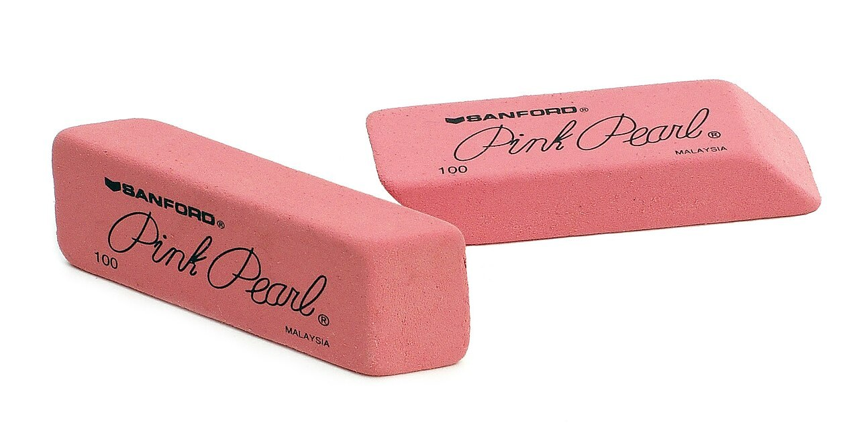
GRADE 7 · LESSON 36
Consolidation: Working on Mistakes
Evan-Amos · Public domain
Mustahkamlash: xatolar ustida ishlash
Consolidation lesson
sozlar.com

Slide 2
LESSON AIMS
Bugungi maqsad
1
Find and correct twelve typical mistakes in a 20-sentence error auction
2
Explain each correction with a short rule (be / have got, -s, -ing, stative verbs, pronouns, question order, too / very)
3
Rewrite three of their own wrong test answers correctly
4
Use the Units 1–4 grammar correctly in a short interview

Slide 3
VOCABULARY
A. Unit 1: things we have and own (1/2)
💻️
a laptop
noutbuk
Our teacher has got a laptop on her desk.
🐰️
a pet rabbit
uyda boqiladigan quyon
My cousin has got a white pet rabbit.
👯️
twins
egizaklar
Are you and your brother twins?
🛹️
a skateboard
skeytbord
The boys haven’t got bikes, but they’ve got a skateboard.

Slide 4
VOCABULARY
A. Unit 1: things we have and own (2/2)
🏷️
belong to
(biror kishiga) tegishli bo‘lmoq
This phone belongs to my sister — it isn’t mine.
🤲️
borrow
qarzga olmoq, vaqtincha olib turmoq
Can I borrow your pen? I can’t find mine.
🚲️
lend
qarzga bermoq, vaqtincha berib turmoq
I can lend you my bike on Saturday.
👤️
the owner
egasi
Who is the owner of this bike? Is it yours?

Slide 5
VOCABULARY
B. Unit 2: daily life and time (1/2)
🚌️
go to work
ishga bormoq
My mum goes to work by bus.
🚪️
leave
jo‘nab ketmoq, (uydan) chiqmoq
Dad leaves the house at seven every day.
🚏️
arrive
yetib kelmoq
Our school bus arrives at half past seven.
👨‍🏫
teach
o‘rgatmoq, dars bermoq
Mr Karimov teaches maths at our school.

Slide 6
VOCABULARY
B. Unit 2: daily life and time (2/2)
🕞️
half past three
soat uch yarim (3:30)
Our football practice starts at half past three.
🚉️
on time
o‘z vaqtida
The train to Samarkand always leaves on time.
❄️
hardly ever
deyarli hech qachon
It hardly ever snows in Termez.
🤝️
join a club
to‘garakka qo‘shilmoq (yozilmoq)
New students often join a club in September.

Slide 7
VOCABULARY
C. Unit 3: actions, feelings and yourself (1/2)
🏦️
save money
pul yig‘moq
I’m saving money for a new bike this year.
⏳️
waste time
vaqtni behuda o‘tkazmoq
Come on! We’re wasting time and the film starts soon.
🥁️
play the drums
baraban chalmoq
My brother is playing the drums — it’s so noisy!
🤔️
believe
ishonmoq
I don’t believe you! Nobody can swim ten kilometres.

Slide 8
VOCABULARY
C. Unit 3: actions, feelings and yourself (2/2)
👍️
agree
rozi bo‘lmoq, fikriga qo‘shilmoq
I don’t agree with you — I think the film is great.
👂️
hear
eshitmoq
Shh! Do you hear that? Somebody is playing the piano next door.
🤕️
hurt yourself
lat yemoq, o‘zini jarohatlamoq
Are you OK? Did you hurt yourself?
🪞️
look at yourself
o‘ziga qaramoq (ko‘zguda)
Look at yourself in the mirror — you’ve got chocolate on your face!

Slide 9
VOCABULARY
D. Unit 4: school, travel and describing (1/2)
📍️
far from
(biror joydan) uzoqda
Why do you go by bus? — Because my school is far from my house.
🚗️
by car
mashinada
How do you go to your grandma’s house? — By car, with my dad.
🙃️
make a mistake
xato qilmoq
Don’t be sad when you make a mistake. Try again!
📥️
hand in your homework
uy vazifasini topshirmoq
Always hand in your homework on time.

Slide 10
VOCABULARY
D. Unit 4: school, travel and describing (2/2)
🏃️
run in the corridor
yo‘lakda yugurmoq
Never run in the corridor between lessons.
👶️
young
yosh (yoshi kichik)
I’m too young to have a car.
💪️
strong
kuchli
My dad is very strong: he can carry two big boxes.
✍️
well
yaxshi (ravish)
Diane writes poems very well.

Slide 11
FOCUS
Top five mistakes — and the rules
• Yosh — be bilan: ✗ I have twelve years. → I’m twelve.; egalik — have got: She’s got a cat.
• he / she / it + -s: ✗ My sister go → My sister goes; inkor va so‘roqda — doesn’t / does + -s’siz fe’l.
• Hozir — am / is / are + -ing, lekin holat fe’llari -ing olmaydi: ✗ I’m liking → I like.
• Savol tartibi: so‘roq so‘zi + do / does / is / are + ega: ✗ Where you live? → Where do you live?
• too — muammo bor: ✗ very hot to drink → too hot to drink; fe’ldan keyin ravish: She sings well.

Slide 12
ERROR AUCTION · 8 MINUTES
Error auction — part 1 (1/2)
Each team has 100 points. Bet 10–30 points on the sentences you think are CORRECT. A wrong bet loses the points.
1
My sister is fourteen years old.
2
I have got twelve years.
3
Is this pencil yours?
4
My parent’s car is red. (two parents)
5
Aziz don’t like fish.
6
Does your brother play football?

Slide 13
ERROR AUCTION · 8 MINUTES
Error auction — part 1 (2/2)
7
We go usually to school by bus.
8
It’s quarter past eight.
9
Look! Those boys is running.
10
I’m knowing the answer.

Slide 14
ERROR AUCTION · 8 MINUTES
Error auction — part 2 (1/2)
Same rules. Then correct every wrong sentence in your notebook.
11
Can you help me with my homework?
12
We made the cake ourself.
13
Where you live?
14
Who knows the answer?
15
Don’t to run in the corridor!
16
This tea is very hot to drink.

Slide 15
ERROR AUCTION · 8 MINUTES
Error auction — part 2 (2/2)
17
She sings very good.
18
What does your mum do?
19
Are you doing your homework now?
20
How much people are there in your family?

Slide 16
CHECK AND TEACH · 6 MINUTES
Answer key — error auction
1
Correct (✓): 1 · 3 · 6 · 8 · 11 · 14 · 18 · 19
2
2 I’m twelve (years old). · 4 My parents’ car is red. · 5 Aziz doesn’t like fish.
3
7 We usually go to school by bus. · 9 Those boys are running. · 10 I know the answer.
4
12 We made the cake ourselves. · 13 Where do you live? · 15 Don’t run in the corridor!
5
16 This tea is too hot to drink. · 17 She sings very well. · 20 How many people …?
6
Each correction — say the rule number from the focus slide (1–5).

Slide 17
PRONUNCIATION
Say it — don’t just read it
Endings and stress we often get wrong — say them clearly:
leaves
/liːvz/
arrives
/əˈraɪvz/
teaches
/ˈtiːtʃɪz/
belongs to
/bɪˈlɒŋz tə/
the owner
/ði ˈəʊnə/
borrow
/ˈbɒrəʊ/
believe
/bɪˈliːv/
a mistake
/ə mɪˈsteɪk/
He / she / it: listen for the /z/ or /ɪz/ at the end — leaves, arrives, teaches.

Slide 18
WHOLE CLASS
Practice — complete the sentence (1/2)
1
My brother ________ got a new skateboard. (h…)
2
Is this your pen? — No, it isn’t ________. Mine is blue. (m…)
3
My dad ________ to work by bus every day. (g…)
4
________ your sister like music? — Yes, she does. (D…)
5
I’m ________ late for school. I always come at eight. (n…)
6
Look! The children are ________ in the park. (r…)

Slide 19
WHOLE CLASS
Practice — complete the sentence (2/2)
7
This bag is too heavy ________ me to carry. (f…)
8
Can you help ________? He’s lost. (h…)
9
________ forget your homework! (D…)
10
What does your mum ________? — She’s a nurse. (d…)

Slide 20
PAIR / GROUP WORK · 4 MINUTES
Vocabulary activity
1
Match the beginnings (1-10) with the endings (a-j).
2
Read your complete sentences aloud.
3
Give the Uzbek meaning of the key word in each sentence.
4
When you finish, swap tables with the other group.

Slide 21
PAIRS · 6 MINUTES
Speaking
Correct interview: ask your partner five questions, one from each part (Have you got a pet …? / What time do you leave home? / Are you saving money for …? / Is your school far from your house? / Is it too … to …?). Your partner answers in full sentences.
Listen for mistakes: if your partner makes a mistake, say Stop! and help him or her to correct it.
Swap roles. At the end, tell the class one mistake you corrected.

Slide 22
TODAY'S WORDS IN CONTEXT
Mistake detectives (1/2)
Every Monday our teacher gives us a ‘mistake detective’ game. Today we’re looking at Bobur’s email to his English friend.
His first sentence is: “I have twelve years old.” We know the answer: in English we say I’m twelve — with be, not have!
The next one is: “My mum go to work by car.” Malika finds the mistake, and we all agree: she goes to work — he, she, it + -s.
Then: “I am liking football very much.” That’s easy — like is a stative verb: I like football very much.
Cover the word list. Can you understand the words in bold from the sentence?

Slide 23
TODAY'S WORDS IN CONTEXT
Mistake detectives (2/2)
The last mistake is: “I’m very tired to play the drums today.” Everybody shouts: “You’re too tired to play!” Bobur laughs: “OK, OK — everybody can make a mistake! You’re very good detectives!”
Cover the word list. Can you understand the words in bold from the sentence?

Slide 24
TODAY'S WORDS IN CONTEXT
Read and answer
1
What game does the class play every Monday?
2
What is wrong in ‘I have twelve years old’?
3
Why is ‘My mum go’ wrong?
4
Why can’t we say ‘I am liking’?
5
Correct the last sentence.

Slide 25
PAIRS · ESDA QOLDIMI?
Memory check — say it right
Men xato gapni aytaman, siz to‘g‘risini va qoidasini aytasiz.
1
He have got a pet rabbit.
2
Where your dad goes to work?
3
I always am on time for school.
4
Look! My brother plays the drums.
5
This is my sister skateboard.

Slide 26
UZ
Qiyin joyi — o‘zbekcha
Bu dars YANGI so‘z bermaydi — kartalar I chorakdagi 1–4-bo‘limlardan (2–28-darslar).
Yosh be bilan aytiladi: I’m twelve — «o‘n ikki yoshdaman» (✗ I have twelve).
he / she / it — fe’lga -s: she goes, he watches; inkorda doesn’t go (-s yo‘q).
always, usually, never — asosiy fe’ldan oldin, lekin be dan keyin: I usually walk, I’m usually late.
myself, yourself, ourselves — «o‘zim, o‘zing, o‘zimiz»: We did it ourselves. Did you hurt yourself?

Slide 27
HOMEWORK
Uy vazifasi
1
Working on mistakes: rewrite all your wrong ChSB 1 answers correctly in your notebook.
2
Quick check — Workbook p. 22 and p. 28.
3
Learn the 32 items with the flashcards: sozlar.com/vocab/cards/?set=grade7-lesson36

Slide 28
IMAGE CREDITS
Rasmlar manbasi
cover
Evan-Amos · Public domain · https://commons.wikimedia.org/wiki/File:Office-pink-erasers.jpg

Slide 29
Uchta so‘z — ertaga ham esingizda qoladi
Juftingizga ayting, so‘ng daftaringizga yozib qo‘ying.
sozlar.com/vocab/cards/?set=grade7-lesson36

