Slide 1
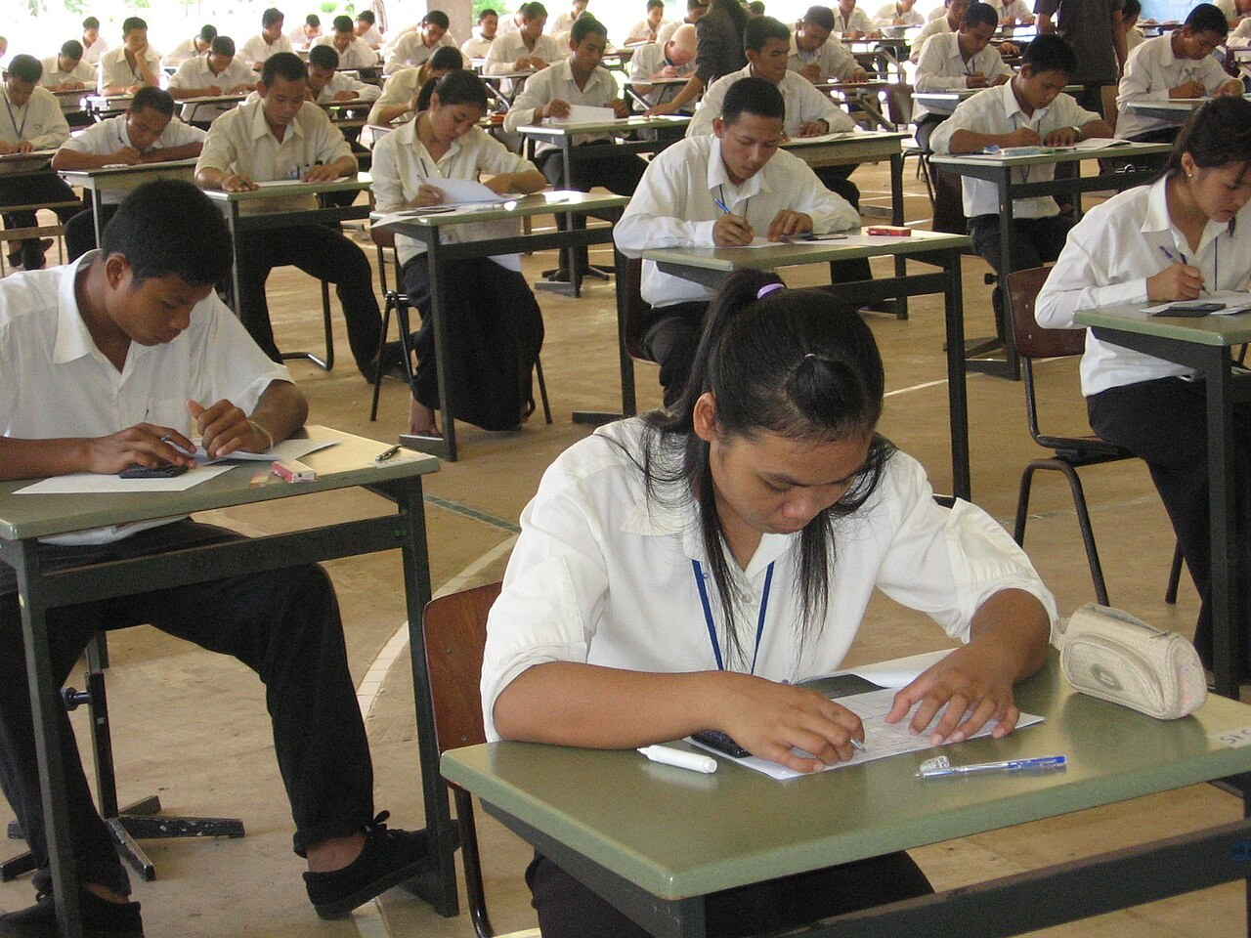
GRADE 10 · LESSON 36
Consolidation: Working on Mistakes
Mustahkamlash: xatolar ustida ishlash
Consolidation lesson
Albeiro Rodas · Public domain
sozlar.com

Slide 2
LESSON AIMS
Bugungi maqsad
1
Find and correct twelve typical mistakes in sentences from Units 1–4
2
Explain the rule for each correction (stative verbs, past perfect, used to, comparatives, articles)
3
Correct their own ChSB-1 mistakes and write a new example for each rule
4
Complete ten sentences without the same mistakes (gap-fill)

Slide 3
ERROR CLINIC · 7 MINUTES
Find and correct the mistake (1–6)
Every sentence has ONE mistake. Work with a partner: correct it and name the rule.
1
I’m knowing him since primary school.
2
When I arrived, the film already started.
3
I didn’t used to like vegetables.
4
My brother is more taller than me.
5
She’s interested about becoming a journalist.
6
Let’s go out when you will finish.

Slide 4
ERROR CLINIC · 7 MINUTES
Find and correct the mistake (7–12)
Every sentence has ONE mistake. Work with a partner: correct it and name the rule.
7
We did a lot of mistakes in the test.
8
My sister plays judo every Friday.
9
He works as engineer.
10
It’s the more exciting film I’ve ever seen.
11
Many people leave because the low salary.
12
I’m living in Tashkent since 2015.

Slide 5
VOCABULARY
A. Verbs for states (1/2)
🔊️
sound
(eshitganda) … bo‘lib tuyulmoq
Your plan sounds great — let’s try it on Saturday.
👅️
taste
ta’mi kelmoq, (qanday) ta’mli bo‘lmoq
This soup tastes of nothing — pass me the salt, please.
👃️
smell
hidi kelmoq
Grandma’s kitchen always smells of fresh bread.
🪞️
look like
(tashqi ko‘rinishdan) o‘xshamoq
Everybody says I look like my grandfather.

Slide 6
VOCABULARY
A. Verbs for states (2/2)
🏋️
weigh
og‘irligi … bo‘lmoq, … kilo kelmoq
The parcel weighs almost five kilos.
💰️
cost
narxi … bo‘lmoq, … turmoq
These trainers cost more than my whole school uniform.
👟️
fit
(kiyim) o‘lchamiga to‘g‘ri kelmoq
These shoes don’t fit me any more — my feet have grown.
🤔️
be thinking about
… haqida o‘ylab turmoq (jarayon)
You look worried. What are you thinking about?

Slide 7
VOCABULARY
B. Life in the past (used to) (1/2)
🪪️
a driving licence
haydovchilik guvohnomasi
My dad didn’t use to have a driving licence, so we went everywhere by bus.
📜️
in those days
o‘sha paytlarda
In those days, people used to write letters instead of emails.
🚫️
no longer
endi … emas
Grandpa used to drive a lorry, but he no longer works.

Slide 8
VOCABULARY
B. Life in the past (used to) (2/2)
🫣️
be afraid of
…dan qo‘rqmoq
I used to be afraid of the dark when I was small.
🧒️
as a child
bolalikda
As a child, I would always sit by the window on the bus.
⏰️
long hours
uzoq ish soatlari
My dad is used to working long hours at the airport.

Slide 9
VOCABULARY
C. Experiences and earlier events (1/2)
⌛️
wait for ages
juda uzoq kutmoq
Where are you? I’ve been waiting for ages outside the cinema!
🎤️
take part in
…da qatnashmoq
I’ve never taken part in a school concert before.
🏆️
win a competition
musobaqada g‘olib bo‘lmoq
Our chess team has won two competitions this year.
🗂️
find a job
ish topmoq
By the end of the summer, Aziza had found a job in a café.

Slide 10
VOCABULARY
C. Experiences and earlier events (2/2)
🌷️
quit your job
ishdan bo‘shamoq (o‘z xohishi bilan)
Nilufar had quit her job at the bank before she opened her flower shop.
⏱️
a deadline
oxirgi muddat (topshirish muddati)
We had been working late every evening because the deadline was on Friday.
⚖️
make a decision
qaror qabul qilmoq
Our club hasn’t made a decision about the summer trip yet.

Slide 11
VOCABULARY
D. Words that go together (1/2)
😟️
worry about
… haqida xavotirlanmoq
My grandma worries about everything, even the weather.
📣️
complain about
… dan shikoyat qilmoq
Our neighbours always complain about the noise from our flat.
✅️
succeed in
… ga muvaffaq bo‘lmoq, uddasidan chiqmoq
Did you succeed in getting the children to bed before nine?
☝️
blame somebody for
kimnidir biror narsa uchun ayblamoq
Don’t blame the weather for your bad result.

Slide 12
VOCABULARY
D. Words that go together (2/2)
🎉️
congratulate somebody on
kimnidir biror narsa bilan tabriklamoq
We all congratulated her on her exam results.
🥇️
do judo
dzyudo bilan shug‘ullanmoq
My brother does judo at the sports centre.
♟️
play chess
shaxmat o‘ynamoq
My grandfather taught me to play chess when I was six.

Slide 13
VOCABULARY
E. Comparing and places (1/2)
⚠️
dangerous
xavfli
Mining is one of the most dangerous jobs in the world.
🦺️
safe
xavfsiz
Working in an office is safer than working on a building site.
😰️
demanding
mashaqqatli, ko‘p kuch talab qiladigan
A pilot’s job is more demanding than a gardener’s.
🎢️
exciting
hayajonli, qiziqarli
Being a reporter is more exciting than I had expected.

Slide 14
VOCABULARY
E. Comparing and places (2/2)
🏔️
the Alps
Alp tog‘lari
My uncle went hang-gliding in the Alps last year.
📻️
on the radio
radioda
My dad always listens to football matches on the radio in the car.
📅️
at the weekend
dam olish kunlari
We play football in the park at the weekend with friends.

Slide 15
CHECK AND EXPLAIN
Answer key — Error clinic (1–6)
1
I’ve known him since primary school.
2
When I arrived, the film had already started.
3
I didn’t use to like vegetables.
4
My brother is taller than me.
5
She’s interested in becoming a journalist.
6
Let’s go out when you finish / have finished.

Slide 16
CHECK AND EXPLAIN
Answer key — Error clinic (7–12)
7
We made a lot of mistakes in the test.
8
My sister does judo every Friday.
9
He works as an engineer.
10
It’s the most exciting film I’ve ever seen.
11
Many people leave because of the low salary.
12
I’ve lived / I’ve been living in Tashkent since 2015.

Slide 17
FOCUS
Eng ko‘p uchragan beshta xato
• Holat fe’llari (know, like, want, believe) davomli shaklda kelmaydi; hozirgacha davom etsa — present perfect: I’ve known him since 2019.
• O‘tmishdagi voqeadan ham OLDIN bo‘lgan ish — past perfect: When I arrived, the film had already started.
• didn’t use to (✗ didn’t used to); be used to + -ing — «o‘rganib qolgan».
• make a mistake / a decision (✗ do); do judo, play chess, go skiing; interested in, good at.
• Qiyoslash: taller (✗ more taller), the most exciting, as tall as; kasb oldida a / an: an engineer.

Slide 18
PRONUNCIATION
Say it — don’t just read it
Hard words from today’s cards — silent letters and stress. Repeat after me:
weigh
/weɪ/
a driving licence
/ə ˈdraɪvɪŋ ˈlaɪsns/
no longer
/nəʊ ˈlɒŋɡə/
quit your job
/ˈkwɪt jə ˈdʒɒb/
succeed in
/səkˈsiːd ɪn/
congratulate somebody on
/kənˈɡrætʃuleɪt ˈsʌmbədi ɒn/
demanding
/dɪˈmɑːndɪŋ/
the Alps
/ði ˈælps/
weigh — the gh is silent: /weɪ/, like way; used to = /ˈjuːstə/ (s, not z).

Slide 19
WHOLE CLASS
Practice — complete the sentence (1/2)
1
I ________ him since primary school. (know)
2
When I arrived, the film had already ________. (start)
3
I didn’t ________ to like vegetables.
4
My brother is ________ than me. (tall)
5
She’s interested ________ becoming a journalist.
6
We ________ a lot of mistakes in the test. (make)

Slide 20
WHOLE CLASS
Practice — complete the sentence (2/2)
7
My sister ________ judo every Friday.
8
He works as ________ engineer.
9
It’s the ________ exciting film I’ve ever seen.
10
Many people leave because ________ the low salary.

Slide 21
PAIR / GROUP WORK · 4 MINUTES
Vocabulary activity
1
Match the beginnings (1-10) with the endings (a-j).
2
Read your complete sentences aloud.
3
Give the Uzbek meaning of the key word in each sentence.
4
When you finish, swap tables with the other group.

Slide 22
PAIRS
Speaking
Which section of ChSB-1 was the easiest for you, and which was the hardest? Why?
Tell your partner about one mistake you made and the rule behind it.
Give your partner a ‘mistake sentence’ — he or she corrects it and explains why.

Slide 23
TODAY'S WORDS IN CONTEXT
How to learn from your mistakes (1/2)
A test is not only a mark — it is a map of what you still need to learn. Look at your paper and put every mistake into a group: tenses, words that go together, comparisons or articles.
Then find the rule. If you wrote I’m knowing him, remember that know is a stative verb. If you wrote the film already started, remember that the earlier action needs the past perfect: had already started.
Next, correct your mistakes in a different colour and write one new sentence of your own for each rule. A new sentence is better than copying the right answer, because your brain has to make a decision.
Cover the word list. Can you understand the words in bold from the sentence?

Slide 24
TODAY'S WORDS IN CONTEXT
How to learn from your mistakes (2/2)
Finally, give yourself a deadline and come back to your list after a week. Don’t worry about one bad mark, and don’t blame the test for it. Everyone makes mistakes; good learners just don’t make the same mistake twice.
Cover the word list. Can you understand the words in bold from the sentence?

Slide 25
TODAY'S WORDS IN CONTEXT
Read and answer
1
What can a test show you, apart from your mark?
2
Into which four groups can you put your mistakes?
3
Why is ‘I’m knowing him’ wrong?
4
Why is a new sentence better than copying the right answer?

Slide 26
PAIRS · ESDA QOLDIMI?
Memory check — right or wrong?
Men gapni aytaman: to‘g‘ri bo‘lsa «Right!», xato bo‘lsa to‘g‘risini ayting.
1
This soup is tasting of nothing. → ?
2
We made a decision. → ?
3
I’m afraid from the dark. → ?
4
He succeeded to win the competition. → ?
5
Our neighbours complain about the noise. → ?

Slide 27
UZ
Qiyin joyi — o‘zbekcha
Holat fe’llari — know, like, want, believe, own: «bilyapman» deb tarjima qilsak ham, inglizchada I know.
«…dan beri» — since (nuqta: since 2015) yoki for (davr: for two years) + present perfect.
make — yaratmoq/qilmoq (make a mistake, make a decision); do — ish/mashg‘ulot (do homework, do judo).
worry about, complain about, succeed in, be afraid of — predlogni so‘z bilan birga yodlang; predlogdan keyin fe’l -ing bilan: succeed in getting.
-er / more — ikkalasi birga EMAS: taller yoki more expensive; ✗ more taller.

Slide 28
HOMEWORK
Uy vazifasi
1
Working on mistakes: finish your personal mistakes log (mistake → correct form → rule → new sentence) — rejadagi vazifa.
2
Workbook p. 30 — do again the exercises where you lost points.
3
Learn the 35 items with the flashcards: sozlar.com/vocab/cards/?set=grade10-lesson36

Slide 29
IMAGE CREDITS
Rasmlar manbasi
cover
Albeiro Rodas · Public domain · https://commons.wikimedia.org/wiki/File:Donboscocambodia0001.JPG

Slide 30
Uchta so‘z — ertaga ham esingizda qoladi
Juftingizga ayting, so‘ng daftaringizga yozib qo‘ying.
sozlar.com/vocab/cards/?set=grade10-lesson36

