Slide 1
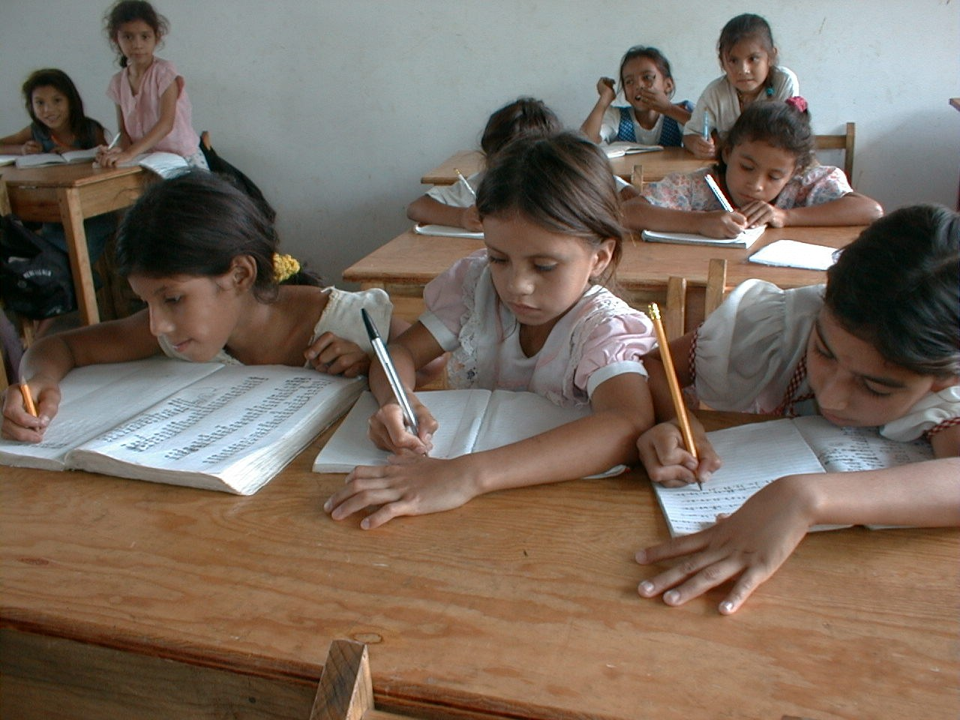
GRADE 8 · LESSON 36
Consolidation: Term 1 Review
Mustahkamlash: 1-chorak yakuni
Consolidation lesson
noma'lum · Public domain
sozlar.com

Slide 2
LESSON AIMS
Bugungi maqsad
1
Correct eight typical ChSB 1 mistakes and their own mistakes, saying the rule
2
Complete six vocabulary items from Units 1–4 (first letter given)
3
Put six verbs into the correct tense (present simple / continuous, past simple / continuous, present perfect, to + verb)
4
Talk about their term using at least three different tenses

Slide 3
WORKING ON MISTAKES · 10 MINUTES
Working on mistakes — ChSB 1 (1/2)
Typical ChSB 1 mistakes. Correct them in pairs, then correct your own test and write the rule.
1
He don't like basketball.
2
Where you are going now?
3
We was playing football when it started to rain.
4
I have seen this film last week.
5
She enjoys to read ghost stories.
6
Have you ever went to Samarkand?

Slide 4
WORKING ON MISTAKES · 10 MINUTES
Working on mistakes — ChSB 1 (2/2)
7
The film was very bored.
8
Don't laugh to me!

Slide 5
CHECK
Working on mistakes — answers
1
1 He doesn't like basketball. · 2 Where are you going now?
2
3 We were playing football … · 4 I saw this film last week.
3
5 She enjoys reading ghost stories. · 6 Have you ever been to Samarkand?
4
7 The film was very boring. · 8 Don't laugh at me!

Slide 6
VOCABULARY
A. Units 1–2: daily routine (1/2)
🌅️
wake up
uyg‘onmoq
On school days I wake up before my alarm clock rings.
🙆️
get up
o‘rnidan turmoq (yotoqdan)
My grandfather gets up at five and goes for a walk.
👕️
get dressed
kiyinmoq
My little brother can’t get dressed without Mum’s help.
🪥️
brush your teeth
tish yuvmoq
I brush my teeth twice a day, in the morning and before bed.

Slide 7
VOCABULARY
A. Units 1–2: daily routine (2/2)
🍳️
have breakfast
nonushta qilmoq
We have breakfast together in the kitchen at seven.
📚️
do homework
uy vazifasini bajarmoq
I do my homework at the kitchen table before dinner.
🔌️
turn off
o‘chirmoq (chiroq, kompyuter)
Please turn off the TV before you go to bed.
🌙️
go to bed
uxlashga yotmoq
On school nights I go to bed at about ten o’clock.

Slide 8
VOCABULARY
B. Units 1–2: free time and hobbies (1/2)
🧑‍🤝‍🧑
hang out with friends
do‘stlar bilan vaqt o‘tkazmoq
On Saturdays I hang out with friends in the park.
📷️
a photography club
fotografiya to‘garagi
Malika takes great pictures because she goes to a photography club.
📸️
a photographer
fotograf
A photographer came to our school and took a photo of every class.
🎸️
a guitarist
gitarachi
The guitarist played a song and everybody sang along.

Slide 9
VOCABULARY
B. Units 1–2: free time and hobbies (2/2)
🪙️
collect coins
tanga yig‘moq
My uncle collects coins and keeps them in a special book.
🎲️
board games
stol o‘yinlari
On rainy evenings our family plays board games.
😍️
be keen on
…ga qiziqmoq, …ni yoqtirmoq
Dilshod is keen on photography and takes his camera everywhere.
🥳️
have a great time
ajoyib vaqt o‘tkazmoq
We went to the water park and had a great time.

Slide 10
VOCABULARY
C. Unit 3: stories (1/2)
🏴‍☠️
an adventure story
sarguzasht hikoya
Treasure Island is a famous adventure story about pirates.
💰️
treasure
xazina
The children dug in the sand, looking for treasure.
💨️
disappear
g‘oyib bo‘lmoq
The weekend went so fast — it just disappeared!
😱️
a scream
chinqiriq, qichqiriq
Suddenly we heard a loud scream from the kitchen.

Slide 11
VOCABULARY
C. Unit 3: stories (2/2)
🚌️
wait for
(kimnidir, nimanidir) kutmoq
We waited for the bus for twenty minutes.
😂️
laugh at
(kimgadir, nimagadir) kulmoq
Everybody laughed at Sardor’s funny drawing.
⚡️
suddenly
to‘satdan, birdan
Suddenly, the lights went out and everybody screamed.
🧭️
get lost
adashib qolmoq
We got lost in the old city and asked a policeman for help.

Slide 12
VOCABULARY
D. Unit 4: parties and feelings (1/2)
🎊️
decorations
bezaklar
The paper decorations on the walls looked beautiful.
🎈️
balloons
havo sharlari
There were red and yellow balloons all over the room.
🌳️
outdoors
ochiq havoda, tashqarida
In summer my family eats outdoors in the garden.
🚪️
arrive
yetib kelmoq
The first guests will arrive at six o’clock.
🍕️
order pizza
pitsaga buyurtma bermoq
Nobody wants to cook, so let’s order pizza tonight.

Slide 13
VOCABULARY
D. Unit 4: parties and feelings (2/2)
🤩️
amazed / amazing
hayratda qolgan / hayratlanarli
The magic show was amazing, and all the children were amazed.
⚽️
excited / exciting
hayajonlangan / hayajonli
The match was exciting, and the fans were very excited.
🤫️
a surprise party
syurpriz ziyofat (kutilmagan ziyofat)
We’re having a surprise party for Grandpa — he doesn’t know anything!
🔒️
keep a secret
sir saqlamoq
Can you keep a secret? It’s about Dilnoza’s birthday.

Slide 14
TODAY'S WORDS IN CONTEXT
My first term in Year 8 (1/2)
Hi, I'm Nodira. My first term in Year 8 is nearly over! On weekdays I usually wake up at half past six, get dressed and walk to school. I always have breakfast — my mum makes great pancakes.
In September I joined a club: the photography club. Our teacher is a real photographer, and last month we went on a trip to the old town and took pictures of the old buildings.
In English we read some great stories. My favourite was about pirates and treasure. While the pirates were sleeping, the treasure disappeared! I really enjoyed reading it.
Cover the word list. Can you understand the words in bold from the sentence?

Slide 15
TODAY'S WORDS IN CONTEXT
My first term in Year 8 (2/2)
Then we learnt about parties. Last week our class had a party outdoors — we ordered pizza and the guests arrived at four. I was amazed by the decorations. I've never had so much fun at school! This is my report about the term — I have just finished it.
Cover the word list. Can you understand the words in bold from the sentence?

Slide 16
TODAY'S WORDS IN CONTEXT
Read and answer
1
What does Nodira usually do in the morning?
2
Which club did she join in September?
3
What happened while the pirates were sleeping?
4
Where did the class have their party, and what did they order?
5
Find one present perfect sentence in the text.

Slide 17
PAIRS · ESDA QOLDIMI?
Memory check — one minute per section
Juftingiz bo‘lim harfini aytadi (A–D), siz bir daqiqada iloji boricha ko‘p so‘z yoki misol aytasiz.
1
A: daily routine · B: free time and hobbies
2
C: stories · D: parties and feelings
3
Which three words do you still forget? Write them on a sticky note.

Slide 18
FOCUS
1-chorak grammatikasi — bitta jadvalda
• Present simple — odat: I usually walk to school. · Present continuous — hozir: Look! It's snowing.
• Past simple — tugagan voqea, vaqt bilan: We went to Khiva last year.
• Past continuous — fon: While we were playing, it started to rain.
• Present perfect — tajriba / natija, vaqtsiz: I've never been to Paris. · I've just finished.
• to / -ing: decide / hope / promise to · enjoy / finish / stop -ing; -ed / -ing: amazed (odam) / amazing (narsa).

Slide 19
EXERCISES · 8 MINUTES
Exercises — part 1 (vocabulary)
Write the missing word. The first letter is given.
1
I always b___ my teeth before I go to bed.
2
My sister is a great g___. She plays in a rock band.
3
The children were looking for the pirates' t___.
4
Stop laughing a___ me! It isn't funny.
5
It's warm and sunny. Let's have lunch o___.
6
I was so e___ about the trip that I couldn't sleep.

Slide 20
EXERCISES · 8 MINUTES
Exercises — part 2 (grammar)
Put the verb in brackets in the correct form.
7
My dad usually ___ (go) to work by bus.
8
Look! It ___ (snow)!
9
We ___ (watch) TV when the phone rang.
10
I ___ (buy) these shoes last Saturday.
11
___ you ever ___ (be) to Tashkent City Park?
12
She hopes ___ (become) a doctor one day.

Slide 21
CHECK · 5 MINUTES
Answer key — exercises
1
Part 1 1 brush · 2 guitarist · 3 treasure · 4 at · 5 outdoors · 6 excited
2
Part 2 7 goes · 8 's snowing (is snowing) · 9 were watching · 10 bought
3
Part 2 11 Have … been · 12 to become
4
Ask WHY: 8 — Look! → hozir; 9 — fon + qisqa voqea; 11 — tajriba, vaqt aytilmagan.

Slide 22
PRONUNCIATION
Say it — don’t just read it
O‘tgan zamon -ed oxiri — uch xil talaffuz (kartalardagi fe’llar):
brushed /brʌʃt/
laughed /lɑːft/
arrived /əˈraɪvd/
disappeared /ˌdɪsəˈpɪəd/
ordered /ˈɔːdəd/
amazed /əˈmeɪzd/
excited /ɪkˈsaɪtɪd/
waited /ˈweɪtɪd/
t yoki d dan keyin -ed alohida bo‘g‘in: /ɪd/.

Slide 23
WHOLE CLASS
Practice — complete the sentence (1/2)
1
I always ________ up at seven and get up at quarter past.
2
My brother ________ (play) computer games every evening.
3
Shh! The baby ________ sleeping.
4
We ________ (stop) at a café on the way to Samarkand.
5
I was reading ________ my little sister was drawing.
6
They decided ________ go to the cinema.

Slide 24
WHOLE CLASS
Practice — complete the sentence (2/2)
7
It's a lovely day. Let's eat ________.
8
I was so ________ when I saw the snow in July! (amaze)
9
We've ________ finished our project — look, here it is!
10
Have you ever ________ (try) Korean food?

Slide 25
PAIRS · 4 MINUTES
Speaking
Juftingizga choragingiz haqida ayting: odatingiz (I usually wake up / go to bed …), o‘tgan oy (last month), hozir (at the moment) va tajriba (I've never …).
Juftingizdan so‘rang: What was the most interesting lesson this term? Why?
Bir-biringizga 2-chorak uchun bitta maqsad ayting: Next term I want to …

Slide 26
PAIR / GROUP WORK · OPTIONAL
Vocabulary activity
1
Match the beginnings (1-10) with the endings (a-j).
2
Read your complete sentences aloud.
3
Give the Uzbek meaning of the key word in each sentence.
4
When you finish, swap tables with the other group.

Slide 27
UZ
Qiyin joyi — o‘zbekcha
Bu dars YANGI so‘z bermaydi — kartalar 1–26-darslardan: kundalik hayot, bo‘sh vaqt, hikoyalar, ziyofat va his-tuyg‘ular.
usually, hardly ever — present simple bilan; now, Look! — present continuous bilan.
last week, yesterday, ago — past simple; ever, never, just, already, yet — present perfect.
ChSB xatolaringizni daftarga to‘g‘ri yozib, yoniga qoidasini yozing — 2-chorakda shu xato qaytmasin.

Slide 28
HOMEWORK
Uy vazifasi
1
Working on mistakes: write your ChSB 1 mistakes correctly with the rule.
2
Quick check — Workbook p. 35, ex. 1–6.
3
Learn the 33 words with the flashcards: sozlar.com/vocab/cards/?set=grade8-lesson36

Slide 29
IMAGE CREDITS
Rasmlar manbasi
cover
noma'lum · Public domain · https://commons.wikimedia.org/wiki/File:School_girls_write_in_their_exercise_books,_San_Ramón,_Choluteca,_Honduras.jpg

Slide 30
Uchta so‘z — ertaga ham esingizda qoladi
Juftingizga ayting, so‘ng daftaringizga yozib qo‘ying.
sozlar.com/vocab/cards/?set=grade8-lesson36

