Slide 1
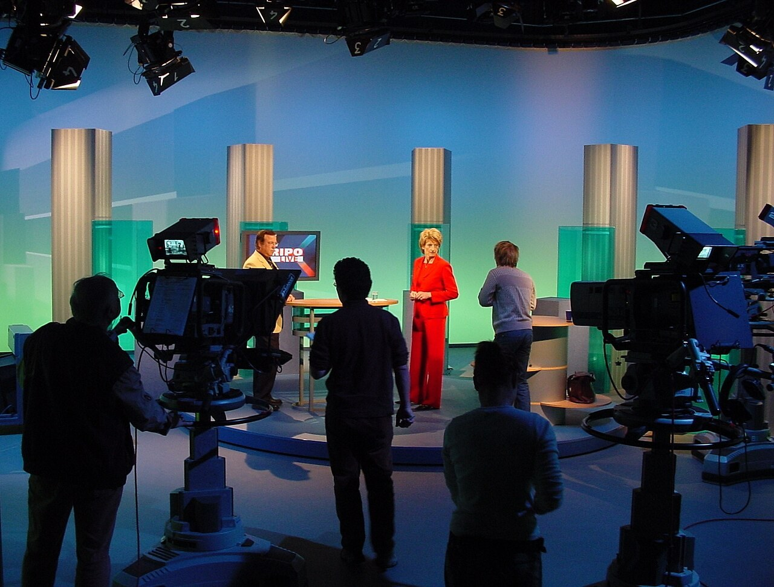
GRADE 10 · LESSON 34
Word Box: TV programmes
Word Box: televizor va ko‘rsatuvlar
Word box: TV programmes
noma'lum (Wikimedia Commons) · CC BY-SA 3.0
sozlar.com

Slide 2
LESSON AIMS
Bugungi maqsad
1
Complete seven Word box definitions from the first letter (ex. 4)
2
Name ten types of TV programme and describe them with gripping, moving, unrealistic, violent …
3
Form ten words from the same word family (worksheet Part A)
4
Discuss the Have your say! questions and plan a TV evening

Slide 3
BOOK TASK · EX.4
Word box — Laser B1+, p. 43, ex. 4
Find words or phrases in the article (pp. 42–43). The first letter is given.
1
change channels on a TV — t________ o________
2
worldwide — g________
3
electronic means of communication — t________
4
pictures — i________
5
send (a programme) through the air — b________
6
informed about the latest news — u________ t________ d________

Slide 4
BOOK TASK · EX.4
Word box — Laser B1+, p. 43, ex. 4 (7)
One more — then compare with your partner.
7
titles of news stories — h________

Slide 5
VOCABULARY
A. TV and news (1/2)
🔁️
turn over
boshqa kanalga o‘tmoq
There’s nothing good on — let’s turn over and watch the football.
🌐️
global
global, butun dunyoga oid
Climate change is a global problem.
📶️
telecommunications
telekommunikatsiya (masofaviy aloqa)
My uncle works for a big telecommunications company.
🖼️
images
tasvirlar
The space station sends clear images of the Earth.

Slide 6
VOCABULARY
A. TV and news (2/2)
📡️
broadcast
efirga uzatmoq, ko‘rsatmoq
The President’s speech was broadcast on all channels.
🗞️
up to date
eng so‘nggi yangiliklardan xabardor
I read the news online every morning to stay up to date.
📰️
headlines
(yangiliklar) sarlavhalari
This morning’s headlines were all about the earthquake.

Slide 7
VOCABULARY
B. Types of TV programme and film (1/2)
🎙️
a news bulletin
qisqa yangiliklar dasturi
There is a short news bulletin on the radio every hour.
🌦️
a weather forecast
ob-havo ma’lumoti
The weather forecast says it will snow tomorrow.
🎤️
a talent show
iste’dodlar tanlovi (shou)
Thousands of young singers took part in the talent show this year.
👑️
a period drama
tarixiy drama (serial)
My mother loves period dramas with beautiful old costumes.
🎨️
an animation
multfilm, animatsiya
Toy Story is a famous animation about toys that come to life.

Slide 8
VOCABULARY
B. Types of TV programme and film (2/2)
👽️
a science fiction film
ilmiy-fantastik film
We watched a science fiction film about life on Mars.
🕵️
a thriller
triller (hayajonli, sirli film)
The thriller was so exciting that nobody moved until the end.
👻️
a horror film
dahshat janridagi film
I never watch a horror film late at night.
⚽️
a sports programme
sport ko‘rsatuvi
Dad never misses the sports programme on Saturday.
🍳️
a cookery show
pazandachilik ko‘rsatuvi
On a cookery show, a chef shows you how to make a dish.

Slide 9
VOCABULARY
C. Describing programmes (1/3)
😮️
gripping
maroqli, ko‘zni uzib bo‘lmaydigan
It’s a gripping detective series — I watched three episodes in one evening.
😢️
moving
ta’sirli
It was a very moving film — everybody cried at the end.
🎭️
convincing
ishonarli
The actor was totally convincing as a doctor.
🦄️
unrealistic
hayotdan uzoq, real bo‘lmagan
The ending was a bit unrealistic — the hero survived a fall from a plane.

Slide 10
VOCABULARY
C. Describing programmes (2/3)
🥊️
violent
zo‘ravonlikka to‘la
I don’t like violent films with a lot of fighting.
😱️
scary
qo‘rqinchli
The film was too scary for my little sister.
✨️
imaginative
xayolotga boy, ijodiy
It’s a very imaginative cartoon about flying cats.
🌀️
confusing
chalkash, tushunarsiz
The plot was confusing — I didn’t understand the ending.

Slide 11
VOCABULARY
C. Describing programmes (3/3)
🎆️
spectacular
ajoyib, ko‘zni qamashtiradigan
The final scene of the film, with fireworks over the city, was spectacular.
🧵️
the plot
syujet, voqealar rivoji
The plot of the film was simple but exciting.
💥️
special effects
maxsus effektlar
The special effects in the new space film are amazing.

Slide 12
VOCABULARY
D. Watching TV (1/2)
📺️
a channel
telekanal
What’s on the other channel?
🎬️
an episode
(serial) qismi
I missed the last episode — what happened?
📚️
a series
serial, turkum
The new series starts on Monday at eight o’clock.

Slide 13
VOCABULARY
D. Watching TV (2/2)
🔴️
live
jonli (efirda)
The concert is shown live on TV tonight.
📢️
an advert
reklama (roligi)
I hate it when there’s an advert in the middle of a film.
💬️
subtitles
subtitrlar
I watch English films with subtitles.

Slide 14
CHECK · 2 MINUTES
Answer key — Word box, p. 43
1
1 turn over · 2 global · 3 telecommunications · 4 images
2
5 broadcast · 6 up to date · 7 headlines

Slide 15
FOCUS
Word box: beshta tuzoq
• turn over — kanalni almashtirmoq; turn on / off — yoqmoq / o‘chirmoq. ✗ change the TV.
• broadcast — noto‘g‘ri fe’l: broadcast – broadcast – broadcast (✗ broadcasted).
• up to date — «xabardor» (stay up to date); ot oldida chiziqcha bilan: up-to-date news.
• the news — birlikdagi fe’l bilan: The news is on at eight. (✗ are).
• a series — birlik ham, ko‘plik ham bir xil: one series, two series; bitta qismi — an episode.

Slide 16
PRONUNCIATION
Say it — don’t just read it
Hard words from today’s cards — listen for the stressed syllable (ˈ). Repeat after me:
broadcast
/ˈbrɔːdkɑːst/
headlines
/ˈhedlaɪnz/
global
/ˈɡləʊbl/
images
/ˈɪmɪdʒɪz/
telecommunications
/ˌtelikəˌmjuːnɪˈkeɪʃnz/
animation
/ˌænɪˈmeɪʃn/
spectacular
/spekˈtækjələ/
imaginative
/ɪˈmædʒɪnətɪv/
image = /ˈɪmɪdʒ/ (not ‘imeyj’); spectacular: spec-TAC-u-lar.

Slide 17
WHOLE CLASS
Practice — complete the sentence (1/2)
1
This film is boring — let’s turn ________ and watch something else.
2
The final will be ________ live on TV.
3
I watch the news every evening to stay up to ________.
4
Titles of news stories are called ________.
5
Let’s watch the weather ________ before the trip.
6
My cousin sang on a talent ________ and won.

Slide 18
WHOLE CLASS
Practice — complete the sentence (2/2)
7
The last episode was so ________ that I couldn’t stop watching. (g…)
8
The story is ________ — nobody lives like that. (u…)

Slide 19
PAIR / GROUP WORK · 8 MINUTES
Vocabulary activity
1
Part A — write the correct form of the word in CAPITALS (10 items).
2
Part B — complete each phrase with ONE word.
3
Work alone first, then compare with your partner and explain your choice.

Slide 20
GROUPS OF THREE · 11 MINUTES
Speaking
Have your say! How do you think television has changed the world?
Do you think it will still be important in the future? Why? / Why not?
Plan a TV evening for your group: three programmes — say what type each one is and describe it.

Slide 21
TODAY'S WORDS IN CONTEXT
Our TV evening (1/2)
In our house, the remote is the most important thing in the evening. Dad wants the news bulletin at eight because he likes to stay up to date. Mum wants the weather forecast, because she plans everything for tomorrow.
My sister loves talent shows and period dramas, and she cries at every moving scene. My little brother only watches animations. I prefer science fiction films — the special effects are spectacular — but when the plot is confusing, I turn over.
Cover the word list. Can you understand the words in bold from the sentence?

Slide 22
TODAY'S WORDS IN CONTEXT
Our TV evening (2/2)
Last Saturday the final was broadcast live, so for once we all watched the same channel. There were too many adverts, but the match was really gripping. Television hasn’t only changed the world; it brings our family together, too.
Cover the word list. Can you understand the words in bold from the sentence?

Slide 23
TODAY'S WORDS IN CONTEXT
Read and answer
1
Why does Dad watch the news bulletin?
2
What does the writer’s sister like?
3
When does the writer turn over?
4
What did the whole family watch last Saturday?
5
What was bad and what was good about it?

Slide 24
PAIRS · ESDA QOLDIMI?
Memory check — so‘zni toping
Men ta’rifni aytaman, siz Word box so‘zini ayting (birinchi harf yordam beradi).
1
change channels on a TV → t… o…
2
worldwide → g…
3
pictures → i…
4
send a programme through the air → b…
5
titles of news stories → h…

Slide 25
UZ
Qiyin joyi — o‘zbekcha
turn over — «boshqa kanalga o‘tkazmoq»; turn on / off — «yoqmoq / o‘chirmoq».
broadcast — «efirga uzatmoq»: uchala shakli ham bir xil (broadcast – broadcast – broadcast).
headlines — «sarlavhalar»; up to date — «yangiliklardan xabardor».
the news — o‘zbekchada «yangiliklar» (ko‘plik), inglizchada BIRLIK: The news is …
gripping — «maroqli»; moving — «ta’sirli» (harakatlanuvchi emas!).

Slide 26
HOMEWORK
Uy vazifasi
1
Write 10 sentences about TV programmes you watch (rejadagi vazifa) — use the types in B and the adjectives in C.
2
Learn the 34 items with the flashcards: sozlar.com/vocab/cards/?set=grade10-lesson34
3
Use all seven Word box words (turn over, global, telecommunications, images, broadcast, up to date, headlines).

Slide 27
IMAGE CREDITS
Rasmlar manbasi
cover
noma'lum (Wikimedia Commons) · CC BY-SA 3.0 · https://commons.wikimedia.org/wiki/File:MDR_Kripo_live.jpg

Slide 28
Uchta so‘z — ertaga ham esingizda qoladi
Juftingizga ayting, so‘ng daftaringizga yozib qo‘ying.
sozlar.com/vocab/cards/?set=grade10-lesson34

