Slide 1
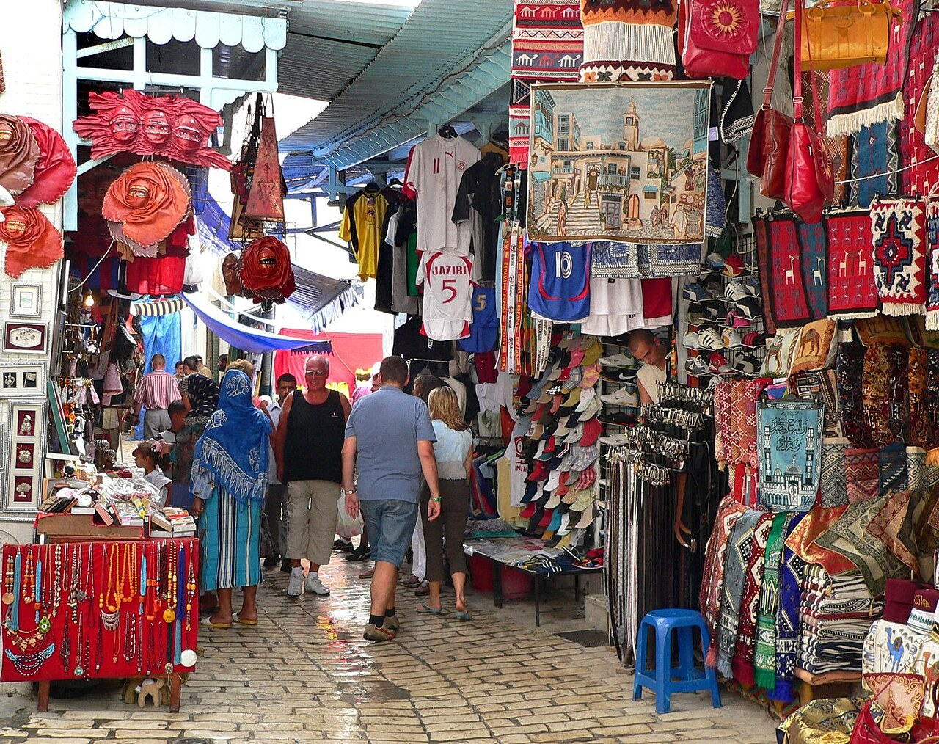
GRADE 7 · LESSON 34
Vocabulary Review: Units 3–4
Lug‘at takrori: 3–4-bo‘limlar
Vocabulary review
matthew Hunt · CC BY 2.0
sozlar.com

Slide 2
LESSON AIMS
Bugungi maqsad
1
Unscramble eight shopping words (p. 40 ex. 1)
2
Complete six sentences about sizes and shapes (ex. 2)
3
Put six reading words in the right place in a text (ex. 3)
4
Score at least 14/20 in the Units 3–4 vocabulary test

Slide 3
BOOK TASK · 7 MINUTES
Book tasks — Laser A1+, p. 40 (Revision Units 3–4)
Books open, word list closed. In ex.1 the first letter of each word is in bold.
1
ex.1 — rearrange the letters to find eight shopping words (oboksohp → b…).
2
ex.2 — write a word in each gap: opposites and shapes (6).
3
ex.3 — «My Dad’s Job»: each bold word is in the wrong place. Write the correct word on the line (6).
4
Compare with a partner.

Slide 4
CHECK AND TEACH · 5 MINUTES
Answer key — Laser A1+, p. 40
1
ex.1 1 bookshop · 2 busy · 3 customers · 4 lift · 5 expensive · 6 clothes shop · 7 butcher’s · 8 florist’s
2
ex.2 1 narrow · 2 thin · 3 round · 4 huge (gigantic) · 5 triangular · 6 square (rectangular)
3
ex.3 1 interviews · 2 views · 3 article · 4 email · 5 editor · 6 newspaper
4
Ask WHY: which word goes with «with famous people»? — interviews.

Slide 5
VOCABULARY
A. Shops and shopping (1/3)
📚️
a bookshop
kitob do‘koni
I buy my school books at the bookshop near our house.
🥩️
a butcher’s
qassob do‘koni
Mum buys meat at the butcher’s on Saturdays.
👗️
a clothes shop
kiyim do‘koni
There’s a new clothes shop in our shopping centre.
💐️
a florist’s
gul do‘koni
Let’s buy some roses for Mum at the florist’s.

Slide 6
VOCABULARY
A. Shops and shopping (2/3)
🍎️
a grocer’s
oziq-ovqat do‘koni
We buy apples and tomatoes at the grocer’s.
🧸️
a toy shop
o‘yinchoq do‘koni
My little brother loves the toy shop — he wants everything!
👥️
a customer
xaridor
The shop is full of customers on Saturday.
🛗️
a lift
lift
Let’s take the lift to the top floor.

Slide 7
VOCABULARY
A. Shops and shopping (3/3)
🚶️
busy
gavjum, odam ko‘p
The market is very busy on Sunday mornings.
🔖️
a sale
chegirmali savdo
I buy my winter coat in the January sale.
💎️
expensive
qimmat
This watch is very expensive.

Slide 8
VOCABULARY
B. Sizes and shapes (1/2)
🔵️
round
dumaloq
We need a round table for our big family.
🟩️
square
kvadrat shaklidagi
I prefer square plates — they look modern.
🔺️
triangular
uchburchak shaklidagi
My little brother loves triangular sandwiches.
🏢️
huge
ulkan, juda katta
The new shopping centre is huge! I don’t know where the shoe shop is.
🐜️
tiny
jajji, juda kichkina
An ant is a tiny insect, but it’s very strong.

Slide 9
VOCABULARY
B. Sizes and shapes (2/2)
📕️
thick
qalin
This dictionary is very thick — it has two thousand pages.
🥞️
thin
yupqa
I prefer thin pancakes with honey.
🛣️
narrow
tor
Our street is very narrow, so big buses don’t go there.
🌉️
wide
keng
The river is very wide here, so we need a bridge.

Slide 10
VOCABULARY
C. Newspapers and media (1/2)
🗞️
a newspaper
gazeta
Dad reads the newspaper with his morning tea.
🧑‍💼
the editor
muharrir
The editor chooses the best articles for the magazine.
🎤️
a reporter
muxbir
A reporter from the local TV is at our school today.
🎙️
an interview
intervyu, suhbat
The famous footballer gives an interview after the match.

Slide 11
VOCABULARY
C. Newspapers and media (2/2)
💬️
an opinion
fikr
In my opinion, this film is too long.
⭐️
a review
taqriz (film, kitob haqida fikr)
I always read a review of a film before I watch it.
🗓️
a calendar
taqvim; tadbirlar jadvali
There’s a big calendar on the wall of our classroom.
📺️
a programme
(tele/radio) ko‘rsatuv, dastur
My favourite TV programme is about wild animals.

Slide 12
VOCABULARY
D. Ways of talking (1/2)
🗣️
speak
gapirmoq, so‘zlamoq
Please speak slowly — I’m still learning English.
☎️
talk
gaplashmoq, suhbatlashmoq
My best friend and I talk for hours after school.
🤫️
whisper
shivirlamoq
Don’t tell anyone — just whisper it in my ear.
📢️
shout
baqirmoq, qichqirmoq
Please don’t shout in the library.

Slide 13
VOCABULARY
D. Ways of talking (2/2)
😱️
scream
chinqirmoq, qattiq qichqirmoq
My sister screams when she sees a spider.
🤥️
tell a lie
yolg‘on aytmoq
Pinocchio’s nose grows when he tells a lie.
🔒️
keep a secret
sir saqlamoq
Can you keep a secret? Don’t tell anyone!

Slide 14
FOCUS
Units 3–4 words — five things to remember
• Do‘kon nomi: the butcher’s / the florist’s / the grocer’s (’s = do‘kon), lekin a bookshop, a toy shop, a clothes shop.
• busy — «gavjum» (do‘kon) yoki «band» (odam): The shop is busy. I’m busy.
• Juft so‘zlar: narrow ↔ wide, thick ↔ thin, tiny ↔ huge; shakl: round, square, triangular.
• a newspaper — gazeta, the editor — muharrir, a reporter — muxbir, a review — taqriz, an interview — intervyu.
• tell a lie / the truth, keep a secret; ovoz: whisper → talk → shout → scream; talk to / shout at somebody.

Slide 15
TEST · 8 MINUTES
Units 3–4 vocabulary test — part 1 (1/2)
Choose A, B or C. Write only the letter.
1
You buy potatoes and apples at the ___. A butcher’s · B grocer’s · C florist’s
2
There are a lot of people in the shop. It’s very ___. A busy · B cheap · C tiny
3
The jacket costs five hundred dollars! It’s very ___. A expensive · B cheap · C narrow
4
Let’s take the ___ to the fourth floor. A sale · B bench · C lift
5
A football is ___. A square · B triangular · C round
6
The opposite of thick is ___. A wide · B thin · C narrow

Slide 16
TEST · 8 MINUTES
Units 3–4 vocabulary test — part 1 (2/2)
7
An ant is a ___ insect. A huge · B wide · C tiny
8
A ___ from the local TV asks the footballer questions after the match. A reporter · B customer · C butcher
9
The newspaper has a ___ of the new film: four stars! A sale · B review · C calendar
10
Please don’t ___ at me! I can hear you. A whisper · B say · C shout

Slide 17
TEST · 8 MINUTES
Units 3–4 vocabulary test — part 2 (1/2)
Complete the word. The first letter is given.
11
This bridge is too n___ for two cars.
12
We need flowers for Grandma’s birthday. Let’s go to the f___.
13
The film is so scary that I sometimes s___.
14
Can you k___ a secret?
15
In my o___, this book is better than the film.
16
Pinocchio always t___ lies.

Slide 18
TEST · 8 MINUTES
Units 3–4 vocabulary test — part 2 (2/2)
17
If you cut a square sandwich from corner to corner, you get two t___ pieces.
18
Mum buys meat at the b___.
19
The famous singer gives an i___ on TV tonight.
20
Grandma loves a TV p___ about cooking.

Slide 19
PRONUNCIATION
Say it — don’t just read it
Word stress — say the strong syllable louder:
CUStomers
/ˈkʌstəməz/
exPENsive
/ɪkˈspensɪv/
triANgular
/traɪˈæŋɡjələ/
rePORter
/rɪˈpɔːtə/
oPINion
/əˈpɪnjən/
INterview
/ˈɪntəvjuː/
CALendar
/ˈkæləndə/
WHISper
/ˈwɪspə/
Shops with ’s: the BUTcher’s /ˈbʊtʃəz/, the GROcer’s /ˈɡrəʊsəz/ — say the ’s at the end!

Slide 20
WHOLE CLASS
Practice — complete the sentence (1/2)
1
The shopping centre is very ________ on Saturdays — lots of people! (b…)
2
My legs are tired — let’s use the ________ to go to the fifth floor. (l…)
3
There’s a ________ at the shoe shop — everything is half price! (s…)
4
Our classroom door is very ________ — two students can walk in together. (w…)
5
My English dictionary is very ________ — it has nine hundred pages. (t…)
6
My cousin works for a newspaper. She’s a ________ — she writes about sport. (r…)

Slide 21
WHOLE CLASS
Practice — complete the sentence (2/2)
7
Look at the school ________ — the concert is on Friday. (c…)
8
Don’t ________ a lie, please. Tell the truth. (t…)
9
I can’t tell you — it’s a ________. (s…)
10
Please ________ — the baby is sleeping. (w…)

Slide 22
PAIR / GROUP WORK · 4 MINUTES
Vocabulary activity
1
Match the beginnings (1-10) with the endings (a-j).
2
Read your complete sentences aloud.
3
Give the Uzbek meaning of the key word in each sentence.
4
When you finish, swap tables with the other group.

Slide 23
PAIRS · 4 MINUTES
Speaking
Shop quiz: A names something (meat, roses, apples, a book, a doll, a T-shirt); B says the shop: You buy it at the butcher’s.
Describe and guess: A describes an object in the classroom with shape and size words (It’s round and thin. It’s on the wall.); B guesses.
Talk about you: Who do you talk to when you’ve got a problem? Can you keep a secret? Do you read a newspaper? When do you whisper and when do you shout?

Slide 24
TODAY'S WORDS IN CONTEXT
Saturday at Grand Mall (1/2)
Hi, readers! I’m Aziza, and I’m a pupil reporter for our school blog. This week I’m writing an article about the new shopping centre, Grand Mall.
On Saturday it is very busy. There are lots of people in the clothes shop because there’s a big sale. My little brother loves the toy shop, and my sister goes to the music shop for new CDs.
The building is huge! It has four floors and two escalators. In the middle there is a round fountain and some square tables.
I talk to a shop assistant. In her opinion, Saturday is the best day: “The customers enjoy themselves, and nobody gets bored!”
Cover the word list. Can you understand the words in bold from the sentence?

Slide 25
TODAY'S WORDS IN CONTEXT
Saturday at Grand Mall (2/2)
Do you want to see the photos? Click on the link below — they’re online. And can you keep a secret? My next article is about the new cinema!
Cover the word list. Can you understand the words in bold from the sentence?

Slide 26
TODAY'S WORDS IN CONTEXT
Read and answer
1
Who is Aziza?
2
Why is the clothes shop busy?
3
What is round in the shopping centre?
4
Why is Saturday the best day for the shop assistant?
5
What is Aziza’s secret?

Slide 27
PAIRS · ESDA QOLDIMI?
Memory check — odd one out
Qaysi so‘z ortiqcha? Sababini ayting.
1
butcher’s · florist’s · grocer’s · lift
2
round · square · busy · triangular
3
newspaper · review · interview · sale
4
whisper · shout · scream · expensive
5
narrow · thick · tiny · calendar

Slide 28
UZ
Qiyin joyi — o‘zbekcha
Bu dars YANGI so‘z bermaydi — hammasi 15-, 17-, 22-, 25-darslardan.
the butcher’s — «qassoblik do‘koni», the butcher — «qassob».
busy: a busy shop — «gavjum do‘kon», I’m busy — «bandman».
tell a lie — «yolg‘on gapirmoq», keep a secret — «sir saqlamoq»; whisper → talk → shout → scream — ovoz pastdan balandga.
narrow — yo‘l, ko‘cha uchun «tor»; thin — kitob, daftar, odam uchun «yupqa, ozg‘in».

Slide 29
HOMEWORK
Uy vazifasi
1
Revise the Units 3–4 Wordpower words: Workbook p. 24 and p. 26.
2
Write 10 sentences with words from the lesson (two from each section and two from the test).
3
Learn the 35 items with the flashcards: sozlar.com/vocab/cards/?set=grade7-lesson34

Slide 30
IMAGE CREDITS
Rasmlar manbasi
cover
matthew Hunt · CC BY 2.0 · https://commons.wikimedia.org/wiki/File:Souk_in_Tunisia_1.jpg

Slide 31
Uchta so‘z — ertaga ham esingizda qoladi
Juftingizga ayting, so‘ng daftaringizga yozib qo‘ying.
sozlar.com/vocab/cards/?set=grade7-lesson34

