Slide 1
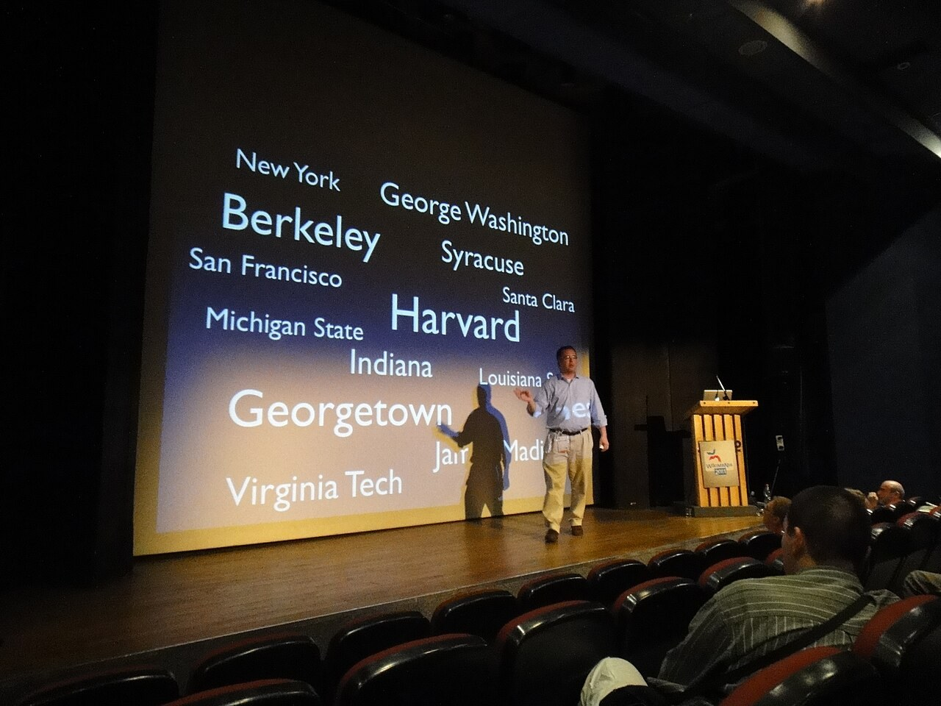
GRADE 8 · LESSON 34
Presentation Day
Taqdimot kuni
Presentation Day
User:Southgeist · CC BY-SA 3.0
sozlar.com

Slide 2
LESSON AIMS
Bugungi maqsad
1
Start and finish a presentation with set phrases (Today I'm going to talk about … / To sum up, …)
2
Describe a picture: the photo shows …, in the background, on the left
3
Give a 2-minute presentation using key words, not a full text
4
Give one positive comment and one tip to a classmate (two stars and a wish)

Slide 3
VOCABULARY
A. Describing a photo (1/2)
🖼️
describe a photo
suratni tasvirlamoq
In the exam you describe a photo for about one minute.
🍲️
in the foreground
old planda
In the foreground there’s a big pot of sumalak.
🌳️
in the background
orqa planda
In the background you can see the mountains and a blue sky.
👈️
on the left
chap tomonda
On the left is my sister, and next to her is my cousin.

Slide 4
VOCABULARY
A. Describing a photo (2/2)
👉️
on the right
o‘ng tomonda
The boy on the right was holding a big cake.
↗️
in the top right corner
yuqori o‘ng burchakda
In the top right corner you can see a red balloon.
↙️
in the bottom left corner
pastki chap burchakda
My little brother is sitting in the bottom left corner of the photo.

Slide 5
VOCABULARY
B. Preparing a presentation (1/2)
📊️
a presentation
taqdimot
My presentation is about Navruz in Samarkand.
🎤️
give a presentation
taqdimot qilmoq
Have you ever given a presentation in English?
💬️
a talk
nutq, qisqa ma’ruza
Dilnoza gave a short talk about her trip to Khiva.
🖥️
a slide
slayd
On the first slide there’s a map of our town.
💾️
a memory stick
fleshka
I’ve saved my presentation on a memory stick, so I can open it on the school computer.

Slide 6
VOCABULARY
B. Preparing a presentation (2/2)
📽️
a projector
proyektor
The projector wasn’t working, so I showed my photos on a laptop.
🎙️
a microphone
mikrofon
In the school hall you need a microphone because the room is very big.
🔁️
practise
mashq qilmoq
I’ve practised my talk three times at home.
📄️
a handout
tarqatma varaq
I’ve made a handout with the new words for everyone in the class.

Slide 7
VOCABULARY
C. Speaking to the class (1/2)
👥️
the audience
tinglovchilar
Don’t look at the floor. Look at the audience!
🗣️
speak slowly
sekin gapirmoq
Don’t hurry — speak more slowly, please.
📢️
speak loudly
baland ovozda gapirmoq
Please speak more loudly — we can’t hear you at the back.

Slide 8
VOCABULARY
C. Speaking to the class (2/2)
👀️
make eye contact
ko‘zlariga qarab gapirmoq
Good speakers make eye contact with the people in the room.
😮‍💨
take a deep breath
chuqur nafas olmoq
Take a deep breath and smile — you can do it!
💪️
confident
o‘ziga ishongan
After a lot of practice, Bobur felt confident.

Slide 9
VOCABULARY
D. Listening and feedback (1/2)
❓️
ask a question
savol bermoq
Can I ask a question about the second photo?
📝️
give feedback
fikr-mulohaza bildirmoq
After each presentation, two students give feedback.
🤫️
keep quiet
jim turmoq
Please keep quiet while your classmate is speaking.

Slide 10
VOCABULARY
D. Listening and feedback (2/2)
👂️
pay attention
diqqat qilmoq, e’tibor bermoq
Please pay attention — this part is important.
✋️
interrupt
gapini bo‘lmoq
Please don’t interrupt — wait for the questions at the end.
📈️
improve
yaxshilamoq
Your talk was good, and with more practice you can improve it even more.

Slide 11
TODAY'S WORDS IN CONTEXT
Model presentation: The best celebration I've ever been to (1/2)
Good morning, everyone. Today I'm going to talk about the best celebration I've ever been to — Navruz at my grandparents' house in Samarkand.
First of all, look at this slide. In the background you can see my grandparents' garden, and in the foreground, on the left, there is a big pot of sumalak. While the women were cooking it, the children were playing games outdoors.
Now I'd like to move on to the food. The refreshments were amazing: plov, samsa and lots of sweets. In the bottom left corner you can see me with my cousins in our new clothes — we were so excited!
Cover the word list. Can you understand the words in bold from the sentence?

Slide 12
TODAY'S WORDS IN CONTEXT
Model presentation: The best celebration I've ever been to (2/2)
Finally, something funny happened: my little brother fell asleep in the middle of the party!
To sum up, it was the most exciting day of the year. The main reason is that all my family was together. Thank you for listening. Are there any questions?
Cover the word list. Can you understand the words in bold from the sentence?

Slide 13
TODAY'S WORDS IN CONTEXT
Read and answer
1
What is the presentation about?
2
What can you see on the left of the first slide?
3
What were the children doing while the women were cooking?
4
What funny thing happened?
5
Find three phrases the speaker uses to start, move on and finish.

Slide 14
PAIRS · ESDA QOLDIMI?
Memory check — which word?
Men vaziyatni aytaman, siz kerakli so‘z yoki iborani ayting.
1
The people who watch and listen to your talk. → ?
2
It shows your slides on the wall. → ?
3
You feel nervous before you start. What should you do? → ?
4
Nobody at the back can hear you. → ?
5
You start talking while your classmate is still speaking. → ?

Slide 15
FOCUS
Taqdimot tuzilishi — to‘rt qadam
• Boshlash: salom + mavzu — Good morning, everyone. Today I'm going to talk about …
• Rasm: Look at this picture. The photo shows … · In the background … · On the left …
• O‘tish: First of all, … · Now I'd like to move on to … · Finally, …
• Yakun: To sum up, … · Thank you for listening. Are there any questions?
• 8–10 gap, 2 daqiqa; matnni o‘qimang — kartochkada faqat tayanch so‘zlar. Unit 3–4 grammatikasi: was/were + -ing, I've never …, I've been to …

Slide 16
SPEAKING STRATEGY · 7 MINUTES
Book phrases — Solutions Pre-Intermediate, p. 82
Speaking Strategy: when you give a short presentation, use set phrases to structure it.
1
Start: I'd like to start by … · First of all, …
2
Pictures (ex.2): the photo shows … · in the foreground / background · on the left / right · in the top right corner
3
Order: First, … Second, … Finally, … · Now I'd like to move on to …
4
Reasons: The main reason is …
5
Sum up: To sum up, … · In conclusion, …

Slide 17
TWO STARS AND A WISH
Presentation checklist and feedback card
1
☐ I said hello and my topic. · ☐ I showed and described a picture.
2
☐ I used First of all / Now I'd like to move on to / Finally.
3
☐ I said 8–10 sentences in about 2 minutes. · ☐ I made eye contact with the audience and spoke loudly.
4
☐ I finished with To sum up … Thank you for listening.
5
Feedback card: ★ I liked … ★ Your pictures … ✎ One thing to improve is …

Slide 18
PRONUNCIATION
Say it — don’t just read it
Taqdimot so‘zlarida urg‘u:
presentation /ˌpreznˈteɪʃn/
audience /ˈɔːdiəns/
foreground /ˈfɔːɡraʊnd/
microphone /ˈmaɪkrəfəʊn/
projector /prəˈdʒektə/
confident /ˈkɒnfɪdənt/
interrupt /ˌɪntəˈrʌpt/
take a deep breath /ˌteɪk ə ˌdiːp ˈbreθ/
Ibora oxirida ovozni tushiring: Thank you for LISTening ↘

Slide 19
WHOLE CLASS
Practice — complete the sentence (1/2)
1
Good morning, ________. Today I'm going to talk about my family.
2
Are you nervous? Take a deep ________ and count to three.
3
In the ________ of the photo there's a big mountain.
4
My dad is on the ________, next to my mum.
5
Now I'd like to move ________ to the second picture.
6
To sum ________, it was a fantastic trip.

Slide 20
WHOLE CLASS
Practice — complete the sentence (2/2)
7
Don't look at your notes all the time — make eye ________ with your classmates.
8
Don't read your text. Look at the ________!

Slide 21
PAIRS · 6 MINUTES
Speaking
Juftingiz oldida taqdimotingizni bir marta mashq qiling (2 daqiqa).
Juftingiz ro‘yxat bo‘yicha belgi qo‘yadi: boshlash iborasi, rasm iborasi, o‘tish iborasi, yakun; speak slowly and loudly, make eye contact.
Bitta maqtov va bitta maslahat ayting: I liked … / One thing to improve is …

Slide 22
PAIR / GROUP WORK · OPTIONAL
Vocabulary activity
1
Match the beginnings (1-10) with the endings (a-j).
2
Read your complete sentences aloud.
3
Give the Uzbek meaning of the key word in each sentence.
4
When you finish, swap tables with the other group.

Slide 23
UZ
Qiyin joyi — o‘zbekcha
Bugun taqdimot: 3- yoki 4-bo‘lim loyihangiz (hikoya, ziyofat) yoki o‘zingiz borgan bayram — 8–10 gap va rasmlar.
in the foreground — oldingi planda; in the background — orqa planda.
make eye contact — tinglovchilarning ko‘ziga qarab gapirmoq; speak slowly / loudly — sekin / baland ovozda gapirmoq.
feedback — fikr-mulohaza: avval maqtov (★★), keyin bitta maslahat (✎).

Slide 24
HOMEWORK
Uy vazifasi
1
Prepare your presentation: 8–10 sentences and pictures (if you did not present today, you will present next lesson).
2
Learn the 28 words with the flashcards: sozlar.com/vocab/cards/?set=grade8-lesson34
3
Write two sentences about your presentation: what went well and one thing to improve.

Slide 25
IMAGE CREDITS
Rasmlar manbasi
cover
User:Southgeist · CC BY-SA 3.0 · https://commons.wikimedia.org/wiki/File:Frank_Schulenburg_giving_a_presentation_at_Wikimania_2011.jpg

Slide 26
Uchta so‘z — ertaga ham esingizda qoladi
Juftingizga ayting, so‘ng daftaringizga yozib qo‘ying.
sozlar.com/vocab/cards/?set=grade8-lesson34

