Slide 1
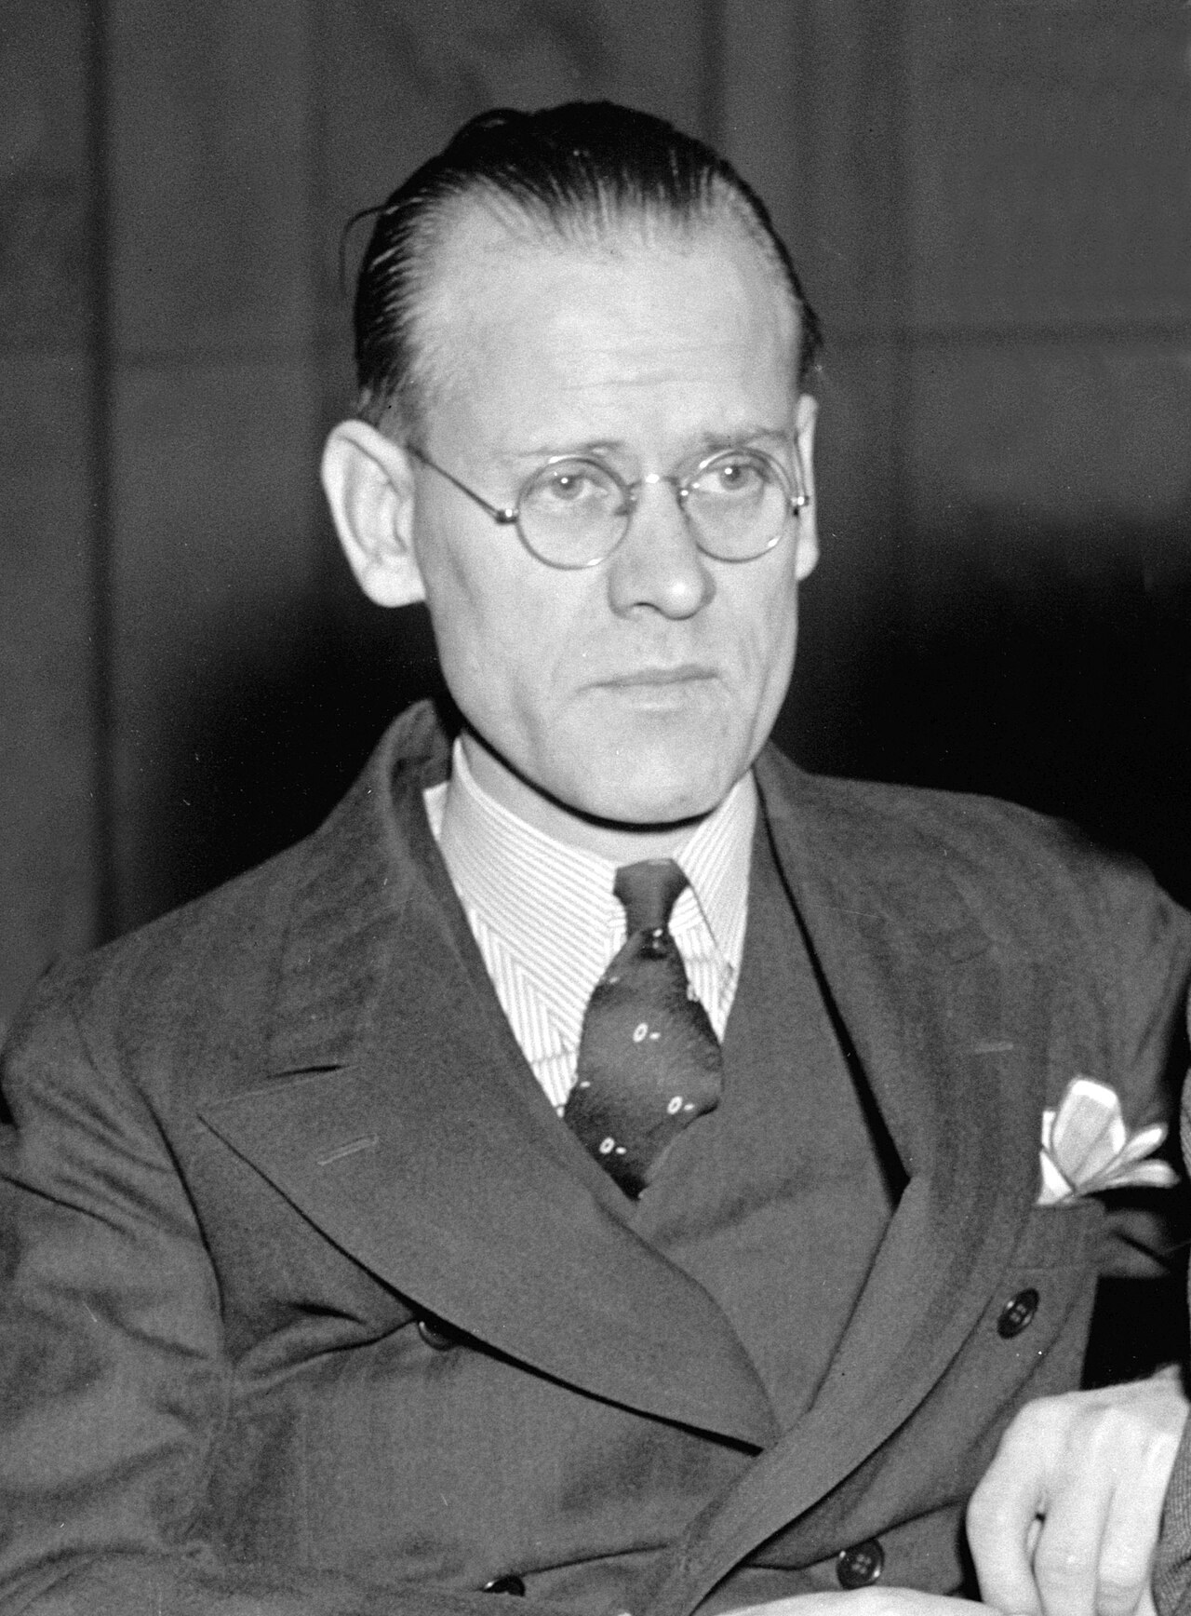
GRADE 10 · LESSON 33
Unit 5 Reading: How it all began
5-bo‘lim. O‘qish: hammasi qanday boshlangan — televizor tarixi
Unit 5. The global village Reading: How it all began
Harris & Ewing · Public domain
sozlar.com

Slide 2
LESSON AIMS
Bugungi maqsad
1
Answer the Start thinking! questions about the media and TV
2
Say what is surprising about the article (ex. 1)
3
Match six dates to six events (ex. 2)
4
Choose the sentence A–G that fits each of the six gaps (ex. 3)

Slide 3
BOOK TASK · OVERVIEW
Book tasks — Laser B1+, pp. 42–43
Unit 5 The Global Village — Reading. The book audio (1.15) is not available: read the article silently.
1
Start thinking! What does ‘media’ mean to you? How much TV do you watch?
2
ex.1 Read the magazine article. What is surprising about what it says?
3
ex.2 Match the dates 1837, 1876, 1895, 1901, 1922, 1927 to what happened (a–f).
4
ex.3 Six sentences have been removed. Choose from A–G; there is one extra sentence.

Slide 4
VOCABULARY
A. TV and the media
📺️
the media
ommaviy axborot vositalari (OAV)
TV, radio and newspapers are all part of the media.
🎛️
the remote
(televizor) pulti
Where’s the remote? I want to watch the news.
🌈️
full-colour
to‘liq rangli
The first full-colour TV programmes appeared in the 1950s.
🏆️
a success story
muvaffaqiyat tarixi
The mobile phone is another great success story of modern technology.
🚲️
take its modern form
bugungi ko‘rinishiga kelmoq
The bicycle took its modern form in the 1880s.

Slide 5
VOCABULARY
B. Communication before television (1/3)
🧱️
the basis for
…uchun asos
The telegraph was the basis for many later inventions.
📠️
the telegraph
telegraf
The telegraph sent short messages along long wires.
💡️
an invention
ixtiro
The radio was an amazing invention for its time.
✉️
send messages
xabar yubormoq
Today we send messages to our friends in a second.
📞️
over long distances
uzoq masofalarga
The telephone let people talk over long distances for the first time.

Slide 6
VOCABULARY
B. Communication before television (2/3)
🔌️
wires
simlar
Old telephones only worked if there were wires between the two buildings.
💪️
be capable of
…ga qodir bo‘lmoq
Early computers were capable of doing only very simple sums.
📻️
through the air
havo orqali
Radio signals travel through the air without any wires.
🚫️
an impossibility
imkonsiz narsa
A hundred years ago, a phone in your pocket was an impossibility.
🎞️
moving pictures
harakatlanuvchi tasvirlar (kino)
The first moving pictures had no sound at all.

Slide 7
VOCABULARY
B. Communication before television (3/3)
🤩️
impressive
hayratlanarli, kishini qoyil qoldiradigan
The first TV pictures were not clear, but they were very impressive for the time.
⚙️
mechanical
mexanik
My grandfather’s old watch is mechanical, not digital.
💿️
spinning discs
aylanuvchi disklar
In the 1920s, some televisions worked with spinning discs instead of electronics.
📱️
basic
oddiy, sodda
My first phone was very basic — it didn’t even have a camera.

Slide 8
VOCABULARY
C. Philo’s big idea (1/2)
📡️
electronic
elektron
Philo wanted to build an electronic television with no moving parts.
🚀️
be fascinated by
…ga maftun bo‘lmoq, juda qiziqmoq
My little brother is fascinated by space and rockets.
⚡️
electricity
elektr (toki)
Without electricity, we couldn’t watch TV or charge our phones.
🧲️
magnets
magnitlar
We played with magnets in our physics lesson.

Slide 9
VOCABULARY
C. Philo’s big idea (2/2)
📐️
draw diagrams
chizmalar chizmoq
Our teacher drew diagrams on the board to explain the idea.
🏗️
a working model
ishlaydigan maket (namuna)
Jasur built a working model of a windmill for the science fair.
🧳️
be forced to
…ga majbur bo‘lmoq
After the flood, many families were forced to leave their homes.

Slide 10
VOCABULARY
D. From an idea to everyday life (1/2)
🛠️
repair
ta’mirlamoq
My uncle can repair old radios and TVs.
🪙️
raise money
pul (mablag‘) to‘plamoq
Our class raised money for new books for the library.
🌍️
world-changing
dunyoni o‘zgartirgan
The internet was a world-changing invention.
💼️
an investor
investor, sarmoyador
The young inventor found an investor who believed in his idea.

Slide 11
VOCABULARY
D. From an idea to everyday life (2/2)
🏦️
provide money
mablag‘ ajratmoq, pul bilan ta’minlamoq
Two businessmen agreed to provide money for the new project.
📜️
register a patent
patent olmoq (rasmiylashtirmoq)
If you invent something new, you should register a patent for it.
🏠️
everyday life
kundalik hayot
Smartphones are now a part of everyday life for most people.

Slide 12
FOCUS
Gapped text: yo‘qolgan gapni qanday topamiz?
• Bo‘shliqdan oldingi va keyingi gapni o‘qing — yo‘qolgan gap ikkalasini bog‘lashi kerak.
• Olmoshlar qayerga ishora qiladi? he, they, it: B It finally came … — «it» = «the chance to raise money».
• Bog‘lovchilar: However (zid fikr), Although (qarshilik), Over the next few weeks (vaqt).
• Matndagi takrorlangan so‘zlar: wires ↔ through the air, images ↔ basic, fields ↔ farm.
• Oxirida ortiqcha gapni tekshiring: u matnning hech qaysi joyiga mantiqan tushmasligi kerak.

Slide 13
BOOK TASK · GAPPED TEXT
Ex.3 — which sentence fits each gap?
A everyday life · B two rich investors · C wires · D nobody understood · E next few weeks · F basic · G the fields
1
gap 1 — after: «people’s voices could be sent over long distances.» ___
2
gap 2 — after: «spinning discs … allowed light through small holes.» ___
3
gap 3 — after: «it could never be fast enough to produce good pictures.» ___
4
gap 4 — after: «He drew diagrams … explaining how it would work.» ___
5
gap 5 — after: «… looking out for the chance to raise money …» ___
6
gap 6 — after: «… across Europe and the rest of the world.» ___

Slide 14
PRONUNCIATION
Say it — don’t just read it
Hard words from today’s cards — listen for the stressed syllable (ˈ). Repeat after me:
telegraph
/ˈtelɪɡrɑːf/
invention
/ɪnˈvenʃn/
mechanical
/məˈkænɪkl/
electronic
/ɪˌlekˈtrɒnɪk/
electricity
/ɪˌlekˈtrɪsəti/
impossibility
/ɪmˌpɒsəˈbɪləti/
investor
/ɪnˈvestə/
register a patent
/ˈredʒɪstə ə ˈpætnt/
The stress moves: electric /ɪˈlektrɪk/ → electricity /ɪˌlekˈtrɪsəti/; patent: /ˈpætnt/ or /ˈpeɪtnt/.

Slide 15
TEACHER · CHECK
Answer key — Laser B1+, p. 43
1
ex.1 Modern TV began in the mind of a 13-year-old farm boy, Philo T. Farnsworth.
2
ex.2 1 d (1837) · 2 b (1876) · 3 f (1895) · 4 c (1901) · 5 a (1922) · 6 e (1927)
3
ex.3 1 C · 2 F · 3 G · 4 E · 5 B · 6 A
4
ex.3 extra sentence: D (Nobody understood how it worked …)

Slide 16
WHOLE CLASS
Practice — complete the sentence (1/2)
1
Without even thinking about it, we click the ________ to turn our TVs on.
2
The telephone was a great ________ — it changed the way people talked to each other.
3
For the first time, people’s voices could be sent over long ________.
4
Sending pictures with sound seemed to be an ________.
5
Philo T. Farnsworth was ________ by electricity.
6
Crowds came to see the new machine — everyone thought it was very ________.

Slide 17
WHOLE CLASS
Practice — complete the sentence (2/2)
7
There was no way they could build a working ________.
8
He was looking for a chance to ________ money for his invention.
9
Farnsworth registered the ________ for his idea in 1927.
10
Television became a part of ________ life.

Slide 18
PAIR / GROUP WORK · 4 MINUTES
Vocabulary activity
1
Match the beginnings (1-10) with the endings (a-j).
2
Read your complete sentences aloud.
3
Give the Uzbek meaning of the key word in each sentence.
4
When you finish, swap tables with the other group.

Slide 19
PAIRS · 4 MINUTES
Speaking
Start thinking! What does the word ‘media’ mean to you?
How much TV do you watch? What kinds of TV programme do you like?
Ex.1: What is surprising about the article? Which invention from it is the most important, in your opinion?

Slide 20
TODAY'S WORDS IN CONTEXT
The farm boy who imagined television (1/2)
In the nineteenth century, the telegraph and the telephone let people send messages round the world and talk over long distances, but only with wires. Then the radio sent sound through the air. Sending moving pictures the same way seemed an impossibility.
Early inventors built mechanical televisions with spinning discs, but the pictures were very basic. In 1922, a thirteen-year-old farm boy, Philo Farnsworth, who was fascinated by electricity, had a better idea: magnets could control electrons and make an electronic picture.
Cover the word list. Can you understand the words in bold from the sentence?

Slide 21
TODAY'S WORDS IN CONTEXT
The farm boy who imagined television (2/2)
Philo drew diagrams for his chemistry teacher, but they could not build a working model, and his family was forced to move. Years later he repaired radios, found two investors who agreed to provide the money, and in 1927 he registered the patents and saw the first pictures.
After the Second World War, television became a part of everyday life. Today billions of us watch it — and it all began with an idea in the mind of a young boy.
Cover the word list. Can you understand the words in bold from the sentence?

Slide 22
TODAY'S WORDS IN CONTEXT
Read and answer
1
What could the telegraph and the telephone not do without?
2
What was the problem with mechanical television?
3
How old was Philo when he had his idea, and what was it?
4
Why couldn’t Philo and his teacher build the television?
5
What happened in 1927?

Slide 23
PAIRS · ESDA QOLDIMI?
Memory check — which date?
Men voqeani aytaman, siz yilni aytasiz (1837 · 1876 · 1895 · 1901 · 1922 · 1927).
1
the telegraph sent the first messages along wires → ?
2
voices travelled over long distances (the telephone) → ?
3
the first moving pictures (the cinema) → ?
4
the radio sent sound through the air → ?
5
Philo drew diagrams of an electronic TV → ?

Slide 24
UZ
Qiyin joyi — o‘zbekcha
the media — «OAV» (televidenie, radio, gazetalar, internet); ko‘plikdagi so‘z.
invent — ixtiro qilmoq, invention — ixtiro, inventor — ixtirochi.
be fascinated by — «…ga maftun bo‘lmoq», predlogi by.
be capable of + -ing — «…ga qodir bo‘lmoq»: capable of sending messages.
raise money — «mablag‘ to‘plamoq» (rise emas!); register a patent — «patentni ro‘yxatdan o‘tkazmoq».

Slide 25
HOMEWORK
Uy vazifasi
1
Learn the Unit 5 Word box vocabulary (TV programmes) — Laser B1+ p. 43 ex.4; write 8 sentences (rejadagi vazifa).
2
Learn the 33 items with the flashcards: sozlar.com/vocab/cards/?set=grade10-lesson33
3
Read «The farm boy who imagined television» on the lesson page and answer the five questions.

Slide 26
IMAGE CREDITS
Rasmlar manbasi
cover
Harris & Ewing · Public domain · https://commons.wikimedia.org/wiki/File:Philo_T_Farnsworth.jpg

Slide 27
Uchta so‘z — ertaga ham esingizda qoladi
Juftingizga ayting, so‘ng daftaringizga yozib qo‘ying.
sozlar.com/vocab/cards/?set=grade10-lesson33

