Slide 1
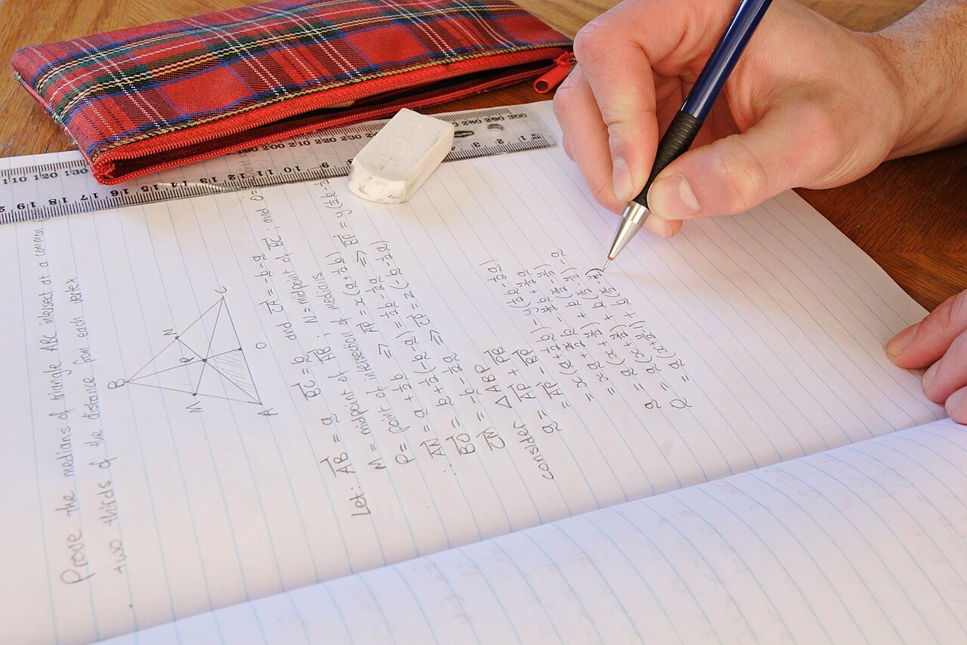
GRADE 8 · LESSON 33
Grammar Review: Units 3–4 — Working on Mistakes
Grammatika takrori: 3–4-bo‘limlar — xatolar ustida ishlash
Grammar review (Unit 3-4)
noma'lum (Wikimedia Commons) · GFDL 1.2
sozlar.com

Slide 2
LESSON AIMS
Bugungi maqsad
1
Find the incorrect sentence in twenty pairs and say why it is wrong (Grammar database Quick checks 5–8)
2
Choose between the past simple and the past continuous with when and while
3
Form present perfect questions, negatives and short answers correctly
4
Correct their own BSB 2 mistakes and write the rule next to each

Slide 3
BOOK TASK · 12 MINUTES
Book task — Grammar database, pp. 148–149
Books open at p. 148. Put a line through the incorrect sentence. Work alone, then compare.
1
Quick check 5 — past simple / past continuous (5 juft gap).
2
Quick check 6 — imperative, to + fe’l, -ing (5 juft gap).
3
Quick check 7 — present perfect 1: shakl (5 juft gap).
4
Quick check 8 (p. 149) — present perfect 2: already, ever, never, aniq vaqt (5 juft gap).
5
Har xato gapning yoniga sababini yozing: tense · form · to / -ing · word order.

Slide 4
CHECK · 6 MINUTES
Answer key — Grammar database (incorrect sentences)
1
QC 5 ✗ 1 I was seeing Angie … · 2 What Angie doing … · 3 No, she wasn't buying. · 4 Conor was breaking the window … · 5 I had lunch.
2
QC 6 ✗ 1 Sally, you to wake up! · 2 Adam, not make a mess! · 3 Sten promised helping me. · 4 Do you enjoy to collect stamps? · 5 … you can see Fiona run.
3
QC 7 ✗ 1 My dad given me some money. · 2 What you have done to your arm? · 3 Are you sent the invitations? · 4 Yes, I've had. · 5 I not have seen Peter today.
4
QC 8 ✗ 1 I already saw that film. · 2 I've been to China and India last year. · 3 Were you ever visit America? · 4 I've ever not met your brother. · 5 No, I haven't read.
5
Ask WHY: QC 5.5 — at 2 o'clock → davom etayotgan ish; QC 6.5 — suratda harakatning bir qismi → running.

Slide 5
GRAMMAR
Past continuous and present perfect — form
Past continuous
Present perfect
+
I was reading when he called.
I've already read it.
−
They weren't listening.
She hasn't seen it yet.
?
Were you sleeping at ten?
Have you ever been to Bukhara?
short
Yes, I was. / No, I wasn't.
Yes, I have. / No, I haven't.
Aniq o‘tgan vaqt aytilsa (yesterday, last week, at five o'clock) — past simple yoki past continuous; vaqt aytilmasa — present perfect.

Slide 6
FOCUS
To‘rt qoida — to‘rt tipik xato (Grammar database 5–8)
QOIDA
QOIDA
5: fon — was/were + -ing, qisqa voqea — past simple: I was walking home when it started to rain. (✗ was starting)
6: buyruq — fe’lning o‘zi: Wake up! · Don't make a mess! (✗ you to wake up, ✗ not make); promise / decide to, enjoy / stop -ing.
7: have / has + 3-shakl: My dad's given me … (✗ My dad given); savol — Have you sent …? (✗ Are you sent); qisqa javob — Yes, I have.
8: aniq vaqt bilan present perfect EMAS: I went there last year. (✗ I've been there last year); never — ever not emas.
been to — borib QAYTGAN; gone to — ketgan, hali u yerda: He's gone to the market.

Slide 7
WORKING ON MISTAKES · 8 MINUTES
Working on mistakes — BSB 2 (1/2)
Typical BSB 2 mistakes. What's wrong? Correct the sentences in pairs. Then correct your own test.
1
While I run to the bus stop, I was seeing my friend.
2
We were walking home when it was starting to rain.
3
My grandparents have never flew on a plane.
4
Have you ever ate Japanese food?
5
I'm sorry, I didn't finish my project yet.
6
Dilnoza has gone to Samarkand three times — she loves it there.

Slide 8
WORKING ON MISTAKES · 8 MINUTES
Working on mistakes — BSB 2 (2/2)
7
The ghost story was really frightened.
8
Please don't laugh to me!

Slide 9
CHECK
Working on mistakes — answers
1
1 While I was running to the bus stop, I saw my friend. · 2 … when it started to rain.
2
3 … have never flown … · 4 Have you ever eaten Japanese food?
3
5 I haven't finished my project yet. · 6 Dilnoza has been to Samarkand three times.
4
7 … really frightening. · 8 Please don't laugh at me!

Slide 10
VOCABULARY
A. Stories in the past (GD 5) (1/2)
☎️
talk to
(kimdir) bilan gaplashmoq
I was talking to my grandma on the phone when you called.
🎧️
listen to
(nimanidir) tinglamoq
Malika was listening to music when the lights went out.
🛋️
the living room
mehmonxona (uydagi umumiy xona)
We were sitting in the living room and watching TV.
🚪️
come in
kirib kelmoq
When Mum came in, we were still playing on the floor.
⏳️
still
hali ham, hamon
It was ten o’clock, but my brother was still sleeping.

Slide 11
VOCABULARY
A. Stories in the past (GD 5) (2/2)
🤕️
fall over
yiqilib tushmoq
Sardor fell over while he was running to the shop.
💡️
realise
anglamoq, sezib qolmoq
I didn’t realise that my friend was standing behind me.
😢️
cry
yig‘lamoq
The little girl was crying because she couldn’t find her mum.
🔔️
at that moment
o‘sha paytda, shu payt
At that moment, the door opened and Grandma walked in.

Slide 12
VOCABULARY
B. Instructions and verb patterns (GD 6) (1/2)
😟️
worry about
(nimadan) xavotirlanmoq, tashvishlanmoq
Don’t worry about the test — you’re ready.
📢️
shout at
(kimgadir) baqirmoq
Please don’t shout at your little brother.
〰️
underline
tagiga chizmoq
Underline the most important words in red.
✅️
make sure
ishonch hosil qilmoq, albatta …ishini ta’minlamoq
Make sure everybody brings a coat — it’s cold.
🙋️
offer to help
yordam berishni taklif qilmoq
Bobur always offers to help when we tidy the classroom.

Slide 13
VOCABULARY
B. Instructions and verb patterns (GD 6) (2/2)
🙇️
apologise for
(nimadir) uchun uzr so‘ramoq
Bekzod apologised for breaking the window.
🤭️
can’t stop laughing
kulgidan to‘xtay olmaslik
The film was so funny that I couldn’t stop laughing.
🏁️
finish
tugatmoq, (aytib) bo‘lmoq
When he finished telling the joke, we all laughed.
🌙️
dream about
(nimanidir) orzu qilmoq; tushida ko‘rmoq
Jasur dreams about playing for a big football team.

Slide 14
VOCABULARY
C. What has happened? (GD 7)
✂️
rip
yirtmoq
Oh no! The cat has ripped the paper decorations.
🏺️
knock over
turtib ag‘darib yubormoq
Someone has knocked over the vase, and there’s water everywhere.
👟️
stand on
ustiga bosib olmoq
Oh no! The dog has stood on my new glasses!
⛄️
build a snowman
qordan odam yasamoq
We’ve built a snowman in the school yard!

Slide 15
VOCABULARY
D. Party jobs we have done (GD 7–8) (1/2)
🎂️
a birthday cake
tug‘ilgan kun torti
Mum has made a chocolate birthday cake for my sister.
🤝️
agree to help
yordam berishga rozi bo‘lmoq
My cousin has agreed to help us with the cake.
🗂️
arrange everything
hamma narsani tashkil qilib qo‘ymoq
Don’t worry — my dad has arranged everything for the trip.
🎁️
a farewell present
xayrlashuv sovg‘asi
We’ve bought a nice farewell present for our English teacher.
✍️
sign a card
otkritkaga imzo qo‘ymoq
Everyone in the class has signed the card for Mrs Smith.

Slide 16
VOCABULARY
D. Party jobs we have done (GD 7–8) (2/2)
💰️
collect money
pul yig‘moq
We’ve collected money from the whole class for a present.
🎈️
blow up balloons
havo sharlarini puflamoq
My little brother and I have blown up fifty balloons!
🍋️
make lemonade
limonad tayyorlamoq
Mum and I have made two big jugs of lemonade.
🪑️
borrow chairs
stullarni vaqtincha olib turmoq
We’ve borrowed ten chairs from our neighbours.

Slide 17
VOCABULARY
E. Experiences: ever and never (GD 8)
✈️
fly on a plane
samolyotda uchmoq
My grandma has never flown on a plane.
📺️
be on TV
televizorga chiqmoq
My uncle has been on TV twice — he’s a famous chef.
🦸️
hire a costume
kostyum ijaraga olmoq
I’ve never hired a costume — I always make my own.
🐘️
in real life
haqiqiy hayotda, o‘z ko‘zi bilan
I’ve seen tigers on TV, but never in real life.

Slide 18
TODAY'S WORDS IN CONTEXT
Malika's busy week (1/2)
Last Monday was a crazy day for Malika. While she was walking to school, it started to rain. She wasn't wearing a coat, so when she came in, she was completely wet! Her classmates couldn't stop laughing.
In the afternoon her friends were planning a party for their teacher. 'Don't tell her!' said Aziza. Malika promised to keep the secret, and she enjoyed making the decorations. The class collected money for a farewell present.
Now it's Friday. Malika has already sent the invitations and she has just finished the cake. Her friends have blown up balloons too. She hasn't bought the card yet. Her brother has gone to the shop to get one.
Cover the word list. Can you understand the words in bold from the sentence?

Slide 19
TODAY'S WORDS IN CONTEXT
Malika's busy week (2/2)
'Have you ever been so busy?' her mum asks. 'No, I haven't,' says Malika. 'I've never worked so hard — but it's fun!'
Cover the word list. Can you understand the words in bold from the sentence?

Slide 20
TODAY'S WORDS IN CONTEXT
Read and answer
1
What happened while Malika was walking to school?
2
What did Malika promise to do?
3
What has Malika already done?
4
What hasn't she done yet?
5
Where is her brother? Is he back?

Slide 21
PAIRS · ESDA QOLDIMI?
Memory check — right or wrong?
Men gap aytaman: to‘g‘ri bo‘lsa — qo‘lingizni ko‘taring, xato bo‘lsa — to‘g‘rilang.
1
I was listening music when you called.
2
She offered helping me with the cake.
3
Have you ever flown on a plane?
4
My uncle has been on TV last year.
5
Don't shout at the dog!

Slide 22
PRONUNCIATION
Say it — don’t just read it
Kartalardagi qiyin so‘zlar — urg‘uga e’tibor bering:
realise /ˈriːəlaɪz/
apologise /əˈpɒlədʒaɪz/
laughing /ˈlɑːfɪŋ/
arrange /əˈreɪndʒ/
a farewell present /ə ˌfeəˈwel ˈpreznt/
balloons /bəˈluːnz/
lemonade /ˌleməˈneɪd/
costume /ˈkɒstjuːm/
-ise oxiri /aɪz/: realise, apologise. Qisqa javobda kuchli shakl: Yes, I HAVE. / Yes, I WAS.

Slide 23
WHOLE CLASS
Practice — complete the sentence (1/2)
1
I ________ talking to my friend when the teacher came in. (be)
2
While Aziz was playing football, he ________ over and hurt his knee. (fall)
3
________ shout at your little sister — she's only five!
4
Bobur offered ________ help me with the lemonade.
5
Do you enjoy ________ (play) chess?
6
'Has Lola tidied her room?' 'No, she ________. She's still playing.'

Slide 24
WHOLE CLASS
Practice — complete the sentence (2/2)
7
What have you ________ to your hair? It looks great! (do)
8
I've ________ seen a lion in real life. I'd love to see one.
9
We ________ to Khiva last year. (go)
10
Aziz isn't at home. He's ________ to the football match.

Slide 25
PAIR / GROUP WORK · OPTIONAL
Vocabulary activity
1
Match the beginnings (1-10) with the endings (a-j).
2
Read your complete sentences aloud.
3
Give the Uzbek meaning of the key word in each sentence.
4
When you finish, swap tables with the other group.

Slide 26
PAIRS · 4 MINUTES
Speaking
Juftingizdan so‘rang: What were you doing at 8 o'clock last night? — u past continuous bilan javob beradi (I was listening to music / talking to …).
Have you ever …? bilan uchta savol bering (fly on a plane, be on TV, hire a costume …); Yes bo‘lsa — When did you …? (past simple) deb davom eting.
Juftingizga bugun qilgan va hali qilmagan ikki ishingizni ayting: I've already … / I haven't … yet (make lemonade, sign a card …).

Slide 27
UZ
Qiyin joyi — o‘zbekcha
Kartalar 18–31-darslar so‘zlari (takror); grammatikada YANGI faqat Grammar database qoidalari (pp. 148–149) va gone to.
was/were + -ing — «…ayotgan edi» (fon); past simple — «…di» (qisqa voqea): I was sleeping when the phone rang.
It's starting to rain — davomli shakldan keyin to: starting raining deyilmaydi.
been to — «borib kelgan»; gone to — «ketgan (hali o‘sha yerda)».

Slide 28
HOMEWORK
Uy vazifasi
1
Exercises 1–4 on page 29 (Workbook: Check your progress! Units 3–4).
2
Learn the 35 words with the flashcards: sozlar.com/vocab/cards/?set=grade8-lesson33
3
Write your three BSB 2 mistakes correctly and the rule for each.

Slide 29
IMAGE CREDITS
Rasmlar manbasi
cover
noma'lum (Wikimedia Commons) · GFDL 1.2 · https://commons.wikimedia.org/wiki/File:Homework_-_vector_maths.jpg

Slide 30
Uchta so‘z — ertaga ham esingizda qoladi
Juftingizga ayting, so‘ng daftaringizga yozib qo‘ying.
sozlar.com/vocab/cards/?set=grade8-lesson33

