Slide 1
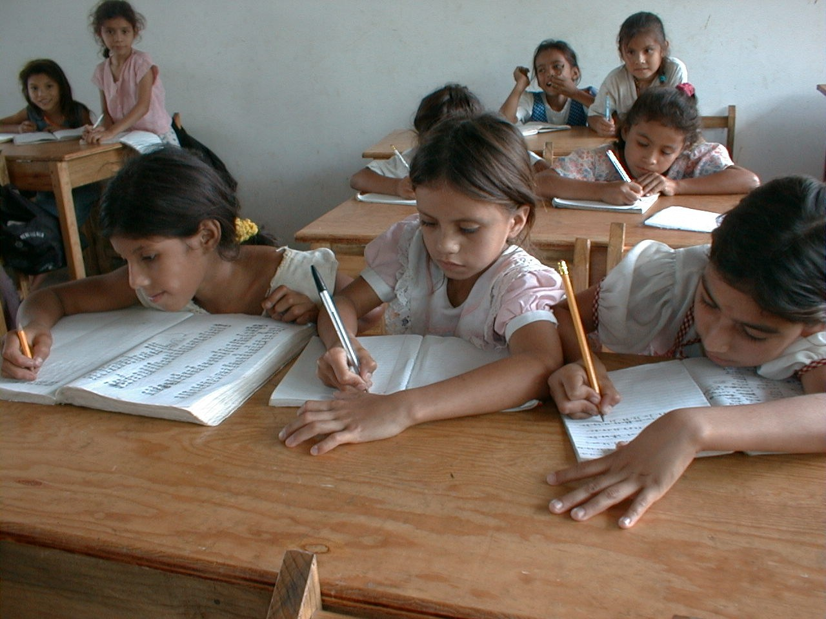
GRADE 7 · LESSON 33
Grammar Review: Units 3–4
Grammatika takrori: 3–4-bo‘limlar
Grammar review
noma'lum · Public domain
sozlar.com

Slide 2
LESSON AIMS
Bugungi maqsad
1
Complete six present continuous sentences with short forms (p. 41 ex. 4)
2
Choose too or very for positive and negative situations (ex. 5)
3
Write the right question word and choose the right pronoun (ex. 6–7)
4
Write questions for given answers and ask a partner (ex. 8)

Slide 3
GRAMMAR
Units 3–4 grammar — Grammar database 5–8
FORM
EXAMPLE
-ing
am / is / are (+ not) + verb-ing
We’re waiting for the bus. It isn’t raining.
?
Am / Is / Are + subject + verb-ing?
Are they doing a test? — Yes, they are.
state
know, like, need, prefer — no -ing
I know the answer. (not: I’m knowing)
pron.
us, them · myself · these / those
Tell us! They’re cooking it themselves.
Wh-
Wh- word + do / does / is / are + subject
What time does the film start?
too
too / very + adj. · too + adj. + to
It’s too hot (for me) to eat.
BE CAREFUL! Who as the subject — no do: Who knows the answer?

Slide 4
BOOK TASK · 8 MINUTES
Book tasks — Laser A1+, p. 41 (Revision Units 3–4)
Books open, word list closed. Work alone first, then compare with a partner.
1
ex.4 — put the verbs into the present continuous. Use short forms (I’m, it isn’t …).
2
ex.5 — positive → very, negative → too (six pizza sentences).
3
ex.6 — write one question word in each gap (7).
4
ex.7 — choose the correct pronoun (6).
5
ex.8 — write a question for each answer (4) — for the speaking stage.

Slide 5
CHECK AND TEACH · 6 MINUTES
Answer key — Laser A1+, p. 41
1
ex.4 1 I’m listening · 2 Are they doing · 3 (Who) is Sarah talking · 4 It isn’t raining / It’s not raining · 5 Simon and Greg aren’t waiting · 6 (Why) are we watching
2
ex.5 1 too · 2 very · 3 very · 4 too · 5 too · 6 too
3
ex.6 1 Where · 2 When · 3 What · 4 How · 5 Who · 6 How · 7 Why
4
ex.7 1 us · 2 this · 3 those · 4 yourself · 5 themselves · 6 ours
5
ex.8 (open) 1 Who is your favourite actress? · 2 Which do you prefer, tennis or football? · 3 What time do you go to bed? · 4 Why are you learning English?
6
Ask WHY for every answer: is it happening now? Is there a problem? A person or a place?

Slide 6
FOCUS
Units 3–4 grammar — five things to remember
QOIDA
QOIDA
Present continuous = am / is / are + -ing — hozir bo‘layotgan ish: She’s cooking right now. Imlo: run → running, dance → dancing.
Holat fe’llari (know, like, love, want, need, prefer, understand) -ing olmaydi: ✗ I’m knowing → I know.
Olmoshlar: I, we, they → me, us, them → myself, ourselves, themselves; this / these — yaqin, that / those — uzoq.
So‘roq so‘zi + do / does / am / is / are + ega: Where do you live? Why are they laughing?
very — yaxshi ham, yomon ham; too — muammo bor: too hot (for me) to eat.

Slide 7
VOCABULARY
A. Actions happening now (1/2)
💸️
spend money
pul sarflamoq
My sister is spending money on clothes again!
⏰️
hurry up
shoshilmoq, tezroq bo‘lmoq
Hurry up! Everybody is waiting for us.
⬅️
turn left
chapga burilmoq
The bus is turning left at the traffic lights.
👋️
wave
qo‘l silkitmoq
Look! Grandpa is waving at us from the window.

Slide 8
VOCABULARY
A. Actions happening now (2/2)
😊️
smile
jilmaymoq
Why are you smiling? What’s funny?
🎤️
sing
qo‘shiq aytmoq
My little sister is singing in the bathroom again!
🕐️
at the moment
ayni paytda
At the moment Malika is reading in the library.
⏱️
right now
hozirning o‘zida
I can’t talk right now — I’m having lunch.

Slide 9
VOCABULARY
B. Liking, knowing and needing (1/2)
😖️
hate
yomon ko‘rmoq, nafratlanmoq
Joel hates shopping, so he never comes with us.
🏀️
prefer
afzal ko‘rmoq
Football is OK, but I prefer basketball.
🥕️
need
kerak bo‘lmoq, muhtoj bo‘lmoq
I need some carrots for the soup.

Slide 10
VOCABULARY
B. Liking, knowing and needing (2/2)
🧠️
know
bilmoq
Do you know that boy over there? He’s in my class.
📝️
remember
esida bo‘lmoq, eslamoq
I don’t remember his phone number. Can you help me?
📖️
mean
anglatmoq, ma’noni bildirmoq
What does ‘gigantic’ mean? — It means very, very big.

Slide 11
VOCABULARY
C. Doing things yourself (1/2)
🩹️
cut yourself
biror joyini kesib olmoq
Careful! Don’t cut yourself on that broken glass.
🤕️
hurt yourself
lat yemoq, o‘zini jarohatlamoq
Are you OK? Did you hurt yourself?
🎸️
teach yourself
mustaqil o‘rganmoq
You can teach yourself to play the guitar with online videos.

Slide 12
VOCABULARY
C. Doing things yourself (2/2)
🍛️
help yourself
marhamat, o‘zingiz oling
There’s plov on the table — help yourself!
🎂️
by myself
o‘zim, hech kimning yordamisiz
I made this cake by myself — nobody helped me!
🧳️
look after yourself
o‘ziga ehtiyot bo‘lmoq
Look after yourself on the school trip, Ali!

Slide 13
VOCABULARY
D. Places and getting around
🏫️
get to school
maktabga bormoq, maktabga yetib bormoq
How do you get to school every morning?
🚌️
by bus
avtobusda
How does your mum go to work? — By bus. It’s quick and cheap.
🚶️
on foot
piyoda
How do you get home after school? — On foot. I live in the next street.
🚏️
a bus stop
avtobus bekati
Where is the nearest bus stop? — Over there, next to the bank.
🎨️
a hobby
sevimli mashg‘ulot, xobbi
What’s your hobby? — I collect old coins.

Slide 14
VOCABULARY
E. Describing words with too and very (1/2)
📦️
heavy
og‘ir
This box is very heavy, but I can carry it.
👥️
crowded
odam gavjum
The bus is too crowded — let’s wait for the next one.
🥵️
hot
issiq
It’s too hot — I can’t sleep!
🥶️
cold
sovuq
In March the sea is too cold for swimming.

Slide 15
VOCABULARY
E. Describing words with too and very (2/2)
😩️
tired
charchagan
After the match I was too tired to do my homework.
🧩️
difficult
qiyin
The question’s very difficult, but I know the answer.
🔍️
carefully
diqqat bilan, ehtiyotkorlik bilan
Read the questions very carefully.

Slide 16
PRONUNCIATION
Say it — don’t just read it
Review words — say the stressed syllable clearly:
hurry up
/ˌhʌri ˈʌp/
prefer
/prɪˈfɜː/
remember
/rɪˈmembə/
cut yourself
/ˌkʌt jɔːˈself/
heavy
/ˈhevi/
crowded
/ˈkraʊdɪd/
tired
/ˈtaɪəd/
carefully
/ˈkeəfəli/
Question words are stressed: WHERE do you live? WHY are you laughing?

Slide 17
WHOLE CLASS
Practice — complete the sentence (1/2)
1
Shh! The baby ________ sleeping. (i…)
2
We aren’t ________ TV — we’re doing our homework. (w…)
3
I ________ this song! It’s my favourite. (l…)
4
My little sister can dress ________ now. She’s five. (h…)
5
Look at ________ birds in the sky! (t…)
6
Can you help ________? We can’t find the bus stop. (u…)

Slide 18
WHOLE CLASS
Practice — complete the sentence (2/2)
7
________ do you live? — In Chirchiq. (W…)
8
________ kind of books do you like? — Comics. (W…)
9
This tea is ________ hot to drink. (t…)
10
My brother swims very ________. He’s in the school team. (w…)

Slide 19
PAIR / GROUP WORK · 5 MINUTES
Vocabulary activity
1
Match the beginnings (1-10) with the endings (a-j).
2
Read your complete sentences aloud.
3
Give the Uzbek meaning of the key word in each sentence.
4
When you finish, swap tables with the other group.

Slide 20
PAIRS · 6 MINUTES
Speaking
Book ex. 8: read your four questions to a partner; the partner gives the book answer, then his or her own answer.
Find someone who …: Are you wearing something blue today? How do you get to school — by bus or on foot? Which do you prefer, hot or cold weather? Ask three classmates and take notes.
Report back: Malika is wearing a blue scarf. Bobur and Aziz prefer cold weather — like me!

Slide 21
TODAY'S WORDS IN CONTEXT
A message from Samarkand
Hi Kamola! It’s Saturday morning and I’m in Samarkand with my family. We are staying at my aunt’s house.
Right now I am sitting in the garden. My cousins are playing football and my aunt is cooking plov. It smells great!
My mum isn’t here at the moment. She is spending money on presents at the bazaar. She always buys too many!
Samarkand is beautiful, but it’s too hot to walk in the afternoon. In the evening we usually go out on foot. I love the Registan — it’s very big and very old.
What are you doing now? Which do you prefer, the mountains or the city? Write back soon! — Nilufar
Cover the word list. Can you understand the words in bold from the sentence?

Slide 22
TODAY'S WORDS IN CONTEXT
Read and answer
1
Where is Nilufar staying?
2
What are her cousins doing?
3
Why doesn’t the family go out in the afternoon?
4
Find one stative verb and one sentence in the present simple with an adverb of frequency.
5
Find two question words in the message.

Slide 23
PAIRS · ESDA QOLDIMI?
Memory check — fix the mistake
Men xato gapni aytaman, siz uni to‘g‘ri aytasiz va qoidani eslatasiz.
1
She smiling at me now.
2
I’m remembering his phone number.
3
Careful! Don’t cut you on that glass.
4
How you get to school?
5
This box is very heavy to carry.

Slide 24
UZ
Qiyin joyi — o‘zbekcha
Present continuous — «…yapman / …yapti»: I’m reading — «o‘qiyapman».
know, like, hate, need, prefer, remember, mean — holat fe’llari, -ing olmaydi: I need — «menga kerak», I remember — «esimda».
us / them — «bizni, bizga / ularni, ularga»; myself / themselves — «o‘zim / o‘zlari»: by myself — «o‘zim, yordamsiz».
Which — tanlov bo‘lsa (qaysi biri?), What — umumiy savol (nima?).
too — «haddan tashqari» (natija yomon), very — «juda».

Slide 25
HOMEWORK
Uy vazifasi
1
Revise Grammar databases 5–8 (SB pp. 147–148) and do the Quick checks.
2
Write 10 example sentences: 2 present continuous, 2 stative verbs, 2 pronouns, 2 questions with question words, 2 with too / very.
3
Learn the 32 items with the flashcards: sozlar.com/vocab/cards/?set=grade7-lesson33

Slide 26
IMAGE CREDITS
Rasmlar manbasi
cover
noma'lum · Public domain · https://commons.wikimedia.org/wiki/File:School_girls_write_in_their_exercise_books,_San_Ramón,_Choluteca,_Honduras.jpg

Slide 27
Uchta so‘z — ertaga ham esingizda qoladi
Juftingizga ayting, so‘ng daftaringizga yozib qo‘ying.
sozlar.com/vocab/cards/?set=grade7-lesson33

