Slide 1
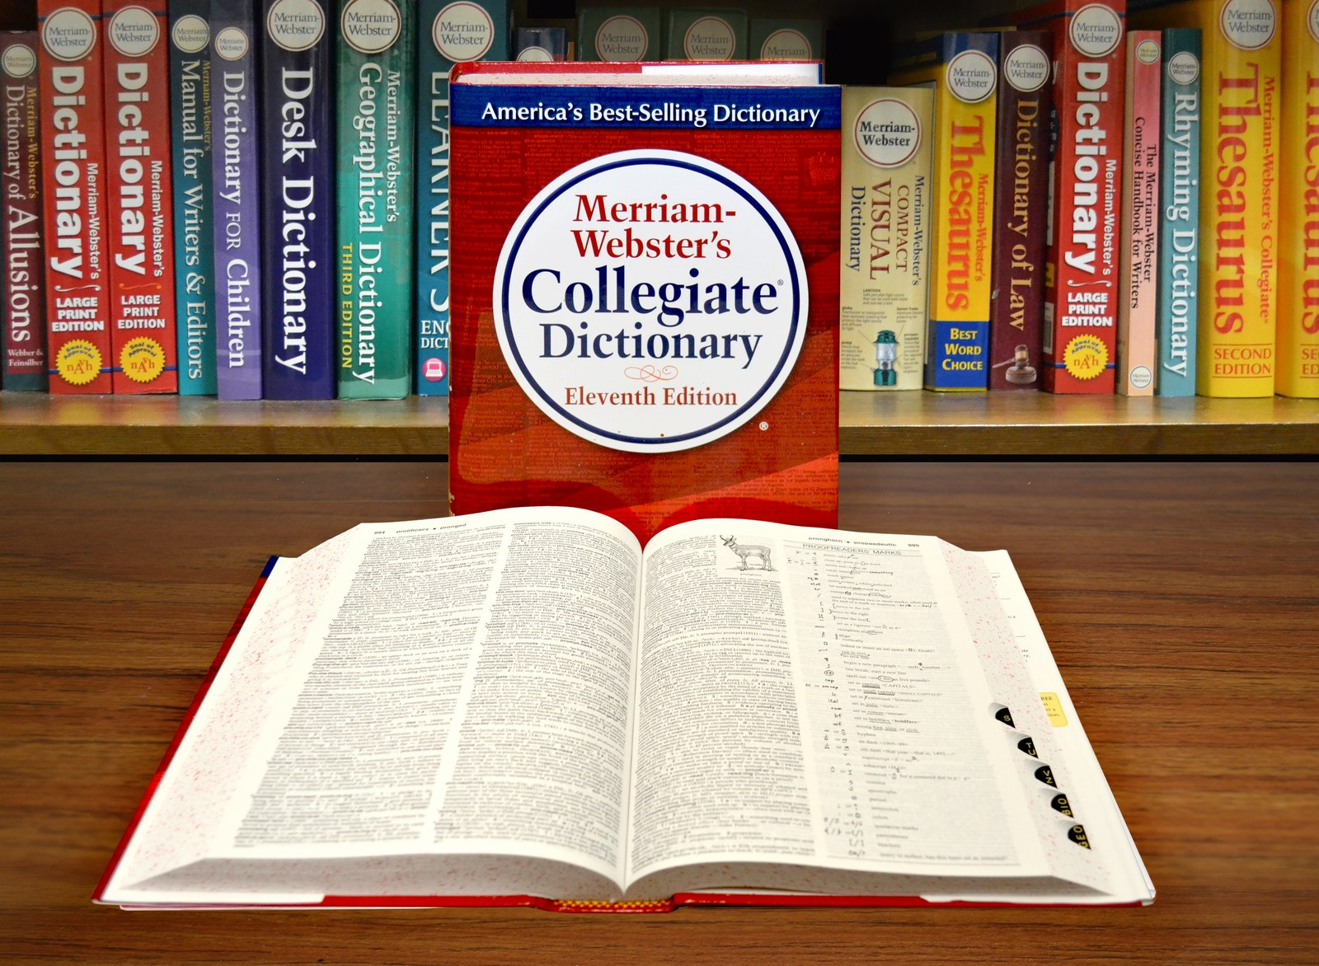
GRADE 8 · LESSON 32
Vocabulary Review: Units 3–4
Lug‘at takrori: 3–4-bo‘limlar
Vocabulary review (Unit 3-4)
Noah1806 · CC BY-SA 4.0
sozlar.com

Slide 2
LESSON AIMS
Bugungi maqsad
1
Recall thirty-five Units 3–4 words and phrases in context
2
Use the WB p. 18 words (childhood, notice, unfortunately, terrible) in sentences
3
Choose between -ed and -ing adjectives and the correct preposition after a verb
4
Complete a mixed revision test with at least 14/20

Slide 3
VOCABULARY
A. Story words (1/3)
🧍️
a character
qahramon, personaj
The main character in the book is a brave girl called Malika.
🧸️
childhood
bolalik
My father often talks about his childhood in Samarkand.
🔭️
in the distance
uzoqda
We could see the mountains in the distance.
😱️
a scream
chinqiriq, qichqiriq
Suddenly we heard a loud scream from the kitchen.

Slide 4
VOCABULARY
A. Story words (2/3)
👁️
notice
payqamoq, sezib qolmoq
Nobody noticed the man in the black coat.
💨️
disappear
g‘oyib bo‘lmoq
The weekend went so fast — it just disappeared!
💰️
treasure
xazina
The children dug in the sand, looking for treasure.
🌧️
unfortunately
afsuski
Unfortunately, it started to rain, so we went home.

Slide 5
VOCABULARY
A. Story words (3/3)
🌀️
strange
g‘alati
A strange thing happened to me on the way home.
😰️
worried
xavotirlangan, tashvishlangan
Mum was worried because I came home late.
😖️
terrible
juda yomon, dahshatli
That new quiz show is terrible — let’s watch a film instead.

Slide 6
VOCABULARY
B. Verbs and prepositions (1/2)
🙋️
ask for
(nimanidir) so‘ramoq
I was thirsty, so I asked for a glass of water.
😂️
laugh at
(kimgadir, nimagadir) kulmoq
Everybody laughed at Sardor’s funny drawing.
🔑️
look for
(nimanidir) qidirmoq
I’m looking for my keys. Have you seen them?
🚌️
wait for
(kimnidir, nimanidir) kutmoq
We waited for the bus for twenty minutes.

Slide 7
VOCABULARY
B. Verbs and prepositions (2/2)
😟️
worry about
(nimadan) xavotirlanmoq, tashvishlanmoq
Don’t worry about the test — you’re ready.
🎧️
listen to
(nimanidir) tinglamoq
Malika was listening to music when the lights went out.
☎️
talk to
(kimdir) bilan gaplashmoq
I was talking to my grandma on the phone when you called.

Slide 8
VOCABULARY
C. Party words (1/2)
🥤️
refreshments
yegulik va ichimliklar (mehmonlar uchun)
We’ve got refreshments for thirty guests: juice, sandwiches and fruit.
🎊️
decorations
bezaklar
The paper decorations on the walls looked beautiful.
🛋️
indoors
ichkarida, bino ichida
It’s cold and windy, so let’s play indoors today.
🌳️
outdoors
ochiq havoda, tashqarida
In summer my family eats outdoors in the garden.

Slide 9
VOCABULARY
C. Party words (2/2)
🍕️
order pizza
pitsaga buyurtma bermoq
Nobody wants to cook, so let’s order pizza tonight.
🚪️
arrive
yetib kelmoq
The first guests will arrive at six o’clock.
🏷️
cheap
arzon
Running is a cheap hobby: you only need good shoes.
↩️
a reply
javob xati, javob
I sent Kamola an email, but there’s no reply yet.

Slide 10
VOCABULARY
D. -ed and -ing adjectives (1/2)
🤩️
amazed / amazing
hayratda qolgan / hayratlanarli
The magic show was amazing, and all the children were amazed.
📖️
interested / interesting
qiziqqan / qiziqarli
I’m interested in space, so this book is really interesting for me.
⚽️
excited / exciting
hayajonlangan / hayajonli
The match was exciting, and the fans were very excited.

Slide 11
VOCABULARY
D. -ed and -ing adjectives (2/2)
⛈️
frightened / frightening
qo‘rqib ketgan / qo‘rqinchli
The storm was frightening, and my little brother was frightened.
😮️
surprised / surprising
hayron qolgan / ajablanarli
The news was surprising, so we were all surprised.
😵‍💫
confused / confusing
boshi qotgan / chalkash
The rules of the game were confusing, so the players got confused.

Slide 12
VOCABULARY
E. Offers and reminders
🤲️
an offer
taklif (yordam berishni taklif qilish)
Thanks for your offer, but I can carry the bag myself.
💡️
a suggestion
taklif, fikr
Nodira made a good suggestion: a picnic by the river.
🔔️
remind (sb) about (sth)
(kimgadir biror narsani) eslatmoq
Can you remind me about the test tomorrow?

Slide 13
TODAY'S WORDS IN CONTEXT
Grandad's story (1/2)
My grandad loves telling stories about his childhood. My favourite one is a ghost story about his village. 'It was a terrible night,' he always begins. 'The wind was blowing and the dogs were barking.'
He and his brother were looking for their lost goat. Suddenly they heard a scream in the distance. They were very frightened. Then they noticed a white figure near the old mill. It moved, and then it disappeared!
'Were you worried about the goat?' I asked. 'Not at all,' he said. 'I was worried about my brother — he was running home!' Unfortunately, they never found the goat. Or maybe it found them — the white figure was the goat!
Cover the word list. Can you understand the words in bold from the sentence?

Slide 14
TODAY'S WORDS IN CONTEXT
Grandad's story (2/2)
Grandad tells this story at every family party, and everybody always laughs at the end. It's a strange story, but it's also a really amazing one.
Cover the word list. Can you understand the words in bold from the sentence?

Slide 15
TODAY'S WORDS IN CONTEXT
Read and answer
1
What kind of story is Grandad's favourite one?
2
What were Grandad and his brother looking for?
3
What did they notice near the old mill?
4
Who was Grandad worried about?
5
What was the white figure, maybe?

Slide 16
PAIRS · ESDA QOLDIMI?
Memory check — one minute per section
Juftingiz bo‘lim harfini aytadi (A–E), siz bir daqiqada iloji boricha ko‘p so‘z aytasiz.
1
A: story words · B: verbs and prepositions
2
C: party words · D: -ed / -ing · E: offers and reminders
3
Which three words do you still forget? Write them on a sticky note.

Slide 17
FOCUS
So‘zlarni qanday yodlaymiz: juftliklar va birikmalar
• -ed — kim qanday his qiladi, -ing — narsa qanday: I was confused. The rules were confusing.
• Fe’l + predlog — birga yodlang: wait for, worry about, listen to, laugh at, look for.
• Qarama-qarshi juftliklar: indoors ↔ outdoors · cheap ↔ expensive · appear ↔ disappear.
• So‘z oilasi: child → childhood · fortunately ↔ unfortunately · a reply → to reply.
• Taklif va javob: Shall I …? / Why don't I …? = an offer → Yes, please. · taklifga: That's a good suggestion.

Slide 18
TEST · 7 MINUTES
Revision test — part 1 (choose) (1/2)
Choose A, B or C. Write only the letter. Circle the two items you were not sure about.
1
When I was a child, I lived in Nukus. I have happy memories of my ___. A) distance B) childhood C) adventure
2
I didn't ___ the new student in our class. Was she here yesterday? A) notice B) reply C) disappear
3
The guests ___ at six o'clock, and the party started. A) noticed B) arrived C) screamed
4
We heard a loud ___ in the night and woke up. A) scream B) treasure C) character
5
Can you wait ___ me after school? A) to B) at C) for
6
I'm worried ___ my maths test tomorrow. A) about B) for C) at

Slide 19
TEST · 7 MINUTES
Revision test — part 1 (choose) (2/2)
7
We had the party ___ because it was a sunny day. A) indoors B) outdoors C) cheap
8
Let's ___ two big pizzas for the party. A) order B) arrive C) reply
9
This book is really ___. I can't stop reading it! A) interested B) interesting C) confused
10
'Why don't I carry the boxes?' — '___' A) That's very kind of you. B) Poor you! C) You're joking!

Slide 20
TEST · 6 MINUTES
Revision test — part 2 (complete) (1/2)
Complete with one word.
11
The crew of the spaceship saw a strange light far away in the ___.
12
___, we lost the match 0–3. (= sadly)
13
Please don't laugh ___ me!
14
Who are you talking ___ on the phone?
15
We put up balloons and other ___ in the school hall.
16
I sent the invitation, but I haven't had a ___ from Ali yet.

Slide 21
TEST · 6 MINUTES
Revision test — part 2 (complete) (2/2)
17
I was so ___ (frighten) that I couldn't move.
18
The football match was ___ (excite) — it finished 4–4!
19
Sh___ I help you with the decorations? — Yes, please!
20
Can you ___ me about the meeting tomorrow? I always forget!

Slide 22
PRONUNCIATION
Say it — don’t just read it
3–4-bo‘lim so‘zlarida urg‘u — takrorlang:
CHILDhood
unFORtunately
deco-RA-tions
re-FRESH-ments
IN-doors · OUT-doors
FRIGHT-en-ing
sur-PRIS-ing
sug-GES-tion
-ed oxiri: frightened /t/ emas — /d/; excited, interested — /ɪd/.

Slide 23
WHOLE CLASS
Practice — complete the sentence (1/2)
1
Robin Hood is my favourite ________ in the book.
2
I lived in a village in my ________, but now I live in Tashkent.
3
I didn't ________ your new haircut. It looks great!
4
We ran to the station. ________, we missed the train.
5
Can I listen ________ your new song?
6
My little brother is always looking ________ his socks!

Slide 24
WHOLE CLASS
Practice — complete the sentence (2/2)
7
This café is very ________ — a sandwich is only 5,000 som.
8
It's too cold to play outside. Let's play ________.
9
The end of the film was really ________. Nobody expected it! (surprise)
10
'Let's have the party in the garden.' 'That's a good ________.'

Slide 25
PAIRS · 6 MINUTES
Speaking
Juftingizga bolaligingiz haqida uch gap ayting: In my childhood, I …
Ikki so‘zni tanlang (masalan, frightened va in the distance) va ular bilan mini-hikoya to‘qing.
Juftingizga yordam taklif qiling (Shall I …? / Why don't I …?) — u javob beradi.

Slide 26
PAIR / GROUP WORK · 6 MINUTES
Vocabulary activity
1
Match the beginnings (1-10) with the endings (a-j).
2
Read your complete sentences aloud.
3
Give the Uzbek meaning of the key word in each sentence.
4
When you finish, swap tables with the other group.

Slide 27
UZ
Qiyin joyi — o‘zbekcha
Kartalar 17–28-darslardan (+ 8, 11, 12-darslardan to‘rtta); WB p. 18 so‘zlariga alohida e’tibor: childhood, notice, unfortunately, terrible, worried.
notice — «sezib qolmoq» (ko‘zga tashlanmoq); see — oddiy «ko‘rmoq».
-ed — «…ib qolgan, …gan» (odam): confused — boshi qotgan; -ing — «…arli» (narsa): confusing — chalkash.
Shall I …? / Why don’t I …? — yordam taklifi; Let's … — birga qilishni taklif qilish.

Slide 28
HOMEWORK
Uy vazifasi
1
Revise the Units 3–4 Wordpower words (WB p. 18, 24, 26); write 10 sentences.
2
Learn the 35 items with the flashcards: sozlar.com/vocab/cards/?set=grade8-lesson32
3
Revise the two items you circled in the test — write a sentence with each.

Slide 29
IMAGE CREDITS
Rasmlar manbasi
cover
Noah1806 · CC BY-SA 4.0 · https://commons.wikimedia.org/w/index.php?curid=59440801

Slide 30
Uchta so‘z — ertaga ham esingizda qoladi
Juftingizga ayting, so‘ng daftaringizga yozib qo‘ying.
sozlar.com/vocab/cards/?set=grade8-lesson32

