Slide 1
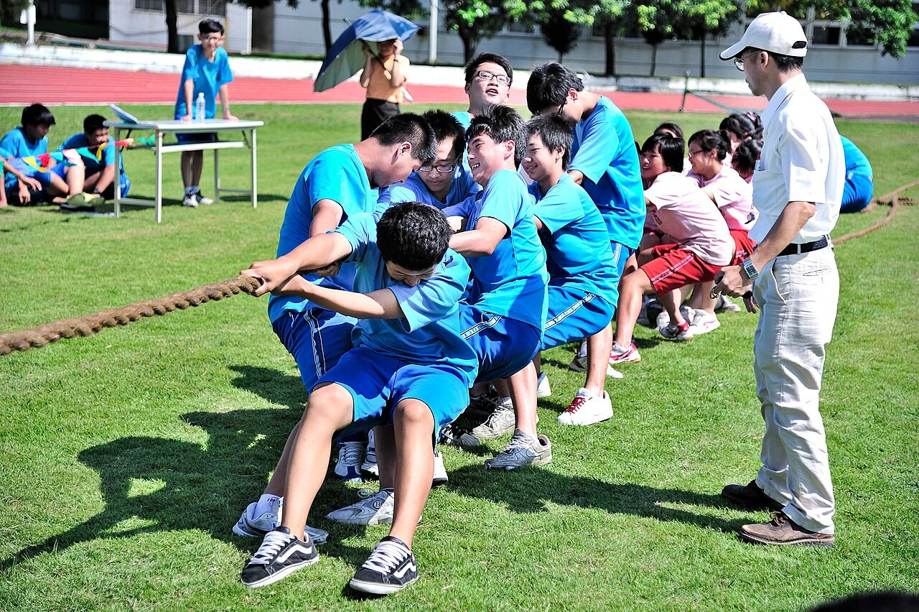
GRADE 7 · LESSON 31
Units 3–4 Game Lesson
3–4-bo‘limlar: o‘yinli takror darsi
Skill based game lesson
Baozhong Junior High School (褒忠國中 雲端網) · CC BY 2.0
sozlar.com

Slide 2
LESSON AIMS
Bugungi maqsad
1
Recognise and use about 35 Units 3–4 words and phrases quickly in two So‘z poygasi rounds
2
Describe actions in the present continuous in a charades game (What am I doing? — You’re …ing.)
3
Guess shops and shapes from short riddles and make their own riddle
4
Work in a team, follow the rules and play fairly

Slide 3
VOCABULARY
A. Shops and shopping (lessons 15, 17) (1/3)
💐️
a florist’s
gul do‘koni
Let’s buy some roses for Mum at the florist’s.
🥩️
a butcher’s
qassob do‘koni
Mum buys meat at the butcher’s on Saturdays.
🍎️
a grocer’s
oziq-ovqat do‘koni
We buy apples and tomatoes at the grocer’s.
📚️
a bookshop
kitob do‘koni
I buy my school books at the bookshop near our house.

Slide 4
VOCABULARY
A. Shops and shopping (lessons 15, 17) (2/3)
👟️
a shoe shop
poyabzal do‘koni
I need new trainers. Let’s go to the shoe shop.
👥️
a customer
xaridor
The shop is full of customers on Saturday.
🏷️
a special offer
maxsus taklif, aksiya
There’s a special offer: two T-shirts for the price of one!
💎️
expensive
qimmat
This watch is very expensive.

Slide 5
VOCABULARY
A. Shops and shopping (lessons 15, 17) (3/3)
🪙️
cheap
arzon
The bananas are cheap at the market today.
👖️
try on
kiyib ko‘rmoq
Can I try on these jeans, please?
🧑‍💼
a shop assistant
sotuvchi
The shop assistant is helping a customer at the moment.

Slide 6
VOCABULARY
B. What are they doing? (lessons 16, 18, 20) (1/2)
⏰️
hurry up
shoshilmoq, tezroq bo‘lmoq
Hurry up! Everybody is waiting for us.
👋️
wave
qo‘l silkitmoq
Look! Grandpa is waving at us from the window.
💃️
dance
raqsga tushmoq
Look! Those girls are dancing on the stage.
🍲️
cook dinner
kechki ovqat pishirmoq
Something smells great! Dad is cooking dinner in the kitchen.
🧽️
wash the dishes
idish-tovoq yuvmoq
Right now my brother is washing the dishes after dinner.

Slide 7
VOCABULARY
B. What are they doing? (lessons 16, 18, 20) (2/2)
📷️
take a photo
suratga olmoq
Dad is taking a photo of the mountains.
👨‍👦
carry somebody on your shoulders
yelkasiga mindirib olmoq
Dad is carrying my little brother on his shoulders at the bazaar.
☃️
throw snowballs
qorbo‘ron o‘ynamoq, qor otishmoq
After school the children are throwing snowballs in the yard.
😂️
laugh
kulmoq
The two girls are laughing at a funny video on the phone.

Slide 8
VOCABULARY
C. Shapes and sizes (lesson 17) (1/2)
🔵️
round
dumaloq
We need a round table for our big family.
🟩️
square
kvadrat shaklidagi
I prefer square plates — they look modern.
🔺️
triangular
uchburchak shaklidagi
My little brother loves triangular sandwiches.
📺️
flat
yassi, tekis
I love my new tablet — it’s thin and flat.

Slide 9
VOCABULARY
C. Shapes and sizes (lesson 17) (2/2)
🐜️
tiny
jajji, juda kichkina
An ant is a tiny insect, but it’s very strong.
🚶️
narrow
tor
Our street is very narrow, so big buses don’t go there.
🌉️
wide
keng
The river is very wide here, so we need a bridge.

Slide 10
VOCABULARY
D. Unit 4 mix (lessons 22–28) (1/2)
🗞️
a newspaper
gazeta
Dad reads the newspaper with his morning tea.
📜️
a poem
she’r
We’re learning a poem by heart for the spring concert.
🔊️
speak up
balandroq gapirmoq
Speak up, please — we can’t hear you at the back.

Slide 11
VOCABULARY
D. Unit 4 mix (lessons 22–28) (2/2)
🤫️
whisper
shivirlamoq
Don’t tell anyone — just whisper it in my ear.
📢️
shout
baqirmoq, qichqirmoq
Please don’t shout in the library.
📦️
heavy
og‘ir
This box is very heavy, but I can carry it.

Slide 12
VOCABULARY
E. Help yourself! (lessons 15, 19)
🍛️
help yourself
marhamat, o‘zingiz oling
There’s plov on the table — help yourself!
🥳️
enjoy yourself
maza qilmoq, zavqlanmoq
We always enjoy ourselves at the shopping centre.

Slide 13
FOCUS
Before we play — five things to remember
• Do‘konlar: the butcher’s, the florist’s, the grocer’s — oxirida ’s («…ning do‘koni»).
• Present continuous — hozir bo‘layotgan ish: He’s carrying a box. What are you doing?
• Shakllar: round, square, triangular, narrow / wide, tiny — A football is round.
• myself / yourself — «o‘zim / o‘zing»: Help yourself!; these — yaqindagi ko‘p narsa.
• O‘yin qoidasi: har jamoaga bitta urinish, javob faqat inglizcha, ko‘chirmaymiz!

Slide 14
GAME · 7 MINUTES
Games 1–2: So‘z poygasi — tug of war
sozlar.com/oyin → So‘z poygasi → set «7-sinf 31-dars» · 2 jamoa · Savollar: Alohida (arqon tortish).
1
Round 1 — Ma’no poygasi: an English word → choose the Uzbek meaning (A S D F / J K L ;).
2
Round 2 — Bo‘shliq: a sentence with a gap → choose the missing English word.
3
Each team has its OWN question — don’t look at the other side!
4
A right answer pulls the rope one step; a wrong answer gives one step to the other team.
5
Change the two players at the panel every 3–4 questions.

Slide 15
GAME · 5 MINUTES
Game 4: Shop and shape riddles (1/2)
Listen, put up your hand and answer in a full sentence: It’s the … / It’s …
1
I’m a shop. You buy sausages and chicken here. What am I?
2
I’m a shop. You buy apples, potatoes and onions here. What am I?
3
I’m a shop. You buy roses and tulips here. What am I?
4
I’m a shop. You buy trainers and boots here. What am I?
5
I’m round and flat. You eat me with tomatoes and cheese. What am I?
6
I’ve got three sides. A piece of cake often has my shape. What shape am I?

Slide 16
GAME · 5 MINUTES
Game 4: Shop and shape riddles (2/2)
7
I’m the opposite of wide. What am I?
8
I’m very, very small — like an ant. What am I?
9
I work in a shop and I help the customers. Who am I?
10
Your guests are at the table. You say: «Help …!»

Slide 17
PRONUNCIATION
Say it — don’t just read it
Shop names end in ’s — say the /s/ or /z/ clearly:
butcher’s
/ˈbʊtʃəz/
florist’s
/ˈflɒrɪsts/
grocer’s
/ˈɡrəʊsəz/
customers
/ˈkʌstəməz/
triangular
/traɪˈæŋɡjələ/
yourself
/jɔːˈself/
-ing is one sound /ɪŋ/: carrying, washing, throwing — no hard /g/ at the end.

Slide 18
WHOLE CLASS
Practice — complete the sentence (1/2)
1
Mum wants some roses for Grandma, so we’re going to the ________. (f…)
2
There are lots of ________ in the shops on Saturdays. (c…)
3
Our friends are on the train now. They’re ________ goodbye to us. (w…)
4
Hurry ________! The bus is coming! (u…)
5
A football is ________. (r…)
6
There’s some fruit on the table — help ________! (y…)

Slide 19
WHOLE CLASS
Practice — complete the sentence (2/2)
7
Look at this baby mouse! It’s ________ — only three centimetres long! (t…)
8
Can you ________ up, please? We can’t hear you. (s…)
9
My grandpa reads the ________ every morning. (n…)
10
I can’t carry this bag — it’s too ________. (h…)

Slide 20
PAIR / GROUP WORK · 4 MINUTES
Vocabulary activity
1
Match the beginnings (1-10) with the endings (a-j).
2
Read your complete sentences aloud.
3
Give the Uzbek meaning of the key word in each sentence.
4
When you finish, swap tables with the other group.

Slide 21
TEAMS
Speaking
Charades — What am I doing? One student from each team takes a card and mimes the action. The team asks: Are you …ing? The actor answers: Yes, I am. / No, I’m not.
Score: the team guesses in 30 seconds — 2 points; if not, the other team can steal with one guess — 1 point.
Make your own riddle for the other team: I’m a shop. You buy … here. What am I? / I’m round and … What am I?

Slide 22
TODAY'S WORDS IN CONTEXT
Game day in 7-A (1/2)
It’s Friday, and 7-A is having a game lesson. The class is in two teams — the Blue team and the Orange team.
Right now the Blue team is playing So‘z poygasi on the big screen. Madina is shouting the answers, and Bobur is whispering: “The florist’s! You buy flowers there!”
The Orange team isn’t playing at the moment. They’re getting ready for charades. Aziz is standing in front of the class. He is carrying something on his shoulders.
“What am I doing?” he asks. “You’re carrying a heavy box!” says Lola. “No!” “You’re carrying somebody on your shoulders!” “Yes!” But it’s only his school bag!
Cover the word list. Can you understand the words in bold from the sentence?

Slide 23
TODAY'S WORDS IN CONTEXT
Game day in 7-A (2/2)
Then the teacher asks a riddle: “I’m round and flat, and you eat me with cheese. What am I?” Everyone knows the answer — a pizza!
At the end the score is 21 : 21. “It’s a draw!” says the teacher. Everybody is laughing.
Cover the word list. Can you understand the words in bold from the sentence?

Slide 24
TODAY'S WORDS IN CONTEXT
Read and answer
1
What is 7-A doing on Friday?
2
Which game is the Blue team playing?
3
What is Aziz really carrying?
4
What is round and flat in the riddle?
5
Find three verbs in the present continuous.

Slide 25
PAIRS · ESDA QOLDIMI?
Memory check — which team remembers more?
Har jamoa navbat bilan bitta so‘z aytadi; takrorlagan yoki to‘xtab qolgan jamoa yutqazadi.
1
A: five shops in 30 seconds
2
B: three things people are doing right now in our school
3
C: five shape and size words
4
D: three Unit 4 words · E: two phrases with yourself

Slide 26
UZ
Qiyin joyi — o‘zbekcha
Bu dars YANGI so‘z bermaydi — hammasi 15–28-darslardan (3- va 4-bo‘limlar).
the butcher’s — «qassoblik do‘koni» (the butcher — qassobning o‘zi), the florist’s — gul do‘koni, the grocer’s — oziq-ovqat do‘koni.
What are you doing? — «Nima qilyapsan?»: javob ham present continuous’da: I’m cooking dinner.
Help yourself! — «Marhamat, oling!» (mehmonga dasturxonda).
O‘yinda faqat inglizcha javob hisoblanadi — o‘zbekcha javob ball bermaydi.

Slide 27
HOMEWORK
Uy vazifasi
1
Learn the 35 Units 3–4 items with the flashcards: sozlar.com/vocab/cards/?set=grade7-lesson31
2
Prepare 5 quiz questions for the class game: one about shops, one in the present continuous, one about shapes, one with a pronoun (yourself, these …) and one with a Unit 4 word.
3
Play So‘z poygasi at home in the 1 o‘yinchi mode (set «7-sinf 31-dars») and try to beat your class score.

Slide 28
IMAGE CREDITS
Rasmlar manbasi
cover
Baozhong Junior High School (褒忠國中 雲端網) · CC BY 2.0 · https://commons.wikimedia.org/wiki/File:Students_engaging_in_tug-of-war_competition_in_Baozhong_Junior_High_School_20120601.jpg

Slide 29
Uchta so‘z — ertaga ham esingizda qoladi
Juftingizga ayting, so‘ng daftaringizga yozib qo‘ying.
sozlar.com/vocab/cards/?set=grade7-lesson31

