Slide 1
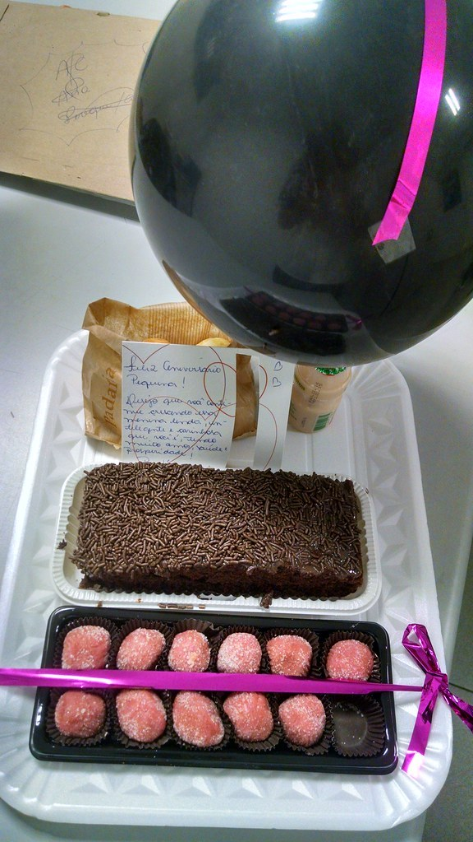
GRADE 8 · LESSON 31
Project: A Reply about a Surprise Party
Loyiha: syurpriz ziyofat haqida do‘stga javob xati
Project work: Writing a reply to a friend
Android-a · CC BY 2.0
sozlar.com

Slide 2
LESSON AIMS
Bugungi maqsad
1
Choose the correct information in four sentences about a voicemail (ex. 1)
2
Complete the planner: first line, three paragraphs, closing expressions, final line (ex. 2)
3
Use the present perfect to say what they have done for the party (I've made …, I haven't … yet)
4
Write a 60–80 word note to a friend (ex. 3)

Slide 3
BOOK TASK · 8 MINUTES
Book task — Laser A2, p. 39 (ex. 1)
Books open at p. 39, word list closed.
1
Before you listen — to‘rt gapni o‘qing: har birida ikki variant. Qaysi biri bo‘lishi mumkin?
2
ex.1 — Anna’ning ovozli xabarini tinglang va to‘g‘ri variantni tanlang (1–4).
3
Diqqat: ikkala variant ham tilga olinadi — gapning oxirigacha tinglang!
4
Second listening — javobingizni tekshiring va har javob uchun bitta «dalil» so‘zni yozing.

Slide 4
CHECK · 4 MINUTES
Answer key — Laser A2, p. 39 (ex. 1)
1
1 Mrs Smith — «It isn't for Mr Smith … he's staying with us.»
2
2 write a note to Ben — «Please don't call Ben — he's lost his phone.»
3
3 your house — «his flat is too small … the party is going to be at your house.»
4
4 7.30 — «Ben said seven o'clock, but … the party starts at half past seven.»
5
Kalit faqat bizning yozuvga mos (kitob audiosi 15 bizda yo‘q).

Slide 5
VOCABULARY
A. Phone messages (1/2)
📳️
a voicemail message
ovozli xabar (telefonda qoldirilgan)
I couldn’t answer, so my aunt left a voicemail message.
💬️
leave a message
xabar qoldirmoq
Nobody answered the phone, so I left a message for Aziz.
📲️
a missed call
javobsiz qolgan qo‘ng‘iroq
I saw a missed call from Anna, so I phoned her at once.

Slide 6
VOCABULARY
A. Phone messages (2/2)
🗣️
speak to somebody
kim bilandir gaplashmoq
Hello, it’s Anna. Can I speak to Ben, please?
☎️
a phone call
telefon qo‘ng‘irog‘i
I got a phone call from my cousin in Bukhara last night.
📱️
answer the phone
telefonga javob bermoq
Mum was cooking, so I answered the phone.

Slide 7
VOCABULARY
B. A leaving party (1/2)
🎉️
a leaving party
xayrlashuv ziyofati
Our class is having a leaving party for Mr Rahimov on Friday.
👋️
say goodbye
xayrlashmoq
We want to say goodbye to our coach in a special way.
🥺️
miss somebody
kimnidir sog‘inmoq
Mrs Smith is a great teacher. We’ll really miss her.
🎁️
a farewell present
xayrlashuv sovg‘asi
We’ve bought a nice farewell present for our English teacher.

Slide 8
VOCABULARY
B. A leaving party (2/2)
✍️
sign a card
otkritkaga imzo qo‘ymoq
Everyone in the class has signed the card for Mrs Smith.
🏢️
a flat
kvartira
Ben’s flat is too small for thirty people.
🕢️
at half past seven
soat yetti yarimda
The party starts at half past seven, so please don’t be late.
📅️
the end of the month
oyning oxiri
Our teacher is leaving at the end of the month.

Slide 9
VOCABULARY
C. How to get there (1/2)
🛣️
go along the street
ko‘cha bo‘ylab yurmoq
Go along the street until you see a big blue gate.
🚶️
a five-minute walk
piyoda besh daqiqalik yo‘l
My house is a five-minute walk from the school.
🚏️
a bus stop
avtobus bekati
There’s a bus stop right in front of my house.
🔀️
the crossroads
chorraha
Turn right at the crossroads, and my house is the third one.

Slide 10
VOCABULARY
C. How to get there (2/2)
➡️
turn right
o‘ngga burilmoq
Turn right at the traffic lights and you’ll see the café.
⬆️
go straight on
to‘g‘ri yurib bormoq
Go straight on for about two hundred metres.
↔️
opposite
qarshisida
Our block of flats is opposite the park.
🚸️
cross the road
yo‘ldan o‘tmoq
Be careful when you cross the road near the school.

Slide 11
VOCABULARY
D. Getting ready for the party (1/2)
💰️
collect money
pul yig‘moq
We’ve collected money from the whole class for a present.
🎈️
blow up balloons
havo sharlarini puflamoq
My little brother and I have blown up fifty balloons!
🍋️
make lemonade
limonad tayyorlamoq
Mum and I have made two big jugs of lemonade.

Slide 12
VOCABULARY
D. Getting ready for the party (2/2)
🎵️
make a playlist
qo‘shiqlar ro‘yxatini tuzmoq
Aziz has made a playlist of our teacher’s favourite songs.
🍽️
buy paper plates
bir martalik likopchalar sotib olmoq
We’ve bought paper plates and cups for thirty people.
🪑️
borrow chairs
stullarni vaqtincha olib turmoq
We’ve borrowed ten chairs from our neighbours.

Slide 13
FOCUS
Javob eslatmasi — rejadagi besh qism (p. 39 ex. 2)
• 1-qator: Dear + ism, — vergul bilan.
• 1-xatboshi — his-tuyg‘u: I'm really excited about … / I'm really looking forward to … (to dan keyin ot yoki -ing: looking forward to seeing).
• 2-xatboshi — qachon, qayerda, qanday boriladi: The party is at … · on Friday at 7.30 · take the number … bus; iltimos: On the invitations, can you tell people to …?
• 3-xatboshi — yana nima qildingiz (present perfect): I've made a great cake! · I've already bought … · I haven't … yet.
• Yakun: I've got to go now because … · Bye for now! · Love, / From, va oxirgi qator — ismingiz.

Slide 14
STRATEGY
Loyiha — uch qadam
1
Listen: Anna’ning xabarini tinglang — kimga, qayerda, qachon?
2
Plan: rejani to‘ldiring — har xatboshiga ikki-uch so‘z.
3
Write: 60–80 so‘z; oxirida so‘zlarni sanang va rejani qayta tekshiring.

Slide 15
MODEL · READ BEFORE YOU WRITE
Model note — a reply to Ben
Read the note. Find the five parts of the planner.
1
Dear Ben,
2
Anna left me a voicemail message about Mrs Smith's leaving party. I'm really excited about it! I'm really looking forward to seeing her face.
3
The party is at my house, 24 Navoi Street, on Friday at half past seven. Go along Navoi Street and turn right at the crossroads — my house is opposite the park. On the invitations, can you tell people to arrive before 7.15?
4
I've already blown up the balloons and made lemonade. We've collected money for a farewell present, but I haven't bought it yet.
5
I've got to go now because Mum needs the computer. See you on Friday! Love, Aziza

Slide 16
TASK 1 · DETAILS
First listening — complete the sentences (ex.1)
Listen to Anna's voicemail. Choose the correct answer in each sentence.
1
The party is for a teacher called Mr / Mrs Smith.
2
Anna wants you to call / write a note to Ben.
3
The party is going to be at Ben's / your house.
4
The party is on Friday at 7 / 7.30.

Slide 17
PRONUNCIATION
Say it — don’t just read it
Bugungi so‘zlar — urg‘u va aytilmaydigan harflar:
a voicemail message /ə ˈvɔɪsmeɪl ˈmesɪdʒ/
a farewell present /ə ˌfeəˈwel ˈpreznt/
at half past seven /ət ˌhɑːf pɑːst ˈsevn/
the crossroads /ðə ˈkrɒsrəʊdz/
opposite /ˈɒpəzɪt/
make lemonade /meɪk ˌleməˈneɪd/
borrow chairs /ˈbɒrəʊ tʃeəz/
half — l aytilmaydi: /hɑːf/; opposite — urg‘u birinchi bo‘g‘inda: OP-po-site.

Slide 18
WHOLE CLASS
Practice — complete the sentence (1/2)
1
Mrs Smith is leaving our school, so we're having a ________ party for her.
2
I'm really looking ________ to the party on Friday!
3
I'm really excited ________ the school trip.
4
Go straight on to the ________ and then turn left — my house is the second one.
5
I've ________ bought the drinks, so you don't need to.
6
I haven't made the cake ________. I'll make it tomorrow.

Slide 19
WHOLE CLASS
Practice — complete the sentence (2/2)
7
I didn't hear my phone, so I've got three ________ calls from Mum.
8
I've ________ up thirty balloons for the party — my face is red!

Slide 20
PAIR / GROUP WORK · OPTIONAL
Vocabulary activity
1
Match the beginnings (1-10) with the endings (a-j).
2
Read your complete sentences aloud.
3
Give the Uzbek meaning of the key word in each sentence.
4
When you finish, swap tables with the other group.

Slide 21
PAIRS
Speaking
Juftingizga Anna’ning xabarini o‘z so‘zlaringiz bilan qayta ayting: kim uchun, qayerda, qachon?
Rejangizni og‘zaki ayting: I'm really excited about … The party is at … (go along the street, turn right at the crossroads …) I've already blown up / made / borrowed …
Juftingiz eslatmangizni o‘qib, rejaning har bir qismiga belgi qo‘yadi.

Slide 22
LISTENING SCRIPT — USE AFTER THE TASKS
Listening script — Anna's voicemail (1/2)
Hi, it's Anna! You didn't answer the phone, so I'm leaving a message about the surprise party for our English teacher. She's leaving our school at the end of the month, and we want to say goodbye in a special way.
It isn't for Mr Smith, of course — he's staying with us next year. The party is for Mrs Smith.
Can you do something for me? Please don't call Ben — he's lost his phone again! Can you write him a note and give it to him at school tomorrow? Tell him all about the party.
Show the script only after the listening tasks are checked.

Slide 23
LISTENING SCRIPT — USE AFTER THE TASKS
Listening script — Anna's voicemail (2/2)
At first we wanted to have the party at Ben's house, but his flat is too small for thirty people. Your mum says it's OK, so the party is going to be at your house. Thank you so much!
It's on Friday. Ben said seven o'clock, but Mrs Smith finishes her lessons late on Fridays, so the party starts at half past seven. Everyone needs to be there before her!
OK, that's all. Call me back when you get this message. Bye!
Show the script only after the listening tasks are checked.

Slide 24
LISTENING SCRIPT — USE AFTER THE TASKS
Listen and answer
1
Why are they having a party for Mrs Smith?
2
Why can't you call Ben?
3
Why isn't the party at Ben's house?
4
Why does the party start at 7.30, not at 7?
5
What does Anna ask you to do at the end?

Slide 25
PAIRS · ESDA QOLDIMI?
Memory check — which paragraph?
Men iborani aytaman, siz u eslatmaning qaysi qismiga tushishini ayting.
1
I'm really excited about the leaving party → ?
2
The party starts at half past seven → ?
3
Go along the street and turn right at the crossroads → ?
4
I've already borrowed chairs from our neighbours → ?
5
We've collected money for a farewell present → ?

Slide 26
UZ
Qiyin joyi — o‘zbekcha
a voicemail message — telefonda javob berilmaganda qoldiriladigan ovozli xabar.
I'm really looking forward to + ot yoki -ing: looking forward to the party / to seeing you (24-darsdagi look forward to).
I've made …, I've already bought … — natija hozir muhim (present perfect); yet — inkor va savolda, gap oxirida.
go straight on, turn right / left, at the crossroads — yo‘l tushuntirish; opposite predlogsiz: opposite the park — «park qarshisida».

Slide 27
HOMEWORK
Uy vazifasi
1
Project: write a reply to a friend’s invitation (60–80 words).
2
Learn the 28 items with the flashcards: sozlar.com/vocab/cards/?set=grade8-lesson31
3
Check your note: Dear + name, three paragraphs, a closing expression and your name on the final line.

Slide 28
IMAGE CREDITS
Rasmlar manbasi
cover
Android-a · CC BY 2.0 · https://www.flickr.com/photos/90083465@N05/16058074290

Slide 29
Uchta so‘z — ertaga ham esingizda qoladi
Juftingizga ayting, so‘ng daftaringizga yozib qo‘ying.
sozlar.com/vocab/cards/?set=grade8-lesson31

