Slide 1
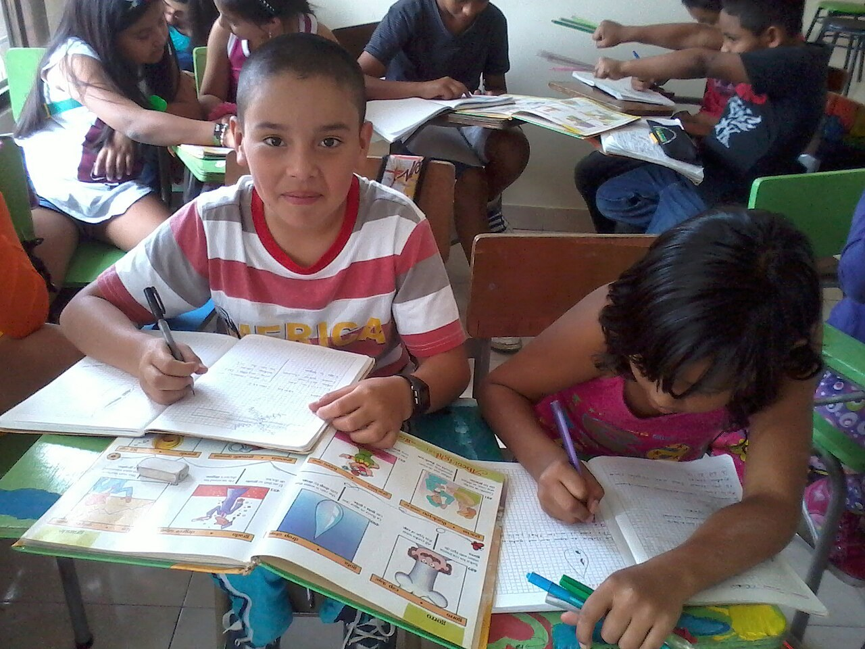
GRADE 7 · LESSON 30
Unit 4 Skills Practice
4-bo‘lim: ko‘nikmalar mashqi va takror
Skill based practice
Catherine gallego · CC BY-SA 3.0
sozlar.com

Slide 2
LESSON AIMS
Bugungi maqsad
1
Recall the 34 Unit 4 words and phrases in context
2
Choose the right question word, imperative and too / very in a revision test (at least 14/20)
3
Read a school website page and answer five questions
4
Ask and answer interview questions with short answers and extra information, then write a five-question interview

Slide 3
VOCABULARY
A. The school website and media (lessons 22, 26) (1/3)
🧑‍💼
the editor
muharrir
The editor chooses the best articles for the magazine.
🎤️
a reporter
muxbir
A reporter from the local TV is at our school today.
🆕️
the latest news
eng so‘nggi yangiliklar
I check my phone for the latest news every morning.
🗂️
a section
bo‘lim
The sports section is at the back of the newspaper.
🏠️
the home page
bosh sahifa
You can see all the sections on the home page of the website.

Slide 4
VOCABULARY
A. The school website and media (lessons 22, 26) (2/3)
🎙️
an interview
intervyu, suhbat
The famous footballer gives an interview after the match.
⭐️
a review
taqriz (film, kitob haqida fikr)
I always read a review of a film before I watch it.
💬️
an opinion
fikr
In my opinion, this film is too long.
🎶️
a concert
konsert
My sister sings in the school concert on Friday.
🎭️
a school play
maktab spektakli
Aziz is the king in our school play this year.

Slide 5
VOCABULARY
A. The school website and media (lessons 22, 26) (3/3)
👥️
a meeting
yig‘ilish, majlis
The website team has a meeting every Monday after lessons.
🍲️
a cook
oshpaz
Our school cook makes delicious soup every day.
👍️
useful
foydali
The school website is useful for pupils and parents.

Slide 6
VOCABULARY
B. Questions about you (lessons 23, 27) (1/2)
🏫️
get to school
maktabga bormoq, maktabga yetib bormoq
How do you get to school every morning?
🚶️
on foot
piyoda
How do you get home after school? — On foot. I live in the next street.
🚪️
next door
qo‘shni uyda, qo‘shnida
Who lives next door to you? — An old doctor and his wife.
🎨️
a hobby
sevimli mashg‘ulot, xobbi
What’s your hobby? — I collect old coins.

Slide 7
VOCABULARY
B. Questions about you (lessons 23, 27) (2/2)
💪️
keep fit
sog‘lom va chaqqon bo‘lib yurmoq
How do you keep fit? — I swim three times a week.
👶️
be born
tug‘ilmoq
I was born in Namangan, but now I live in Tashkent.
🏷️
a nickname
laqab, erkalatma ism
My name is Abdurahmon, but my nickname is Abdu.

Slide 8
VOCABULARY
C. Ways of talking (lesson 25) (1/2)
✅️
tell the truth
rostini aytmoq
It’s always better to tell the truth.
🤫️
whisper
shivirlamoq
Don’t tell anyone — just whisper it in my ear.
📢️
shout
baqirmoq, qichqirmoq
Please don’t shout in the library.
🌍️
speak a language
biror tilda gapirmoq
How many languages can you speak? — Three.

Slide 9
VOCABULARY
C. Ways of talking (lesson 25) (2/2)
⚽️
talk about something
biror narsa haqida gaplashmoq
My friends and I talk about football all the time.
💡️
explain
tushuntirmoq
Can you explain the rule again, please? I don’t understand it.
🔒️
keep a secret
sir saqlamoq
Can you keep a secret? Don’t tell anyone!

Slide 10
VOCABULARY
D. Describing and writing (lessons 28–29) (1/2)
📦️
heavy
og‘ir
This box is very heavy, but I can carry it.
🚌️
crowded
odam gavjum
The bus is too crowded — let’s wait for the next one.
😩️
tired
charchagan
After the match I was too tired to do my homework.
🔍️
carefully
diqqat bilan, ehtiyotkorlik bilan
Read the questions very carefully.

Slide 11
VOCABULARY
D. Describing and writing (lessons 28–29) (2/2)
👌️
well
yaxshi (ravish)
Diane writes poems very well.
✍️
a writer
yozuvchi
Abdulla Qodiriy is a famous Uzbek writer.
🙂️
sound friendly
samimiy tuyulmoq
Short forms like I’m and it’s sound friendly.

Slide 12
FOCUS
Unit 4 — five things to remember
• So‘roq so‘zi + do / does / is + ega: Where do you live? — Who ega bo‘lsa do yo‘q: Who knows?
• Qisqa javob + qo‘shimcha ma’lumot: Twelve. I’m thirteen next month.
• Buyruq: fe’lning o‘zi yoki Don’t + fe’l: Make sure … · Don’t forget to …
• say nimani, tell kimga, speak tilda, talk to / about: tell the truth, speak a language.
• very — yaxshi ham, yomon ham; too — muammo bor: too long to watch.

Slide 13
TEST · 7 MINUTES
Unit 4 revision test — part 1 (vocabulary) (1/2)
Choose A, B or C. Write only the letter.
1
The person who runs a school newspaper or website is the ___. A reporter · B editor · C reader
2
Paula writes a ___ of the concert: she says if it is good or bad. A review · B calendar · C link
3
Little Malika is five. She can’t ___ the time yet. A say · B speak · C tell
4
The baby is sleeping, so please ___. A shout · B whisper · C scream
5
My cousin can ___ three languages. A talk · B say · C speak
6
«Do you like fish?» «___ I prefer chicken.» A Not really. · B Me too! · C Good question!

Slide 14
TEST · 7 MINUTES
Unit 4 revision test — part 1 (vocabulary) (2/2)
7
I live very near the school, so I go there ___. A on foot · B by foot · C with feet
8
My name is Abdurahmon, but my friends call me Abdu — it’s my ___. A hobby · B nickname · C section
9
Short forms like it’s and that’s make an interview ___ friendly. A look · B sound · C listen
10
My best friend never tells anyone my news. She can keep a ___. A secret · B truth · C nickname

Slide 15
TEST · 7 MINUTES
Unit 4 revision test — part 2 (grammar) (1/2)
Complete with ONE word.
11
___ do you live? — In a little village.
12
___ do you prefer, tea or juice? — Juice, please.
13
___ old is your grandpa? — Seventy-two.
14
___ knows the answer? — Me!
15
Be quiet! ___ talk in the library!
16
This bag is ___ heavy for me to carry.

Slide 16
TEST · 7 MINUTES
Unit 4 revision test — part 2 (grammar) (2/2)
17
The test is ___ difficult, but I can do it!
18
He speaks too fast ___ me to understand him.
19
She sings very ___. (good / well)
20
What time ___ the film start? — At seven.

Slide 17
PRONUNCIATION
Say it — don’t just read it
Unit 4 words — say them clearly:
editor
/ˈedɪtə/
interview
/ˈɪntəvjuː/
opinion
/əˈpɪnjən/
whisper
/ˈwɪspə/
talk
/tɔːk/
truth
/truːθ/
explain
/ɪkˈspleɪn/
crowded
/ˈkraʊdɪd/
talk and whisper: silent letters — the l in talk, the h in whisper.

Slide 18
WHOLE CLASS
Practice — complete the sentence (1/2)
1
Angela is the ________ of the website — she decides what goes on it. (e…)
2
Our class reporter wrote a ________ of the new film: «Great story, bad music.» (r…)
3
________ one is your bag, the red one or the blue one? (W…)
4
Don’t ________ to close the window when you leave. (f…)
5
Please don’t lie to me. Tell me the ________. (t…)
6
We can’t talk in the library, so we ________. (w…)

Slide 19
WHOLE CLASS
Practice — complete the sentence (2/2)
7
My grandma can speak three ________. (l…)
8
The music is too loud for me ________ hear you. (t…)
9
My dad cooks very ________. His plov is the best! (w…)
10
Do you like rap music? — Not ________. I prefer pop. (r…)

Slide 20
PAIR / GROUP WORK · 4 MINUTES
Vocabulary activity
1
Match the beginnings (1-10) with the endings (a-j).
2
Read your complete sentences aloud.
3
Give the Uzbek meaning of the key word in each sentence.
4
When you finish, swap tables with the other group.

Slide 21
PAIRS · 5 MINUTES
Speaking
Website interview: A is a reporter for the Linton School website, B is a teacher or a pupil. Ask six questions with six different question words (your hobby, how you get to school, how you keep fit, where you were born …); B gives a short answer + extra information.
React and swap: use Not really. / It depends. / That’s a very difficult question!
Too or very? Tell your partner three things about our school: one very good thing, one thing that is too … and one thing you want to change.

Slide 22
TODAY'S WORDS IN CONTEXT
Linton School website — this week (1/2)
NEWS. Hello, readers! This is Angela, the editor. Here’s the latest news from our school. Remember: the school concert is on Thursday. Don’t forget to buy your tickets!
INTERVIEW. This week Tariq talks to Mrs Hill, our school cook. «What kind of food do you cook?» «That’s a very difficult question! Everything! But my soup is the most popular.»
REVIEW. Paula writes about the new school play: «It’s funny and the actors speak very well. But it’s too long — two and a half hours! It’s too long to watch after a day of lessons.»
Cover the word list. Can you understand the words in bold from the sentence?

Slide 23
TODAY'S WORDS IN CONTEXT
Linton School website — this week (2/2)
YOUR OPINION. We want to hear from you! What do you talk about with your friends at lunch? Send us an email — and please tell the truth! Make sure your name is on it.
Cover the word list. Can you understand the words in bold from the sentence?

Slide 24
TODAY'S WORDS IN CONTEXT
Read and answer
1
Who is Angela?
2
When is the school concert?
3
Who does Tariq interview?
4
What does Paula like about the play, and what doesn’t she like?
5
Find one imperative and one sentence with too … to …

Slide 25
PAIRS · ESDA QOLDIMI?
Memory check — one minute per section
Juftingiz bo‘lim harfini aytadi (A, B, C yoki D), siz bir daqiqada iloji boricha ko‘p so‘z va ibora aytasiz.
1
A: the school website and media · B: questions about you (hobby, nickname …)
2
C: ways of talking · D: describing words (heavy, tired …) and writing
3
Which three items do you still forget? Write them on a sticky note.

Slide 26
UZ
Qiyin joyi — o‘zbekcha
Bu dars YANGI so‘z bermaydi — hammasi 22–29-darslardan (4-bo‘lim).
editor — «muharrir», reporter — «muxbir», review — «taqriz», interview — «intervyu, suhbat».
tell the truth (✗ say the truth), speak a language (✗ talk English).
very — «juda», too — «haddan tashqari» (muammo bor): too long to watch.
Qisqa javob + qo‘shimcha ma’lumot — og‘zaki ham, yozma intervyuda ham.

Slide 27
HOMEWORK
Uy vazifasi
1
Quick check — Workbook p. 28, ex. 4 (six questions).
2
Learn the 34 items with the flashcards: sozlar.com/vocab/cards/?set=grade7-lesson30
3
Revise the two test items you circled — write a sentence with each.

Slide 28
IMAGE CREDITS
Rasmlar manbasi
cover
Catherine gallego · CC BY-SA 3.0 · https://commons.wikimedia.org/wiki/File:Estudiantes_feedback_children_II.jpg

Slide 29
Uchta so‘z — ertaga ham esingizda qoladi
Juftingizga ayting, so‘ng daftaringizga yozib qo‘ying.
sozlar.com/vocab/cards/?set=grade7-lesson30

