Slide 1
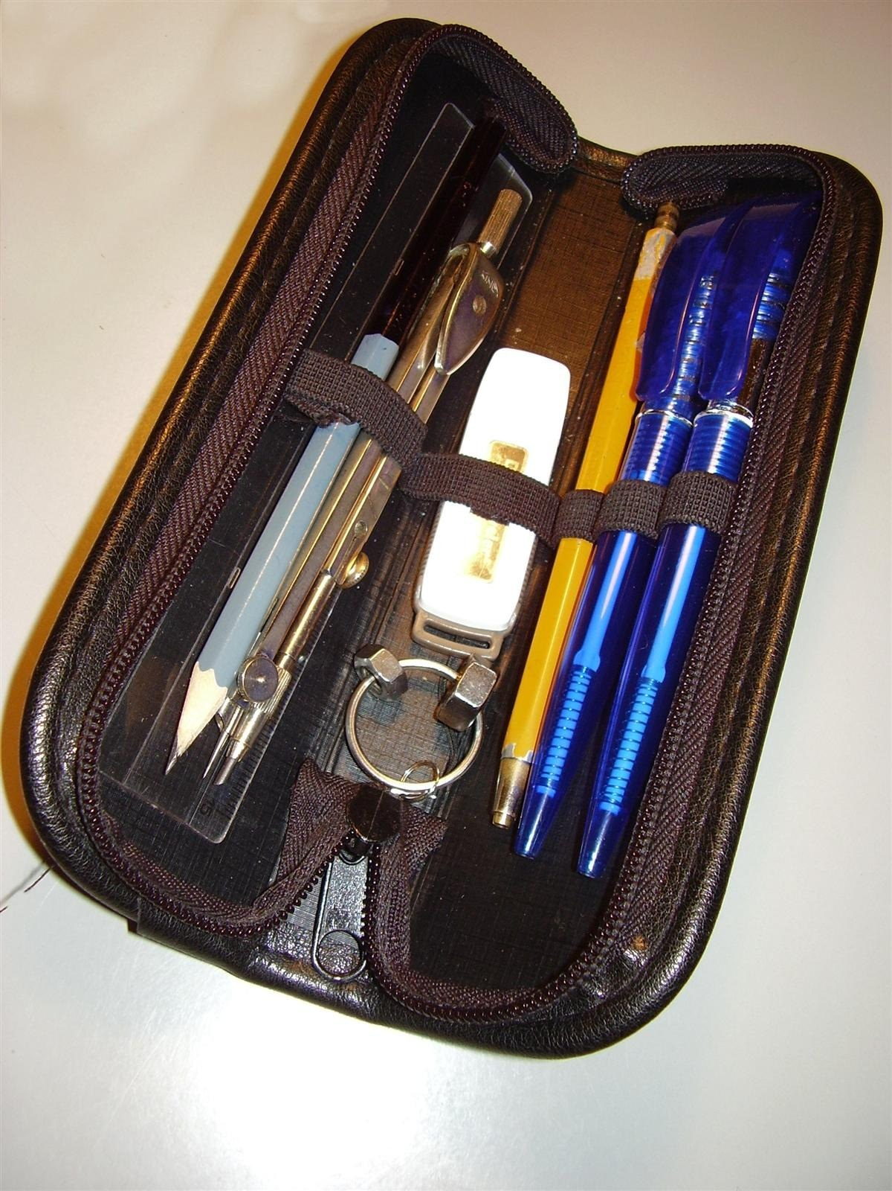
GRADE 7 · LESSON 2
Grammar: be and have got
Grammatika: be va have got
Grammar: be, have/have got
Honza Groh · CC BY 3.0
sozlar.com

Slide 2
LESSON AIMS
Bugungi maqsad
1
Choose between be and have/have got in eight sentences (ex.1)
2
Say and write what they have got and haven't got (ex.2)
3
Ask and answer with Have you got…? / Do you have…? and give short answers
4
Carry out a short class survey and report one result

Slide 3
BOOK TASK · 8 MINUTES
Book tasks — Laser A1+, p. 8
Open your books at page 8.
1
ex.1 Choose the correct word or phrase (eight sentences): is / are, has / have, Are / Do…
2
ex.2 Tick the things you have got, then write sentences: I've got…, but I haven't got…
3
ex.3 Class survey: ask other students and tick what they have got.
4
Grammar database 1, p. 145 — qo‘shimcha jadval.

Slide 4
GRAMMAR
be va have got — shakllar
be
have got
men
I am / I'm
I have got / I've got
u
he is / he's
he has got / he's got
biz
we are / we're
we have got / we've got
inkor
isn't / aren't
hasn't got / haven't got
savol
Are you …?
Have you got …? / Has he got …?
Qisqa javob: Yes, I am. / No, I'm not. — Yes, I have. / No, I haven't.

Slide 5
FOCUS
be or have got?
QOIDA
QOIDA
be — qanaqaligini aytadi: I am twelve. She is tall. We are friends.
have got — nimang borligini aytadi: I've got two sisters. He's got a dog.
Inkor: isn't / aren't va haven't got / hasn't got.
So‘roq: Are you…? va Have you got…? — fe’l birinchi o‘ringa chiqadi.
have got = have: Have you got a room? = Do you have a room?
Farqi: She has got a dog (nimasi bor) — She gets up at seven (har kuni qiladigan ishi, 9-dars).

Slide 6
VOCABULARY
A. Gadgets (1/2)
🚲️
a bicycle
velosiped
I’ve got a new bicycle, but I haven’t got a helmet.
📱️
a mobile phone
mobil telefon
Has your little sister got a mobile phone?
📲️
a smartphone
smartfon
My dad has got a smartphone with a great camera.
⌚️
a watch
qo‘l soati
My grandfather has got an old watch from his father.
💻️
a laptop
noutbuk
Our teacher has got a laptop on her desk.

Slide 7
VOCABULARY
A. Gadgets (2/2)
🖥️
a computer
kompyuter
Anna has got a computer, and she plays games on it.
🎵️
an MP3 player
MP3 pleyer
Is this your MP3 player? It’s very small!
🎧️
headphones
quloqchin
I haven’t got my headphones today — they’re at home.
📷️
a camera
fotoapparat, kamera
Has your new phone got a good camera?
📟️
a tablet
planshet
My cousin has got a tablet, and she reads books on it.

Slide 8
VOCABULARY
B. School and sport things (1/2)
🧢️
a baseball cap
beysbolka
He’s got a red baseball cap for the summer.
🛹️
a skateboard
skeytbord
The boys haven’t got bikes, but they’ve got a skateboard.
🎒️
a school bag
maktab sumkasi
My school bag is very heavy today.

Slide 9
VOCABULARY
B. School and sport things (2/2)
✏️
a pencil case
penal
Have you got a ruler in your pencil case?
📖️
a dictionary
lug‘at (kitob)
Have you got an English dictionary at home?
⚽️
a football
futbol to‘pi
We’ve got a new football for the school team.

Slide 10
VOCABULARY
C. Pets and home (1/2)
🐰️
a pet rabbit
uyda boqiladigan quyon
My cousin has got a white pet rabbit.
🐕️
a dog
it
Harry’s family has got a dog called Max.
🐱️
a cat
mushuk
Our cat hasn’t got a name yet!

Slide 11
VOCABULARY
C. Pets and home (2/2)
🌐️
the internet
internet
Have you got the internet on your phone?
🏡️
a house
hovli uy
My grandparents have got a big house with a garden.
🏢️
a flat
kvartira, xonadon
We haven’t got a house — we’ve got a flat in Chilonzor.

Slide 12
VOCABULARY
D. People and photos (1/2)
👯️
twins
egizaklar
Are you and your brother twins?
🪞️
identical
aynan o‘xshash (egizaklar haqida)
The twins in our class are identical — they look the same!
💇️
black hair
qora soch
My sister has got long black hair, like me.

Slide 13
VOCABULARY
D. People and photos (2/2)
👁️
brown eyes
jigarrang ko‘zlar
Has your baby brother got brown eyes?
🖼️
a photo
surat, fotosurat
This is a photo of my cousins — they’re in Samarkand.
✅️
ready
tayyor
Is everybody ready for the test?

Slide 14
TODAY'S WORDS IN CONTEXT
Two brothers, two bags
Aziz and Bek are brothers, but their school bags aren't the same. Aziz has got a laptop, a watch and a blue baseball cap in his bag. He hasn't got a book!
Bek hasn't got a laptop. He's got two books, a pencil case and an old MP3 player. 'Have you got my headphones?' he asks his brother every morning.
The boys haven't got bicycles, but they've got one skateboard. They share it — one day Aziz, the next day Bek. Their little sister has got a pet rabbit called Momo.
'Are you ready?' asks Mum at half past seven. 'Yes, we are!' say the boys.
Cover the word list. Can you understand the words in bold from the sentence?

Slide 15
TODAY'S WORDS IN CONTEXT
Read and answer
1
What has Aziz got in his bag?
2
Has Bek got a laptop?
3
How many skateboards have the boys got?
4
Who has got a pet rabbit?
5
Find one question with 'have got' in the text.
6
Find one short answer in the text.

Slide 16
PAIRS · ESDA QOLDIMI?
Memory check — be yoki have got?
Juftingiz o‘zbekchasini aytadi, siz to‘g‘ri shakl bilan inglizcha gap tuzasiz.
1
Menda velosiped bor. · U o‘n uch yoshda. · Bizda noutbuk yo‘q.
2
Senda planshet bormi? · Ular egizakmi?
3
Qisqa javob bering: Have you got a camera? · Are you ready?
4
Write the three forms you keep forgetting.

Slide 17
PRONUNCIATION
Say it — don’t just read it
Urg‘uli bo‘g‘inni kuchliroq ayting:
bicycle /ˈbaɪsɪkl/
laptop /ˈlæptɒp/
headphones /ˈhedfəʊnz/
camera /ˈkæmərə/
dictionary /ˈdɪkʃənri/
identical /aɪˈdentɪkl/
smartphone /ˈsmɑːtfəʊn/
photo /ˈfəʊtəʊ/
identical — urg‘u ikkinchi bo‘g‘inda: i-DEN-ti-cal; camera — uch bo‘g‘in: CAM-e-ra.

Slide 18
WHOLE CLASS
Practice — complete the sentence (1/2)
1
My brother ________ also my best friend. (be)
2
Jack and I ________ close friends. (be)
3
Holly ________ a really big family! Six sisters! (has / have)
4
________ you have your own room?
5
No, we ________ have a house in the country.
6
Oscar ________ ________ a fantastic bedroom!

Slide 19
WHOLE CLASS
Practice — complete the sentence (2/2)
7
________ you got internet at home?
8
She's an only child; she ________ ________ a big family.
9
'Have you got a bicycle?' 'Yes, I ________.'
10
'Is she thirteen?' 'No, she ________.'
11
I've got a mobile phone, but I ________ ________ an MP3 player.
12
'Are you twins?' 'Yes, we ________, but we aren't identical.'

Slide 20
PAIR / GROUP WORK · 7 MINUTES
Vocabulary activity
1
Match the beginnings (1-10) with the endings (a-j).
2
Read your complete sentences aloud.
3
Give the Uzbek meaning of the key word in each sentence.
4
When you finish, swap tables with the other group.

Slide 21
PAIRS, THEN CLASS SURVEY
Speaking
Ask your partner about five things (bicycle, phone, watch, laptop, pet): 'Have you got…?'
Report one answer to the class: 'Malika has got a bicycle, but she hasn't got a skateboard.'

Slide 22
UZ
Qiyin joyi — o‘zbekcha
have got va have — ma’nosi bir xil: I've got a bike = I have a bike.
So‘roqda shakl boshqacha: Have you got…? lekin Do you have…?
Qisqartmalar: I'm, he's, we're, I've, she's got, haven't, hasn't, isn't, aren't — yozma ishda ham ishlatiladi.
he's ikki xil bo‘ladi: he is yoki he has got — gapga qarab tushuniladi.
Yoshni aytishda be: I'm twelve; «I have twelve years» — o‘zbekchadan so‘zma-so‘z tarjima, xato.

Slide 23
HOMEWORK
Uy vazifasi
1
Laser A1+ Workbook pp. 5–6, ex. 1–4.
2
Learn the 28 items (sections A–D) with the flashcards: sozlar.com/vocab/cards/?set=grade7-lesson2
3
Write six sentences about your family's things: what you have got and haven't got.

Slide 24
IMAGE CREDITS
Rasmlar manbasi
cover
Honza Groh · CC BY 3.0 · https://commons.wikimedia.org/wiki/File:Skolni_penal.jpg

Slide 25
Uchta so‘z — ertaga ham esingizda qoladi
Juftingizga ayting, so‘ng daftaringizga yozib qo‘ying.
sozlar.com/vocab/cards/?set=grade7-lesson2

