Slide 1
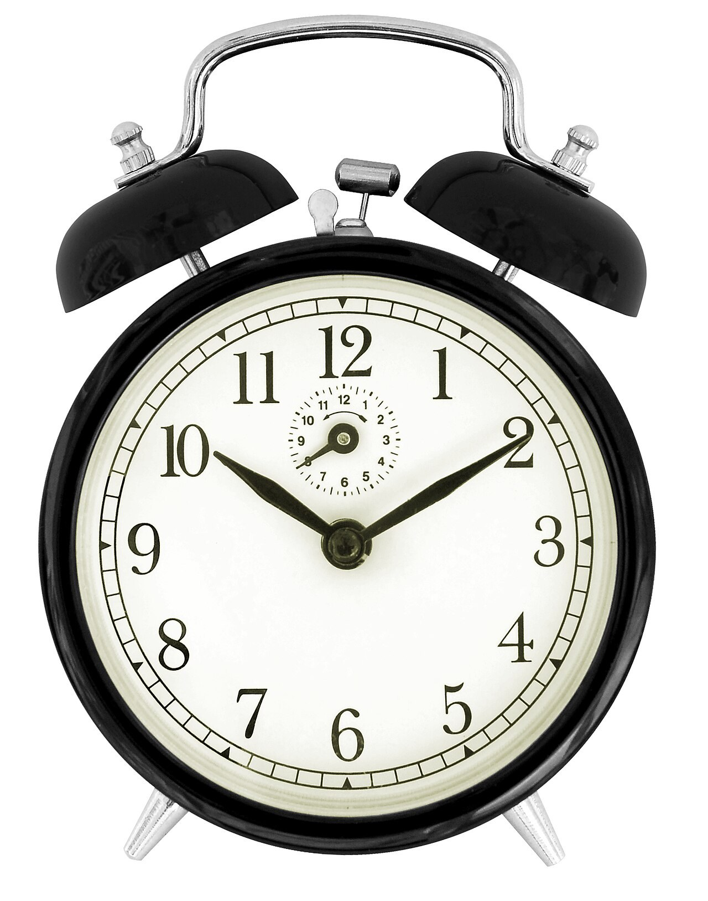
GRADE 8 · LESSON 2
A Typical Day
Kundalik hayot
Wordpower! (daily routine)
Sun Ladder · CC BY-SA 3.0
sozlar.com

Slide 2
LESSON AIMS
Bugungi maqsad
1
Match six phrasal verbs (wake up, get up, go out, get back, turn on, turn off) with their definitions
2
Complete a text about a favourite day with the right phrasal verb (p. 9, ex. 2)
3
Use opposites: turn on / turn off, go out / stay in, get up / go to bed
4
Tell a partner about their own typical day using words and phrases from today’s list

Slide 3
VOCABULARY
A. Phrasal verbs for a daily routine (1/2)
🌅️
wake up
uyg‘onmoq
On school days I wake up before my alarm clock rings.
🙆️
get up
o‘rnidan turmoq (yotoqdan)
My grandfather gets up at five and goes for a walk.
🚪️
go out
ko‘chaga chiqmoq, (uydan) tashqariga chiqmoq
We go out with our friends after lunch on Saturdays.
🏠️
get back
(uyga) qaytib kelmoq
Dad gets back from work at about seven every evening.

Slide 4
VOCABULARY
A. Phrasal verbs for a daily routine (2/2)
💡️
turn on
yoqmoq (chiroq, kompyuter)
It’s dark in here — can you turn on the light, please?
🔌️
turn off
o‘chirmoq (chiroq, kompyuter)
Please turn off the TV before you go to bed.
🧩️
stay in
uyda qolmoq (tashqariga chiqmaslik)
It was very windy, so we stayed in and played chess.

Slide 5
VOCABULARY
B. A lazy Sunday (1/2)
⭐️
a favourite day
eng yoqtirgan kun
Friday is my favourite day because we have PE and art.
😴️
have a lie-in
ertalab kechroq turmoq, to‘yib uxlamoq
There are no lessons tomorrow, so I can have a lie-in.
🛌️
stay in bed
yotoqda qolmoq (turmay yotmoq)
I had a cold, so I stayed in bed all day yesterday.
📖️
read in bed
yotoqda kitob o‘qimoq
I like to read in bed for half an hour every night.
💬️
chat online
internetda yozishmoq, onlayn suhbatlashmoq
In the evening I chat online with my cousin in Andijan.

Slide 6
VOCABULARY
B. A lazy Sunday (2/2)
🤤️
get hungry
qorni ochmoq
After a long football match we always get hungry very quickly.
🎉️
have fun
maza qilib vaqt o‘tkazmoq
We went to the park and had fun on our bikes all afternoon.
🌙️
go to bed
uxlashga yotmoq
On school nights I go to bed at about ten o’clock.
💤️
go to sleep
uyquga ketmoq, uxlamoq
I usually go to sleep at about half past ten.

Slide 7
VOCABULARY
C. Morning and bedtime (1/2)
🍳️
have breakfast
nonushta qilmoq
We have breakfast together in the kitchen at seven.
🛏️
make your bed
o‘rin-ko‘rpani yig‘ishtirmoq
Mum asks me to make my bed every morning before school.
🧼️
have a wash
yuvinmoq (yuz-qo‘lni yuvmoq)
I have a wash and comb my hair in the bathroom.

Slide 8
VOCABULARY
C. Morning and bedtime (2/2)
🥱️
fall asleep
uxlab qolmoq
My little brother fell asleep on the sofa during the film.
🕘️
have an early night
barvaqt yotmoq
I have a test tomorrow, so I’m going to have an early night tonight.
🦉️
have a late night
kech yotmoq
We had a late night at my cousin’s wedding last Saturday.

Slide 9
VOCABULARY
D. Housework and free time (1/2)
🧹️
housework
uy ishlari
Everyone in our family helps with the housework at the weekend.
👚️
do the washing
kir yuvmoq
My sister and I do the washing on Saturday mornings.
🛒️
do the shopping
bozor-o‘char qilmoq
On Sundays Dad does the shopping at the bazaar near our house.
🎨️
spare time
bo‘sh vaqt
In my spare time I draw and play the dutar.

Slide 10
VOCABULARY
D. Housework and free time (2/2)
🍕️
eat out
tashqarida (kafe, restoranda) ovqatlanmoq
On my birthday we eat out at a café in the city centre.
👋️
come round
(uyga) mehmonga kelmoq
My friends come round to watch football on Sunday evenings.
🚶️
go for a walk
sayrga chiqmoq
After supper we go for a walk along the canal.
☎️
phone a friend
do‘stga qo‘ng‘iroq qilmoq
When I don’t understand my homework, I phone a friend from my class.

Slide 11
BOOK TASK · PAIRS · 4 MINUTES
Wordpower! ex. 1 — Laser A2, p. 9
Match each definition with a phrasal verb: a go out · b turn on · c wake up · d turn off · e get up · f get back
1
stop sleeping → ___
2
leave your bed → ___
3
leave your house → ___
4
return home → ___
5
start a computer, light, etc. → ___
6
stop a computer, light, etc. → ___

Slide 12
BOOK TASK · ALONE, THEN CHECK · 4 MINUTES
Wordpower! ex. 2 — Laser A2, p. 9
«Sunday is my favourite day…» — write a phrasal verb from ex. 1 in each gap.
1
I usually ________ early, but I stay in bed and have a lie-in for about an hour!
2
I ________ my laptop and check my email.
3
I ________ when I get hungry and want breakfast!
4
After breakfast, I ________ to meet my friends.
5
I ________ in the early evening. We have a big supper…
6
I read in bed for half an hour before I ________ my light and go to sleep.

Slide 13
FOCUS
Phrasal verbs for a daily routine (p. 9)
• A phrasal verb = verb + small word: wake up, get back, go out. The small word changes the meaning: get up ≠ get back.
• Opposites: turn on ↔ turn off · go out ↔ stay in · get up ↔ go to bed.
• wake up = stop sleeping; get up = leave your bed. In ex. 2 the boy wakes up, has a lie-in and only then gets up.
• turn on / off + thing: turn on my laptop · turn it off (NOT turn off it).
• have + noun: have a shower, have a lie-in, have breakfast (NOT make a shower).

Slide 14
PRONUNCIATION
Say it — don’t just read it
Linking: the last sound joins the next vowel — say each phrase as one word:
wake up /weɪk‿ʌp/
get up /ɡet‿ʌp/
turn on /tɜːn‿ɒn/
turn off /tɜːn‿ɒf/
go out /ɡəʊ‿(w)aʊt/
stay in /steɪ‿(j)ɪn/
eat out /iːt‿aʊt/
fall asleep /fɔːl‿əˈsliːp/
I wake up at seven, get up at ten past and turn on the light. Stress the small word: get UP, turn OFF.

Slide 15
WHOLE CLASS
Practice — complete the sentence (1/2)
1
My alarm clock rings at 6.30, so I ________ and open my eyes.
2
It’s cold and rainy — let’s ________ and watch a film at home.
3
Please ________ the TV. Nobody is watching it.
4
Mum says: ‘________ before you go to school — the blanket is on the floor!’
5
I was so tired that I ________ in the car on the way home. (past)
6
We don’t cook on Fridays — we ________ at a small café near the park.

Slide 16
WHOLE CLASS
Practice — complete the sentence (2/2)
7
My grandparents often ________ for tea on Sunday afternoons.
8
Washing the dishes and cleaning the floor are part of the ________.
9
We need milk, bread and eggs — can you ________ today?
10
I don’t have much ________ on weekdays because of homework and clubs.
11
After a big lunch Grandpa likes to ________ in the park.
12
On Sunday I don’t get up early — I ________ until ten.

Slide 17
PAIR / GROUP WORK · 7 MINUTES
Vocabulary activity
1
Match the beginnings (1-10) with the endings (a-j).
2
Read your complete sentences aloud.
3
Give the Uzbek meaning of the key word in each sentence.
4
When you finish, swap tables with the other group.

Slide 18
PAIRS · 5 MINUTES
Speaking
Ask and answer: What time do you wake up and get up on school days? When do you get back home?
Tell your partner about your favourite day, like the boy on p. 9. Use four phrasal verbs from ex. 1.
What do you do in your spare time? Do your friends come round, or do you go for a walk?

Slide 19
TODAY'S WORDS IN CONTEXT
Sardor’s Saturday
On Saturdays I don’t have lessons, so my alarm clock is quiet. I wake up at about eight, but I have a lie-in and read in bed. Then I get up, have a shower and get dressed.
After breakfast I help around the house: I tidy up my room and do other chores. At eleven I turn on my laptop and chat online with my cousin in Samarkand.
In the afternoon I go out and play football with friends in our neighbourhood. I get back home at six, tired but happy. At ten I turn off the light — it’s my bedtime!
Cover the word list. Can you understand the words in bold from the sentence?

Slide 20
TODAY'S WORDS IN CONTEXT
Read and answer
1
Why is Sardor’s alarm clock quiet on Saturdays?
2
What does he do after he gets up?
3
How does he help around the house?
4
Who does he chat online with?
5
What time does he get back home?

Slide 21
PAIRS · ESDA QOLDIMI?
Memory check — say it in English
O‘zbekcha ustunni yoping. Juftingiz o‘qiydi, siz ma’nosini yoki qarama-qarshisini aytasiz.
1
wake up · get up · go out · get back · turn on · turn off — what do they mean?
2
Opposites: turn on ↔ ? · go out ↔ ? · get up ↔ ?
3
have a ... (lie-in / wash) · make your ... · do the ... (washing / shopping) · go for a ...
4
spare time · eat out · come round — say one true sentence with each

Slide 22
UZ
Qiyin joyi — o‘zbekcha
wake up — uyg‘onmoq (ko‘z ochiladi), get up — o‘rindan turmoq. O‘zbekchada ham ikki alohida fe’l.
turn on / turn off — yoqmoq / o‘chirmoq (chiroq, kompyuter, televizor). Olmosh o‘rtaga tushadi: turn it off.
have a wash, have a lie-in, have breakfast — have bilan aytiladi; «yuvinmoq»ni so‘zma-so‘z make a wash deb o‘girmang.
get back home, go home — home oldidan to qo‘yilmaydi.
go to bed — yotmoq, go to sleep — uxlamoq, fall asleep — (o‘zi bilmay) uxlab qolmoq: I went to bed at ten, but I fell asleep at midnight.

Slide 23
HOMEWORK
Uy vazifasi
1
Laser A2 Workbook p. 7, ex. 1–2 (kalendar reja).
2
Learn the 30 items with the flashcards: sozlar.com/vocab/cards/?set=grade8-lesson2
3
Write about your favourite day (six sentences) with four phrasal verbs from p. 9.

Slide 24
IMAGE CREDITS
Rasmlar manbasi
cover
Sun Ladder · CC BY-SA 3.0 · https://commons.wikimedia.org/wiki/File:2010-07-20_Black_windup_alarm_clock_face.jpg

Slide 25
Uchta so‘z — ertaga ham esingizda qoladi
Juftingizga ayting, so‘ng daftaringizga yozib qo‘ying.
sozlar.com/vocab/cards/?set=grade8-lesson2

