Slide 1
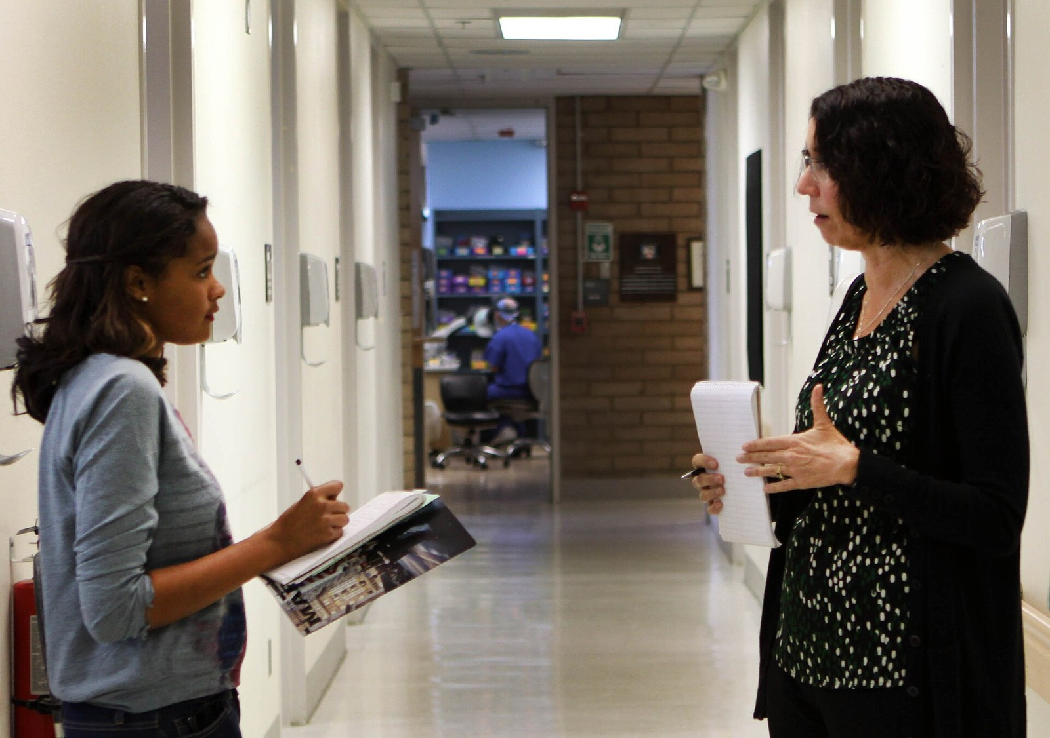
GRADE 7 · LESSON 29
Writing: an Interview (Dialogue)
Yozish: intervyu (dialog)
Writing: interview (dialogue)
U.S. Marine Corps (DVIDS) · Public domain
sozlar.com

Slide 2
LESSON AIMS
Bugungi maqsad
1
Write the question words and phrases in the Jenny Dawlings interview (p. 38 ex. 1)
2
Complete a factfile from the interview (p. 38 ex. 2)
3
Find examples of the four Language Lab rules in the interview
4
Plan and start their own interview with a famous person (p. 39 ex. 1–3)

Slide 3
BOOK TASK · 6 MINUTES
Book tasks — Laser A1+, p. 38
Books open, word list closed. Read the answers first — they tell you the question word!
1
ex.1 — write question words and phrases in gaps 1–10 (Who …? How old …? …).
2
ex.2 — read the interview again and complete Jenny’s factfile (a word, number or short phrase).
3
Language Lab — find and underline examples of rules 1–4 in the interview.
4
Compare with a partner.

Slide 4
CHECK AND TEACH · 4 MINUTES
Answer key — Laser A1+, p. 38
1
ex.1 1 Who · 2 How old · 3 How many · 4 Where · 5 Why
2
ex.1 6 How · 7 What time / When · 8 Which · 9 When · 10 What
3
ex.2 J.K. Rowling · 36 · none · Cornwall (south-west England) · it’s beautiful and peaceful
4
ex.2 the news on TV · about 10 o’clock · four or five · in about three months · The Mystery of the Dark Cave
5
Language Lab 1 Her books are fantastic! · 2 That’s, it’s, I’m, I’ll, don’t · 3 36. / None. · 4 I’ll be 37 next March.

Slide 5
VOCABULARY
A. Books and stories (1/2)
📖️
a happy ending
baxtli yakun (hikoya, filmda)
I like stories with a happy ending, not sad ones.
🧙️
a character
qahramon, personaj (asarda)
Harry Potter is my favourite character in the books.
📑️
a chapter
bob (kitobda)
Read the first chapter of the book before Monday.
📄️
a page
bet, sahifa
The answer is on page twenty-five of your book.
🏷️
the title
(kitob) nomi, sarlavha
What’s the title of your favourite book?

Slide 6
VOCABULARY
A. Books and stories (2/2)
📕️
a cover
muqova
The new book has a dark blue cover with a gold moon on it.
🔍️
a mystery
sir, jumboq; sirli hikoya
Nobody knows who took the cake — it’s a real mystery!
🦇️
a cave
g‘or
The children found an old map in a dark cave near the river.
🗺️
an adventure
sarguzasht
The book is about the adventures of two boys on a desert island.
🧚️
a fairy tale
ertak
My grandma tells me a fairy tale every night.

Slide 7
VOCABULARY
B. Writers and fans (1/2)
✍️
a writer
yozuvchi
Abdulla Qodiriy is a famous Uzbek writer.
🖋️
an author
muallif
Who is the author of this book?
📜️
a poet
shoir
Alisher Navoi is a great Uzbek poet.
🐛️
a bookworm
kitobxon (kitobga juda ishqiboz odam)
My sister is a real bookworm — she reads every evening.
🖊️
an autograph
avtograf, dastxat
I’ve got the autograph of my favourite footballer!

Slide 8
VOCABULARY
B. Writers and fans (2/2)
📅️
come out
chiqmoq (kitob — sotuvga, film — ekranga)
The new cartoon comes out in December.
🛍️
in shops
do‘konlarda, sotuvda
The new phone will be in shops next month.
🖨️
publish
nashr etmoq, chop etmoq
The writer publishes a new book every year.
📚️
a library
kutubxona
I borrow two books from the school library every week.

Slide 9
VOCABULARY
C. A writer’s life (1/2)
💡️
get ideas
g‘oya olmoq, ilhom olmoq
Many artists get ideas from nature.
📺️
watch the news
yangiliklarni ko‘rmoq
My grandpa watches the news every evening at nine.
⏰️
start work
ishni boshlamoq
My mum starts work at eight o’clock every morning.

Slide 10
VOCABULARY
C. A writer’s life (2/2)
🌅️
peaceful
tinch, osoyishta
Grandpa’s village is quiet and peaceful.
🌸️
beautiful
chiroyli, go‘zal
Chimgan is very beautiful in spring.
🧭️
the south-west
janubi-g‘arb
Our dacha is in the south-west of the city.

Slide 11
VOCABULARY
D. Writing an interview
🎙️
an interviewer
intervyu oluvchi
The interviewer asks the questions, and the famous person answers.
💬️
a dialogue
dialog, suhbat
Read the dialogue with your partner: you are A, and your partner is B.
🎉️
sound exciting
hayajonli tuyulmoq
An exclamation mark makes your answer sound exciting.
🙂️
sound friendly
samimiy tuyulmoq
Short forms like I’m and it’s sound friendly.

Slide 12
FOCUS
A good interview — four Language Lab rules
• Undov belgisi (!) javobni qiziqarli qiladi: Her books are fantastic!
• Qisqa shakllar (it’s, that’s, I’m, I’ll) samimiy eshitiladi: That’s a very difficult question!
• Birinchi javob ko‘pincha to‘liq gap emas: How old are you? — 36.
• Qo‘shimcha ma’lumot keyingi gaplarda: 36. I’ll be 37 next March.
• Savollarda turli so‘roq so‘zlari: who, how old, how many, where, why, how, what time, which, when, what.

Slide 13
STRATEGY
Writing your interview — the plan (p. 39)
1
1. Choose a famous person (a singer, a footballer, a writer …). Complete the factfile — use your imagination!
2
2. Write 8–10 questions with different question words: How old …? Where …? Why …? Which …?
3
3. Answers: a short first answer + extra information: In Tashkent. I love my city!
4
4. Make it sound exciting and friendly: exclamation marks and short forms (it’s, I’m, I’ll). Add a title, one sentence about the person and a picture.

Slide 14
PRONUNCIATION
Say it — don’t just read it
Book words: ch is /k/ in character but /tʃ/ in chapter; au is /ɔː/ in author and autograph. In the interview, stress the key word in exclamations (It’s FANTASTIC!).
character
/ˈkærəktə/
chapter
/ˈtʃæptə/
title
/ˈtaɪtl/
mystery
/ˈmɪstri/
adventure
/ədˈventʃə/
author
/ˈɔːθə/
autograph
/ˈɔːtəɡrɑːf/
peaceful
/ˈpiːsfl/
Short forms: I’ll /aɪl/, it’s /ɪts/, that’s /ðæts/, don’t /dəʊnt/.

Slide 15
WHOLE CLASS
Practice — complete the sentence (1/2)
1
Where do you get your ________ for new games? — From my dreams! (i…)
2
What’s your new book ________? — «The Blue Door». (c…)
3
I’m thirty now. I’ll ________ thirty-one next May. (b…)
4
Short forms like I’m and it’s make the interview sound ________. (f…)
5
I can’t stop reading! Just one more ________, Mum, and then I’ll go to bed. (c…)
6
My cousin always has a book in her bag — she reads on the bus, at lunch, everywhere. She’s a ________! (b…)

Slide 16
WHOLE CLASS
Practice — complete the sentence (2/2)
7
We live in a small, ________ village — there are no cars at night. (p…)
8
My dad is a ________. He writes books for children. (w…)
9
The new film comes ________ next Friday. (o…)
10
Which of your songs is the ________? — I don’t know! I like them all. (b…)

Slide 17
PAIR / GROUP WORK · 4 MINUTES
Vocabulary activity
1
Match the beginnings (1-10) with the endings (a-j).
2
Read your complete sentences aloud.
3
Give the Uzbek meaning of the key word in each sentence.
4
When you finish, swap tables with the other group.

Slide 18
PAIRS · 4 MINUTES
Speaking
Role-play: A is the interviewer, B is Jenny Dawlings. Close the book and do the interview from memory — B can change the answers!
Swap: B is the interviewer, A is a famous person of their choice. A gives short first answers and extra information.
Guess who: answer three questions as a famous person — the class guesses who you are.

Slide 19
TODAY'S WORDS IN CONTEXT
Madina Yusupova — chess champion! (1/2)
Madina Yusupova is only fourteen, but she’s the best chess player in our city. Our school website asked her some questions — and I was the interviewer!
How old are you? — Fourteen. I’ll be fifteen next April.
Who is your chess teacher? — My grandpa. He’s a very good player!
How many hours do you play every day? — About three. After school and in the evening.
How do you get ideas for new moves? — I watch famous players online. And I read a lot of chess books from the library.
Which of your games is the best? — That’s a very difficult question! Maybe my game in Tashkent. It’s my favourite!
Cover the word list. Can you understand the words in bold from the sentence?

Slide 20
TODAY'S WORDS IN CONTEXT
Madina Yusupova — chess champion! (2/2)
What’s your favourite thing about chess? — It’s beautiful, quiet and peaceful. But my head is never quiet!
What’s next? — A big competition in Samarkand in about two months. And my grandpa’s chess book comes out in May. Wish me luck!
Cover the word list. Can you understand the words in bold from the sentence?

Slide 21
TODAY'S WORDS IN CONTEXT
Read and answer
1
How old is Madina?
2
Who is her chess teacher?
3
How does she get ideas for new moves?
4
Find two exclamation marks. Why does the writer use them?
5
Find two short first answers with extra information after them.

Slide 22
PAIRS · ESDA QOLDIMI?
Memory check — question word or phrase?
Men javobni aytaman, siz intervyu savolining boshini aytasiz.
1
It’s called «The Mystery of the Dark Cave». → …?
2
From the news on TV. I watch the news every evening. → …?
3
At about 10 o’clock. I start work after breakfast. → …?
4
In the south-west of England. It’s beautiful and peaceful! → …?
5
In about three months. It comes out in May! → …?

Slide 23
UZ
Qiyin joyi — o‘zbekcha
Intervyu = dialog: savol (Q) — javob (A). Har savoldan keyin ?, hayajonli javobdan keyin !
Birinchi javob qisqa bo‘lishi mumkin: 36., In Cornwall., None. — keyin qo‘shimcha ma’lumot.
I’ll be 37 next March. — «Kelasi martda 37 ga to‘laman» (✗ I will have 37).
It’s called … — «… deb ataladi / nomi …»: It’s called «Sarob».
Savol tartibi: so‘roq so‘zi + do / does / is / can + ega: When can we buy your next book?

Slide 24
HOMEWORK
Uy vazifasi
1
Workbook p. 28, ex. 1–2.
2
Learn the 29 items with the flashcards: sozlar.com/vocab/cards/?set=grade7-lesson29
3
Finish your interview with a famous person (p. 39 ex. 3): 8–10 questions and answers, a title and a picture.

Slide 25
IMAGE CREDITS
Rasmlar manbasi
cover
U.S. Marine Corps (DVIDS) · Public domain · https://commons.wikimedia.org/wiki/File:Students_learn_occupation_through_military_observation_130318-M-SC123-002.jpg

Slide 26
Uchta so‘z — ertaga ham esingizda qoladi
Juftingizga ayting, so‘ng daftaringizga yozib qo‘ying.
sozlar.com/vocab/cards/?set=grade7-lesson29

