Slide 1
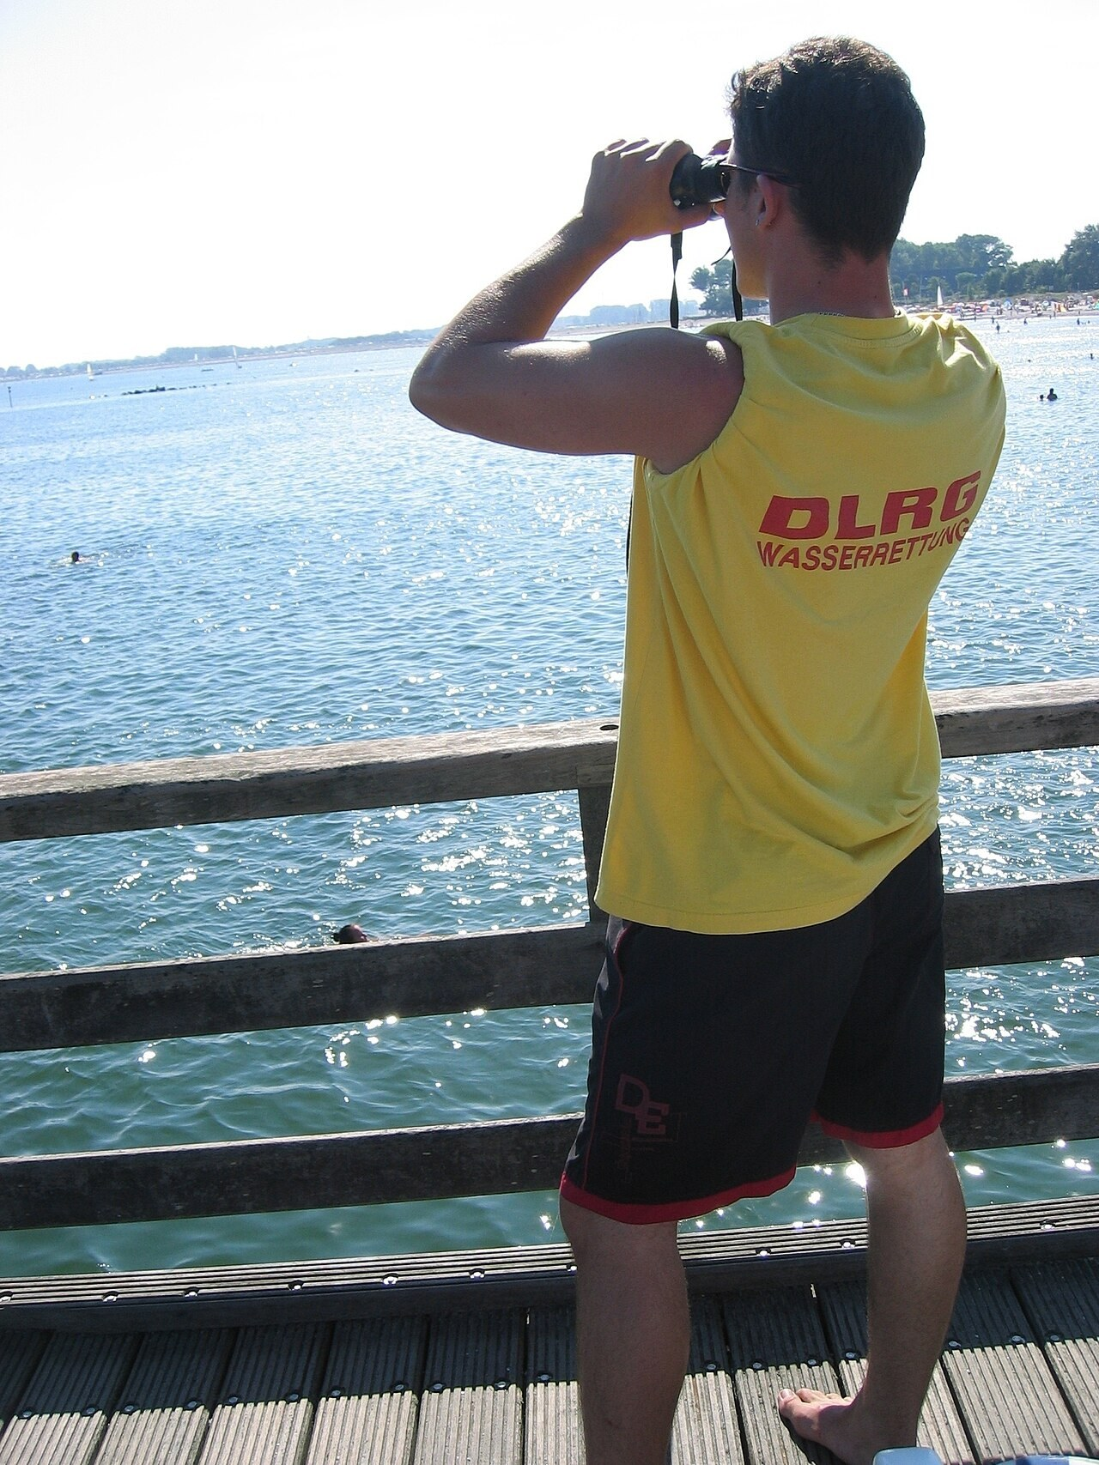
GRADE 10 · LESSON 29
Use of English: Comparatives and Superlatives
Sifatlarning qiyosiy va orttirma darajasi; so‘z yasash
Use of English: Comparatives and superlatives
Alien65 · CC BY-SA 2.5
sozlar.com

Slide 2
LESSON AIMS
Bugungi maqsad
1
Complete four sentences with the comparative or superlative (ex. 1)
2
Complete four key word transformations with no more than five words (ex. 2)
3
Form ten words from the words in capitals in the text «An unusual job» (ex. 3)
4
Compare jobs using as … as, much + comparative and the + superlative

Slide 3
GRAMMAR
Comparatives and superlatives — form
COMPARATIVE (+ than)
SUPERLATIVE (the …)
1
young → younger · big → bigger
the youngest · the biggest
-y
easy → easier · pretty → prettier
the easiest · the prettiest
2+
more / less challenging · more quickly
the most / the least confident
!
good → better · bad → worse · far → further
the best · the worst · the furthest
=
as fast as · not as difficult as
The more you practise, the better you get.
Make the difference stronger with much or far: much easier than, far more interesting than (Grammar database p. 176; Solutions p. 42).

Slide 4
BOOK TASK · 16 MINUTES
Book tasks — Laser B1+, p. 37
Books open, word list closed. Try alone first — then check with Grammar database pp. 175–176.
1
ex.1 — Complete the sentences with the comparative or the superlative of the adjective in brackets.
2
ex.2 — Complete the second sentence with the word given. Do not change it. No more than five words.
3
ex.3 — «An unusual job»: use the word in capitals to form a word for each gap (1–10).
4
Tip for ex.3: noun, adjective or comparative? Plural? Write the answers IN CAPITAL LETTERS.

Slide 5
CHECK AND TEACH · 7 MINUTES
Answer key — Laser B1+, p. 37
1
ex.1 1 easier · 2 more challenging · 3 the most confident · 4 better
2
ex.2 1 the most interesting book · 2 wasn’t as difficult as
3
ex.2 3 more quickly than · 4 less satisfied than
4
ex.3 1 LABOURER · 2 EMPLOYMENT · 3 MAJORITY · 4 BETTER · 5 EASIER
5
ex.3 6 PRETTIEST · 7 ACTIVITIES · 8 ATTRACTIONS · 9 EXPENSES · 10 ENJOYMENT

Slide 6
FOCUS
Qiyosiy va orttirma daraja: qoidalar va tuzoqlar
QOIDA
QOIDA
Qisqa sifat: -er / -est (young → younger → the youngest); -e: late → later; ikkilanish: big → bigger; -y: easy → easier → the easiest.
Uzun sifat va ravishlar: more / the most, less / the least: more challenging, the most confident, more quickly.
Qoidadan tashqari shakllar: good/well → better → the best, bad → worse → the worst, far → further → the furthest.
than — qiyos; much / far kuchaytiradi: much easier than; (not) as … as: not as difficult as I had expected.
Orttirma darajadan keyin: the best in the class / in the world, the busiest day of the week, the most … I have ever read.
Key word transformation: berilgan so‘zni O‘ZGARTIRMANG va 5 so‘zdan oshirmang: (as) → wasn’t as difficult as.

Slide 7
VOCABULARY
A. Comparing jobs (1/2)
😌️
easy
oson
Selling ice cream is easier than working on a building site.
💪️
confident
o‘ziga ishongan
Dilnoza is the most confident speaker in our class.
🥱️
boring
zerikarli
Filling in forms is the most boring part of my mum’s job.
🤓️
interesting
qiziqarli
For me, journalism is more interesting than accounting.
👍️
satisfied
mamnun, qoniqqan
I’m less satisfied with my new timetable than with the old one.

Slide 8
VOCABULARY
A. Comparing jobs (2/2)
☕️
busy
band; gavjum (odam ko‘p)
Friday is the busiest day of the week at the café.
📚️
peaceful
osoyishta, tinch
Working in a library is more peaceful than working in a busy shop.
🏖️
a holiday job
ta’til paytidagi ish
My holiday job was harder than I had expected.
🛒️
a customer
mijoz, xaridor
The customers at the market were friendlier than the ones in town.

Slide 9
VOCABULARY
B. An unusual job (1/3)
🗂️
an occupation
kasb, mashg‘ulot
Teaching is one of the oldest occupations in the world.
⚪️
ordinary
oddiy, odatiy
My job is more ordinary than yours, but I like it.
🦄️
unusual
g‘ayrioddiy, noodatiy
Emma has a more unusual job than her sister.
✋️
a hand model
qo‘l modeli (reklamada qo‘li suratga olinadi)
A hand model takes better care of her hands than most people.

Slide 10
VOCABULARY
B. An unusual job (2/3)
👀️
a surprised stare
hayron nigoh
The most surprised stare came from my grandma when I told her about my new job.
📰️
a magazine ad
jurnaldagi reklama
Her hands appear in more magazine ads than anyone else’s.
🌸️
pretty
chiroyli, go‘zal
Khiva is one of the prettiest towns in Uzbekistan.
💡️
communicate an idea
g‘oyani yetkazmoq (ifoda etmoq)
A good photo can communicate an idea more quickly than a long text.

Slide 11
VOCABULARY
B. An unusual job (3/3)
🏋️
strength
kuch, quvvat
A labourer’s job needs more strength than an office job.
🕊️
freedom
erkinlik
Freelancers have more freedom than office workers.
🧳️
a trip abroad
chet elga safar
This year my dad went on more trips abroad than ever before.
😀️
get satisfaction from
…dan qoniqish hosil qilmoq
Which job do you think people get the most satisfaction from?

Slide 12
VOCABULARY
C. More words to describe jobs (1/2)
😰️
demanding
mashaqqatli, ko‘p kuch talab qiladigan
A pilot’s job is more demanding than a gardener’s.
🤸️
flexible
moslashuvchan, erkin (ish vaqti)
My aunt’s new job has more flexible hours than her old one.
📝️
paperwork
hujjat ishlari, qog‘ozbozlik
Teachers do much more paperwork than they did ten years ago.
🪨️
difficult
qiyin, murakkab
Is a doctor’s job more difficult than a teacher’s?
⚠️
dangerous
xavfli
Mining is one of the most dangerous jobs in the world.

Slide 13
VOCABULARY
C. More words to describe jobs (2/2)
🦺️
safe
xavfsiz
Working in an office is safer than working on a building site.
🎢️
exciting
hayajonli, qiziqarli
Being a reporter is more exciting than I had expected.
🗃️
a heavy workload
og‘ir ish yuki
Nurses usually have a heavier workload than receptionists.
🛠️
a skilled worker
malakali ishchi
An electrician is a more skilled worker than a labourer.

Slide 14
PRONUNCIATION
Say it — don’t just read it
Job words — stress and weak syllables; than is short /ðən/:
occupation
/ˌɒkjuˈpeɪʃn/
satisfied
/ˈsætɪsfaɪd/
peaceful
/ˈpiːsfl/
demanding
/dɪˈmɑːndɪŋ/
flexible
/ˈfleksəbl/
dangerous
/ˈdeɪndʒərəs/
unusual
/ʌnˈjuːʒuəl/
a heavy workload
/ə ˈhevi ˈwɜːkləʊd/
Say it fast: My job is more dangerous /ˈdeɪndʒərəs/ than /ðən/ yours.

Slide 15
WHOLE CLASS
Practice — complete the sentence (1/2)
1
This job is much ________ than my last one. (easy)
2
He’s the ________ confident child I know.
3
Doctors are generally ________ paid than nurses. (well)
4
The exam wasn’t ________ difficult as I had expected.
5
Kim finished her work more quickly ________ everyone else.
6
I am ________ satisfied than I was in my old job. (opposite of more)

Slide 16
WHOLE CLASS
Practice — complete the sentence (2/2)
7
Tashkent is the ________ city in Uzbekistan. (big)
8
That was the ________ day of my life. (happy)
9
The ________ you practise, the better you get.
10
Who lives the ________ from school? (far)

Slide 17
PAIR / GROUP WORK · 5 MINUTES
Vocabulary activity
1
Match the beginnings (1-10) with the endings (a-j).
2
Read your complete sentences aloud.
3
Give the Uzbek meaning of the key word in each sentence.
4
When you finish, swap tables with the other group.

Slide 18
PAIRS · 5 MINUTES
Speaking
Compare two jobs from Unit 4 (for example a plumber and an accountant): which is better paid, more demanding, safer, more interesting?
Superlatives: What is the most useful job, the most dangerous job and the most boring job, in your opinion? Why?
Talk about your own life: the most interesting book you have ever read, the best day of the year, the furthest you have travelled.

Slide 19
TODAY'S WORDS IN CONTEXT
Two summer jobs (1/2)
Last summer my friend Jasur and I both had holiday jobs. I worked in a café, and he helped his uncle, who is a builder. At first I thought my job was much easier than his, but I was wrong.
The café was busier than I had expected, and the customers were less patient than my teachers! Jasur’s job was harder physically, but he said it was more peaceful than mine, because nobody shouted at him.
Cover the word list. Can you understand the words in bold from the sentence?

Slide 20
TODAY'S WORDS IN CONTEXT
Two summer jobs (2/2)
In the end, Jasur was better paid, but I think I had the most interesting summer of all my friends. I met hundreds of people, and the more I talked to them, the more confident I became. My English is not as good as Jasur’s yet — but my coffee is the best in town!
Cover the word list. Can you understand the words in bold from the sentence?

Slide 21
TODAY'S WORDS IN CONTEXT
Read and answer
1
What did the writer think about the café job at first?
2
Why was the café job difficult?
3
Why did Jasur find his job more peaceful?
4
Who earned more money?
5
Find a sentence with ‘the + comparative, the + comparative’.

Slide 22
PAIRS · ESDA QOLDIMI?
Memory check — compare!
Men sifatni aytaman, siz qiyosiy va orttirma darajasini aytasiz.
1
busy → ? → ?
2
safe → ? → ?
3
pretty → ? → ?
4
demanding → ? → ?
5
Office work isn’t … (exciting) as a reporter’s job.

Slide 23
UZ
Qiyin joyi — o‘zbekcha
-er / more — «-roq»: easier — osonroq; the -est / the most — «eng»: the most confident — eng o‘ziga ishongan.
much / far + qiyosiy — «ancha, juda»: much easier — ancha osonroq (✗ very easier).
as … as — «… chalik»: as fast as yours; not as … as — «… chalik emas».
The more …, the better … — «qanchalik ko‘p …, shunchalik yaxshi …».
well (yaxshi — ravish) → better: better paid — yaxshiroq maosh oladigan.

Slide 24
HOMEWORK
Uy vazifasi
1
Laser B1+ Workbook p. 28, ex. 1–3.
2
Learn the 30 items with the flashcards: sozlar.com/vocab/cards/?set=grade10-lesson29
3
Write six sentences comparing two jobs with words from the cards: two with comparatives, two with superlatives, one with as … as and one with less … than.

Slide 25
IMAGE CREDITS
Rasmlar manbasi
cover
Alien65 · CC BY-SA 2.5 · https://commons.wikimedia.org/wiki/File:Deutscher_Rettungsschwimmer.jpg

Slide 26
Uchta so‘z — ertaga ham esingizda qoladi
Juftingizga ayting, so‘ng daftaringizga yozib qo‘ying.
sozlar.com/vocab/cards/?set=grade10-lesson29

