Slide 1
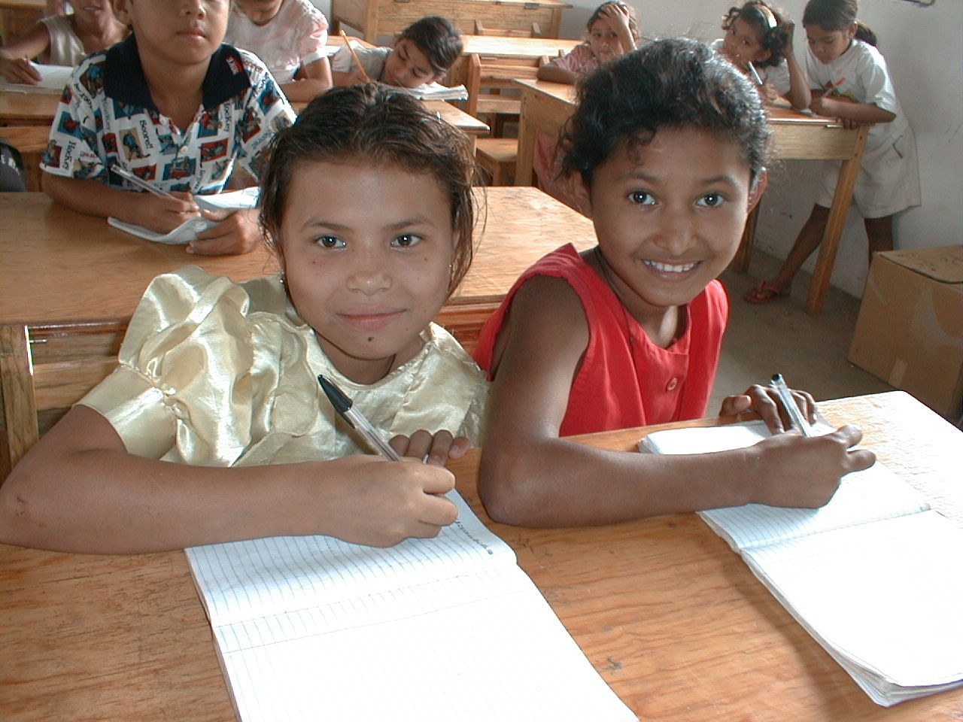
GRADE 8 · LESSON 29
Revision Units 3–4
3–4-bo‘limlar takrori
Revision
Zack Clark · Public domain
sozlar.com

Slide 2
LESSON AIMS
Bugungi maqsad
1
Write the five story types and match six verb patterns (ex. 1–2)
2
Complete a party text with eight words (ex. 3)
3
Choose between the past simple and the past continuous in eight sentences (ex. 4)
4
Choose the imperative, to + verb or -ing in six sentences (ex. 5)

Slide 3
BOOK TASK · 10 MINUTES
Book tasks — Laser A2, p. 40 (vocabulary)
Books open at p. 40, word list closed. Work alone.
1
ex.1 — harflarni tartiblab, beshta hikoya turini yozing (birinchi harf qalin).
2
ex.2 — gap boshlarini (1–6) oxirlari bilan (a–f) moslang: qaysi predlog?
3
ex.3 — «My party»: qutidagi sakkizta so‘zdan birini har bo‘shliqqa yozing.

Slide 4
BOOK TASK · 12 MINUTES
Book tasks — Laser A2, p. 41 (grammar)
Books open at p. 41. Work alone, then compare with a partner.
1
ex.4 — fe’lni past simple yoki past continuous ga qo‘ying (8 gap).
2
ex.5 — to‘g‘ri so‘z yoki iborani tanlang: A, B, C yoki D (imperative, to + verb, -ing).
3
ex.6 — fe’lni present perfect simple ga qo‘ying (6 gap). ever / never qayerda turadi?

Slide 5
CHECK (1/2) · 7 MINUTES IN TOTAL
Answer key — Laser A2, pp. 40–41 (1)
1
ex.1 1 adventure · 2 science fiction · 3 love · 4 ghost · 5 detective
2
ex.2 1 c · 2 f · 3 a · 4 d · 5 e · 6 b
3
ex.3 1 guests · 2 invitations · 3 replies · 4 refreshments · 5 decorations · 6 arrived · 7 presents · 8 tidy
4
ex.5 1 D ask · 2 A to accept · 3 D telling · 4 B to travel · 5 C having · 6 D don't let

Slide 6
CHECK (2/2) · CONTINUED
Answer key — Laser A2, p. 41 (2)
1
ex.4 1 was having · was 2 started · was walking · got 3 were · were … doing
2
ex.4 4 didn't hear · told (was telling ham qabul) 5 was working · called 6 broke · was eating
3
ex.4 7 was listening · went 8 was thinking · saw
4
ex.6 1 have never heard · 2 have you lived · 3 Have you invited
5
ex.6 4 we've met (we have met) · 5 Have you ever said · 6 hasn't eaten (has not eaten)

Slide 7
VOCABULARY
A. Stories and verb patterns (ex. 1–2) (1/3)
🏴‍☠️
an adventure story
sarguzasht hikoya
Treasure Island is a famous adventure story about pirates.
🚀️
a science fiction story
ilmiy-fantastik hikoya
In this science fiction story, people live on Mars.
💕️
a love story
sevgi haqidagi hikoya
My sister cried at the end of the love story.
👻️
a ghost story
arvoh haqidagi hikoya
Grandpa told us a ghost story, and nobody could sleep.

Slide 8
VOCABULARY
A. Stories and verb patterns (ex. 1–2) (2/3)
🕵️
a detective story
detektiv hikoya
In the detective story, a clever woman finds the thief.
🙋️
ask for
(nimanidir) so‘ramoq
I was thirsty, so I asked for a glass of water.
😂️
laugh at
(kimgadir, nimagadir) kulmoq
Everybody laughed at Sardor’s funny drawing.
🌈️
look at
(nimagadir) qaramoq
Look at that beautiful rainbow!

Slide 9
VOCABULARY
A. Stories and verb patterns (ex. 1–2) (3/3)
⚽️
talk about
(nimadir) haqida gaplashmoq
We talked about the football match all evening.
☎️
talk to
(kimdir) bilan gaplashmoq
I was talking to my grandma on the phone when you called.
💭️
think about
(nimadir) haqida o‘ylamoq
I’m thinking about my summer holiday.

Slide 10
VOCABULARY
B. Parties (ex. 3) (1/2)
🧑‍🤝‍🧑
a guest
mehmon
Every guest brought a small present for Bobur.
🥤️
refreshments
yegulik va ichimliklar (mehmonlar uchun)
We’ve got refreshments for thirty guests: juice, sandwiches and fruit.
🎊️
decorations
bezaklar
The paper decorations on the walls looked beautiful.
🚪️
arrive
yetib kelmoq
The first guests will arrive at six o’clock.

Slide 11
VOCABULARY
B. Parties (ex. 3) (2/2)
✉️
an invitation
taklif, taklifnoma
Thanks for the invitation — I’d love to come!
↩️
a reply
javob xati, javob
I sent Kamola an email, but there’s no reply yet.
🎁️
a present
sovg‘a
Thank you for the lovely present!
🥳️
celebrate
nishonlamoq
We always celebrate Navruz with our whole family.

Slide 12
VOCABULARY
C. What happened: story verbs (ex. 4–5) (1/2)
⚡️
suddenly
to‘satdan, birdan
Suddenly, the lights went out and everybody screamed.
💡️
realise
anglamoq, sezib qolmoq
I didn’t realise that my friend was standing behind me.
❌️
make a mistake
xato qilmoq
The waiter made a mistake and brought me fish, not chicken.
🤙️
promise
va’da bermoq
Dad promised to take us to the zoo on Sunday.

Slide 13
VOCABULARY
C. What happened: story verbs (ex. 4–5) (2/2)
🙅️
refuse
rad etmoq, bosh tortmoq
My little brother refused to eat his soup.
🥺️
miss
sog‘inmoq
I really miss playing football with my old friends.
☝️
suggest
taklif qilmoq, maslahat bermoq
Malika suggested going to the park after school.

Slide 14
VOCABULARY
D. Things you have done (p. 37) (1/2)
🦴️
break your arm
qo‘lini sindirib olmoq
Have you ever broken your arm playing football?
✈️
fly on a plane
samolyotda uchmoq
My grandma has never flown on a plane.
🐘️
in real life
haqiqiy hayotda, o‘z ko‘zi bilan
I’ve seen tigers on TV, but never in real life.
🚆️
travel on a train
poyezdda sayohat qilmoq
Have you ever travelled on a train from Tashkent to Samarkand?

Slide 15
VOCABULARY
D. Things you have done (p. 37) (2/2)
⛄️
build a snowman
qordan odam yasamoq
We’ve built a snowman in the school yard!
📺️
be on TV
televizorga chiqmoq
My uncle has been on TV twice — he’s a famous chef.
🦸️
hire a costume
kostyum ijaraga olmoq
I’ve never hired a costume — I always make my own.
🎬️
a theme
mavzu (bazm, kecha mavzusi)
Our class has chosen a theme for the party: ‘Films’.

Slide 16
TODAY'S WORDS IN CONTEXT
The best party I've ever been to (1/2)
I've been to a lot of parties, but the best one was my cousin's birthday last spring. It was a ghost party! Everyone wore white sheets, and we told ghost stories and detective stories in the dark.
My aunt sent invitations to thirty guests, and everybody sent a reply. While the guests were arriving, my cousin and I were putting up decorations — black balloons and paper bats. The refreshments were amazing: 'monster' sandwiches and green juice.
Cover the word list. Can you understand the words in bold from the sentence?

Slide 17
TODAY'S WORDS IN CONTEXT
The best party I've ever been to (2/2)
Suddenly, while we were talking about a scary film, the lights went out. 'Don't move!' shouted my uncle. Nobody laughed at him — we were all a bit frightened! Then the lights came on and there was a huge cake on the table.
I've never seen a cake like that before. I hope to have a party like that one day. Have you ever been to a ghost party?
Cover the word list. Can you understand the words in bold from the sentence?

Slide 18
TODAY'S WORDS IN CONTEXT
Read and answer
1
What kind of party was it?
2
What were the writer and the cousin doing while the guests were arriving?
3
What happened while they were talking about a scary film?
4
Find two present perfect sentences in the text.
5
Find one verb + to and one imperative.

Slide 19
PAIRS · ESDA QOLDIMI?
Memory check — one minute per section
Juftingiz bo‘lim harfini aytadi (A, B, C yoki D), siz bir daqiqada iloji boricha ko‘p so‘z yoki misol aytasiz.
1
A: story types and verb + preposition · B: party words
2
C: story verbs — suddenly, realise, make a mistake; promise / refuse + to; miss / suggest + -ing
3
D: Have you ever …? with five experiences (break your arm, fly on a plane, be on TV …)

Slide 20
FOCUS
Present perfect — ever, never, been (p. 37, p. 41 ex. 6)
• have / has + 3-shakl: I've invited, she's eaten; inkor — haven't / hasn't.
• Vaqt aytilmaydi yoki muhim emas → present perfect: I've been to Samarkand.
• Aniq o‘tgan vaqt (yesterday, last week, in 2024) → past simple: I went there last week.
• ever — savolda, 3-shakldan OLDIN: Have you ever said …? · never — inkor ma’nosi, not kerak emas: I've never heard …
• been to — borib QAYTGAN: He's been to London. (U hozir shu yerda.)

Slide 21
PRONUNCIATION
Say it — don’t just read it
Takror kartalaridagi qiyin so‘zlar — urg‘uga e’tibor bering:
a science fiction story /ə ˌsaɪəns ˈfɪkʃn ˈstɔːri/
a detective story /ə dɪˈtektɪv ˈstɔːri/
refreshments /rɪˈfreʃmənts/
decorations /ˌdekəˈreɪʃnz/
an invitation /ən ˌɪnvɪˈteɪʃn/
realise /ˈrɪəlaɪz/
suggest /səˈdʒest/
a theme /ə θiːm/
theme — th /θ/: til tishlar orasida; realise — urg‘u birinchi bo‘g‘inda: REA-lise.

Slide 22
WHOLE CLASS
Practice — complete the sentence (1/2)
1
Spaceships and robots — I love science ________ stories.
2
Please don't laugh ________ my drawing!
3
We sent invitations and got twenty ________.
4
I was walking home ________ it started to rain.
5
My parents decided ________ buy a new car.
6
Do you remember ________ (meet) him at the party?

Slide 23
WHOLE CLASS
Practice — complete the sentence (2/2)
7
Have you ________ been to Tashkent Zoo?
8
I've ________ eaten Japanese food. I'd like to try it.
9
My brother has ________ his arm twice. (break)
10
'Has your sister ever been to Khiva?' 'No, she ________.'

Slide 24
PAIR / GROUP WORK · OPTIONAL
Vocabulary activity
1
Match the beginnings (1-10) with the endings (a-j).
2
Read your complete sentences aloud.
3
Give the Uzbek meaning of the key word in each sentence.
4
When you finish, swap tables with the other group.

Slide 25
PAIRS · 5 MINUTES
Speaking
Juftingizga Have you ever …? bilan beshta savol bering (see an elephant, fly on a plane, be on TV, build a snowman, break your arm).
Javob: Yes, I have. / No, I haven't. Agar Yes bo‘lsa, past simple bilan qo‘shimcha savol bering: When did you …?
Sinfga ayting: My partner has … but he / she has never …

Slide 26
UZ
Qiyin joyi — o‘zbekcha
Bu dars deyarli YANGI so‘z bermaydi — kartalar 12, 17–24-darslardan; yangisi faqat p. 37 dagi tajriba iboralari (break your arm, fly on a plane, build a snowman, hire a costume, a theme …); ever / never — grammatika.
Present perfect — «…ganman» (tajriba, natija); vaqt aytilsa — past simple: I've been to Bukhara / I went there in May.
ever — «hech (qachon)» savolda; never — «hech qachon …magan», inkor qo‘shimchasiz.
decide / hope / promise / refuse + to; enjoy / miss / suggest / remember + -ing (o‘tganni eslash; remember to — unutmaslik) — fe’l bilan birga yodlang.

Slide 27
HOMEWORK
Uy vazifasi
1
Revise the Units 3–4 grammar (present perfect); write 10 sentences.
2
Learn the 34 items with the flashcards: sozlar.com/vocab/cards/?set=grade8-lesson29
3
Use ever in three sentences and never in three sentences; write four with has / have + past participle.

Slide 28
IMAGE CREDITS
Rasmlar manbasi
cover
Zack Clark · Public domain · https://commons.wikimedia.org/wiki/File:Honduras_San_Ramon_Choluteca_school_6.jpg

Slide 29
Uchta so‘z — ertaga ham esingizda qoladi
Juftingizga ayting, so‘ng daftaringizga yozib qo‘ying.
sozlar.com/vocab/cards/?set=grade8-lesson29

