Slide 1
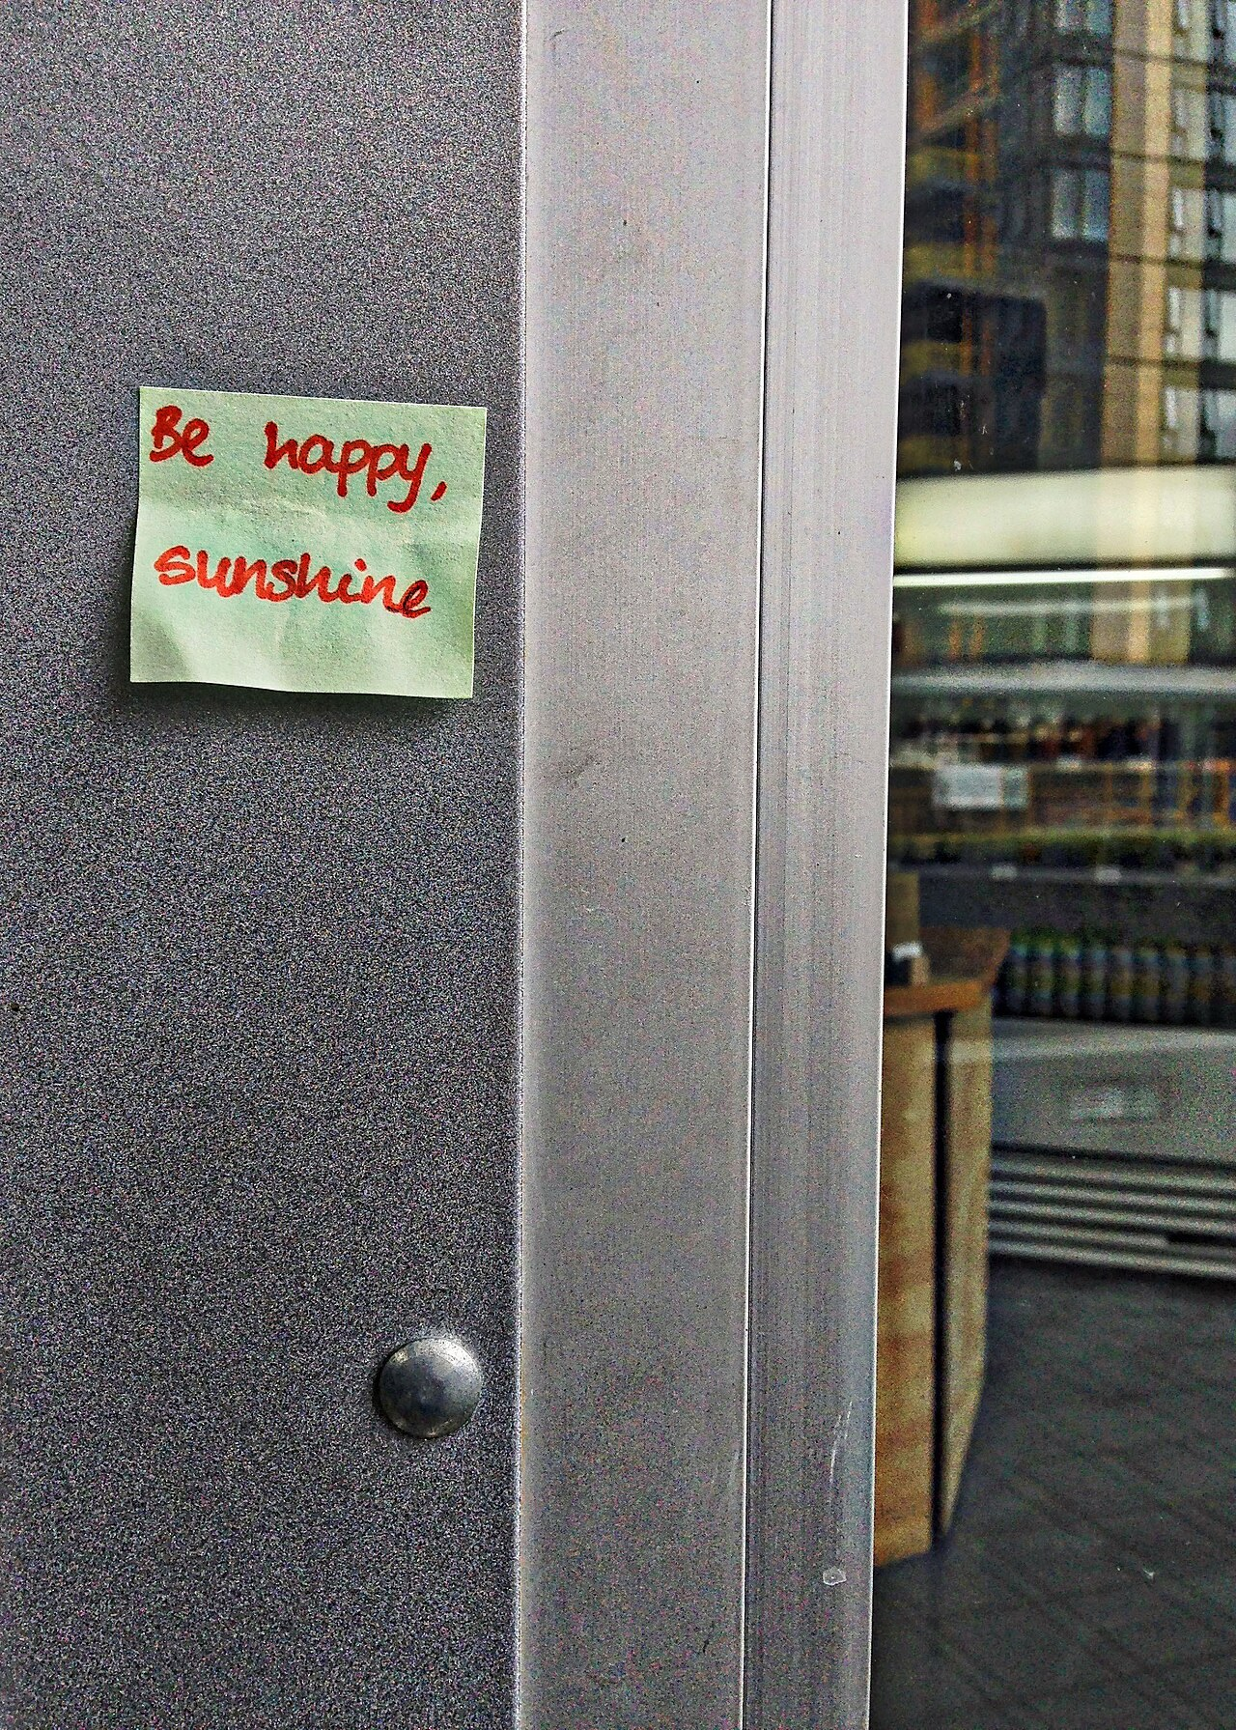
GRADE 8 · LESSON 28
Writing a Note to a Friend
Do‘stga qisqa xat (eslatma) yozish
Writing a note to a friend
Edna Winti · CC BY 2.0
sozlar.com

Slide 2
LESSON AIMS
Bugungi maqsad
1
Answer three KET questions about Katie's note (ex. 1)
2
Match the six parts of a note with their job (ex. 2)
3
Find examples of short sentences, short forms, clear information and can-requests (Language Lab)
4
Write a 50–60 word note to a friend about a party

Slide 3
BOOK TASK · 10 + 6 MINUTES
Book tasks — Laser A2, p. 38
Books open at p. 38, word list closed.
1
ex.1 (KET) — Katie’ning eslatmasini o‘qing va A, B yoki C ni tanlang (3 savol).
2
ex.2 — eslatmaning olti qismini (Dear Grace, … Katie) vazifasi bilan moslang (a–f).
3
Language Lab — to‘rtta qoidaga eslatmadan misol topib, tagiga chizing.
4
Savol — Katie Grace’dan nima iltimos qiladi? Qanday so‘z bilan boshlaydi?

Slide 4
CHECK AND TEACH · 8 MINUTES
Answer key — Laser A2, p. 38
1
ex.1 1 C (Sam doesn't know — I hope no-one's told him) · 2 A (print the invitations) · 3 B (everyone brings their own CDs / MP3 players)
2
ex.2 1 e · 2 b · 3 f · 4 c · 5 d · 6 a
3
Language Lab 1–2: Can you do that? · Thanks! — I'm, no-one's, we'll, don't, I've
4
Language Lab 3: arrive at 7pm at my house, 42 Brown Street · Sam comes at 7.30
5
Language Lab 4: Can you do that? · Can you put that on the bottom of the invitations?

Slide 5
VOCABULARY
A. Notes and messages (1/2)
📝️
a note
qisqa xat, yozma eslatma
I left a note on the kitchen table for Mum.
🚪️
leave a note
xat (yozib) qoldirmoq
Dad wasn’t at home, so I left a note on the door.
🟨️
a sticky note
yopishqoq qog‘ozcha (stiker)
She wrote the phone number on a yellow sticky note.
⏰️
a reminder
eslatma (esga soluvchi xabar)
My phone sends me a reminder about the dentist.
☎️
take a message
(birov uchun) xabarni yozib olmoq
Aziz isn’t here. Can I take a message for him?

Slide 6
VOCABULARY
A. Notes and messages (2/2)
📞️
call (sb) back
qayta qo‘ng‘iroq qilmoq
I’m on the bus now — I’ll call you back later.
🔙️
be back
qaytib kelmoq
Gone to the shop. I’ll be back at six.
🚙️
pick (sb) up
(kimnidir) kelib olib ketmoq
Can you pick me up after football practice?
💌️
give my love to
…ga mendan salom yetkazing
Give my love to your grandparents in Bukhara!

Slide 7
VOCABULARY
B. Katie’s party plans (1/2)
🔔️
remind (sb) about (sth)
(kimgadir biror narsani) eslatmoq
Can you remind me about the test tomorrow?
🗂️
arrange everything
hamma narsani tashkil qilib qo‘ymoq
Don’t worry — my dad has arranged everything for the trip.
🏠️
come over
(uyga) kelmoq, kirib o‘tmoq
Why don’t you come over after school and play chess?
💿️
a CD
kompakt-disk (CD)
My uncle still listens to old CDs in his car.
🎧️
an MP3 player
MP3 pleyer
I listen to songs on my MP3 player on the bus.

Slide 8
VOCABULARY
B. Katie’s party plans (2/2)
🍩️
choose from
(ko‘p narsa ichidan) tanlamoq
The café has lots of cakes to choose from.
✅️
make sure
ishonch hosil qilmoq, albatta …ishini ta’minlamoq
Make sure everybody brings a coat — it’s cold.
🤫️
know about
(biror narsadan) xabardor bo‘lmoq
Grandma doesn’t know about the party yet.
🤞️
hope
umid qilmoq
I hope you can come to my party on Friday.
🤝️
join us
bizga qo‘shilmoq
We’re going to the park — why don’t you join us?

Slide 9
VOCABULARY
C. Writing a good note (1/2)
🎯️
the main point
asosiy masala, asosiy fikr
Each paragraph of the note has one main point.
🗣️
explain
tushuntirmoq
The first paragraph explains why you are writing.
🔍️
clearly
aniq, tushunarli qilib
Write the time and the address clearly.

Slide 10
VOCABULARY
C. Writing a good note (2/2)
✂️
short and simple
qisqa va sodda
A note to a friend should be short and simple.
🙋️
a request
iltimos, so‘rov
‘Can you bring a ball?’ is a friendly request.
😠️
rude
qo‘pol, odobsiz
It’s rude to give orders to your friends.

Slide 11
TODAY'S WORDS IN CONTEXT
A note to Javohir (1/2)
Dear Javohir,
This is just a quick note to remind you about our class picnic on Sunday. I'm so excited! Our teacher doesn't know about the cake — it's a surprise. I hope she likes surprises!
The first thing we need to do is make a list of food. Aziza and I have arranged everything else, but we need you to print the list on your computer. Can you do that? Everyone can meet at the school gate at 10 am.
Cover the word list. Can you understand the words in bold from the sentence?

Slide 12
TODAY'S WORDS IN CONTEXT
A note to Javohir (2/2)
The second thing is games. Why don't we ask everyone to bring a ball or a board game? That way, we'll have lots of games to choose from. Can you please tell the boys? Thanks!
Lots of love,
Lola
Cover the word list. Can you understand the words in bold from the sentence?

Slide 13
TODAY'S WORDS IN CONTEXT
Read and answer
1
What is the note about?
2
What is the surprise for the teacher?
3
What does Lola want Javohir to do first?
4
Where and when will everyone meet?
5
Find two requests with can in the note.

Slide 14
PAIRS · ESDA QOLDIMI?
Memory check — say it in English
Men o‘zbekcha aytaman, siz kartadagi inglizcha iborani ayting.
1
xabarni yozib olmoq → ?
2
qayta qo‘ng‘iroq qilmoq → ?
3
kelib olib ketmoq → ?
4
kimgadir biror narsani eslatmoq → ?
5
qisqa va sodda → ?

Slide 15
FOCUS
Do‘stga eslatma — qanday tuzilgan? (ex. 2, Language Lab)
• 1-qator — kimga: Dear Grace, · Oxiri — xayrlashuv va ism: Lots of love, Katie.
• 1-xatboshi — xat nima haqida va qanday his qilyapsiz: This is just a quick note to … I'm so excited!
• 2- va 3-xatboshi — har birida BITTA asosiy masala: The first thing … / The second thing is
• Do‘stona iltimos — Can you …? (✗ Print the invitations! — bu buyruq, qo‘pol eshitiladi).
• Qisqa va aniq: qisqa gaplar, qisqartmalar (I'm, we'll, don't), aniq vaqt va manzil (7pm, 42 Brown Street).

Slide 16
PRONUNCIATION
Say it — don’t just read it
Darsdagi qiyin so‘zlar — urg‘u qayerda?
note /nəʊt/ — not emas
remind /rɪˈmaɪnd/ — re-MIND
a reminder /rɪˈmaɪndə/ — re-MIN-der
arrange /əˈreɪndʒ/ — a-RANGE
a request /rɪˈkwest/ — re-QUEST
explain /ɪkˈspleɪn/ — ex-PLAIN
clearly /ˈklɪəli/ — CLEAR-ly
rude /ruːd/

Slide 17
WHOLE CLASS
Practice — complete the sentence (1/2)
1
This is just a ________ note to remind you about the concert.
2
Don't forget! Can you ________ me about the meeting tomorrow?
3
The first ________ we need to do is buy the tickets.
4
My mum has ________ everything for the picnic.
5
Mum isn't at home, so I'll ________ a note for her on the fridge.
6
Bring your own songs. That ________, we'll have lots of music.

Slide 18
WHOLE CLASS
Practice — complete the sentence (2/2)
7
'Bring the cake!' is not very friendly. '________ you bring the cake?' is better.
8
'Dilnoza isn't here right now.' 'OK. Can you take a ________? Tell her Aziz called.'

Slide 19
PAIR / GROUP WORK · OPTIONAL
Vocabulary activity
1
Match the beginnings (1-10) with the endings (a-j).
2
Read your complete sentences aloud.
3
Give the Uzbek meaning of the key word in each sentence.
4
When you finish, swap tables with the other group.

Slide 20
PAIRS · 5 MINUTES
Speaking
Juftingiz bilan ziyofat rejasini tuzing: nima haqida, birinchi masala, ikkinchi masala.
Juftingizga uchta do‘stona request ayting: Can you pick me up? Can you call me back? … — u Yes, of course! yoki Sorry, I can't. deb javob beradi.
Eslatmangizni juftingizga o‘qib bering: u har bir main point va request ni ko‘rsatadi.

Slide 21
UZ
Qiyin joyi — o‘zbekcha
a note — qisqa xat, eslatma: odatda do‘stga, xat yoki xabardan qisqaroq.
Can you …? — do‘stona iltimos; buyruq mayli (Help me!) do‘stga qo‘pol eshitiladi.
remind sb about sth — «kimgadir nimanidir eslatmoq»; remember — «eslamoq, yodda tutmoq».
give my love to … — «…ga mendan salom ayt»: Give my love to your mum!; xat oxirida yaqin do‘stga Lots of love, yoziladi.
pick sb up, call sb back — olmosh o‘rtada turadi: pick me up, call you back (✗ call back you).

Slide 22
HOMEWORK
Uy vazifasi
1
Workbook p. 28, ex. 1–2.
2
Learn the 25 items with the flashcards: sozlar.com/vocab/cards/?set=grade8-lesson28
3
Finish your note (50–60 words) and check the six parts.

Slide 23
IMAGE CREDITS
Rasmlar manbasi
cover
Edna Winti · CC BY 2.0 · https://commons.wikimedia.org/wiki/File:2016_366_246_On_the_cafe_door_(29128501790).jpg

Slide 24
Uchta so‘z — ertaga ham esingizda qoladi
Juftingizga ayting, so‘ng daftaringizga yozib qo‘ying.
sozlar.com/vocab/cards/?set=grade8-lesson28

