Slide 1
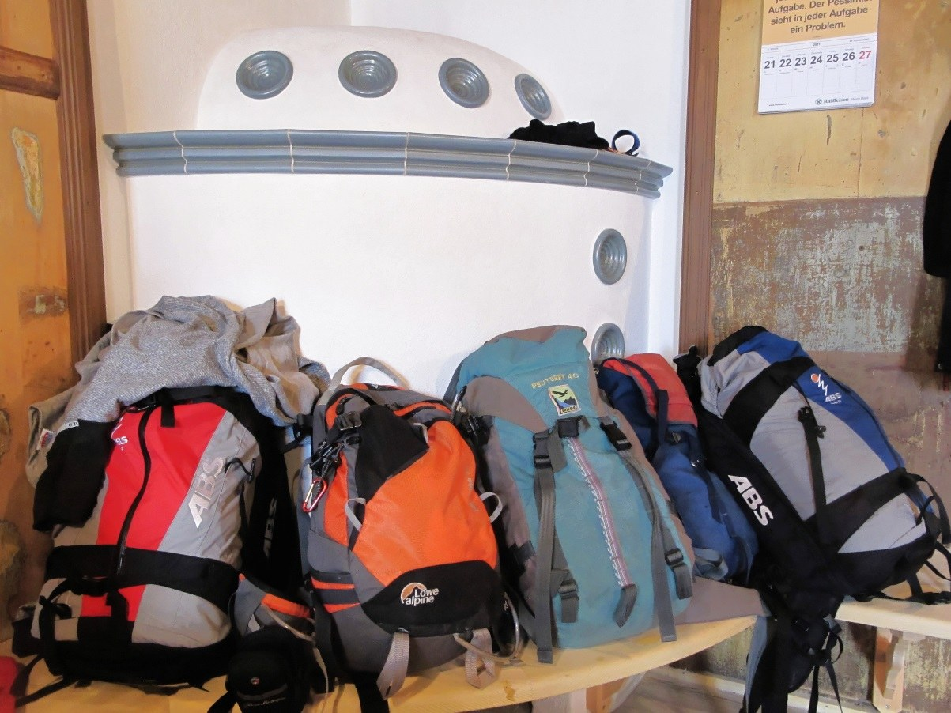
GRADE 7 · LESSON 28
Grammar: too and very
too va very: «juda» va «haddan tashqari»
Grammar: too/very
Bbb · CC BY-SA 3.0
sozlar.com

Slide 2
LESSON AIMS
Bugungi maqsad
1
Decide if eight situations with too or very are positive or negative (p. 37 ex. 1)
2
Write eight answers with too, using their imagination (ex. 2)
3
Rewrite eight sentences with too … (for me) to … (ex. 3)
4
Explain the difference between It’s very hot and It’s too hot

Slide 3
GRAMMAR
Form — Grammar database 8 (p. 148)
FORM
EXAMPLE
very
be + very + adjective
The test is very long — but I can finish it.
very
verb + very + adverb
She walks very slowly — that’s OK.
too
be + too + adjective
The soup’s too hot — I can’t eat it.
too
verb + too + adverb
He talks too fast — I can’t understand him.
too … to
too + adj./adv. + (for sb) + to + verb
The box is too heavy (for me) to carry.
BE CAREFUL! ✗ very hot for me to drink — after very there is no (for me) to ….

Slide 4
BOOK TASK · 13 MINUTES
Book tasks — Laser A1+, p. 37
Books open, word list closed. Read the Look! box first, then try alone.
1
Look! + Use — what is the difference between very difficult and too difficult?
2
ex.1 — positive (P) or negative (N)? Eight sentences.
3
ex.2 — write answers with too. Use your imagination! (1: Because I’m too young.)
4
ex.3 — complete the second sentence using too … (for me) to …
5
Fast finishers — Grammar database 8, p. 148, Quick check 1–5.

Slide 5
CHECK AND TEACH · 7 MINUTES
Answer key — Laser A1+, p. 37
1
ex.1 1 P · 2 N · 3 P · 4 N · 5 N · 6 N · 7 P · 8 P
2
ex.2 (open) 2 too tired / busy · 3 too expensive · 4 too old · 5 too big / small · 6 too difficult · 7 too difficult / boring · 8 too hot
3
ex.3 2 too long (for me) to · 3 too difficult (for them) to · 4 too short (for me) to · 5 too fast (for me) to
4
ex.3 6 too badly (for me) to · 7 too slow (for him) to play · 8 too hot (for me) to
5
Quick check (p. 148) 1 very · 2 noisily · 3 for you to · 4 good · 5 very
6
Ask WHY: is there a problem? → too; good or bad, no problem → very.

Slide 6
FOCUS
too or very? — five rules
QOIDA
QOIDA
very — «juda»: yaxshi ham, yomon ham bo‘lishi mumkin: The book’s very long — I love that!
too — «haddan tashqari», natija yomon (muammo bor): The book’s too long — I can’t finish it.
Ikkalasi ham sifat va ravishdan oldin: too hot, very well, too quickly.
too + sifat + (for me) + to + fe’l: It’s too hot (for me) to sleep.
BE CAREFUL! very … to deyilmaydi: ✗ This tea is very hot for me to drink. → too hot.

Slide 7
VOCABULARY
A. Describing things (1/2)
📏️
long
uzun
Three hours? This film is too long for me.
📦️
heavy
og‘ir
This box is very heavy, but I can carry it.
🪶️
light
yengil (vazni)
My new school bag is very light.
🧩️
difficult
qiyin
The question’s very difficult, but I know the answer.
✅️
easy
oson
This puzzle is too easy for my big brother.

Slide 8
VOCABULARY
A. Describing things (2/2)
🀄️
hard
qiyin, mashaqqatli
Chinese is too hard for me to learn.
🥱️
boring
zerikarli
My sister thinks maths is too boring.
🐢️
slow
sekin (sifat)
His computer is too slow for online games.
💨️
fast
tez
He’s talking too fast — I don’t understand him.

Slide 9
VOCABULARY
B. Weather, time and places (1/2)
🥵️
hot
issiq
It’s too hot — I can’t sleep!
🥶️
cold
sovuq
In March the sea is too cold for swimming.
🌤️
warm
iliq
The water is very warm today — let’s swim!

Slide 10
VOCABULARY
B. Weather, time and places (2/2)
🔦️
dark
qorong‘i
Turn on the light — it’s too dark in here.
🚌️
crowded
odam gavjum
The bus is too crowded — let’s wait for the next one.
🛫️
far
uzoq
The airport is too far to walk to.

Slide 11
VOCABULARY
C. People (1/2)
👶️
young
yosh (yoshi kichik)
I’m too young to have a car.
👵️
old
keksa, qari
Mrs Niles is too old to ski.
😩️
tired
charchagan
After the match I was too tired to do my homework.

Slide 12
VOCABULARY
C. People (2/2)
🧠️
smart
aqlli
Martin is very smart — he writes great articles.
🍽️
hungry
och (qorni och)
I’m very hungry — what’s for lunch?
💪️
strong
kuchli
My dad is very strong: he can carry two big boxes.

Slide 13
VOCABULARY
D. How? — adverbs (1/2)
⚡️
quickly
tez (ravish)
You can read short poems very quickly.
🚶️
slowly
sekin (ravish)
My grandfather walks very slowly.
🔍️
carefully
diqqat bilan, ehtiyotkorlik bilan
Read the questions very carefully.

Slide 14
VOCABULARY
D. How? — adverbs (2/2)
✍️
badly
yomon (ravish)
He writes too badly — I can’t read his handwriting!
🎤️
well
yaxshi (ravish)
Diane writes poems very well.
🥁️
noisily
shovqin solib
You’re eating too noisily!

Slide 15
PRONUNCIATION
Say it — don’t just read it
too /tuː/ and very /ˈveri/ are stressed: It’s TOO hot! It’s VERY good!
difficult
/ˈdɪfɪkəlt/
heavy
/ˈhevi/
tired
/ˈtaɪəd/
crowded
/ˈkraʊdɪd/
hungry
/ˈhʌŋɡri/
carefully
/ˈkeəfəli/
quickly
/ˈkwɪkli/
noisily
/ˈnɔɪzɪli/
Don’t mix too /tuː/ with to /tə/: TOO hot to sleep — /tuː hɒt tə sliːp/.

Slide 16
WHOLE CLASS
Practice — complete the sentence (1/2)
1
This T-shirt is ________ small for me. I can’t wear it. (t…)
2
The film was ________ long, but I loved every minute! (v…)
3
It’s ________ cold to play outside today. Let’s stay at home. (t…)
4
Our English teacher is ________ kind. Everybody likes her. (v…)
5
You’re driving ________ fast! Slow down, please! (t…)
6
The test was ________ difficult, but I got ten out of ten. (v…)

Slide 17
WHOLE CLASS
Practice — complete the sentence (2/2)
7
Dad, I can’t reach the top shelf — I’m ________ short. (t…)
8
Thank you ________ much for your help! (v…)
9
My grandma speaks Russian very ________ (good). (w…)
10
The tea is too hot ________ me to drink. (f…)

Slide 18
PAIR / GROUP WORK · 6 MINUTES
Vocabulary activity
1
Match the beginnings (1-10) with the endings (a-j).
2
Read your complete sentences aloud.
3
Give the Uzbek meaning of the key word in each sentence.
4
When you finish, swap tables with the other group.

Slide 19
PAIRS · 7 MINUTES
Speaking
Excuses game (p. 37 ex. 2): A asks Why don’t you …? (go skiing / learn Chinese / have a car); B answers with too: Because I’m too young.
Very or too? A says a sentence with very (It’s very hot today. / The bus is very crowded.); B adds a result: Great — let’s go swimming! or Oh no — it’s too hot to play football.
Talk about you: Name three things that are too difficult for you and three things you can do very well.

Slide 20
TODAY'S WORDS IN CONTEXT
Why not, Bobur?
Bobur is twelve, and he always has an answer. On Saturday, Grandma has lots of questions.
“Why don’t you go to the park, Bobur?” — “Because it’s too cold, Grandma. It’s too cold to play football.”
“Why don’t you read this book?” — “Because it’s too long. Three hundred pages! It’s too difficult for me to finish.”
“Why don’t you help your dad in the garden?” — “Because I’m too tired. I’m very busy this week.”
Then Grandma says, “OK. I’m making plov for lunch. It’s very good, but maybe it’s too hot for you …”
“No, Grandma!” says Bobur and runs to the kitchen very quickly. “Plov is never too hot for me!”
Cover the word list. Can you understand the words in bold from the sentence?

Slide 21
TODAY'S WORDS IN CONTEXT
Read and answer
1
Why doesn’t Bobur go to the park?
2
Why doesn’t he read the book?
3
Is very busy positive or negative here?
4
What does Grandma make for lunch?
5
Find one sentence with too … to … and one with very + adverb.

Slide 22
PAIRS · ESDA QOLDIMI?
Memory check — too or very?
Men gapni aytaman, siz too yoki very ni qo‘yasiz va sababini aytasiz (yaxshi / yomon).
1
It’s … cold. I can’t go out.
2
My dad is … strong. He can carry me!
3
The bag is … heavy for me to carry.
4
She sings … well.
5
I’m … tired to do my homework.

Slide 23
UZ
Qiyin joyi — o‘zbekcha
very — «juda»: very good «juda yaxshi», very difficult «juda qiyin» (lekin uddalasa bo‘ladi).
too — «haddan tashqari, ortiqcha»: natija yomon. It’s too hot — «Juda issiq (chidab bo‘lmaydi)».
too … to … — «…ish uchun juda …»: too young to drive — «mashina haydash uchun juda yosh».
O‘zbekchada ikkalasi ham ko‘pincha «juda» deb tarjima qilinadi — farqini gap OXIRI ko‘rsatadi: …but I can (very) / …I can’t (too).
Fe’ldan keyin ravish: She sings very well (✗ very good), He runs too quickly.

Slide 24
HOMEWORK
Uy vazifasi
1
Workbook p. 27, ex. 1–3.
2
Learn the 27 items with the flashcards: sozlar.com/vocab/cards/?set=grade7-lesson28
3
Write six sentences about you: three with very (good or bad) and three with too … to …

Slide 25
IMAGE CREDITS
Rasmlar manbasi
cover
Bbb · CC BY-SA 3.0 · https://commons.wikimedia.org/wiki/File:Alps_Wanderrucksäcke.jpg

Slide 26
Uchta so‘z — ertaga ham esingizda qoladi
Juftingizga ayting, so‘ng daftaringizga yozib qo‘ying.
sozlar.com/vocab/cards/?set=grade7-lesson28

