Slide 1
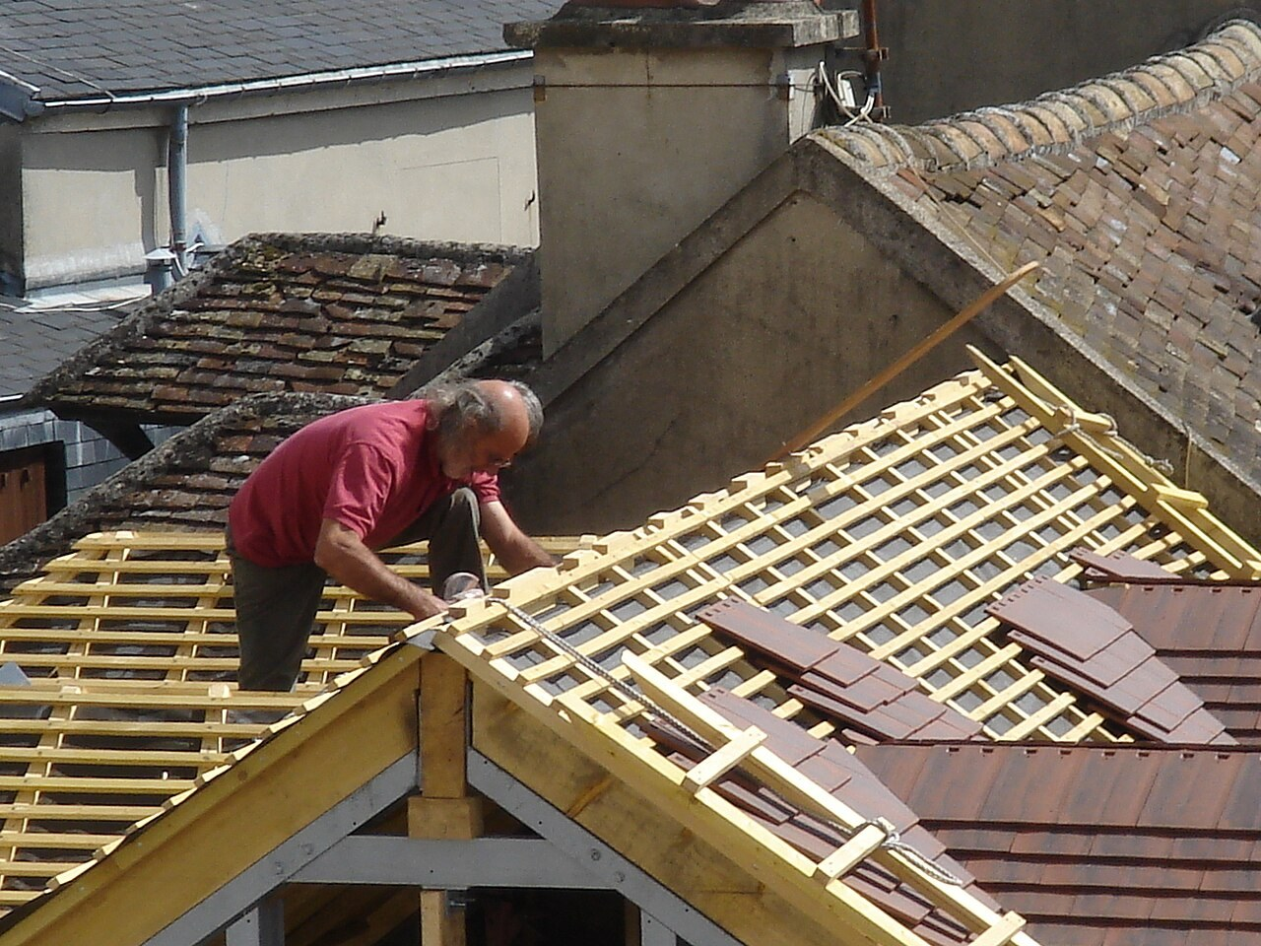
GRADE 10 · LESSON 27
Vocabulary Builder: Occupations
Kasblar, ish hayoti iboralari va -ness, -ment, -tion, -ity qo‘shimchalari
Vocabulary builder: Occupations
Heurtelions · CC BY-SA 3.0
sozlar.com

Slide 2
LESSON AIMS
Bugungi maqsad
1
Match ten jobs with their definitions (ex. 1)
2
Complete five explanations of work expressions with one word (ex. 2)
3
Make ten nouns with the suffixes -ness, -ment, -tion, -ity (ex. 3)
4
Use the new nouns in ten sentences, singular or plural (ex. 4)

Slide 3
BOOK TASK · 15 MINUTES
Book tasks — Laser B1+, p. 35
Vocabulary builder. Books open, word list closed — try alone first.
1
ex.1 — Match the ten jobs in the box with the definitions (This person …).
2
ex.2 — Complete the explanations of the words in bold with ONE word.
3
ex.3 — Word formation: make the words into nouns with -ness, -ment, -tion or -ity. Be careful with spelling.
4
ex.4 — Complete each sentence with a noun from ex.3. You may need the plural.

Slide 4
CHECK AND TEACH · 8 MINUTES
Answer key — Laser B1+, p. 35
1
ex.1 1 labourer · 2 architect · 3 accountant · 4 journalist · 5 civil servant
2
ex.1 6 miner · 7 plumber · 8 civil engineer · 9 electrician · 10 sales rep
3
ex.2 1 work · 2 lose · 3 more / longer · 4 better / higher · 5 stop
4
ex.3 activity, enjoyment, kindness, majority, politeness, employment, attraction, payment, promotion, laziness
5
ex.4 1 activities · 2 employment · 3 majority · 4 politeness · 5 enjoyment
6
ex.4 6 laziness · 7 kindness · 8 promotion · 9 attractions · 10 payment

Slide 5
FOCUS
Word formation: to‘rtta qo‘shimcha va imlo
• -ness — sifatdan ot: kind → kindness, polite → politeness; -y → -i: lazy → laziness.
• -ment — fe’ldan ot: enjoy → enjoyment, employ → employment, pay → payment.
• -tion: attract → attraction; oxiri -e bo‘lsa tushib qoladi: promote → promotion.
• -ity: major → majority; -e tushadi: active → activity.
• Ko‘plik kerak bo‘lishi mumkin: after-school activities, the attractions of a job (ex.4).
• Ish hayoti: be on strike, get the sack, work overtime, be promoted, retire.

Slide 6
VOCABULARY
A. Jobs (1/2)
🧮️
an accountant
buxgalter, hisobchi
My mum works as an accountant in a big hospital.
⚡️
an electrician
elektrik, elektr ustasi
We called an electrician when the kitchen lights stopped working.
🔧️
a plumber
santexnik
A plumber came to fix the pipe under the bathroom sink.
💼️
a sales rep
savdo vakili, savdo agenti
As a sales rep, my uncle visits shops all over the region.
🏛️
a civil servant
davlat xizmatchisi
My aunt is a civil servant at the local tax office.

Slide 7
VOCABULARY
A. Jobs (2/2)
🌉️
a civil engineer
qurilish muhandisi (yo‘l, ko‘prik quruvchi)
Civil engineers designed the new bridge over the river.
🚧️
a labourer
qora ishchi (og‘ir jismoniy mehnat qiluvchi)
Ten labourers were repairing the road outside our school.
⛏️
a miner
konchi, shaxtyor
In Angren many people work as miners in the coal mines.
🚗️
a mechanic
avtousta, mexanik
The mechanic repaired our car in two hours.
🐾️
a vet
veterinar (hayvonlar shifokori)
We took our cat to the vet because it wasn’t eating.

Slide 8
VOCABULARY
B. Life at work (1/2)
✊️
be on strike
ish tashlagan bo‘lmoq (norozilik belgisi sifatida)
The bus drivers are on strike, so we have to walk to school.
📈️
be promoted
lavozimga ko‘tarilmoq
My dad was promoted to manager last year.
🕘️
work overtime
belgilangan vaqtdan ortiq (qo‘shimcha) ishlamoq
Nurses often work overtime when the hospital is busy.
📈️
a pay rise
maosh oshishi
After a year of hard work, she asked her boss for a pay rise.
📦️
get the sack
ishdan haydalmoq
He was always late, so he got the sack after two months.

Slide 9
VOCABULARY
B. Life at work (2/2)
✉️
resign
iste’foga chiqmoq, o‘z xohishi bilan ishdan ketmoq
She resigned because she wanted to start her own business.
👵️
a pension
pensiya (nafaqa)
My grandparents live on their pensions.
🏭️
working conditions
ish sharoitlari
The miners went on strike because of their poor working conditions.
🌻️
retirement
nafaqaga chiqish; nafaqadagi yillar
My grandfather spends his retirement working in the garden.

Slide 10
VOCABULARY
C. Nouns with suffixes (1/2)
🏊️
activity
mashg‘ulot, faoliyat
Swimming is my favourite weekend activity.
😊️
enjoyment
zavq, huzur
Reading gives me a lot of enjoyment.
💝️
kindness
mehribonlik, yaxshilik
Thank you for your kindness — you really helped me.
🗳️
majority
ko‘pchilik
The majority of the class voted for a trip to the mountains.
🎩️
politeness
xushmuomalalik, odob
Saying ‘please’ and ‘thank you’ is a sign of politeness.

Slide 11
VOCABULARY
C. Nouns with suffixes (2/2)
🏢️
employment
ish bilan bandlik, ish
It isn’t easy to find employment in a small village.
🧲️
attraction
jozibali tomon, afzallik
For me, the main attraction of teaching is the long summer holiday.
💳️
payment
to‘lov
You can make the payment by card or in cash.
🏅️
promotion
lavozimga ko‘tarilish
If you work hard, you might get a promotion next year.
🛋️
laziness
dangasalik
His laziness made the whole team angry.

Slide 12
VOCABULARY
D. Getting a job (1/2)
📺️
work in advertising
reklama sohasida ishlamoq
My sister is creative, so she wants to work in advertising.
🤝️
offer someone a job
kimgadir ish taklif qilmoq
The hotel offered him a job as a receptionist.
🎓️
have a degree
diplomga ega bo‘lmoq, oliy ma’lumotli bo‘lmoq
My mother has a degree in economics.

Slide 13
VOCABULARY
D. Getting a job (2/2)
📅️
take a day off
bir kunga ishdan javob olmoq
Dad took a day off to come to my concert.
📌️
notice an advertisement
e’longa ko‘zi tushmoq
My brother noticed an advertisement for a summer job at the bus stop.
📨️
apply for a job
ishga ariza topshirmoq
My cousin has applied for a job at a bank in Tashkent.

Slide 14
PRONUNCIATION
Say it — don’t just read it
Word stress — the capital letters show the stressed syllable:
acCOUNtant
elecTRIcian
PLUMber
/ˈplʌmə/
LAbourer
MIner
maJORity
proMOtion
acTIVity
plumber has a silent b: /ˈplʌmə/. Stress moves: MAjor → maJORity, ACtive → acTIVity.

Slide 15
WHOLE CLASS
Practice — complete the sentence (1/2)
1
A ________ repairs water pipes in houses. (p…)
2
An ________ checks the money a company earns and spends. (a…)
3
The train drivers are on ________, so there are no trains today.
4
He was late every day, so he got the ________.
5
When you work ________, you work more hours than usual.
6
After ten years at the bank, my aunt was ________ to head of department.

Slide 16
WHOLE CLASS
Practice — complete the sentence (2/2)
7
Our neighbours will never forget your ________. (kind)
8
The shop wants the full ________ for the sofa by Friday. (pay)
9
Mum took a day ________ to look after my little brother.
10
After her interview, the bank offered my sister a ________.

Slide 17
PAIR / GROUP WORK · 7 MINUTES
Vocabulary activity
1
Part A — write the correct form of the word in CAPITALS (10 items).
2
Part B — complete each phrase with ONE word.
3
Work alone first, then compare with your partner and check the spelling.

Slide 18
PAIRS · 6 MINUTES
Speaking
Describe a job from ex.1 without saying its name (This person works …). Your partner guesses.
Which job in ex.1 is the most useful, the most dangerous and the best-paid, in your opinion? Why?
Discuss: Is it ever right to go on strike? Would you work overtime for a pay rise? What matters more: good working conditions or a good pension?

Slide 19
TODAY'S WORDS IN CONTEXT
Three jobs in one family (1/2)
In my family nobody has the same job. My dad is a civil engineer: he plans roads and bridges, and he often has to work overtime when a project is late. Last year he was promoted, and the promotion came with a pay rise.
My mum is an accountant in a hospital. She deals with all the payments, and she says the biggest attraction of her job is the friendly team. She has a degree in economics.
Cover the word list. Can you understand the words in bold from the sentence?

Slide 20
TODAY'S WORDS IN CONTEXT
Three jobs in one family (2/2)
My older brother is an electrician. He noticed an advertisement two years ago, and a small company offered him a job. He gets a lot of enjoyment out of his work, but last month he nearly got the sack — he had forgotten an important meeting!
Cover the word list. Can you understand the words in bold from the sentence?

Slide 21
TODAY'S WORDS IN CONTEXT
Read and answer
1
When does the dad have to work overtime?
2
What came with the dad’s promotion?
3
What is the biggest attraction of the mum’s job?
4
How did the brother find his job?
5
Why did he nearly get the sack?

Slide 22
PAIRS · ESDA QOLDIMI?
Memory check — who is it?
Men ta’rifni aytaman, siz kasbni ayting.
1
deals with the water system in buildings → ?
2
works in a government office → ?
3
digs coal or gold from underground → ?
4
designs and builds roads and bridges → ?
5
sells products to businesses → ?

Slide 23
UZ
Qiyin joyi — o‘zbekcha
on strike — «ish tashlash»da; get the sack = be fired — «ishdan haydalmoq»; resign — o‘z xohishi bilan ketish.
work overtime — «qo‘shimcha ishlamoq»; be promoted — «lavozimi oshmoq», ot: a promotion.
-ness sifatga, -ment va -tion ko‘pincha fe’lga qo‘shiladi; -y → -i (lazy → laziness), -e tushadi (active → activity).
civil servant — «davlat xizmatchisi», civil engineer — «qurilish muhandisi»: civil ikkalasida ham «fuqarolik (harbiy emas)» ma’nosida, lekin kasblar butunlay boshqa.
miner («konchi») va minor («kichik; voyaga yetmagan») bir xil talaffuz qilinadi — adashtirmang; plumber da b o‘qilmaydi.

Slide 24
HOMEWORK
Uy vazifasi
1
Laser B1+ Workbook p. 27, ex. 1–2.
2
Learn the 35 items with the flashcards: sozlar.com/vocab/cards/?set=grade10-lesson27
3
Write eight sentences: four about jobs from ex.1 and four with nouns from ex.3 (one with each suffix).

Slide 25
IMAGE CREDITS
Rasmlar manbasi
cover
Heurtelions · CC BY-SA 3.0 · https://commons.wikimedia.org/wiki/File:00486_couvreur.jpg

Slide 26
Uchta so‘z — ertaga ham esingizda qoladi
Juftingizga ayting, so‘ng daftaringizga yozib qo‘ying.
sozlar.com/vocab/cards/?set=grade10-lesson27

