Slide 1
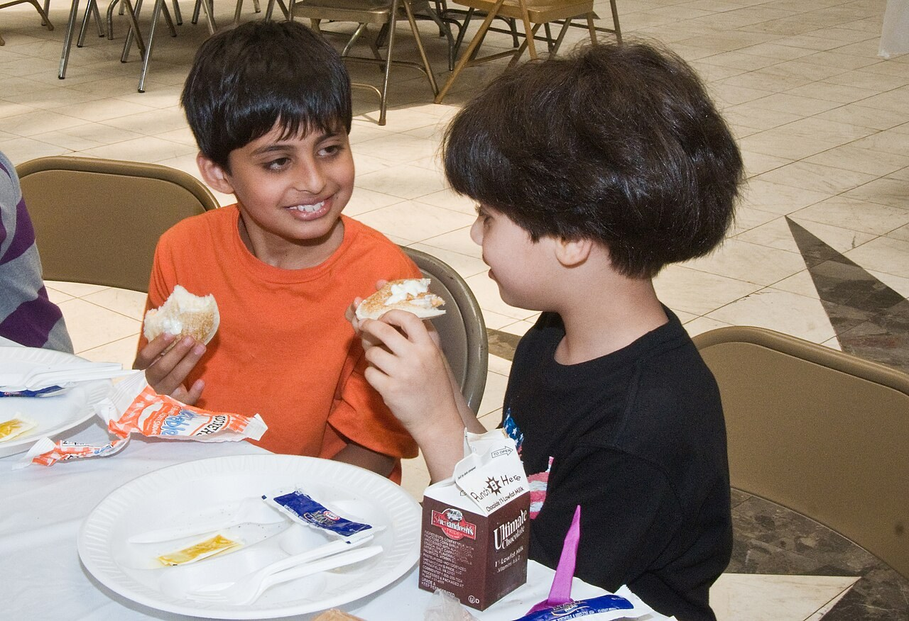
GRADE 8 · LESSON 27
Speaking: Offers and Suggestions
Gapirish: yordam taklif qilish va taklif berish, ularga javob
Speaking: Making and responding to offers and suggestions.
U.S. Department of Agriculture · CC BY 2.0
sozlar.com

Slide 2
LESSON AIMS
Bugungi maqsad
1
Say which events they have been to and which they liked the most (ex. 1)
2
Plan an event in pairs and complete the notes (ex. 2)
3
Make offers (Why don't I …? Shall I …?) and suggestions (Let's ask … to …) and answer them (Phrase Bank)
4
Tell the class about their event and vote (ex. 3)

Slide 3
BOOK TASK · 6 MINUTES
Book tasks — Laser A2, p. 36
Books open at p. 36, word list closed.
1
ex.1 — beshta tadbirdan qaysilariga borgansiz? Belgilang (✓) va qaysi biri ko‘proq yoqqanini ayting.
2
ex.2 dialog — juftlikda o‘qing: Student A va Student B. Taklif qiluvchi gaplar tagiga chizing.
3
Savol — qaysi gap O‘ZI qilishni taklif qiladi (offer), qaysisi BIRGA qilishni (suggestion)?
4
Savol — taklifga qanday javob berildi? Uchta javobni toping.
5
Keyin Phrase Bank ni o‘qing va javoblaringizni tekshiring.

Slide 4
CHECK AND TEACH · 7 MINUTES
Answer key — Laser A2, p. 36 (dialogue)
1
Dialog — offer: Why don't I bring some CDs?
2
Dialog — suggestions: Let's organise a surprise party for our teacher. · We can invite everyone … · We can have the party at school.
3
Dialog — javoblar: Great idea! · Yes, let's do that. · That's a good suggestion.

Slide 5
VOCABULARY
A. Events and parties (1/3)
🥳️
an end-of-year party
o‘quv yili yakuni bazmi
Our class had an end-of-year party in the school garden.
👨‍👩‍👧
a family celebration
oilaviy bayram
Navruz is a big family celebration in our house.
💍️
a wedding reception
to‘y ziyofati, to‘y bazmi
There were three hundred guests at the wedding reception.
🎓️
a school prom
maktab bitiruv kechasi
The older students danced all night at the school prom.

Slide 6
VOCABULARY
A. Events and parties (2/3)
🍢️
a barbecue
ochiq havoda kabob ziyofati
On Sunday we had a barbecue in Grandpa’s garden.
🎭️
a fancy-dress party
kostyumli bazm, maskarad
I went to a fancy-dress party as a pirate.
🏘️
a street party
ko‘cha bayrami
Our neighbours had a street party with music and plov.
🎸️
a music festival
musiqa festivali
Thousands of young people go to the music festival every summer.

Slide 7
VOCABULARY
A. Events and parties (3/3)
🧺️
a picnic
piknik, tabiat qo‘ynida ovqatlanish
Let’s have a picnic in the park after the exams.
🎤️
a talent show
iste’dodlar tanlovi
Why don’t we organise a talent show for the whole school?
🎉️
a fun event
qiziqarli, maroqli tadbir
The sports day was a really fun event for everyone.

Slide 8
VOCABULARY
B. Planning together (1/2)
🤲️
an offer
taklif (yordam berishni taklif qilish)
Thanks for your offer, but I can carry the bag myself.
🙋️
offer to help
yordam berishni taklif qilmoq
Bobur always offers to help when we tidy the classroom.
💡️
a suggestion
taklif, fikr
Nodira made a good suggestion: a picnic by the river.

Slide 9
VOCABULARY
B. Planning together (2/2)
📅️
choose a date
sana (kun) belgilamoq
First we need to choose a date for the party.
🗳️
vote on (sth)
(biror masala) bo‘yicha ovoz bermoq
Let’s vote on the best idea for the class party.
✋️
hands up
qo‘l ko‘taring
Who wants a picnic? Hands up, please!

Slide 10
VOCABULARY
C. Jobs for the party (1/2)
🥤️
buy the drinks
ichimliklarni sotib olmoq
Why don’t I buy the drinks for the picnic?
🥪️
make sandwiches
buterbrod tayyorlamoq
Shall I make sandwiches for the picnic?
🍽️
set the table
dasturxon tuzamoq
Can you help me set the table before the guests arrive?
🧽️
do the washing-up
idish-tovoq yuvmoq
After the party, I’ll do the washing-up with my brother.

Slide 11
VOCABULARY
C. Jobs for the party (2/2)
🎶️
choose the music
musiqani tanlamoq
Let’s ask Javlon to choose the music for the party.
🪑️
carry the chairs
stullarni tashimoq
Shall I carry the chairs into the hall?
🚗️
give (sb) a lift
(kimnidir) mashinada olib borib qo‘ymoq
My dad can give us a lift to the park.
🔊️
a speaker
kolonka (musiqa karnayi)
We need a big speaker for the music.

Slide 12
VOCABULARY
D. Roads and directions (1/2)
🛣️
on the corner
burchakda, muyulishda
The bakery is on the corner of Navoi Street.
🏙️
a street
ko‘cha
My aunt lives on a quiet street in Samarkand.
📍️
near
yaqinida, yonida
The party is at a café near the bus station.
⬇️
come down the road
yo‘l bo‘ylab kelmoq
Come down the road and you will see our school.

Slide 13
VOCABULARY
D. Roads and directions (2/2)
⬅️
on your left
chap tomoningizda
Walk past the bank, and the park is on your left.
↩️
turn left
chapga burilmoq
Turn left at the bank and you’ll see the café.
🚶️
go past
yonidan o‘tib ketmoq
Go past the school, and the shop is on your right.

Slide 14
TODAY'S WORDS IN CONTEXT
The end-of-year party (1/2)
Nodira: The holidays start in two weeks. What event shall we choose for the end of the year?
Sardor: Let's organise a picnic for our class. We can invite everyone in our class — and our teacher too.
Nodira: That's a good suggestion. But how can people get there? The park is quite far.
Sardor: By bus. It's near the bus station, so it's easy.
Nodira: OK. What else do we need to organise? Music? Games?
Sardor: Why don't I bring my speaker and choose the music? And let's ask Javlon to organise some games — he's good at that.
Nodira: Yes, let's do that. And food? What do guests need to bring?
Cover the word list. Can you understand the words in bold from the sentence?

Slide 15
TODAY'S WORDS IN CONTEXT
The end-of-year party (2/2)
Sardor: Everyone can bring one thing — fruit, bread, juice. I can make sandwiches. Shall I write the list?
Nodira: Yes, please. That would be great. Tomorrow we can tell the class and vote on the date!
Cover the word list. Can you understand the words in bold from the sentence?

Slide 16
TODAY'S WORDS IN CONTEXT
Read and answer
1
What event does Sardor suggest?
2
How can people get to the park?
3
What does Sardor offer to bring?
4
Who is going to organise the games?
5
Find one offer and one suggestion in the dialogue.

Slide 17
PAIRS · ESDA QOLDIMI?
Memory check — offer or suggestion?
Men gapni aytaman, siz ayting: offer (o‘zim qilaman) yoki suggestion (taklif)? Keyin javob bering.
1
Why don't I buy the drinks?
2
Let's ask Aziz to choose the music.
3
Shall I carry the chairs?
4
Shall I make sandwiches?
5
Let's have a barbecue in the garden.

Slide 18
FOCUS
Offer va suggestion — Phrase Bank
• Offer — O‘ZIM qilaman: Why don't I bring some CDs? · Shall I …? · I'll … if you like.
• Suggestion — BIRGA yoki BOSHQA odam qilsin: Let's ask David to bring decorations. · Will you …? — iltimos (request): Will you make a cake?
• Why don't I / Shall I / Let's + fe’lning o‘zi (to‘siz): Why don't I bring; lekin ask sb to bring.
• Ha: That's a good suggestion. · Great idea! · Yes, let's do that. · Yes, please. That would be great.
• Yo‘q (muloyim): No, thanks. I can do it. · I'm not sure that's a good idea.

Slide 19
PRONUNCIATION
Say it — don’t just read it
SoundSpot (p. 36): Road yoki Street — urg‘u qayerda?
47 London ROAD
47 LONdon Street
10 Downing ROAD
10 DOWNing Street
The party's at 17 MARket Street. It's near Castle ROAD.
Come down Market ROAD and 22 CAStle Street is on your left.
Street — urg‘u nomda; Road — urg‘u Road da.

Slide 20
SOUNDSPOT · 5 MINUTES
Answer key — Laser A2, p. 36 (SoundSpot)
1
SoundSpot ex.1 1 a (London ROAD) · 2 b (LONdon Street) · 3 a (Downing ROAD) · 4 b (DOWNing Street)
2
Qoida: … Street — urg‘u ko‘cha NOMIDA; … Road — urg‘u ROAD da.

Slide 21
WHOLE CLASS
Practice — complete the sentence (1/2)
1
'________ don't I bring some games?' 'Great idea!'
2
'________ you make a cake for the party?' 'Yes, I will!'
3
Let's ask Malika ________ bring her camera.
4
'We could have it outdoors.' 'That's a good ________.'
5
'Shall I ________ you with the bags?' 'Yes, please.'
6
'Do you want me to wash the cups?' 'No, ________. I can do it.'

Slide 22
WHOLE CLASS
Practice — complete the sentence (2/2)
7
'The park is very far.' 'Don't worry — my dad can ________ us a lift.'
8
Let's vote ________ the date — hands up!
9
Come down Market Road and the café is on your ________.

Slide 23
PAIRS · 11 MINUTES
Speaking
Speaking ex.2: choose an event with your partner (a picnic, a barbecue, a talent show, a street party …) and complete the notes: who to invite, where, how to get there, when, what else, what to bring.
Use at least three offers and three suggestions from the Phrase Bank (Shall I carry the chairs? Let's ask Javlon to choose the music.); answer each one (That's a good suggestion. / Yes, let's do that. / No, thanks …).
Speaking ex.3: tell the class about your event and why it's exciting. Then vote on the party you want to go to!

Slide 24
PAIR / GROUP WORK · 4 MINUTES
Vocabulary activity
1
Match the beginnings (1-10) with the endings (a-j).
2
Read your complete sentences aloud.
3
Give the Uzbek meaning of the key word in each sentence.
4
When you finish, swap tables with the other group.

Slide 25
UZ
Qiyin joyi — o‘zbekcha
Offer — yordam taklifi (o‘zim qilaman): Why don't I …? Shall I …? — «…aymi?», «…sam-chi?».
Suggestion — taklif (birga qilaylik): Let's … — «…aylik».
Great idea! 11-darsda o‘tilgan — Phrase Bankdagi javoblardan biri.
Will you …? — iltimos: «…asizmi?»; ask sb to do — kimdandir biror ishni so‘ramoq.
… Street da urg‘u nomga: DOWNing Street; … Road da Road ga: London ROAD.

Slide 26
HOMEWORK
Uy vazifasi
1
Prepare a dialogue: making and responding to offers (8–10 lines).
2
Learn the 32 items with the flashcards: sozlar.com/vocab/cards/?set=grade8-lesson27
3
Use at least two offers (Why don't I …? / Shall I …?) and two answers (Yes, please. / No, thanks.); add three party jobs from the cards (set the table, carry the chairs …).

Slide 27
IMAGE CREDITS
Rasmlar manbasi
cover
U.S. Department of Agriculture · CC BY 2.0 · https://commons.wikimedia.org/wiki/File:10di1418-0008_-_Flickr_-_USDAgov.jpg

Slide 28
Uchta so‘z — ertaga ham esingizda qoladi
Juftingizga ayting, so‘ng daftaringizga yozib qo‘ying.
sozlar.com/vocab/cards/?set=grade8-lesson27

