Slide 1
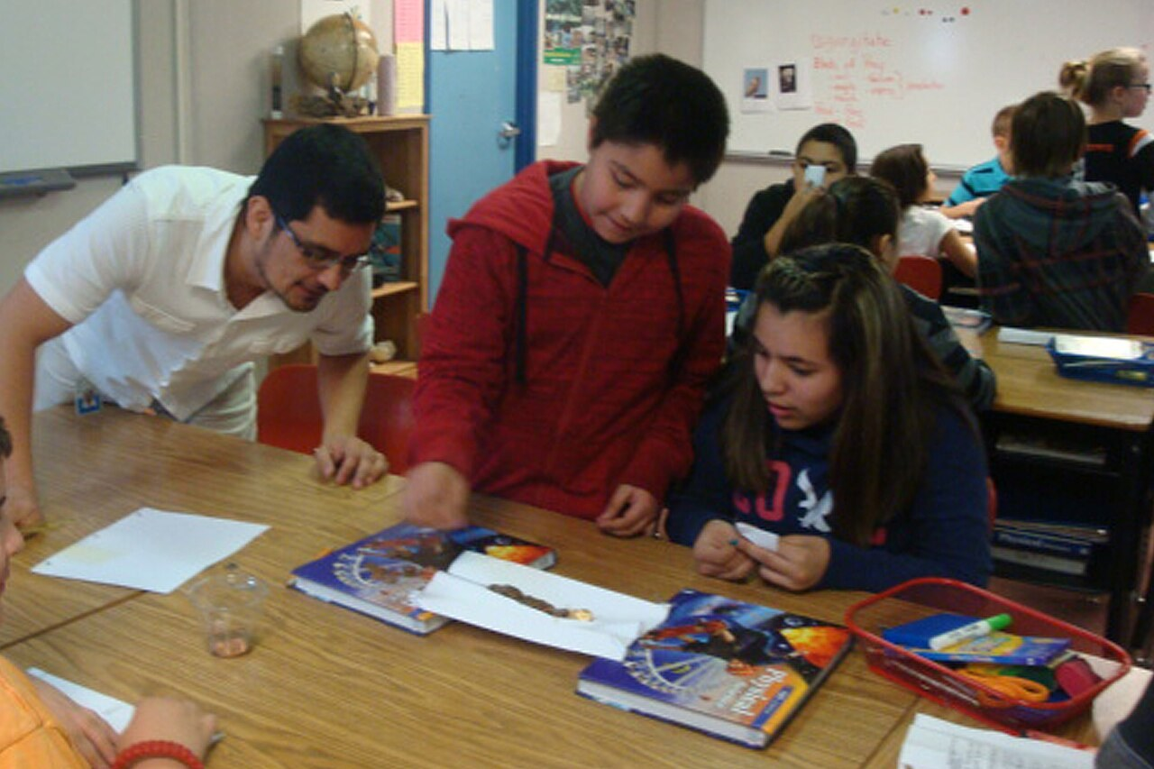
GRADE 7 · LESSON 27
Speaking: Asking and Answering Questions
Gapirish: savol berish va javob qaytarish
Speaking: asking and answering questions
Oregon Department of Transportation · CC BY 2.0
sozlar.com

Slide 2
LESSON AIMS
Bugungi maqsad
1
Complete the interview questions and write three questions of their own (p. 36 ex. 1)
2
Cross out the words we don’t need in six answers (p. 36 ex. 2)
3
Use the Phrase Bank answers: (At) eight o’clock. / In a little village. / Because I love …
4
Interview a partner: short first answer + extra information (p. 36 ex. 3)

Slide 3
BOOK TASK · 5 MINUTES
Book tasks — Laser A1+, p. 36
Books open, word list closed. Try alone first.
1
ex.1 — read the questions in the notebook. Complete Why do you ___? and Which programme do you prefer – ___ or ___?
2
ex.1 — write three questions of your own at the end.
3
ex.2 — cross out the words we don’t need in each answer (1 is done: cross out I’m and years old → Twelve.).
4
Phrase Bank — read the three questions and answers. What is the same in all the answers?

Slide 4
CHECK AND TEACH · 4 MINUTES
Answer key — Laser A1+, p. 36
1
ex.2 1 Twelve. · 2 Zac Efron. · 3 (At) half past seven.
2
ex.2 4 (In) the town centre. · 5 Because it’s fun. · 6 Playing football and (playing) computer games.
3
ex.1 open answers — e.g. Why do you learn English? · Which programme do you prefer – … or …?
4
Phrase Bank the answers are short — only the important part, no repeated words from the question: (At) eight o’clock. / In a little village. / Because I love cycling.
5
Ask WHY: the question word tells you the answer: What time? → a time; Where? → a place; Why? → because.

Slide 5
VOCABULARY
A. About you (1/2)
👶️
be born
tug‘ilmoq
I was born in Namangan, but now I live in Tashkent.
🌱️
grow up
katta bo‘lmoq, ulg‘aymoq
I grew up in a small town near Bukhara.
🗓️
next month
kelasi oy
I’m twelve now, but I’m thirteen next month!

Slide 6
VOCABULARY
A. About you (2/2)
🏷️
a nickname
laqab, erkalatma ism
My name is Abdurahmon, but my nickname is Abdu.
🖌️
an artist
rassom
My favourite artist paints beautiful pictures of the mountains.
🎤️
a pop star
estrada yulduzi
My sister has got posters of her favourite pop star on the wall.

Slide 7
VOCABULARY
B. Free time (1/3)
🍳️
cooking
ovqat pishirish, pazandalik
My brother’s new hobby is cooking — he makes pancakes on Sundays.
🪶️
write poems
she’r yozmoq
My cousin writes poems about nature and the seasons.
🎸️
play the guitar
gitara chalmoq
My brother plays the guitar in a school band.
🎣️
go fishing
baliq oviga bormoq
On Sundays Dad and I go fishing at the lake.

Slide 8
VOCABULARY
B. Free time (2/3)
⛺️
go camping
chodirda dam olishga bormoq
In summer we go camping in the mountains near Chimgan.
🥋️
do karate
karate bilan shug‘ullanmoq
Bekzod does karate three times a week.
🏀️
play basketball
basketbol o‘ynamoq
The tall boys in our class play basketball after school.
🎾️
play tennis
tennis o‘ynamoq
My aunt plays tennis with her friends every Saturday.

Slide 9
VOCABULARY
B. Free time (3/3)
🎶️
sing in a choir
xorda kuylamoq
Madina sings in a choir at the music school.
📮️
collect stamps
pochta markalari yig‘moq
My uncle collects stamps from all over the world.
🎻️
play the violin
skripka chalmoq
Lola plays the violin at the school concert.
💥️
a comic
komiks (rasmli hikoya)
My little brother reads comics about superheroes.

Slide 10
VOCABULARY
C. Films and TV (1/2)
😂️
a comedy
komediya (kulgili film)
This comedy is so funny — we laughed all the time.
🐭️
a cartoon
multfilm
My little sister watches a cartoon every morning.
👻️
a horror film
qo‘rqinchli film
I never watch a horror film before bed.

Slide 11
VOCABULARY
C. Films and TV (2/2)
🏎️
an action film
jangari film
There are lots of car chases in this action film.
💃️
a musical
myuzikl (qo‘shiq va raqsli film)
High School Musical is a musical with lots of songs and dances.
🚀️
a science fiction film
ilmiy-fantastik film
In this science fiction film, people live on Mars.

Slide 12
VOCABULARY
D. Saying what you think
🤩️
exciting
hayajonli, qiziqarli
The football match was really exciting — we won in the last minute!
😱️
scary
qo‘rqinchli, vahimali
That film is too scary for my little brother.
😍️
amazing
hayratlanarli, ajoyib
The view from the top of the mountain is amazing.
😖️
terrible
dahshatli, juda yomon
The weather was terrible, so we stayed at home.

Slide 13
FOCUS
Answering questions — short and natural
• Og‘zaki nutqda birinchi javob odatda qisqa: How old are you? — Twelve. (I’m twelve years old. ham to‘g‘ri, lekin og‘zaki nutqda uzun va rasmiy eshitiladi)
• Qisqa javob savolning so‘roq so‘ziga mos: What time? — (At) eight o’clock. Where? — In a little village. Why? — Because I love cycling.
• Keyin qo‘shimcha ma’lumot bering — suhbat shunda jonlanadi: Twelve. I’m thirteen next month.
• Suhbatni davom ettiring: Really? · Me too! · That’s interesting! · What about you?
• Wh- savolda ovoz oxirida pasayadi ↘: Where do you live? Yes/no savolda ko‘tariladi ↗: Do you live here?

Slide 14
PRONUNCIATION
Say it — don’t just read it
SoundSpot p. 36: listen and repeat the question words. Be careful! It gets faster each time!
Who?
Where?
What?
Why?
When?
How?
Which?
ex.2: whisper the words as fast as you can. Then say them as fast as you can. Then shout them as fast as you can!

Slide 15
WHOLE CLASS
Practice — complete the sentence (1/2)
1
My name is Muhammadali, but everybody calls me Ali — it’s my ________. (n…)
2
Do you like football? — Not ________. I prefer tennis. (r…)
3
Do you prefer tea or juice? — ________! I like them both. (B…)
4
Do you go to the park at the weekend? — It ________. Sometimes I stay at home. (d…)
5
I’m twelve. I’m thirteen next ________! (m…)
6
I collect stamps. — ________? How many have you got? (R…)

Slide 16
WHOLE CLASS
Practice — complete the sentence (2/2)
7
My hobby is ________ — I make soup and salads for my family. (c…)
8
Sorry, can you ________ the question, please? (r…)
9
Let’s watch a ________ tonight — I want to laugh! (c…)
10
What ________ does the lesson start? — At nine. (t…)

Slide 17
PAIR / GROUP WORK · 5 MINUTES
Vocabulary activity
1
Match the beginnings (1-10) with the endings (a-j).
2
Read your complete sentences aloud.
3
Give the Uzbek meaning of the key word in each sentence.
4
When you finish, swap tables with the other group.

Slide 18
PAIRS · 8 MINUTES
Speaking
Laser p.36 ex.3: ask and answer your questions from ex.1. Student B: give a short first answer, then extra information in other sentences.
React to every answer: Really? / Me too! / That’s interesting! Then swap roles.
Report to the class: three things about your partner (Aziz was born in Fergana. He plays basketball. His favourite films are comedies …).

Slide 19
TODAY'S WORDS IN CONTEXT
Meet Diyora — our new classmate! (1/2)
Every month our class newspaper interviews a new pupil. This month it’s Diyora. Here are our questions and her answers.
How old are you? — Twelve. I’m thirteen next month, so please don’t forget my birthday!
Where do you live? — In a little village near the city. I was born in Fergana, but I grew up here. My dad drives me to school every day.
How many brothers and sisters do you have? — Three. Two brothers and a little sister. Our house is never quiet!
Who is your favourite pop star? — Actually, I have two. My favourite Uzbek singer is Shahzoda. I also like Adele.
Cover the word list. Can you understand the words in bold from the sentence?

Slide 20
TODAY'S WORDS IN CONTEXT
Meet Diyora — our new classmate! (2/2)
What do you like doing in your free time? — Drawing. For example, I draw my friends and my cat. — Really? Can you draw us? — Yes, of course!
Which do you prefer, comedies or action films? — Both! But comedies are more fun. Thanks for your time, Diyora!
Cover the word list. Can you understand the words in bold from the sentence?

Slide 21
TODAY'S WORDS IN CONTEXT
Read and answer
1
How old is Diyora?
2
How does she get to school?
3
Why is her house never quiet?
4
What does she like doing in her free time?
5
Find two short first answers and the extra information after them.

Slide 22
PAIRS · ESDA QOLDIMI?
Memory check — make it short!
Men to‘liq javobni aytaman, siz uni qisqa javobga aylantirasiz va bitta qo‘shimcha ma’lumot qo‘shasiz.
1
I was born in Samarkand.
2
I go fishing with my dad on Sundays.
3
My favourite pop star is Shahzoda.
4
I play the guitar because it’s fun.
5
I like comedies because they’re funny.

Slide 23
UZ
Qiyin joyi — o‘zbekcha
Og‘zaki javobda ega va fe’lni tushirib qoldirish mumkin: Where do you live? — In Chilonzor. (o‘zbekchadagi «Chilonzorda» kabi).
Qisqa javobdan keyin qo‘shimcha ma’lumot: Twelve. I’m thirteen next month. — «O‘n ikkida. Kelasi oy o‘n uchga to‘laman».
Really? — «Rostdanmi?», Me too! — «Men ham!», That’s interesting! — «Qiziq ekan!»
Not really. — «Unchalik emas» (muloyim «yo‘q»); It depends. — «Vaziyatga bog‘liq».
Savol tartibi o‘zgarmaydi: What time does it start? (✗ What time it starts?)

Slide 24
HOMEWORK
Uy vazifasi
1
Workbook p. 26, ex. 1–2 (Wordpower). Read the ex. 2 dialogues aloud with a partner.
2
Learn the 28 items with the flashcards: sozlar.com/vocab/cards/?set=grade7-lesson27
3
Interview a family member with six questions from p. 36. Write their short answers and one piece of extra information for each.

Slide 25
IMAGE CREDITS
Rasmlar manbasi
cover
Oregon Department of Transportation · CC BY 2.0 · https://commons.wikimedia.org/wiki/File:Building_Bridges_in_Nyssa_(8638270224).jpg

Slide 26
Uchta so‘z — ertaga ham esingizda qoladi
Juftingizga ayting, so‘ng daftaringizga yozib qo‘ying.
sozlar.com/vocab/cards/?set=grade7-lesson27

