Slide 1
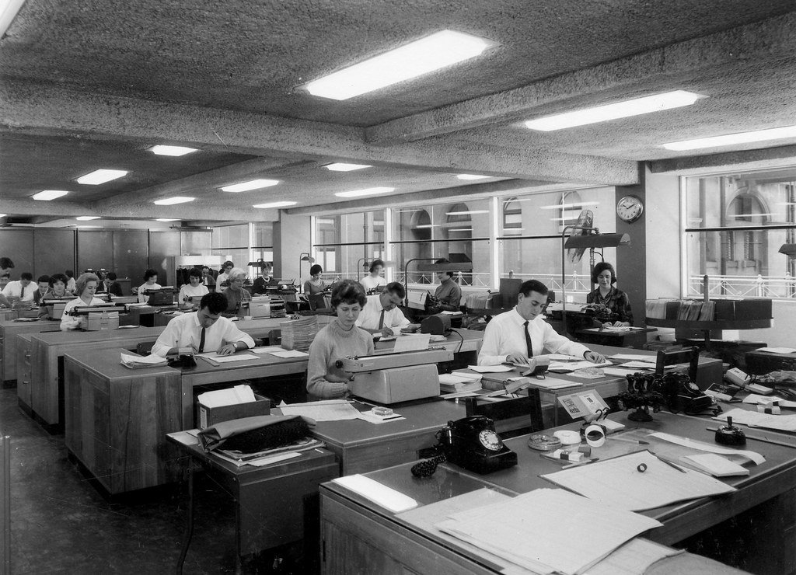
GRADE 10 · LESSON 26
Grammar Clinic: Past Perfect Review
Past perfect simple va continuous takrori
Grammar clinic: Past perfect tense review
Queensland State Archives · PDM 1.0
sozlar.com

Slide 2
LESSON AIMS
Bugungi maqsad
1
Decide if four statements about two past perfect sentences are true or false (ex. 1)
2
Choose the correct tense in five sentences (ex. 2)
3
Correct three mistakes and find the correct sentence (ex. 3)
4
Complete six sentences with the past perfect simple or continuous, including negatives (ex. 4)

Slide 3
GRAMMAR
Form — past perfect simple and continuous
PAST PERFECT SIMPLE
PAST PERFECT CONTINUOUS
+
I/you/he/she/we/they had (’d) worked
I/you/he/she/we/they had been working
−
I hadn’t worked · she hadn’t finished
I hadn’t been working · she hadn’t been sleeping
?
Had you worked …? · How many … had she …?
Had you been working …? · How long had she been …?
time
by the time, before, after, already, as soon as, It was the first time …
for, since, all day, all morning, for months
With after or before the past simple is often possible too: I ate my lunch after my friend left / had left (Grammar database p. 175).

Slide 4
BOOK TASK · 16 MINUTES
Book tasks — Laser B1+, p. 34
Books open, word list closed. Try alone first — then check with Grammar database pp. 174–175.
1
ex.1 — Two sentences, four statements: true (T) or false (F)?
2
ex.2 — Circle the correct tense in each sentence (five sentences).
3
ex.3 — Correct the mistakes. One sentence has no mistakes. Which one?
4
ex.4 — Past perfect simple or continuous: six sentences. You may need a negative form.
5
Tip: ever / never and It was the first time → simple; for months / all day → usually continuous.

Slide 5
CHECK AND TEACH · 7 MINUTES
Answer key — Laser B1+, p. 34
1
ex.1 1: T, T (completed before the main time) · 2: T, F (continuous, not completed)
2
ex.2 1 had been working · 2 had called · 3 had worked · 4 had finished · 5 decided
3
ex.3 1 correct (no mistakes) · 2 had never worked from home
4
ex.3 3 before I had (had) a chance · 4 Dad had been driving all day
5
ex.4 1 had (ever) worked · 2 had already written · 3 had been waiting
6
ex.4 4 had been having · 5 had worked · 6 had been trying

Slide 6
FOCUS
Past simple, past perfect yoki past perfect continuous?
QOIDA
QOIDA
Past perfect simple (had + V3) — o‘tmishdagi asosiy vaqtdan OLDIN tugagan ish: By the time I was 25, I’d had lots of jobs.
Past perfect continuous (had been + -ing) — o‘sha vaqtgacha DAVOM etgan ish: I had been waiting for half an hour when the bus came.
Ketma-ket voqealar — oddiy past simple: He worked as a chef and then decided to apply.
It was the first time, ever / never va holat fe’llari — faqat simple: He had never worked from home. (✗ had never been working)
before + past perfect — ish o‘z vaqtida tugamagan: The boss phoned before I had finished the letter. (= hali tugatmagan edim)
Davomiy ishning o‘sha paytdagi izi (natijasi): He was tired because he had been driving all day.

Slide 7
VOCABULARY
A. Looking for work (1/2)
🗂️
find a job
ish topmoq
By the end of the summer, Aziza had found a job in a café.
⏳️
a part-time job
yarim kunlik ish (to‘liq bo‘lmagan stavka)
Nodir had already had a part-time job in a bookshop, so he knew how to talk to customers.
📢️
a job advert
ish (vakansiya) e’loni
I had seen a job advert online, so I sent in my CV the same day.
📄️
a CV
rezyume (tarjimai hol)
She had checked her CV three times before she sent it to the company.

Slide 8
VOCABULARY
A. Looking for work (2/2)
📮️
send in
(ariza, hujjatni) yubormoq, topshirmoq
By Monday, more than forty people had sent in their applications.
🎤️
a job interview
ishga qabul suhbati (intervyu)
It was the first time Sardor had ever had a job interview, so he was nervous.
🕘️
a full-time job
to‘liq kunlik ish (to‘liq stavka)
Before she got a full-time job at the bank, Kamola had worked part-time for two years.
🧑‍🏫
a training course
o‘quv kursi (malaka oshirish)
Jasur had already done a training course, so he knew how to use the new machines.

Slide 9
VOCABULARY
B. At work and changing jobs (1/3)
🧑‍💼
the boss
boshliq, rahbar
The boss was angry because I hadn’t finished the letter.
🚒️
a fireman
o‘t o‘chiruvchi
My uncle had been a fireman for twenty years when he retired.
📑️
write a report
hisobot yozmoq
Dilshod was tired because he had been writing a report all evening.
🐞️
have problems with
… bilan muammosi bo‘lmoq
Aziz had been having problems with his laptop for weeks, so he bought a new one.

Slide 10
VOCABULARY
B. At work and changing jobs (2/3)
👫️
a colleague
hamkasb
My dad had worked with the same colleagues for fifteen years before he changed jobs.
🌷️
quit your job
ishdan bo‘shamoq (o‘z xohishi bilan)
Nilufar had quit her job at the bank before she opened her flower shop.
🧭️
be in charge of
…ga boshchilik qilmoq, …ga mas’ul bo‘lmoq
Before she moved to Tashkent, Gulnora had been in charge of a team of six nurses.
🗝️
be responsible for
…uchun javobgar bo‘lmoq
For three years Anvar had been responsible for all the computers in the office.

Slide 11
VOCABULARY
B. At work and changing jobs (3/3)
⏱️
a deadline
oxirgi muddat (topshirish muddati)
We had been working late every evening because the deadline was on Friday.
🔑️
the owner
ega, xo‘jayin (do‘kon, firma egasi)
The owner of the café had been looking for a new chef for weeks.
😤️
be fed up with
…dan bezor bo‘lmoq
Bobur had been fed up with the long journey to work for months, so he found a job nearer home.

Slide 12
VOCABULARY
C. A career in films: the stunt double (1/2)
🤸️
a stunt double
kaskadyor (aktyor o‘rniga xavfli sahnalarni ijro etuvchi)
Paul had always wanted to act, but he became a stunt double instead.
🎥️
on set
suratga olish maydonchasida
When I arrived on set, the actors had been working since six in the morning.
✈️
a fighter pilot
qiruvchi samolyot uchuvchisi
Since childhood, Paul had dreamed of becoming a fighter pilot.
🎭️
an extra
ommaviy sahna aktyori (statist)
Before he got his first big role, he had worked as an extra in three films.
🌟️
a role
rol (filmda, spektaklda)
She had played small parts for years before she got the main role.

Slide 13
VOCABULARY
C. A career in films: the stunt double (2/2)
💥️
an action film
jangari film
He had never acted in an action film before, so he trained very hard.
📽️
a director
rejissyor
The director had been watching him for weeks before she offered him a bigger role.
🚀️
take off
(martabasi, ishi) birdan yuksalib ketmoq
After he had won his first prize, his career really took off.
🏅️
win an award
mukofot olmoq (sovrin yutmoq)
By the age of thirty, she had won an award for her photographs.
🩰️
rehearse
repetitsiya qilmoq, (chiqishni) mashq qilmoq
The dancers had been rehearsing for weeks before the big show.

Slide 14
PRONUNCIATION
Say it — don’t just read it
New words — difficult sounds and stress; then weak forms: had and been are short in a sentence:
a colleague
/ˈkɒliːɡ/
rehearse
/rɪˈhɜːs/
a CV
/ˌsiː ˈviː/
be responsible for
/rɪˈspɒnsəbl fə/
be in charge of
/ɪn ˈtʃɑːdʒ əv/
a stunt double
/ˌstʌnt ˈdʌbl/
a fighter pilot
/ˈfaɪtə ˌpaɪlət/
a director
/dəˈrektə/
Say it fast: I’d /aɪd/ been /bɪn/ waiting for an hour. · She’d already left.

Slide 15
WHOLE CLASS
Practice — complete the sentence (1/2)
1
By the time the bus arrived, we had been ________ for forty minutes. (wait)
2
It was the first time I had ________ with such friendly colleagues. (work)
3
The film had already ________ when we got to the cinema. (start)
4
Dad was out of breath because he had been ________. (run)
5
________ the time I arrived on set, the actors had gone home.
6
He had ________ worked from home, so he didn’t know what to expect. (= not ever)

Slide 16
WHOLE CLASS
Practice — complete the sentence (2/2)
7
The boss phoned ________ I had finished the letter. (= it wasn’t finished yet)
8
I hadn’t been doing the job for very ________ when the director noticed me.
9
She had ________ an actor since childhood. (be)
10
As ________ as she had sent in her CV, she started preparing for the interview.

Slide 17
PAIR / GROUP WORK · 5 MINUTES
Vocabulary activity
1
Match the beginnings (1-10) with the endings (a-j).
2
Read your complete sentences aloud.
3
Give the Uzbek meaning of the key word in each sentence.
4
When you finish, swap tables with the other group.

Slide 18
PAIRS · 5 MINUTES
Speaking
Pairs: What had you already done by the time you got to school today? Say three things.
Explain why: Why were you tired / hungry / happy last Friday? Answer with had been + -ing (I had been training all afternoon).
Tell your partner about the first time you did something new (It was the first time I had ever …): a job interview, a training course, a part-time job.

Slide 19
TODAY'S WORDS IN CONTEXT
The day Sardor got the job (1/2)
Last spring my cousin Sardor finally found a job at a hotel in Samarkand. He had been looking for work for almost a year, and he had sent in more than forty CVs. By the time the hotel phoned him, he had almost given up.
On the day of the job interview he arrived early, but the owner had been talking on the phone all morning, so Sardor waited for an hour. He was nervous: it was the first time he had ever had a real interview.
Cover the word list. Can you understand the words in bold from the sentence?

Slide 20
TODAY'S WORDS IN CONTEXT
The day Sardor got the job (2/2)
Luckily, he had prepared well. He had read everything about the hotel, he had done a short training course, and he had been practising his English with me for weeks. When the owner offered him the job, Sardor couldn’t believe it. That evening his face hurt, because he had been smiling all day!
Cover the word list. Can you understand the words in bold from the sentence?

Slide 21
TODAY'S WORDS IN CONTEXT
Read and answer
1
How long had Sardor been looking for work?
2
What had he almost done by the time the hotel phoned?
3
Why did Sardor wait for an hour?
4
Why do we say ‘had ever had’, not ‘had ever been having’?
5
Why did his face hurt that evening?

Slide 22
PAIRS · ESDA QOLDIMI?
Memory check — simple or continuous?
Men gapni boshlayman, siz davom ettirasiz va shaklni tanlaganingiz sababini aytasiz.
1
She was tired because she … a report all night. (write)
2
By the time we arrived on set, the director … (leave)
3
It was the first time he … a job interview. (have)
4
We … for the boss for an hour when he finally came. (wait)
5
He worked as an extra and then … to become a stunt double. (decide)

Slide 23
UZ
Qiyin joyi — o‘zbekcha
Past perfect — «o‘tmishdagi o‘tmish»: Men kelganimda poyezd ketib bo‘lgan edi — the train had left.
had been + -ing — o‘zbekchada ko‘pincha «…ib kelgan edi / …ayotgan edi»: yarim soatdan beri kutayotgan edik.
By the time — «… paytga kelib»: by the time qismida past simple, bosh gapda esa past perfect: By the time I arrived, they had left.
before I had finished — «tugatib ulgurmasimdan»: ish o‘sha paytda hali tugamagan edi.
never / ever va It was the first time bilan davomli shakl ishlatilmaydi.

Slide 24
HOMEWORK
Uy vazifasi
1
Laser B1+ Workbook p. 26, ex. 1–3.
2
Learn the 29 items with the flashcards: sozlar.com/vocab/cards/?set=grade10-lesson26
3
Write six sentences about a busy day you had: three with had + past participle and three with had been + -ing.

Slide 25
IMAGE CREDITS
Rasmlar manbasi
cover
Queensland State Archives · PDM 1.0 · https://www.flickr.com/photos/60455048@N02/25943367857

Slide 26
Uchta so‘z — ertaga ham esingizda qoladi
Juftingizga ayting, so‘ng daftaringizga yozib qo‘ying.
sozlar.com/vocab/cards/?set=grade10-lesson26

