Slide 1
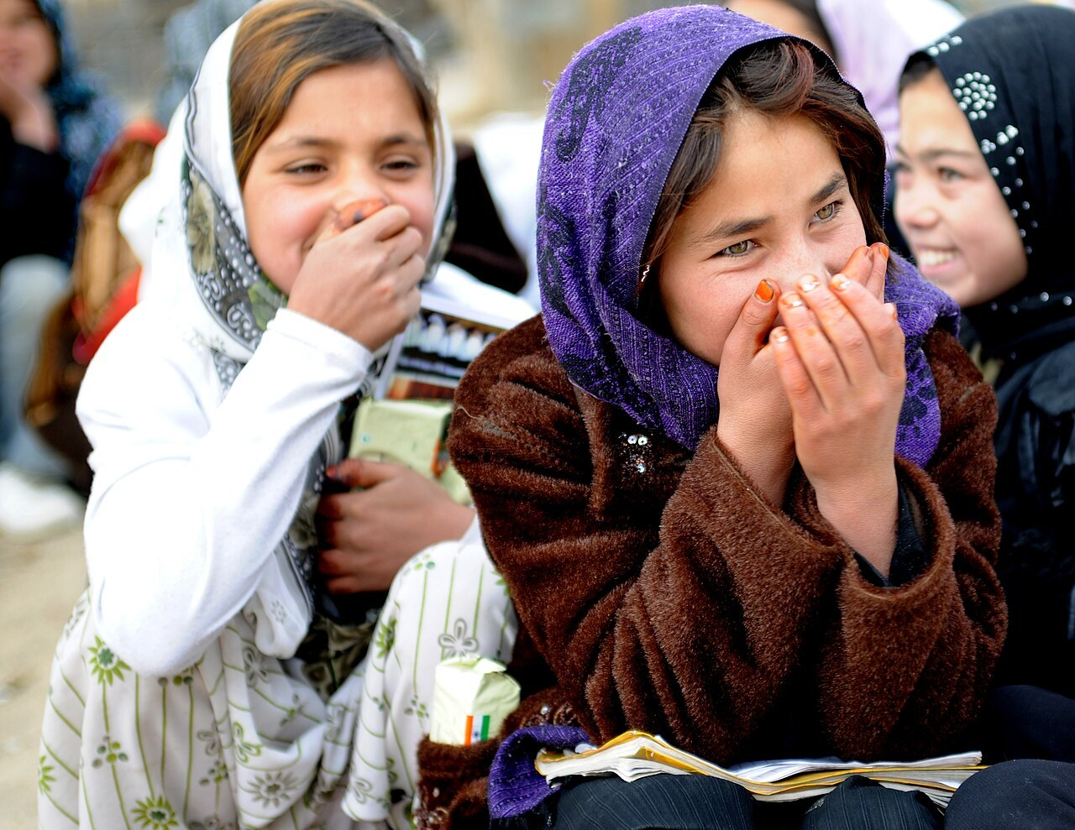
GRADE 8 · LESSON 25
Wordpower! -ed and -ing Adjectives · Present Perfect
Wordpower! -ed va -ing bilan tugaydigan sifatlar · Present perfect
Wordpower!
Sarah R. Webb (U.S. armed forces) · CC BY 2.0
sozlar.com

Slide 2
LESSON AIMS
Bugungi maqsad
1
Choose the correct adjective in six pairs of sentences (ex. 1)
2
Explain the difference: -ing = what something is like, -ed = how someone feels (Be careful!)
3
Form eight words from verbs in capitals in a text (ex. 2)
4
Use the present perfect simple in questions, short answers and a diary text (p. 34 ex. 1–3)

Slide 3
BOOK TASK · 10 MINUTES
Book tasks — Laser A2, p. 35
Books open, word list closed. Read the Be careful! box AFTER ex.1.
1
ex.1 — to‘g‘ri so‘zni tanlang: -ed yoki -ing? (6 gap, 12 ta tanlov).
2
Be careful! — qoidani o‘qing: Peter is amazing / Peter is amazed. Javoblaringizni tekshiring.
3
ex.2 — «How to have the perfect party!»: bosh harfdagi so‘zdan bo‘shliqqa mos so‘z yasang (8 ta).
4
Diqqat — CONFUSE va INTEREST ikki marta, lekin har gal BOSHQA shaklda!

Slide 4
CHECK · 4 MINUTES
Answer key — Laser A2, p. 35
1
ex.1 1 amazing · amazed 2 interesting · interested 3 excited · exciting
2
ex.1 4 frightening · frightened 5 surprised · surprising 6 confusing · confused
3
ex.2 1 excited · 2 frightened · 3 confusing · 4 confused
4
ex.2 5 amazed · 6 surprising · 7 interesting · 8 interested
5
Ask WHY: Is it a feeling (-ed) or what the thing is like (-ing)?

Slide 5
BOOK TASK · 8 MINUTES
Book tasks — Laser A2, p. 34 (Grammar 1)
Present perfect simple. Look at the Look! box sentences from the Ruby–Holly chat first.
1
ex.1 (KET) — to‘g‘ri so‘z yoki iborani tanlang: A, B yoki C (6 gap).
2
ex.2 — rasmga qarang (Patch va Smokey!) va savollarga to‘liq javob yozing: Yes, they have. They've + 3-shakl.
3
ex.3 — 14th March kundaligi: fe’llarni present perfect simple ga qo‘ying, qisqa shakl bilan (8 ta).

Slide 6
CHECK · 4 MINUTES
Answer key — Laser A2, p. 34
1
ex.1 1 B hasn't · 2 A has made · 3 B haven't put · 4 C Has · 5 C decided · 6 B found
2
ex.2 2 Yes, they have. They've stood on the jelly. · 3 No, they haven't. They haven't knocked the cake on the floor.
3
ex.2 4 Yes, they have. They've spilled the drinks. · 5 No, they haven't. They haven't broken the CDs.
4
ex.3 1 've sent · 2 've already had · 3 hasn't sent · 4 've bought
5
ex.3 5 've asked · 6 've forgotten · 7 haven't put up · 8 haven't bought
6
Ask WHY: ex.1 (1) — 'invited' is a past participle → has/hasn't; Leo = he → hasn't (✗ didn't invited).

Slide 7
VOCABULARY
A. The six pairs (ex. 1) (1/2)
🤩️
amazed / amazing
hayratda qolgan / hayratlanarli
The magic show was amazing, and all the children were amazed.
📖️
interested / interesting
qiziqqan / qiziqarli
I’m interested in space, so this book is really interesting for me.
⚽️
excited / exciting
hayajonlangan / hayajonli
The match was exciting, and the fans were very excited.

Slide 8
VOCABULARY
A. The six pairs (ex. 1) (2/2)
⛈️
frightened / frightening
qo‘rqib ketgan / qo‘rqinchli
The storm was frightening, and my little brother was frightened.
😮️
surprised / surprising
hayron qolgan / ajablanarli
The news was surprising, so we were all surprised.
😵‍💫
confused / confusing
boshi qotgan / chalkash
The rules of the game were confusing, so the players got confused.

Slide 9
VOCABULARY
B. More feelings
🤢️
disgusted / disgusting
jirkangan / jirkanch
The old cheese smelt disgusting, and we were all disgusted.
🧘️
relaxed / relaxing
xotirjam, bo‘shashgan / orom beradigan
The music was very relaxing, and soon everyone felt relaxed.
🦕️
fascinated / fascinating
maftun bo‘lgan / maftunkor, juda qiziq
The museum was fascinating, and the children were fascinated by the dinosaurs.
👻️
terrified / terrifying
dahshatga tushgan / dahshatli
The ghost film was terrifying, and I was terrified.

Slide 10
VOCABULARY
C. Word families (ex. 2) (1/2)
✨️
amaze
hayratga solmoq
My grandmother amazes me — she can speak four languages.
😲️
amazement
hayrat
She looked at the present in amazement.
🎢️
excitement
hayajon
I couldn’t sleep the night before my birthday because of the excitement.
😱️
frighten
qo‘rqitmoq
Don’t shout — you’ll frighten the baby.

Slide 11
VOCABULARY
C. Word families (ex. 2) (2/2)
❓️
confuse
chalkashtirmoq, boshini qotirmoq
Long instructions always confuse me.
🔀️
confusion
chalkashlik, tushunmovchilik
There was some confusion about the time of the party.
🎉️
a surprise
kutilmagan voqea, syurpriz
The new bike was a big surprise for my brother.
💔️
disappointment
hafsala pir bo‘lishi, umidsizlik
To our disappointment, the concert was cancelled.

Slide 12
VOCABULARY
D. Parties and plans (1/2)
💍️
a wedding
to‘y (nikoh to‘yi)
My cousin’s wedding is next month.
🏴‍☠️
a costume
karnaval libosi, maxsus kiyim
He wore a pirate costume to the school concert.
🦸️
dress up
karnaval libosini kiymoq; yasanmoq
On the last day of term we dress up as cartoon characters.
🎃️
a Halloween party
Xellouin ziyofati
At a Halloween party people often wear scary masks.
🎣️
a fishing rod
qarmoq
Grandpa gave me a fishing rod for my birthday.

Slide 13
VOCABULARY
D. Parties and plans (2/2)
🧭️
directions
yo‘l-yo‘riq (qanday borishni tushuntirish)
Can you give me directions to your house?
📝️
make a list
ro‘yxat tuzmoq
Before you go shopping, make a list.
🙃️
go wrong
chappasiga ketmoq (ish buzilmoq)
Everything went wrong: the cake fell and the lights went out.
🏆️
a success
muvaffaqiyat
The school concert was a big success.

Slide 14
VOCABULARY
E. What have the pets done? (p. 34)
✂️
rip
yirtmoq
Oh no! The cat has ripped the paper decorations.
🍮️
jelly
jele (mevali shirinlik)
For dessert we had strawberry jelly with ice cream.
🏺️
knock over
turtib ag‘darib yubormoq
Someone has knocked over the vase, and there’s water everywhere.
👟️
stand on
ustiga bosib olmoq
Oh no! The dog has stood on my new glasses!

Slide 15
TODAY'S WORDS IN CONTEXT
My cousin's surprising wedding (1/2)
Last month my cousin Dilshod got married. I was really excited about the wedding because it was my first wedding.
The day started badly. The directions to the restaurant were confusing and my dad got confused too, so we arrived late. Mum was worried and a little annoyed.
But the evening was amazing. The music was exciting, the food was great and the dancing never stopped. Then the lights went out — a frightening moment for the little children!
Cover the word list. Can you understand the words in bold from the sentence?

Slide 16
TODAY'S WORDS IN CONTEXT
My cousin's surprising wedding (2/2)
It was a surprise: Dilshod's friends came in with a huge cake covered in candles. Everybody was surprised, and the bride looked at it in amazement. In the end, the wedding was a big success and nobody felt bored for a minute.
Cover the word list. Can you understand the words in bold from the sentence?

Slide 17
TODAY'S WORDS IN CONTEXT
Read and answer
1
Why was the writer excited?
2
Why did the family arrive late?
3
Who was frightened when the lights went out?
4
What was the surprise?
5
Find three -ed adjectives in paragraph 2.

Slide 18
PAIRS · ESDA QOLDIMI?
Memory check — -ed or -ing?
Men vaziyatni aytaman, siz to‘g‘ri sifatni aytasiz.
1
The old milk smelt really … (disgust)
2
The rollercoaster was … (terrify)
3
I didn't understand the map. It was … (confuse)
4
We won the cup! We were … (excite)
5
He speaks six languages! He's … (amaze)

Slide 19
GRAMMAR · LOOK! AND USE
Present perfect simple — rule (p. 34)
1
Form: have / has + past participle — I've invited · she has made · they haven't put.
2
Question: Have you sent the invitations? — Yes, I have. / No, I haven't.
3
Use: the PRESENT result of a past action — I've bought snacks = I have snacks now.
4
Past simple = the past action is important: I bought snacks yesterday (no have, a finished time).
5
already (before the verb) · just (before the verb) · yet (end of questions and negatives).

Slide 20
FOCUS
-ed yoki -ing? Ikki savol (Be careful!, p. 35)
• Bu narsa/odam QANDAY? → -ing: The film was boring. (film — zerikarli)
• Odam o‘zini QANDAY HIS QILADI? → -ed: I was bored. (men — zerikdim)
• Odam ham -ing bo‘lishi mumkin: Peter is amazing = Peter boshqalarni hayratga soladi.
• Ko‘pincha: be/feel/get + -ed; -ed + predlog: interested IN, excited ABOUT, frightened OF.
• So‘z yasash: fe’l → -ed / -ing sifat, -ment ot: amaze → amazed / amazing / amazement.

Slide 21
PRONUNCIATION
Say it — don’t just read it
-ed sifatlarda oxirgi tovush:
amazed /əˈmeɪzd/
confused /kənˈfjuːzd/
frightened /ˈfraɪtnd/ — gh o‘qilmaydi
relaxed /rɪˈlækst/
interested /ˈɪntrəstɪd/
excited /ɪkˈsaɪtɪd/
disgusted /dɪsˈɡʌstɪd/
fascinated /ˈfæsɪneɪtɪd/
/d/ — amazed, confused; /t/ — relaxed; t yoki d dan keyin -ed alohida bo‘g‘in /ɪd/: IN-te-res-ted (in-te-res-TED emas), dis-GUS-ted.

Slide 22
WHOLE CLASS
Practice — complete the sentence (1/2)
1
The trip to the mountains was ________ — I loved every minute. (amazed / amazing)
2
I was so ________ that I couldn't sleep before my birthday. (excited / exciting)
3
Are you ________ in football? (interested / interesting)
4
The ghost story was really ________. (frightened / frightening)
5
We were ________ to see snow in April. (surprised / surprising)
6
This homework is ________ — I don't understand it. (confused / confusing)

Slide 23
WHOLE CLASS
Practice — complete the sentence (2/2)
7
Our team lost the final 0–3 — what a big ________! (DISAPPOINT)
8
The children watched the fireworks in ________. (AMAZE)
9
Have you tidied your room ________? — No, not now, Mum!
10
No, thanks — I've ________ had lunch. I'm not hungry.
11
'Has Nodira sent the invitations?' 'Yes, she ________.'

Slide 24
PAIR / GROUP WORK · 6 MINUTES
Vocabulary activity
1
Match the beginnings (1-10) with the endings (a-j).
2
Read your complete sentences aloud.
3
Give the Uzbek meaning of the key word in each sentence.
4
When you finish, swap tables with the other group.

Slide 25
PAIRS
Speaking
Juftingizga ayting: the most exciting / relaxing / frightening day of your life — va o‘zingizni qanday his qildingiz?
«How did you feel?» o‘yini: biri voqeani aytadi (The lights went out), ikkinchisi -ed sifat bilan javob beradi (I was frightened).
Oxirgi ziyofat yoki to‘yni uchta juft sifat bilan tasvirlang.

Slide 26
UZ
Qiyin joyi — o‘zbekcha
-ing sifat — sabab, ta’sir qiluvchi: a relaxing holiday — «orom beradigan ta’til».
-ed sifat — his-tuyg‘u: I’m relaxed — «xotirjamman». O‘zbekchada ikkalasi ham bitta so‘z bo‘lishi mumkin, inglizchada — yo‘q!
I’m disgusting — «men jirkanch odamman»: ehtiyot bo‘ling!
interested IN, excited ABOUT, frightened OF — predlog bilan yodlang.
Present perfect — o‘tgan ishning HOZIRGI natijasi: I’ve bought snacks — «gazak oldim (hozir bor)». Aniq vaqt (yesterday, last week) bo‘lsa — past simple.

Slide 27
HOMEWORK
Uy vazifasi
1
Exercises 2–4 on pages 24–25 of the Workbook.
2
Learn the 31 items with the flashcards: sozlar.com/vocab/cards/?set=grade8-lesson25 — especially section B (more -ed / -ing pairs), which we did not do in class.
3
Write six sentences about a party, a wedding or a holiday with three -ed / -ing pairs.

Slide 28
IMAGE CREDITS
Rasmlar manbasi
cover
Sarah R. Webb (U.S. armed forces) · CC BY 2.0 · https://commons.wikimedia.org/wiki/File:Afghan_girls_from_Ghazni_province.jpg

Slide 29
Uchta so‘z — ertaga ham esingizda qoladi
Juftingizga ayting, so‘ng daftaringizga yozib qo‘ying.
sozlar.com/vocab/cards/?set=grade8-lesson25

