Slide 1
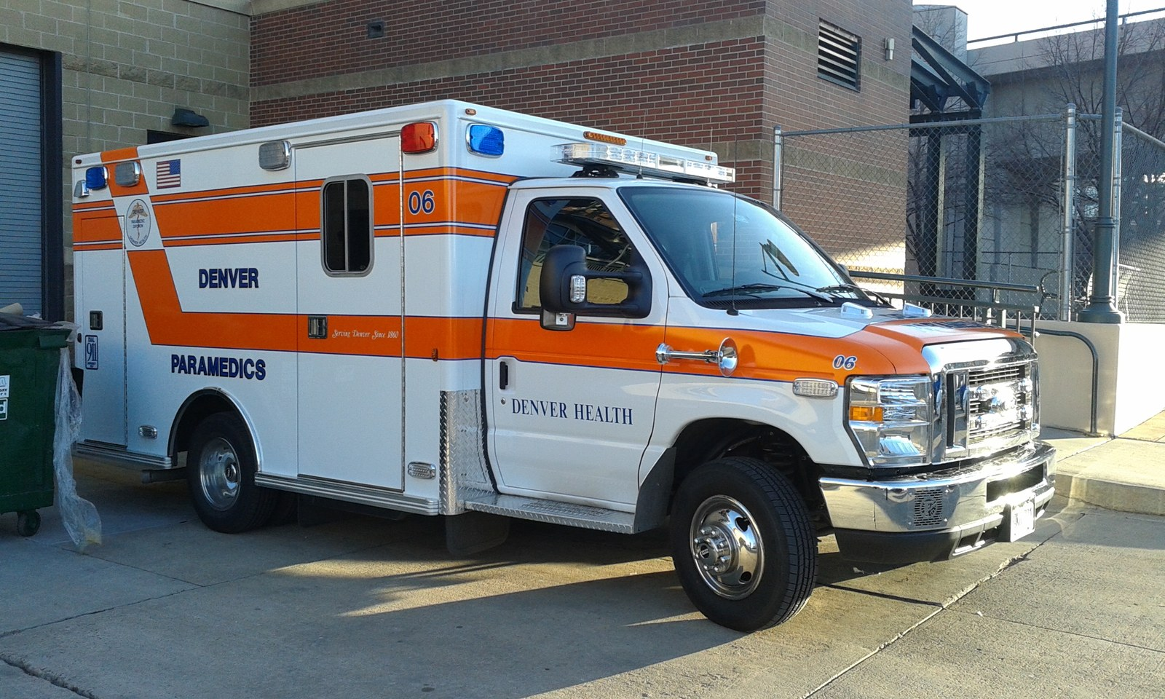
GRADE 10 · LESSON 25
Word Box: Jobs
Xnatedawgx · CC BY-SA 4.0
Word Box: kasblar va ish dunyosi
Word box: Jobs
sozlar.com

Slide 2
LESSON AIMS
Bugungi maqsad
1
Complete seven Word box definitions from the first letter (ex. 4)
2
Name twelve jobs and describe them with repetitive, varied, tiring, badly paid
3
Form ten words from the same word family (worksheet Part A)
4
Discuss the Have your say! questions and find an ideal job for a partner

Slide 3
BOOK TASK · EX.4 (1–4)
Word box — Laser B1+, p. 33, ex. 4 (1–4)
Use words or phrases from the article. The first letter is given.
1
The amount of money you get paid every year to do a job is called your s________.
2
An a________ f________ is something you fill in when you apply for a job.
3
If a company pays your e________, they pay for taxis, meals, travel, etc.
4
When you write a letter to apply for a job, you apply i________ w________.

Slide 4
BOOK TASK · EX.4 (5–7)
Word box — Laser B1+, p. 33, ex. 4 (5–7)
Use words or phrases from the article. The first letter is given.
5
A person applying for a job is called an a________.
6
Work which you do for a charity and which you don’t get paid for is called v________ w________.
7
The s________ are all the people who work for a company.

Slide 5
VOCABULARY
A. Word box (p. 33 ex. 4) (1/2)
💵️
a salary
maosh (oylik yoki yillik ish haqi)
My aunt earns a good salary as a pilot.
📝️
an application form
ariza blanki (anketa)
Send the application form to the school by Friday.
✏️
fill in
(anketani) to‘ldirmoq
Please fill in your name and address in capital letters.
🧾️
expenses
(ish bilan bog‘liq) xarajatlar
The company pays all my expenses when I travel for work.

Slide 6
VOCABULARY
A. Word box (p. 33 ex. 4) (2/2)
✉️
apply in writing
yozma ravishda ariza bermoq
You must apply in writing — phone calls are not accepted.
🙋️
an applicant
nomzod, ariza beruvchi
There were fifty applicants for the job at the hotel.
🐶️
voluntary work
ko‘ngillilik ishi (haq to‘lanmaydigan)
I do voluntary work at an animal shelter on Saturdays.
👥️
the staff
xodimlar (butun jamoa)
All the staff at this hotel are friendly and helpful.

Slide 7
VOCABULARY
B. Jobs (1/3)
📐️
an architect
me’mor
An architect designed our new sports centre.
⚖️
a solicitor
yurist (huquqiy maslahatchi)
We asked a solicitor to check the contract for our new flat.
🛎️
a receptionist
qabulxona xodimi
The receptionist at the hotel gave us our keys.
🛍️
a sales assistant
sotuvchi (do‘konda)
The sales assistant helped me find the right size.

Slide 8
VOCABULARY
B. Jobs (2/3)
🚑️
a paramedic
tez yordam xodimi
Two paramedics arrived in the ambulance in five minutes.
💻️
a programmer
dasturchi
My brother is a programmer — he writes apps for banks.
🧳️
a travel agent
turagent, sayohat agenti
A travel agent booked our flights and hotel in Istanbul.
💇️
a hairdresser
sartarosh
I go to the hairdresser once a month.

Slide 9
VOCABULARY
B. Jobs (3/3)
🍽️
a waiter
ofitsiant
The waiter brought us the menu and some green tea.
🧱️
a builder
quruvchi
The builders are working on a new school in our street.
🧑‍🍳
a chef
oshpaz (restoran oshpazi)
The chef at this restaurant cooks amazing plov.
📰️
a journalist
jurnalist
A journalist from the local newspaper interviewed our headteacher.

Slide 10
VOCABULARY
C. Describing jobs and work activities (1/2)
📞️
answer the phone
telefonga javob bermoq
A receptionist has to answer the phone all day long.
🔁️
repetitive
bir xil, takroriy
Working on a factory line can be very repetitive.
🎨️
varied
turli-tuman, xilma-xil
A journalist’s day is very varied — no two days are the same.
😩️
tiring
charchatadigan
Standing in a shop all day is really tiring.
📉️
badly paid
kam maoshli
Many important jobs are still badly paid.

Slide 11
VOCABULARY
C. Describing jobs and work activities (2/2)
🦶️
be on your feet
tik turib ishlamoq, oyoqda bo‘lmoq
Hairdressers are on their feet all day.
🛒️
serve customers
mijozlarga xizmat ko‘rsatmoq
In a café you serve customers and clean the tables.
👮️
wear a uniform
forma kiymoq
Nurses and police officers wear a uniform at work.
🌳️
work outdoors
ochiq havoda ishlamoq
Farm workers work outdoors in all weathers.
🕘️
work nine to five
soat 9 dan 5 gacha ishlamoq (odatdagi ish kuni)
My dad works nine to five in an office in the city centre.

Slide 12
VOCABULARY
D. Word families
🏢️
an employer
ish beruvchi
The car factory is the biggest employer in our town.
🪪️
an employee
xodim, ishchi
The company has two hundred employees.
🚫️
unemployed
ishsiz
He was unemployed for six months after the factory closed.
🙌️
a volunteer
ko‘ngilli
Volunteers help older people in our mahalla every Saturday.

Slide 13
CHECK · 2 MINUTES
Answer key — Word box, p. 33
1
1 salary · 2 application form · 3 expenses · 4 in writing
2
5 applicant · 6 voluntary work · 7 staff

Slide 14
FOCUS
Word box: besh tuzoq
• salary — yillik/oylik doimiy maosh; wage — soatbay/haftalik haq; expenses — kompaniya qoplaydigan xarajatlar.
• staff — butun jamoa, ko‘plikdagi fe’l bilan: The staff are friendly. (✗ a staff).
• apply for a job, lekin apply in writing — «yozma ravishda»; applicant — odam, application — ariza.
• voluntary work — ish, a volunteer — odam; fill in a form (✗ fill a form).
• Kasb oldida doim a / an: She’s an architect. He wants to be a paramedic.

Slide 15
PRONUNCIATION
Say it — don’t just read it
Word stress — the capital letters show the stressed syllable:
SALary
appliCAtion
APplicant
exPENses
ARchitect
/ˈɑːkɪtekt/
soLIcitor
paraMEDic
reCEPtionist
chef = /ʃef/ (sh!), architect = /ˈɑːkɪtekt/ (k!)

Slide 16
WHOLE CLASS
Practice — complete the sentence (1/2)
1
The amount of money you get paid every year is your ________.
2
You fill in an application ________ when you apply for a job.
3
If a company pays your ________, they pay for taxis, meals and travel.
4
A person applying for a job is called an ________.
5
All the people who work for a company are the ________.
6
Shop assistants are on their ________ from morning till evening, so their legs often hurt.

Slide 17
WHOLE CLASS
Practice — complete the sentence (2/2)
7
Most office workers work nine to ________, from Monday to Friday.
8
Doing the same thing every day is ________. (r…)

Slide 18
PAIR / GROUP WORK · 8 MINUTES
Vocabulary activity
1
Part A — write the correct form of the word in CAPITALS (10 items).
2
Part B — complete each phrase with ONE word.
3
Work alone first, then compare with your partner and explain your choice.

Slide 19
GROUPS OF THREE · 11 MINUTES
Speaking
Have your say! How important is it to earn a high salary?
Explain what other aspects of work you think are important (job satisfaction, people, hours, travel).
Ask your partner about money, uniform, hours and travel and choose the ideal job for him or her: I think you should be a …

Slide 20
TODAY'S WORDS IN CONTEXT
My first application (1/2)
Last summer I saw an advertisement for a holiday job as a sales assistant in a sports shop. The salary wasn’t high, but I wanted the experience. I had to apply in writing, so I filled in the application form very carefully and sent it by email.
There were twelve applicants, and the manager chose three of us. The staff were friendly and I was part of a team. I had to wear a uniform and serve customers. It was tiring — I was on my feet from nine till five — but it was never repetitive, because every customer was different.
Cover the word list. Can you understand the words in bold from the sentence?

Slide 21
TODAY'S WORDS IN CONTEXT
My first application (2/2)
This year I’m doing voluntary work at a children’s library instead. I don’t earn anything, but I’m learning a lot. One day I’d like to be a journalist. For me, a high salary is nice, but other aspects of work — interesting tasks and good people — are more important.
Cover the word list. Can you understand the words in bold from the sentence?

Slide 22
TODAY'S WORDS IN CONTEXT
Read and answer
1
Why did the writer apply for the job if the salary wasn’t high?
2
How did the writer apply?
3
How many applicants were there, and how many got the job?
4
Why was the job tiring, but not repetitive?
5
What is the writer doing this year?

Slide 23
PAIRS · ESDA QOLDIMI?
Memory check — so‘zni toping
Men ta’rifni aytaman, siz Word box so‘zini ayting (birinchi harf yordam beradi).
1
the money you get paid every year → s…
2
a person applying for a job → a…
3
all the people who work for a company → s…
4
unpaid work for a charity → v… w…
5
taxis, meals and travel paid by the company → e…

Slide 24
UZ
Qiyin joyi — o‘zbekcha
salary — «maosh», expenses — «xarajatlar» (kompaniya to‘laydi).
staff — «xodimlar» (jamoa nomi); bitta odam — a member of staff.
applicant — «nomzod, ariza beruvchi», application — «ariza».
voluntary work — «ko‘ngillilik ishi», haq to‘lanmaydi; volunteer — «ko‘ngilli».
be on your feet — «kun bo‘yi oyoqda»; work nine to five — odatdagi ish kuni (soat 9 dan 5 gacha).

Slide 25
HOMEWORK
Uy vazifasi
1
Write 10 sentences about jobs using the Unit 4 words (rejadagi vazifa).
2
Learn the 34 items with the flashcards: sozlar.com/vocab/cards/?set=grade10-lesson25
3
Use all seven Word box words (salary, application form, expenses, in writing, applicant, voluntary work, staff).

Slide 26
IMAGE CREDITS
Rasmlar manbasi
cover
Xnatedawgx · CC BY-SA 4.0 · https://commons.wikimedia.org/w/index.php?curid=47122344

Slide 27
Uchta so‘z — ertaga ham esingizda qoladi
Juftingizga ayting, so‘ng daftaringizga yozib qo‘ying.
sozlar.com/vocab/cards/?set=grade10-lesson25

