Slide 1
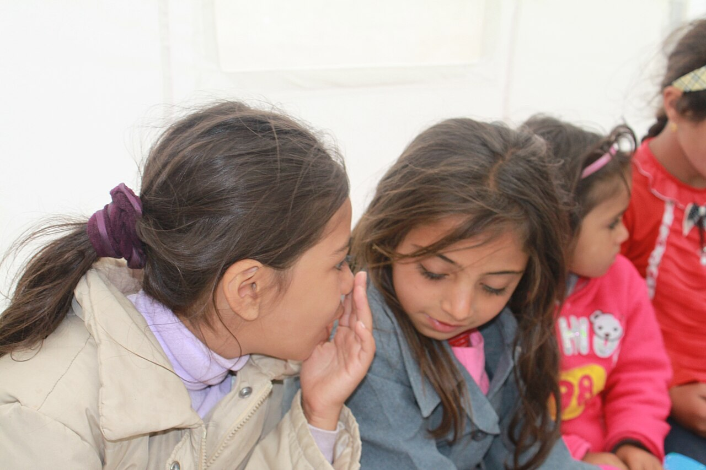
GRADE 7 · LESSON 25
Ways of Talking
Gapirish usullari: say, tell, speak, talk
General basic vocabulary (ways of talking)
Mardetanha · CC BY-SA 3.0
sozlar.com

Slide 2
LESSON AIMS
Bugungi maqsad
1
Complete ten definitions with lie, say, scream, shout, speak, talk, tell, whisper (p. 35 ex. 1)
2
Choose the correct word or phrase for eight speech bubbles (ex. 2)
3
Explain the difference between say / tell and speak / talk
4
Write six true sentences with the new words

Slide 3
BOOK TASK · 7 MINUTES
Book tasks — Laser A1+, p. 35, Wordpower!
Word list closed. Try alone first — some words are used more than once.
1
ex.1 — complete the ten definitions: lie · say · scream · shout · speak · talk · tell · whisper.
2
ex.2 — the teacher reads the eight speech bubbles (whispering, shouting …). Choose the correct word or phrase.
3
The book CD (track 11) is not available — listen to the teacher.
4
Compare with a partner: which words were difficult?

Slide 4
TEACHER · CHECK AFTER EX. 1–2
Answer key — Laser A1+, p. 35
1
ex.1 1 say · 2 whisper · 3 shout · 4 scream · 5 talk
2
ex.1 6 speak / talk · 7 speak · 8 lie · 9 tell · tell · 10 tell
3
ex.2 1 tell the time · 2 whisper · 3 scream · 4 shout
4
ex.2 5 speak French · 6 talk about the weather · 7 tell a lie · 8 tell the truth

Slide 5
VOCABULARY
A. say, tell, ask and answer (1/2)
💬️
say
aytmoq (so‘z, gap)
Can you say that again, please? I didn’t hear you.
❓️
ask a question
savol bermoq
Can I ask a question, please? What does «whisper» mean?
🙏️
say sorry
kechirim so‘ramoq, uzr aytmoq
You took his pencil, so say sorry to him.
📲️
answer the phone
telefonga javob bermoq
Can you answer the phone, please? I’m in the shower!

Slide 6
VOCABULARY
A. say, tell, ask and answer (2/2)
📞️
tell somebody something
kimgadir biror narsani aytmoq
Please tell me your phone number.
🏫️
tell somebody about something
kimgadir biror narsa haqida gapirib bermoq
Tell me about your new school!
😂️
tell a joke
latifa aytib bermoq, hazil qilmoq
Can you tell a joke? We all want to laugh!

Slide 7
VOCABULARY
B. speak, talk and explain (1/3)
🔁️
repeat
takrorlamoq
Listen and repeat the new words after me.
🗣️
speak
gapirmoq, so‘zlamoq
Please speak slowly — I’m still learning English.
🌍️
speak a language
biror tilda gapirmoq
How many languages can you speak? — Three.
🔊️
speak up
balandroq gapirmoq
Speak up, please — we can’t hear you at the back.

Slide 8
VOCABULARY
B. speak, talk and explain (2/3)
☎️
talk
gaplashmoq, suhbatlashmoq
My best friend and I talk for hours after school.
👫️
talk to somebody
kim bilandir gaplashmoq
Can I talk to you for a minute?
⚽️
talk about something
biror narsa haqida gaplashmoq
My friends and I talk about football all the time.
🌦️
talk about the weather
ob-havo haqida gaplashmoq
Grandma and the neighbours always talk about the weather.

Slide 9
VOCABULARY
B. speak, talk and explain (3/3)
☕️
have a conversation
suhbatlashmoq, suhbat qurmoq
I often have a conversation with my grandpa after dinner.
🧑‍🏫
discuss
muhokama qilmoq
Let’s discuss the problem with our teacher.
💡️
explain
tushuntirmoq
Can you explain the rule again, please? I don’t understand it.

Slide 10
VOCABULARY
C. Loud and quiet: shout, scream, whisper (1/2)
📢️
shout
baqirmoq, qichqirmoq
Please don’t shout in the library.
😠️
shout at somebody
kimgadir baqirmoq
My dad never shouts at us.
😱️
scream
chinqirmoq, qattiq qichqirmoq
My sister screams when she sees a spider.
🤫️
whisper
shivirlamoq
Don’t tell anyone — just whisper it in my ear.

Slide 11
VOCABULARY
C. Loud and quiet: shout, scream, whisper (2/2)
🎺️
loudly
baland ovozda
The music next door is playing very loudly.
🐭️
quietly
past ovozda, ohista
Please close the door quietly.
🐶️
make a loud noise
qattiq shovqin chiqarmoq
Our dog makes a loud noise when someone knocks at the door.

Slide 12
VOCABULARY
D. The truth and lies
🍰️
lie
yolg‘on gapirmoq, aldamoq
Don’t lie to me — I know you ate the cake!
🤥️
tell a lie
yolg‘on aytmoq
Pinocchio’s nose grows when he tells a lie.
✅️
tell the truth
rostini aytmoq
It’s always better to tell the truth.
🙅️
a liar
yolg‘onchi
Nobody believes him because he’s a liar.
🔒️
keep a secret
sir saqlamoq
Can you keep a secret? Don’t tell anyone!

Slide 13
FOCUS
say, tell, speak or talk?
• say + so‘zlar: say hello, say sorry, say «Thank you» (✗ say me → tell me).
• tell + kishi: tell me, tell your mum; turg‘un iboralar: tell the time, tell the truth, tell a lie, tell a joke.
• speak + til: speak English, speak French; speak up — «balandroq gapiring».
• talk + to / about: talk to a friend, talk about football.
• Ovoz balandligi: whisper → talk → shout → scream.

Slide 14
PRONUNCIATION
Say it — don’t just read it
Silent letters, a strange vowel and word stress:
talk
/tɔːk/ — silent l
whisper
/ˈwɪspə/ — silent h
say
/seɪ/ — says /sez/
shout
/ʃaʊt/
scream
/skriːm/
truth
/truːθ/
explain
/ɪkˈspleɪn/
a conversation
/ə ˌkɒnvəˈseɪʃn/
Say it: He says hello. · Don’t talk — whisper!

Slide 15
WHOLE CLASS
Practice — complete the sentence (1/2)
1
Our maths teacher can ________ every problem very clearly. (e…)
2
Please speak ________ — I can’t hear you! (u…)
3
The baby is sleeping, so we’re ________. (whisper)
4
Don’t ________ at your little brother! (sh…)
5
People ________ on the roller coaster because it’s scary. (sc…)
6
My cousin can ________ three languages. (s…)

Slide 16
WHOLE CLASS
Practice — complete the sentence (2/2)
7
Let’s ________ about the weekend. What do you want to do? (t…)
8
Please tell me the ________. Did you break the window? (t…)
9
Don’t tell ________! I know the truth. (l…)
10
When you come into the room, ________ hello to everyone. (s…)

Slide 17
PAIR / GROUP WORK · 6 MINUTES
Vocabulary activity
1
Match the beginnings (1-10) with the endings (a-j).
2
Read your complete sentences aloud.
3
Give the Uzbek meaning of the key word in each sentence.
4
When you finish, swap tables with the other group.

Slide 18
GROUPS · 8 MINUTES
Speaking
Find someone who: can speak three languages / often tells jokes / never shouts at a brother or sister / can keep a secret / talks about football every day. Ask: Can you …? Do you …?
Whisper, talk, shout: one student whispers a short sentence, the next says it, the next shouts it (not too loud!).
Talk about you: When do you whisper? When do people scream? Is it OK to tell a lie sometimes? Why?

Slide 19
TODAY'S WORDS IN CONTEXT
A noisy evening at our house (1/2)
It’s seven o’clock in the evening. My little sister Malika is six. She can’t tell the time yet, so every five minutes she asks me: “Is it bedtime?”
In the kitchen, Grandma is talking to our neighbour on the phone. They always talk about the weather! The phone line is very bad, so Grandma says: “Speak up, please! Can you hear me?”
Suddenly my brother screams: “Ouch!” A big book falls on his foot. Dad shouts from the living room: “What’s happening?” My brother tells the truth — he’s playing football in his bedroom again!
Cover the word list. Can you understand the words in bold from the sentence?

Slide 20
TODAY'S WORDS IN CONTEXT
A noisy evening at our house (2/2)
Then Mum comes home. The baby is asleep, so she whispers: “Can everyone be quiet, please?” And for five minutes, nobody says anything.
Cover the word list. Can you understand the words in bold from the sentence?

Slide 21
TODAY'S WORDS IN CONTEXT
Read and answer
1
Why does Malika ask «Is it bedtime?»
2
What do Grandma and the neighbour always talk about?
3
Why does Grandma say «Speak up, please!»?
4
Why does the brother scream?
5
Why does Mum whisper?

Slide 22
PAIRS · ESDA QOLDIMI?
Memory check — say, tell, speak or talk?
Men iborani aytaman, siz qaysi fe’l kerakligini aytasiz.
1
… the truth
2
… French
3
… sorry
4
… about the weather
5
… a joke

Slide 23
UZ
Qiyin joyi — o‘zbekcha
say — «aytmoq» (nimani?): say hello; tell — «aytmoq» (kimga?): tell me. (✗ say me)
speak — «gapirmoq» (tilda): speak English; talk — «gaplashmoq» (kim bilan, nima haqida): talk to Ali about football.
explain — «tushuntirmoq»: explain the homework; repeat — «takrorlamoq»: Repeat after me — «Mendan keyin takrorlang».
tell the truth — «rostini aytmoq», tell a lie — «yolg‘on gapirmoq» (✗ say a lie).
discuss dan keyin about qo‘yilmaydi: discuss the problem — «muammoni muhokama qilmoq».

Slide 24
HOMEWORK
Uy vazifasi
1
Learn the Unit 4 «ways of talking» words; write 6 sentences with them (kalendar reja).
2
Learn the 30 items with the flashcards: sozlar.com/vocab/cards/?set=grade7-lesson25
3
Read «A noisy evening at our house» again and listen to the audio on the lesson page.

Slide 25
IMAGE CREDITS
Rasmlar manbasi
cover
Mardetanha · CC BY-SA 3.0 · https://commons.wikimedia.org/wiki/File:2012_East_Azerbaijan_earthquakes._by_Mardetanha_1521.JPG

Slide 26
Uchta so‘z — ertaga ham esingizda qoladi
Juftingizga ayting, so‘ng daftaringizga yozib qo‘ying.
sozlar.com/vocab/cards/?set=grade7-lesson25

