Slide 1
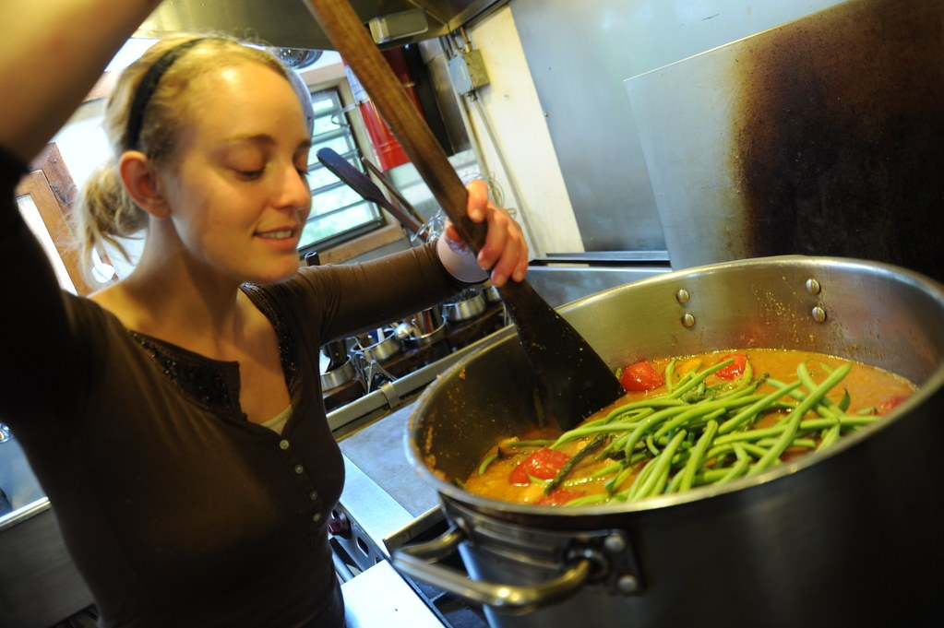
GRADE 10 · LESSON 24
Unit 4 Reading: Making a living
4-bo‘lim. O‘qish: tirikchilik — beshta ish turi
Unit 4. Work wonders Reading: Making a living
Wonderlane · CC0 1.0
sozlar.com

Slide 2
LESSON AIMS
Bugungi maqsad
1
Answer the Start thinking! questions about their future job
2
Say which type of work from the headings they would rather do (ex. 1)
3
Decide if six statements are true or false (ex. 2)
4
Match ten questions to the types of work A–E, some more than once (ex. 3)

Slide 3
BOOK TASK · OVERVIEW
Book tasks — Laser B1+, pp. 32–33
Unit 4 Work Wonders — Reading. The book audio (1.11) is not available: read the article silently.
1
Start thinking! What job would you like to do? Money or job satisfaction? Your parents’ job?
2
ex.1 Look at the paragraph headings A–E. Which type of work would you rather do? Why?
3
ex.2 Read the article and decide if statements 1–6 are true (T) or false (F).
4
ex.3 For questions 1–10, choose from the types of work A–E. They may be chosen more than once.

Slide 4
VOCABULARY
A. Choosing a career
💰️
make a living
tirikchilik qilmoq, kun ko‘rmoq
It isn’t easy to make a living as a young musician.
😊️
job satisfaction
ishdan qoniqish
For my mother, job satisfaction is more important than money.
🧭️
a career
kasb yo‘li, martaba
My sister wants a career in medicine after university.
🍔️
flip burgers
burger pishirmoq (fastfud kafesidagi oddiy ish)
Last summer my cousin flipped burgers in a café near the bazaar.
📚️
take a course
kursda o‘qimoq
Dilnoza took a course in web design during the holidays.

Slide 5
VOCABULARY
B. Office work and work with your hands (1/3)
🔒️
secure
barqaror, ishonchli (ish joyi)
A job in a big bank is usually quite secure.
💵️
well-paid
yaxshi maoshli
Pilots and surgeons have very well-paid jobs.
🤝️
work in a team
jamoada ishlamoq
Many people in offices like to work in a team.
👔️
become a manager
menejer (rahbar) bo‘lmoq
After six years at the bank, my aunt became a manager.

Slide 6
VOCABULARY
B. Office work and work with your hands (2/3)
🌍️
go on trips abroad
chet elga safarga chiqmoq
Sales managers often go on trips abroad to meet new clients.
🔁️
day after day
kundan-kunga, har kuni bir xil
I couldn’t sit at the same desk day after day.
🏕️
the outdoors type
ochiq havoni yaxshi ko‘radigan odam
Rustam is the outdoors type — he hates sitting in an office.
💪️
physical skills
jismoniy ko‘nikmalar
Builders and chefs need good physical skills.

Slide 7
VOCABULARY
B. Office work and work with your hands (3/3)
🧍️
independent
mustaqil
Farida is very independent and likes to make her own decisions.
🎓️
stay in education
o‘qishni davom ettirmoq
Not everyone wants to stay in education until they are twenty-five.
⏰️
work long hours
uzoq soatlab ishlamoq
Chefs often work long hours, even at weekends.
💎️
make a fortune
katta boylik orttirmoq
You won’t make a fortune as a carpenter, but you’ll enjoy your work.

Slide 8
VOCABULARY
C. Voluntary work and the public (1/2)
🎗️
a charity
xayriya tashkiloti
My sister helps a charity that looks after old people.
🧰️
get experience
tajriba orttirmoq
Summer jobs help you get experience before you finish school.
🔍️
try out different jobs
turli ishlarni sinab ko‘rmoq
In the summer holidays you can try out different jobs.
🤔️
make up your mind
qaror qilmoq, bir to‘xtamga kelmoq
I can’t make up my mind which university to choose.
🏷️
a paid job
haq to‘lanadigan ish
After a year of voluntary work, Laylo found a paid job at the zoo.

Slide 9
VOCABULARY
C. Voluntary work and the public (2/2)
🗣️
deal with the public
odamlar (mijozlar) bilan ishlamoq
Bank clerks deal with the public all day.
🧘️
patience
sabr-toqat
Working with small children needs a lot of patience.
📈️
earn a lot
ko‘p pul topmoq
Good salespeople can earn a lot in this company.
🚪️
an opportunity
imkoniyat
This job gives you an opportunity to travel.

Slide 10
VOCABULARY
D. Running your own business (1/2)
🏪️
set up your own business
o‘z biznesingni ochmoq
My brother wants to set up his own business online.
📊️
run your own business
o‘z biznesingni yuritmoq
Running your own business can be very hard work.
🙋️
work for yourself
o‘zing uchun ishlamoq (hech kimga yollanmay)
When you work for yourself, nobody tells you what to do.
✍️
work alone
yolg‘iz ishlamoq
Most writers work alone for many hours every day.

Slide 11
VOCABULARY
D. Running your own business (2/2)
🏠️
work from home
uydan turib ishlamoq
My father works from home two days a week.
🦁️
confidence
o‘ziga ishonch
You need a lot of confidence to start a business.
👑️
be your own boss
o‘zingga o‘zing xo‘jayin bo‘lmoq
My uncle loves being his own boss at his small bakery.

Slide 12
FOCUS
Multiple matching: savolni xatboshiga qanday moslaymiz?
• Avval savollarni o‘qing va kalit so‘zlarni belgilang: on your own, not paid, earn a lot, travel, other people.
• Matnda AYNAN o‘sha so‘z bo‘lmaydi — ma’nodoshini qidiring: earn a lot = well-paid; travel = trips abroad / other countries.
• on your own = independent, working alone; not paid = there’s no money in it.
• Bir tur bir necha marta tanlanishi mumkin — javob topilgach ham qolgan xatboshilarni tekshiring.
• Ikki javobli savolda (1–2, 4–5, 7–8, 9–10) ikkala xatboshini toping.

Slide 13
BOOK TASK · MULTIPLE MATCHING
Ex.3 — According to the writer, which type(s) of work …
A office · B hands · C voluntary work · D the public · E own business
1
would be good, if you like working on your own? 1 ___ 2 ___
2
do you not get paid to do? 3 ___
3
can you earn a lot of money from? 4 ___ 5 ___
4
would be good, if you haven’t chosen a career? 6 ___
5
could allow you to travel? 7 ___ 8 ___
6
would be good, if you like working with other people? 9 ___ 10 ___

Slide 14
PRONUNCIATION
Say it — don’t just read it
Word stress — the capital letters show the stressed syllable:
caREER
/kəˈrɪə/
opporTUnity
/ˌɒpəˈtjuːnəti/
satisFACtion
/ˌsætɪsˈfækʃn/
exPERience
/ɪkˈspɪəriəns/
indePENdent
/ˌɪndɪˈpendənt/
PAtience
/ˈpeɪʃns/
BUSiness
/ˈbɪznəs/
FORtune
/ˈfɔːtʃuːn/
career is NOT /ˈkæriə/ — the stress is on the second syllable: ca-REER.

Slide 15
TEACHER · CHECK
Answer key — Laser B1+, p. 33
1
ex.2 1 F · 2 F · 3 F · 4 T · 5 F · 6 T
2
ex.3 1–2 B, E (independent / working alone) · 3 C (no money in it)
3
ex.3 4–5 A, D (well-paid / earn a lot) · 6 C (try out jobs while you make up your mind)
4
ex.3 7–8 A, C (trips abroad / other countries) · 9–10 A, D (working in teams / meeting people)
5
Ex.3 answers in any order within each pair.

Slide 16
WHOLE CLASS
Practice — complete the sentence (1/2)
1
Which is more important, money or job ________?
2
I’d flipped ________ in a fast-food place.
3
My cousin helps a ________ that collects clothes and food for poor families.
4
Office work can be secure and well-________.
5
If you’re the ________ type, office work might not be ideal for you.
6
You might never make a ________, but you feel the satisfaction of making something.

Slide 17
WHOLE CLASS
Practice — complete the sentence (2/2)
7
You can try out different jobs while you make up your ________.
8
Shop assistants and receptionists deal with the ________ every day, so they need patience.
9
On the plus ________, there are lots of opportunities to earn a lot.
10
There’s nothing like being your own ________.

Slide 18
PAIR / GROUP WORK · 3 MINUTES
Vocabulary activity
1
Match the beginnings (1-10) with the endings (a-j).
2
Read your complete sentences aloud.
3
Give the Uzbek meaning of the key word in each sentence.
4
When you finish, swap tables with the other group.

Slide 19
PAIRS · 4 MINUTES
Speaking
Start thinking! What job would you like to do in the future? Why?
Which is more important, money or job satisfaction? Would you like to do the same job as your parents?
Ex.1: Look at the five headings. Which of these types of work would you rather do? Why?

Slide 20
TODAY'S WORDS IN CONTEXT
Five ways to make a living (1/3)
Ivy Saunders didn’t always want to be a journalist. As a teenager she changed her mind again and again about what she wanted to be. She flipped burgers and worked in shops before she took a course in writing. Her message is simple: if you have no idea what to do yet, don’t worry — finding a career takes time.
Cover the word list. Can you understand the words in bold from the sentence?

Slide 21
TODAY'S WORDS IN CONTEXT
Five ways to make a living (2/3)
Office work is secure and often well-paid, you usually work in a team, and you may go on trips abroad. But if you’re the outdoors type, sitting at a desk day after day could be hard. Work with your hands suits independent people with good physical skills. You may work long hours and never make a fortune, but you get the satisfaction of making something.
Cover the word list. Can you understand the words in bold from the sentence?

Slide 22
TODAY'S WORDS IN CONTEXT
Five ways to make a living (3/3)
Voluntary work for a charity isn’t paid — there’s no money in it — but it is a useful step to a paid job. You get lots of experience and can try out different jobs before you make up your mind. Dealing with the public needs patience, but on the plus side you can earn a lot and become a manager.
Finally, you can set up your own business and work for yourself. It is hard work, and you need confidence, but it can be very rewarding — and there’s nothing like being your own boss.
Cover the word list. Can you understand the words in bold from the sentence?

Slide 23
TODAY'S WORDS IN CONTEXT
Read and answer
1
What did Ivy Saunders do before she became a journalist?
2
Who might not like office work?
3
What is the bad side and the good side of working with your hands?
4
Why can voluntary work be useful if there’s no money in it?
5
What do you need to run your own business?

Slide 24
PAIRS · ESDA QOLDIMI?
Memory check — which type of work?
Men iborani aytaman, siz maqoladagi ish turini aytasiz (A–E).
1
go on trips abroad → ?
2
physical skills → ?
3
work for a charity → ?
4
deal with the public → ?
5
be your own boss → ?

Slide 25
UZ
Qiyin joyi — o‘zbekcha
make a living — «tirikchilik qilmoq», make a fortune — «katta boylik orttirmoq».
job — sanaladi (a job, two jobs), work — sanalmaydi (a lot of work).
career — butun hayot davomidagi kasb yo‘li; job — hozirgi aniq ish.
make up your mind — «qaror qilmoq»; make up yolg‘iz kelsa — «to‘qib chiqarmoq».
There’s no money in it — «undan pul chiqmaydi», ish foyda keltirmaydi.

Slide 26
HOMEWORK
Uy vazifasi
1
Learn the Unit 4 Word box vocabulary (jobs) — Laser B1+ p.33 ex.4; write 8 sentences (rejadagi vazifa).
2
Learn the 33 items with the flashcards: sozlar.com/vocab/cards/?set=grade10-lesson24
3
Read «Five ways to make a living» on the lesson page and answer the five questions.

Slide 27
IMAGE CREDITS
Rasmlar manbasi
cover
Wonderlane · CC0 1.0 · https://www.flickr.com/photos/71401718@N00/6231890399

Slide 28
Uchta so‘z — ertaga ham esingizda qoladi
Juftingizga ayting, so‘ng daftaringizga yozib qo‘ying.
sozlar.com/vocab/cards/?set=grade10-lesson24

