Slide 1
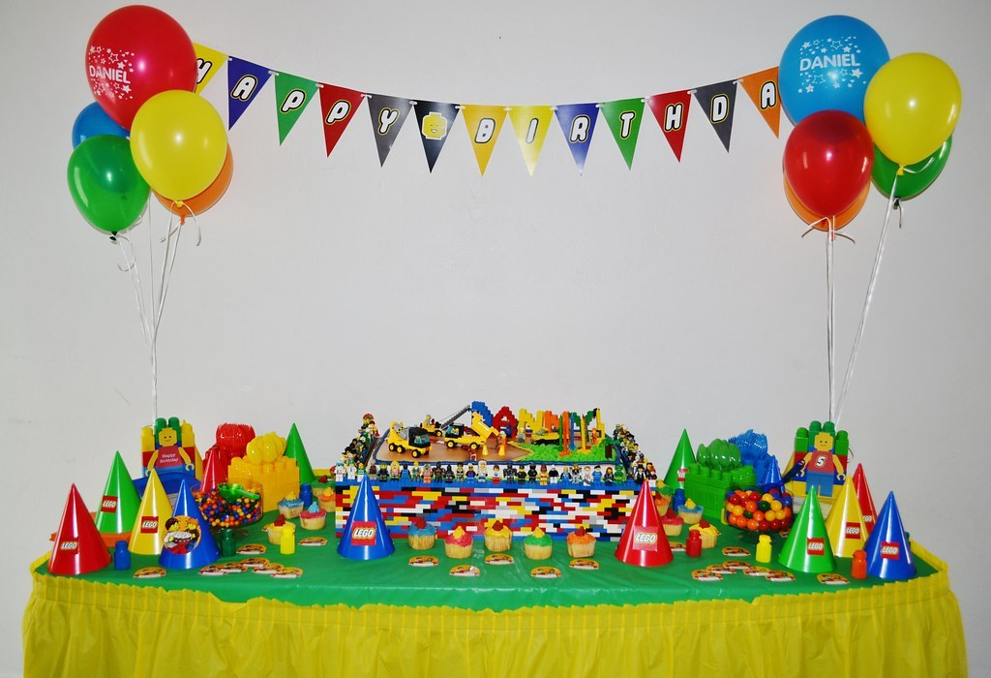
GRADE 8 · LESSON 24
Unit 4. Let's Celebrate: Ruby and Holly
4-bo‘lim. Bayram qilamiz: Ruby va Holly
Unit 4. Let’s Celebrate: Ruby and Holly.
Kid's Birthday Parties · CC BY 2.0
sozlar.com

Slide 2
LESSON AIMS
Bugungi maqsad
1
Match five party words to pictures (Get ready)
2
Tick the things Holly has done (ex. 1) and answer three KET questions (ex. 2)
3
Say who did what in the chat — Ruby, Holly or Dylan (ex. 3)
4
Write eight words from their definitions (ex. 4)

Slide 3
BOOK TASK · 12 MINUTES
Book tasks — Laser A2, pp. 32–33
Books open, word list closed.
1
Get ready — beshta rasmni so‘zlar bilan moslang (a–e).
2
ex.1 — chatni o‘qing va Holly QILGAN ishlarni belgilang (✓) — 8 band.
3
ex.2 (KET) — chatni qayta o‘qing va A, B yoki C ni tanlang (3 savol).
4
ex.3 — bo‘shliqqa Ruby, Holly yoki Dylan ni yozing (5 gap).
5
ex.4 Wordpower (KET) — ta’rifga mos so‘zni yozing; birinchi harf berilgan (8 ta).

Slide 4
CHECK AND TEACH · 9 MINUTES
Answer key — Laser A2, pp. 32–33
1
Get ready 1 c guests · 2 e present · 3 b invitation · 4 d decorations · 5 a refreshments
2
ex.1 ✓ sent invitations · told people online · bought snacks · organised music
3
ex.1 ✗ decided where the party is · ordered pizzas · organised video games · put up decorations
4
ex.2 1 B · 2 B · 3 C ex.3 1 Holly · 2 Ruby · 3 Holly · 4 Dylan · 5 Ruby
5
ex.4 1 replies · 2 indoors · 3 outdoors · 4 arrive · 5 order · 6 popular · 7 cheap · 8 tidy up

Slide 5
VOCABULARY
A. Party things (1/2)
🥤️
refreshments
yegulik va ichimliklar (mehmonlar uchun)
We’ve got refreshments for thirty guests: juice, sandwiches and fruit.
🥔️
crisps
chips (kartoshka chipsi)
There were bowls of crisps and nuts on every table.
🧑‍🤝‍🧑
a guest
mehmon
Every guest brought a small present for Bobur.
🎊️
decorations
bezaklar
The paper decorations on the walls looked beautiful.
🎈️
balloons
havo sharlari
There were red and yellow balloons all over the room.

Slide 6
VOCABULARY
A. Party things (2/2)
🎂️
a birthday cake
tug‘ilgan kun torti
Mum has made a chocolate birthday cake for my sister.
💌️
a birthday card
tug‘ilgan kun tabriknomasi
Everyone in our class signed a birthday card for our teacher.
🕯️
blow out the candles
shamlarni puflab o‘chirmoq
Aziz blew out the candles and everyone clapped.
🌠️
make a wish
niyat qilmoq, tilak tilamoq
Close your eyes and make a wish before you cut the cake.
🏠️
a host
mezbon (mehmon kutuvchi)
The host met all the guests at the door with a big smile.

Slide 7
VOCABULARY
B. Getting ready for a party (1/3)
🥳️
celebrate
nishonlamoq
We always celebrate Navruz with our whole family.
🤔️
think of
o‘ylab topmoq, eslamoq
Can you think of a good game for the party?
🎵️
organise the music
musiqani tayyorlamoq (tashkil qilmoq)
My brother will organise the music for the party, so we can dance.
🪜️
put up decorations
bezaklarni osmoq
Let’s put up decorations in the hall on Saturday morning.
🍕️
order pizza
pitsaga buyurtma bermoq
Nobody wants to cook, so let’s order pizza tonight.

Slide 8
VOCABULARY
B. Getting ready for a party (2/3)
🤡️
provide entertainment
ko‘ngilochar dastur taqdim etmoq, ko‘ngil ochmoq
A clown will provide entertainment for the little children.
🎀️
wrapping paper
sovg‘a o‘raydigan qog‘oz
We need some colourful wrapping paper for Dad’s present.
🪩️
throw a party
ziyofat bermoq (uyushtirmoq)
My parents want to throw a party for Grandma’s seventieth birthday.
📋️
a guest list
mehmonlar ro‘yxati
There are thirty names on our guest list already.
💡️
ask for advice
maslahat so‘ramoq
When I have a problem, I ask my mum for advice.

Slide 9
VOCABULARY
B. Getting ready for a party (3/3)
🤝️
agree to help
yordam berishga rozi bo‘lmoq
My cousin has agreed to help us with the cake.
✅️
be ready for
…ga tayyor bo‘lmoq
Are you ready for the big day tomorrow?
⏳️
can’t wait for
intiqlik bilan kutmoq, kutib turolmaslik
I can’t wait for the summer holidays!

Slide 10
VOCABULARY
C. Wordpower words
🛋️
indoors
ichkarida, bino ichida
It’s cold and windy, so let’s play indoors today.
🌳️
outdoors
ochiq havoda, tashqarida
In summer my family eats outdoors in the garden.
🚪️
arrive
yetib kelmoq
The first guests will arrive at six o’clock.

Slide 11
TODAY'S WORDS IN CONTEXT
Bobur's surprise party (1/2)
Next Saturday is Bobur's fourteenth birthday, and his sister Nilufar wants to throw a surprise party to celebrate it. She has already sent invitations to twelve guests and she has had replies from almost everybody.
The party is going to be outdoors, in the garden. 'But what if it rains?' asks her mum. 'Then we can move everything indoors,' Nilufar answers.
For refreshments, Nilufar has bought some crisps and juice. Later they are going to order pizza from a cheap but popular café near the school. Her cousin has agreed to help: he will provide entertainment with his guitar.
Cover the word list. Can you understand the words in bold from the sentence?

Slide 12
TODAY'S WORDS IN CONTEXT
Bobur's surprise party (2/2)
On Saturday morning they will put up decorations and balloons, and Mum will make a birthday cake. After the party, everybody will help to tidy up. Nilufar can't wait for Saturday!
Cover the word list. Can you understand the words in bold from the sentence?

Slide 13
TODAY'S WORDS IN CONTEXT
Read and answer
1
Why is Nilufar organising a party?
2
Where is the party going to be?
3
What has Nilufar already done?
4
Who is going to provide the entertainment?
5
What will they do on Saturday morning?

Slide 14
PAIRS · ESDA QOLDIMI?
Memory check — say the word
Men ta’rifni aytaman, siz so‘zni aytasiz.
1
food and drink for guests → ?
2
the person who invites guests and meets them at the door → ?
3
colourful paper for presents → ?
4
the names of all the people you invite → ?
5
inside a building → ?

Slide 15
FOCUS
Qilinganmi yoki hali yo‘qmi? (ex. 1)
• I’ve … / I’ve already … — ish BAJARILGAN: I’ve bought snacks.
• I haven’t … / I haven’t … yet — hali QILINMAGAN: I haven’t thought about it.
• Let’s … / I’ll … / We can … — bu REJA, hali bajarilmagan: Let’s put them up on Saturday.
• I can ask Mum … and then decide — qaror hali QABUL QILINMAGAN.
• KET maslahati: savoldagi so‘z matnda boshqacha aytilishi mumkin — can’t wait for = is looking forward to.

Slide 16
PRONUNCIATION
Say it — don’t just read it
Ziyofat so‘zlarida urg‘u va tovushlar:
refreshments /rɪˈfreʃmənts/
decorations /ˌdekəˈreɪʃnz/
guest /ɡest/ — u o‘qilmaydi
celebrate /ˈselɪbreɪt/
balloons /bəˈluːnz/
entertainment /ˌentəˈteɪnmənt/
indoors / outdoors /ˌɪnˈdɔːz/ /ˌaʊtˈdɔːz/
wrapping paper /ˈræpɪŋ ˌpeɪpə/

Slide 17
WHOLE CLASS
Practice — complete the sentence (1/2)
1
We had a picnic ________ because the weather was beautiful.
2
It's raining, so let's stay ________ and play board games.
3
We've invited thirty people — all their names are on the guest ________.
4
What time will your guests a________?
5
At the party my uncle did magic tricks to provide ________ for the little kids.
6
Sevara closed her eyes, made a wish and blew out all fourteen ________.

Slide 18
WHOLE CLASS
Practice — complete the sentence (2/2)
7
Juice, sandwiches and cake — we've got all the ________.
8
We can't wait ________ the school trip next week!

Slide 19
PAIR / GROUP WORK · OPTIONAL
Vocabulary activity
1
Match the beginnings (1-10) with the endings (a-j).
2
Read your complete sentences aloud.
3
Give the Uzbek meaning of the key word in each sentence.
4
When you finish, swap tables with the other group.

Slide 20
GROUPS OF THREE · 7 MINUTES
Speaking
Uchlikda sinf ziyofatini rejalashtiring (throw a party): qayerda (indoors yoki outdoors)? qanday refreshments? qanday entertainment?
Har biringiz bitta vazifani oling va ayting: I'll organise the music. / Let's order pizza. / I'll put up decorations.
Sinfga ayting: what you have decided and what you haven't decided yet.

Slide 21
UZ
Qiyin joyi — o‘zbekcha
refreshments — mehmonlar uchun yegulik va ichimlik («dasturxon»), odatda ko‘plikda.
guest — mehmon; host — mezbon (ziyofat egasi).
throw a party — ziyofat uyushtirmoq (✗ make a party); tug‘ilgan kunda: blow out the candles, make a wish.
can’t wait for / be ready for — FOR bilan: I can’t wait for Saturday (✗ can’t wait Saturday).

Slide 22
HOMEWORK
Uy vazifasi
1
Workbook pp. 23–24, ex. 1–3.
2
Learn the 26 items with the flashcards: sozlar.com/vocab/cards/?set=grade8-lesson24
3
Write a short chat message (5–6 lines) inviting a friend to your party.

Slide 23
IMAGE CREDITS
Rasmlar manbasi
cover
Kid's Birthday Parties · CC BY 2.0 · https://www.flickr.com/photos/13698839@N00/10403039754

Slide 24
Uchta so‘z — ertaga ham esingizda qoladi
Juftingizga ayting, so‘ng daftaringizga yozib qo‘ying.
sozlar.com/vocab/cards/?set=grade8-lesson24

