Slide 1
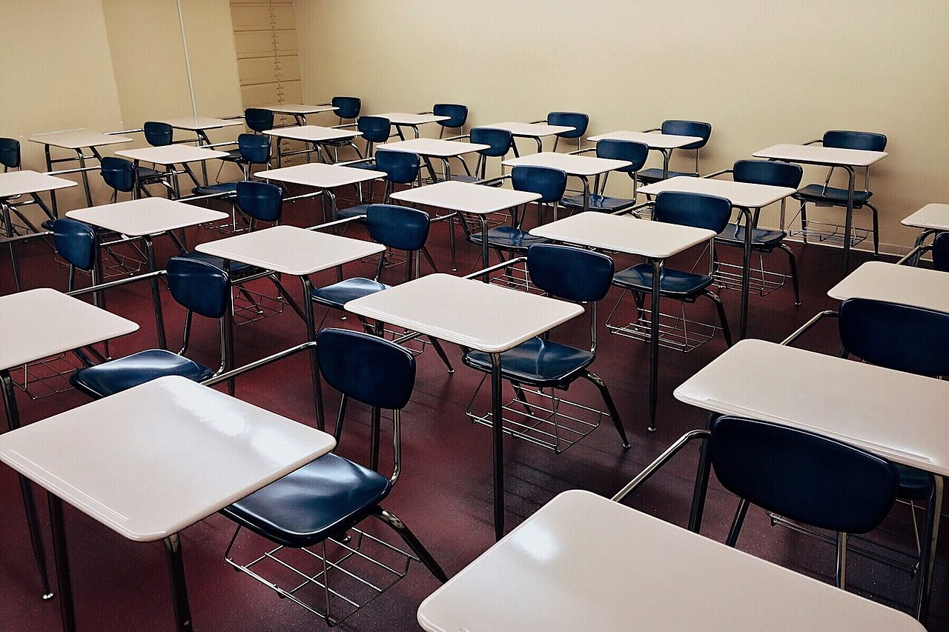
GRADE 7 · LESSON 24
Grammar: The Imperative
Buyruq mayli: Open! Don’t run!
Grammar: the imperative
Abdes Dabai · CC BY-SA 4.0
sozlar.com

Slide 2
LESSON AIMS
Bugungi maqsad
1
Say how we make the imperative and the negative imperative (form table)
2
Complete instructions with the correct verb, positive or negative (Solutions p. 126 ex. 1)
3
Change statements into instructions (You open your books → Open your books.)
4
Write six classroom rules — three do’s and three don’ts

Slide 3
GRAMMAR
Form — the imperative
FORM
EXAMPLES
+
verb (no subject, no to)
Open your books. · Be quiet!
−
Don’t + verb
Don’t run! · Don’t be late!
never
Never + verb
Never swim in the river alone.
please
Please + verb · verb …, please
Please sit down. · Sit down, please.
Solutions Elementary p. 127 (Grammar Reference 2.8): we use imperatives to give commands and instructions; we often use them in announcements.

Slide 4
BOOK TASK · 10 MINUTES
Book tasks — the imperative
Word list closed. Try alone first, then check with a partner.
1
Laser pp. 34–35 — find five instructions in the task titles and speech bubbles (Match …, Choose …, Be quiet …).
2
Solutions p. 126, 2H ex.1 — complete with: not be · not eat · meet · not open · put · share · stop · not swim.
3
Change it — 1 You open your books. 2 You don’t talk. 3 You listen to me. 4 You don’t forget your pen. 5 You are careful.
4
Make each one an instruction: You open your books. → Open your books.

Slide 5
BOOK TASK · THE SIX SENTENCES
Solutions Elementary p. 126, 2H ex.1
Complete with: not be · not eat · meet · not open · put · share · stop · not swim.
1
1 ______ all the cake! ______ it with your brother!
2
2 ______ talking!
3
3 ‘Let’s see a film tomorrow evening.’ ‘OK. ______ me at the cinema at six. ______ late!’
4
4 ______ your hand up if you know the answer.
5
5 ______ in that river. It’s dangerous.
6
6 It’s cold outside. Please ______ the window.

Slide 6
CHECK AND TEACH · 9 MINUTES
Answer key — the imperative
1
Laser Match each question … · Choose the correct word … · Write a word … · Listen and choose … · Be quiet. · Talk about you.
2
Solutions 2H ex.1 1 Don’t eat · Share 2 Stop 3 Meet · Don’t be 4 Put 5 Don’t swim 6 don’t open
3
Change it 1 Open your books. 2 Don’t talk. 3 Listen to me. 4 Don’t forget your pen. 5 Be careful.
4
Ask WHY: no subject, no to; negative = Don’t + verb; be → Be quiet! / Don’t be late!

Slide 7
FOCUS
The imperative — five rules
QOIDA
QOIDA
Buyruq = fe’lning o‘zi, egasiz va to siz: Open your books. (✗ You open, ✗ To open)
Inkor: Don’t + fe’l: Don’t run! Don’t be late!
Qat’iy taqiq: Never + fe’l: Never swim alone.
Muloyim qilish: please boshida yoki oxirida: Please sit down. / Sit down, please.
Bitta odamga ham, butun sinfga ham bir xil shakl: Ali, sit down! — Children, sit down!

Slide 8
VOCABULARY
A. Classroom instructions (1/3)
📖️
open your book
kitobni ochmoq
Open your books at page 40, please.
🪟️
close the window
derazani yopmoq
Please close the window — it’s very windy today.
🪑️
sit down
joyiga o‘tirmoq
Please sit down and take out your notebooks.
🧍️
stand up
o‘rnidan turmoq
Stand up, everyone, and say good morning to our guest!

Slide 9
VOCABULARY
A. Classroom instructions (2/3)
✋️
put your hand up
qo‘l ko‘tarmoq
Put your hand up before you speak, please.
🖊️
take out
(sumkadan) olmoq, chiqarmoq
Take out your pens and start the test.
👀️
look at the board
doskaga qaramoq
Stop talking and look at the board, please.
👥️
work in pairs
juftlikda ishlamoq
Work in pairs and ask your partner five questions.

Slide 10
VOCABULARY
A. Classroom instructions (3/3)
✅️
check your answers
javoblarni tekshirmoq
Now check your answers with the key on page 50.
✏️
underline
tagiga chizmoq
Underline the new words in the text.
📝️
copy
ko‘chirib yozmoq
Copy the new words into your notebook.

Slide 11
VOCABULARY
B. Classroom rules (1/3)
📥️
hand in your homework
uy vazifasini topshirmoq
Always hand in your homework on time.
📢️
shout out
(so‘ralmasdan) baqirib aytib yubormoq
Don’t shout out the answer — put your hand up!
🛑️
interrupt
gapini bo‘lmoq
Please don’t interrupt — Aziz is speaking.
🏃️
run in the corridor
yo‘lakda yugurmoq
Never run in the corridor between lessons.

Slide 12
VOCABULARY
B. Classroom rules (2/3)
🍬️
chew gum
saqich chaynamoq
Don’t chew gum in class, please.
📱️
use your phone
telefondan foydalanmoq
Never use your phone during a test.
📴️
turn off
o‘chirmoq (telefon, chiroq)
Turn off your phones before the lesson starts.
🎒️
bring
olib kelmoq
Always bring your dictionary to English lessons.

Slide 13
VOCABULARY
B. Classroom rules (3/3)
👂️
listen carefully
diqqat bilan tinglamoq
Please listen carefully when your classmates are speaking.
🙃️
make a mistake
xato qilmoq
Don’t be sad when you make a mistake. Try again!
🚮️
drop litter
(yerga) axlat tashlamoq
Don’t drop litter in the school yard.
⏳️
wait your turn
navbat kutmoq
Please wait your turn and don’t push.

Slide 14
VOCABULARY
C. School events (1/2)
🏅️
sports day
sport kuni (maktabda)
Don’t forget: sports day is on Friday! Bring your trainers.
🗺️
a school trip
maktab sayohati
Come on the school trip to Samarkand next month!
🎭️
a school club
maktab to‘garagi
Join a school club and make new friends!

Slide 15
VOCABULARY
C. School events (2/2)
⛺️
a school camp
maktab lageri
Come to our summer school camp in the mountains!
🎟️
buy a ticket
chipta sotib olmoq
Buy a ticket before Monday and get a discount!
📅️
miss
o‘tkazib yubormoq (tadbirni)
Don’t miss the school concert on Thursday!

Slide 16
PRONUNCIATION
Say it — don’t just read it
Card words with tricky stress and sounds. Then say each one in an instruction: Don’t interrupt! Listen carefully!
underline
/ˌʌndəˈlaɪn/
interrupt
/ˌɪntəˈrʌpt/
corridor
/ˈkɒrɪdɔː/
chew gum
/ˌtʃuː ˈɡʌm/
litter
/ˈlɪtə/
listen carefully
/ˈlɪsn ˈkeəfəli/
buy a ticket
/baɪ ə ˈtɪkɪt/
a school trip
/ə ˌskuːl ˈtrɪp/
Say please with a friendly voice — an instruction without please can sound unfriendly.

Slide 17
WHOLE CLASS
Practice — complete the sentence (1/2)
1
Please ________ the window. It’s very hot in here. (open)
2
________ in the corridor! You can fall. (not run)
3
________ careful! The road is very busy. (be)
4
________ late for school tomorrow — we’ve got a test! (not be)
5
________ your name at the top of the page. (write)
6
Please ________ me — I’m talking! (not interrupt)

Slide 18
WHOLE CLASS
Practice — complete the sentence (2/2)
7
________ to bring your PE kit on Friday! (not forget)
8
________! The test is very easy. (not worry)
9
________ the TV and go to bed! (turn off)
10
________ with your partner and compare your answers. (work)

Slide 19
PAIR / GROUP WORK · 6 MINUTES
Vocabulary activity
1
Match the beginnings (1-10) with the endings (a-j).
2
Read your complete sentences aloud.
3
Give the Uzbek meaning of the key word in each sentence.
4
When you finish, swap tables with the other group.

Slide 20
PAIRS · 8 MINUTES
Speaking
The teacher says: A gives five instructions (Stand up! Look at the board! Don’t chew gum!). B does them only if A says please first.
Group rules: in groups of three, write three do’s and three don’ts for our classroom. Use the cards (hand in your homework, drop litter, wait your turn …). Read them to the class.
Give directions: tell your partner how to get from our classroom to the canteen (Go out of the door. Turn left. Don’t go upstairs.).

Slide 21
TODAY'S WORDS IN CONTEXT
Our classroom rules (a poster by 7-A)
Welcome to Room 12! Here are our classroom rules. Please read them and remember them!
Rule 1. Be on time. Don’t be late — the lesson starts at eight o’clock.
Rule 2. Put your hand up when you want to speak. Don’t shout out the answer!
Rule 3. Listen carefully to the teacher and to your classmates. Please don’t interrupt.
Rule 4. Turn off your phone and put it in your bag. Never use it in class.
Rule 5. Always bring your book, your notebook and a pen. Don’t forget to hand in your homework!
Rule 6. Be kind and help each other. And don’t worry if you make a mistake — everyone makes mistakes!
Cover the word list. Can you understand the words in bold from the sentence?

Slide 22
TODAY'S WORDS IN CONTEXT
Read and answer
1
What time does the lesson start?
2
What do you do when you want to speak?
3
Where do you put your phone?
4
What three things do you always bring?
5
Find three negative imperatives in the rules.

Slide 23
PAIRS · ESDA QOLDIMI?
Memory check — make it an instruction
Men vaziyatni aytaman, siz bitta buyruq gap aytasiz (ijobiy yoki inkor).
1
The floor in the corridor is wet. → Don’t …!
2
The test is starting. → … your phone!
3
Your friend is answering a question. → Don’t …!
4
You know the answer. → … your hand up!
5
Sports day is on Friday. → Don’t …!

Slide 24
UZ
Qiyin joyi — o‘zbekcha
Buyruq — fe’lning lug‘atdagi shakli: Open the door — «Eshikni och(ing)».
Inkor: Don’t + fe’l — «…ma(ng)»: Don’t run in the corridor — «Yo‘lakda yugurma(ng)».
be bilan: Be quiet! — «Jim bo‘ling!», Don’t be late! — «Kechikmang!» (✗ Don’t late).
O‘zbekchada «-ing» qo‘shib hurmat bildiramiz (oching); inglizchada shakl o‘zgarmaydi — muloyimlik please bilan.
Never — «hech qachon …ma»: Never drop litter — «Hech qachon axlat tashlama».

Slide 25
HOMEWORK
Uy vazifasi
1
Write 6 imperative sentences: classroom rules — three do’s and three don’ts (kalendar reja). Use the poster on the lesson page as a model and at least three words from the cards.
2
Learn the 29 items with the flashcards: sozlar.com/vocab/cards/?set=grade7-lesson24
3
Read «Our classroom rules» again and listen to the audio on the lesson page.

Slide 26
IMAGE CREDITS
Rasmlar manbasi
cover
Abdes Dabai · CC BY-SA 4.0 · https://commons.wikimedia.org/wiki/File:Aula,_escola..jpg

Slide 27
Uchta so‘z — ertaga ham esingizda qoladi
Juftingizga ayting, so‘ng daftaringizga yozib qo‘ying.
sozlar.com/vocab/cards/?set=grade7-lesson24

