Slide 1
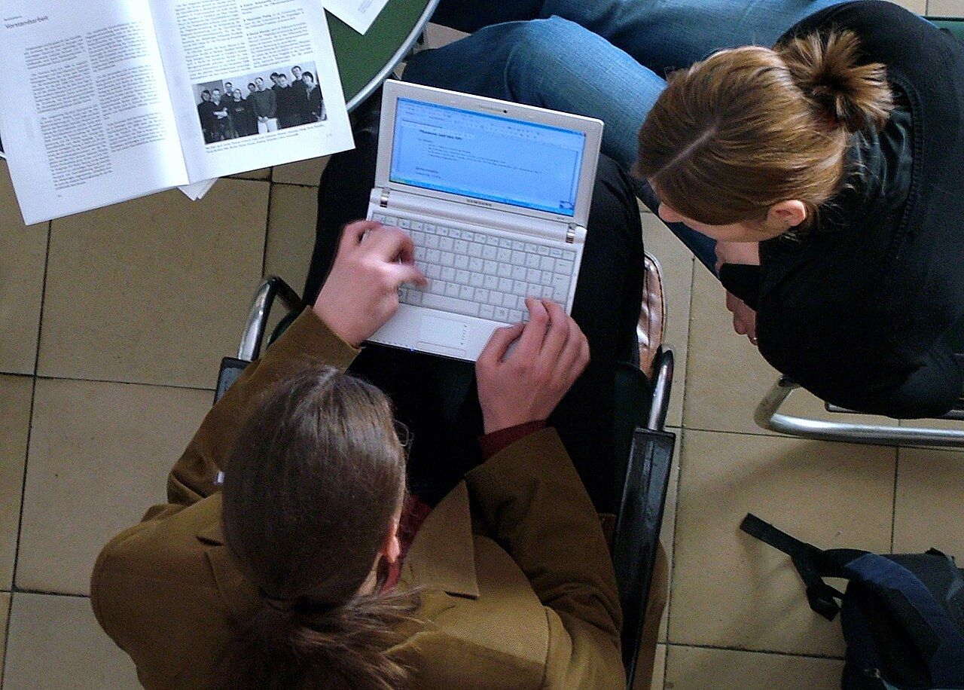
GRADE 10 · LESSON 23
Writing: An informal email offering a choice
Yozish: do‘stga norasmiy xat — ikki tanlov taklif qilish
Writing: An informal letter/email
Ziko · CC BY-SA 3.0
sozlar.com

Slide 2
LESSON AIMS
Bugungi maqsad
1
Say why the task needs an informal email and decide if four statements are true or false (ex. 1–2)
2
Find six functions in Kelly’s email (ex. 4)
3
Plan an email to Tom with the ex. 6 questions and Writing Planner 3
4
Write the email and check it with the Check it out! list (ex. 7–8)

Slide 3
BOOK TASK · 13 MINUTES
Book tasks — Laser B1+, pp. 30–31
Books open, word list closed. Writing database p. 154 helps with ex.2.
1
ex.1 — Read the writing task (Craig, the leaflet, the notes). Why should your email be informal?
2
ex.2 — True or false? 1 always formal · 2 ask about news · 3 include all the notes · 4 add extra information
3
ex.3 — Read Kelly’s email (Working model).
4
ex.4 — Underline where Kelly: 1 asks a friendly question · 2 checks information · 3 gives choice 1
5
ex.4 — 4 gives choice 2 · 5 says what Craig should do next · 6 gives a reason for closing

Slide 4
CHECK AND TEACH · 7 MINUTES
Answer key — Laser B1+, pp. 30–31
1
ex.1 Craig is a friend of yours — so the email is informal.
2
ex.2 1 F · 2 T · 3 T · 4 T
3
ex.4 1 Have your exams finished? · 2 You’re arriving on the 19th, aren’t you?
4
ex.4 3 The first is the Royal Orchestra on the 20th or 21st.
5
ex.4 4 The Wilson Brothers are playing after that. · 5 Decide which one you want to see and let me know.
6
ex.4 6 Got to go! Mum’s calling me.

Slide 5
VOCABULARY
A. Concerts and tickets (1/3)
🎶️
a concert
konsert
Craig wants to go to a concert while he’s staying with us.
📄️
a leaflet
varaqa, reklama varag‘i
The tourist office gave me a leaflet about summer concerts.
ℹ️
the local tourist office
mahalliy turistik axborot markazi
You can get a free map at the local tourist office in the centre.
🎟️
the box office
chipta kassasi
You can buy tickets at the box office before the show.

Slide 6
VOCABULARY
A. Concerts and tickets (2/3)
✅️
be available
mavjud bo‘lmoq, sotuvda bo‘lmoq
Cheap tickets are available online and at the hall.
📲️
book tickets
chiptalarni oldindan band qilmoq
We have to book tickets before the 6th of June.
💺️
good seats
yaxshi o‘rinlar
If we buy early, we can get good seats near the stage.
💵️
birthday money
tug‘ilgan kunga sovg‘a qilingan pul
Tom is going to spend his birthday money on the concert.

Slide 7
VOCABULARY
A. Concerts and tickets (3/3)
🏛️
a concert hall
konsert zali
Washington Hall is the biggest concert hall in our town.
📍️
a venue
tadbir o‘tkaziladigan joy
The old theatre is now a great venue for rock concerts.
🎪️
a show
tomosha, shou
The show starts at eight, so let’s meet at half past seven.

Slide 8
VOCABULARY
B. Music and performers (1/3)
🤘️
a rock group
rok guruhi
The Robbers are a rock group from London.
🎻️
an orchestra
orkestr
My sister plays the violin in an orchestra at her music school.
🎼️
a classical music lover
mumtoz musiqa ixlosmandi
My cousin is a real classical music lover and goes to every concert.
🤠️
country music
kantri musiqasi
Country music often tells stories about ordinary people.

Slide 9
VOCABULARY
B. Music and performers (2/3)
🎵️
a melody
kuy, ohang
I like songs with a good melody and great singing.
📀️
old classics
eski mashhur asarlar
The orchestra will play some old classics and a few new pieces.
🎹️
a piece
musiqiy asar
The pianist played a beautiful piece by Mozart.
🎉️
entertain
(birovning) ko‘nglini ochmoq, xursand qilmoq
A good comedian can entertain an audience for hours.

Slide 10
VOCABULARY
B. Music and performers (3/3)
💃️
get you dancing
raqsga tushirib yubormoq
This rock group will get you dancing all night!
🔊️
loud
baland ovozli, shovqinli
Their concerts are loud and full of energy.
🎤️
perform live
jonli ijro etmoq
The band will perform live at Washington Hall in June.

Slide 11
VOCABULARY
C. Writing an informal email (1/2)
📧️
an informal email
norasmiy elektron xat
I wrote an informal email to my cousin about the concert.
🧳️
be thinking of visiting
kelib ketishni o‘ylab yurmoq
My aunt is thinking of visiting us in Samarkand next month.
🔀️
offer sb a choice
birovga tanlash imkonini bermoq
I want to offer Tom a choice of two concerts.
📝️
relevant information
mavzuga oid ma’lumot
You can add extra relevant information to your email.

Slide 12
VOCABULARY
C. Writing an informal email (2/2)
💬️
ask about sb’s news
birovning yangiliklarini so‘ramoq
In an informal email we usually ask about our friend’s news first.
👂️
hear of
(kim yoki nima haqida) eshitgan bo‘lmoq
Have you ever heard of this singer? She’s very popular in Korea.
😞️
a shame
afsus, achinarli hol
It’s a shame that the concert finished so early.

Slide 13
FOCUS
Choice email — the shape (4 paragraphs)
• 1 — salom + do‘stning hayoti haqida samimiy savol: Have your exams finished? I can’t wait for you to arrive!
• 2 — ma’lumotni aniqlash, question tag bilan: You’re arriving on the 19th, aren’t you?
• 3 — ikki tanlov + o‘z fikringiz: So, I’ve got two choices… The first is… I’ve seen them and they were very good.
• 4 — keyin nima qilsin: Decide which one you want… I’ll get the tickets before you come.
• Yakun — sabab bilan: Got to go! Mum’s calling me. · See you soon, + ism.
• Qaydlardagi HAMMA ma’lumot bo‘lsin; mavzuga oid qo‘shimcha qo‘shsa bo‘ladi; 120–150 so‘z.

Slide 14
STRATEGY
Writing the email to Tom — four steps
1
Read the task and the notes: Tom arrives on 15 June, leaves on the 21st (?), money is no problem, book before the 6th.
2
Choose the two concerts that fit his dates (leaflet p.30).
3
Plan with the ex.6 questions and Writing Planner 3 p.156.
4
Write four short paragraphs + an informal ending (120–150 words), then check it out! — tick the ex.8 list.

Slide 15
PLAN AND WRITE · 14 MINUTES
Ready to write! — Laser B1+, p. 31, ex. 5–8
Tom: 15–21 June (?) · money no problem — birthday money! · book tickets before the 6th
1
ex.6 How will you start? What will you ask Tom about his life?
2
ex.6 What will you check? What are the two choices — and your opinion of each?
3
ex.6 Why is money not a problem? What should Tom do next — and before when?
4
ex.6 How will you end the email? → Writing Planner 3, p. 156
5
ex.7 Now write! Informal language, all the information, 120–150 words.
6
ex.8 Check it out! Tick the list before you hand it in.

Slide 16
PRONUNCIATION
Say it — don’t just read it
Checking information: a question tag with FALLING intonation means ‘I think I know — please confirm’:
…, aren’t you? ↘
…, isn’t it? ↘
orchestra
/ˈɔːkɪstrə/
leaflet
/ˈliːflət/
melody
/ˈmelədi/
available
/əˈveɪləbl/
classical
/ˈklæsɪkl/
choice
/tʃɔɪs/
Say it: You’re arriving on the nineteenth, aren’t you? ↘

Slide 17
WHOLE CLASS
Practice — complete the sentence (1/2)
1
Our favourite band is going to ________ live in the park on Saturday.
2
Tickets are available at the box ________.
3
You’re arriving on the 19th, ________ you?
4
We’ll miss them. It’s a ________ because they’re great!
5
So really you’ve got a ________ of two concerts.
6
The Wilson Brothers are playing next. Have you heard ________ them?

Slide 18
WHOLE CLASS
Practice — complete the sentence (2/2)
7
Sorry, there are no tickets left — nothing is ________ until next month.
8
Decide ________ one you want and I’ll get the tickets.
9
________ to go! Mum’s calling me.
10
Have you heard this song? It has a lovely ________ that stays in your head.

Slide 19
PAIR / GROUP WORK · 4 MINUTES
Vocabulary activity
1
Match the beginnings (1-10) with the endings (a-j).
2
Read your complete sentences aloud.
3
Give the Uzbek meaning of the key word in each sentence.
4
When you finish, swap tables with the other group.

Slide 20
PAIRS
Speaking
Ex.6 orally: A asks the plan questions (How are you going to start? What will you check? What’s the first choice?), B answers for Tom’s email.
Look at the leaflet: which two concerts fit Tom’s dates (15th–21st)? Why not the third one?
Give your opinion of each choice in one sentence: I’ve seen them perform live and … / I’ve never heard of them, but …

Slide 21
TODAY'S WORDS IN CONTEXT
Model answer — an email to Tom (1/2)
Hi Tom,
Did your team win the match on Saturday? I’m sure you played brilliantly. I can’t wait for you to arrive!
I know you’re arriving on the 15th, but I just wanted to check one thing — you’re leaving on the 21st, aren’t you?
Cover the word list. Can you understand the words in bold from the sentence?

Slide 22
TODAY'S WORDS IN CONTEXT
Model answer — an email to Tom (2/2)
So, I’ve got two choices for you. The first is The Robbers, a rock group. They’re playing up to the 18th, and they’ll really get us dancing! The second is the Royal Orchestra on the 20th or 21st. My cousin has seen them and she says they’re amazing, especially if you’re a classical music lover. Don’t worry about the money — you’ve got your birthday money, so we can get good seats.
Decide which one you want and tell me by the 5th, because I have to book tickets at the box office before the 6th.
Got to go — my dinner’s getting cold!
See you soon,
Aziz
Cover the word list. Can you understand the words in bold from the sentence?

Slide 23
TODAY'S WORDS IN CONTEXT
Read and answer
1
What friendly question does Aziz ask about Tom’s life?
2
Which piece of information does he check?
3
Where does Aziz have to book tickets, and before when?
4
Why is money not a problem?
5
What does Aziz want Tom to do next, and by when?

Slide 24
PAIRS · ESDA QOLDIMI?
Memory check — which paragraph?
Men iborani aytaman, siz u xatning nechanchi qismiga tegishli ekanini aytasiz (1–4 yoki yakun).
1
Did your team win? Tell me all your news! → ?
2
You’re leaving on the 21st, aren’t you? → ?
3
The first is the Royal Orchestra — they play old classics. → ?
4
Decide which one you want — I have to book tickets at the box office. → ?
5
Got to go! Mum’s calling me. → ?

Slide 25
UZ
Qiyin joyi — o‘zbekcha
Do‘stga xat — norasmiy: qisqartmalar, undov belgisi, to‘g‘ridan-to‘g‘ri savollar.
Question tag — ma’lumotni aniqlash: You’re arriving on the 19th, aren’t you? — «…kelyapsan, to‘g‘rimi?»
It’s a shame — «Afsus!»; shame bu yerda «uyat» emas.
hear of — «nomini eshitgan bo‘lmoq»: Have you heard of them? (about emas).
Got to go! — I’ve got to go ning og‘zaki qisqa shakli: «ketishim kerak».

Slide 26
HOMEWORK
Uy vazifasi
1
Write an informal email about your free time (100–120 words) — rejadagi vazifa.
2
Or finish the email to Tom (ex.7, 120–150 words) and tick the Check it out! list.
3
Learn the 29 items with the flashcards: sozlar.com/vocab/cards/?set=grade10-lesson23

Slide 27
IMAGE CREDITS
Rasmlar manbasi
cover
Ziko · CC BY-SA 3.0 · https://commons.wikimedia.org/wiki/File:2009-03-21_mvbln_11.JPG

Slide 28
Uchta so‘z — ertaga ham esingizda qoladi
Juftingizga ayting, so‘ng daftaringizga yozib qo‘ying.
sozlar.com/vocab/cards/?set=grade10-lesson23

