Slide 1
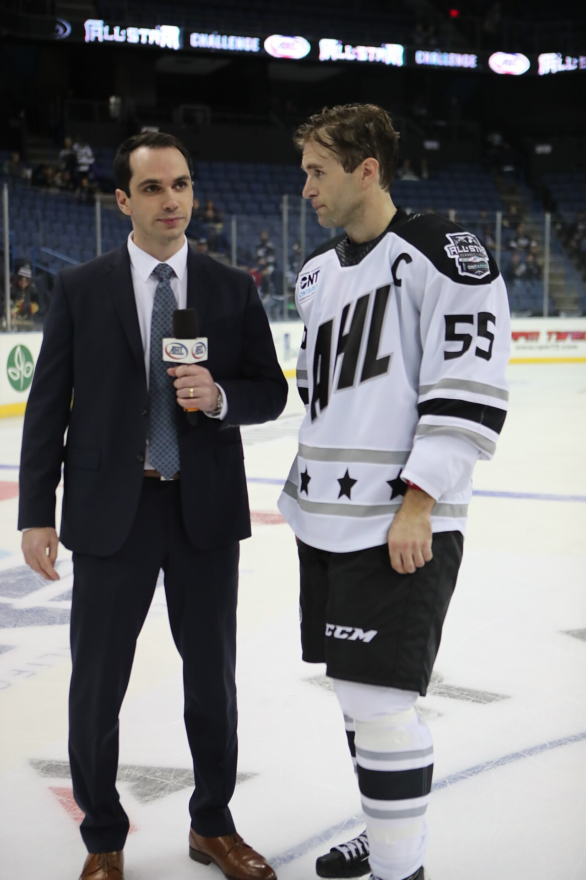
GRADE 7 · LESSON 23
Grammar: Question Words
So‘roq so‘zlari: who, which, why, how …
Grammar: question words
TheAHL · CC BY 2.0
sozlar.com

Slide 2
LESSON AIMS
Bugungi maqsad
1
Say what each question word in the Look! box asks about (p. 34)
2
Match ten interview questions with their answers (ex. 1)
3
Choose the correct question word A, B or C in ten sentences (ex. 2)
4
Interview a partner with six different question words

Slide 3
GRAMMAR
Form — Grammar database 7 (p. 148)
ASKS ABOUT
EXAMPLE
who
people
Who is your favourite singer?
what
things, actions (general)
What do you do after school?
which
one thing from a choice
Which bag is yours, the red or the blue?
where
places
Where does your grandma live?
when
days, dates, times
When is your birthday?
why
reasons (→ because)
Why are you tired?
how
the way, explanations
How do you get to school?
how old → age · how many + countable · how much + uncountable · what time → clock time.

Slide 4
BOOK TASK · 11 MINUTES
Book tasks — Laser A1+, p. 34
Books open, word list closed. Try alone first, then check with Grammar database 7 (p. 148).
1
Look! — underline the question words. What does each one ask about?
2
ex.1 — Mr Jennings’ interview: match questions 1–10 with answers a–j.
3
ex.2 — Choose the correct word or phrase, A, B or C (ten sentences).
4
Fast finishers — Quick check on p. 148 (five items).

Slide 5
CHECK AND TEACH · 9 MINUTES
Answer key — Laser A1+, p. 34
1
ex.1 1 d · 2 h · 3 b · 4 f · 5 j
2
ex.1 6 a · 7 g · 8 c · 9 i · 10 e
3
ex.2 1 B Who · 2 A What · 3 B How old · 4 A Where · 5 B Which
4
ex.2 6 C Why · 7 C How many · 8 B What time · 9 C When · 10 B How
5
Quick check (p. 148) 1 What time do you · 2 How old are you · 3 Who is your favourite singer? · 4 When · 5 Why
6
Ask WHY: a person → who; a choice → which; a day → when; a clock time → what time.

Slide 6
FOCUS
Question words — six rules
QOIDA
QOIDA
So‘roq so‘zi gap boshida, keyin do / does / is, keyin ega: Where do you live? (✗ Where you live?)
what — umumiy («nima, qanaqa»), which — tanlov bor («qaysi biri»): Which do you prefer, tea or juice?
when — kun, sana; what time — soat: When is the party? On Saturday. What time? At six.
why → javob because bilan: Why are you late? — Because the bus was late.
how many + sanaladigan (books), how much + sanalmaydigan (water).
Who ega bo‘lsa do kerak emas: Who knows the answer? To‘ldiruvchi bo‘lsa: Who do you know?

Slide 7
VOCABULARY
A. People and favourites (1/2)
🎬️
a favourite actor
eng yoqtirgan aktyor
Who is your favourite actor? — Will Smith. He’s so funny!
🥅️
a footballer
futbolchi
Which footballer do you like best, Messi or Ronaldo?
🌟️
brilliant
ajoyib, zo‘r
What do you think of the new cartoon? — It’s brilliant!
📺️
a talent show
iste’dodlar tanlovi (teleko‘rsatuv)
Which talent show do you watch on Saturday evenings?

Slide 8
VOCABULARY
A. People and favourites (2/2)
🎉️
great fun
juda maroqli, juda qiziqarli
Why do you go to the drama club? — Because it’s great fun!
🗑️
rubbish
bema’ni, arzimas narsa
Why do you watch this cartoon? It’s rubbish!
⚽️
support a team
jamoaga muxlislik qilmoq
Which team do you support? — Pakhtakor, of course!

Slide 9
VOCABULARY
B. Where? — places (1/2)
🏢️
a block of flats
ko‘p qavatli uy
Where do you live? — In a big block of flats near the park.
🛣️
just outside the town
shahardan sal tashqarida, shahar chetida
Where do your cousins live? — Just outside the town, near the river.
🏙️
the city centre
shahar markazi
How do you get to the city centre from your house?

Slide 10
VOCABULARY
B. Where? — places (2/2)
🚪️
next door
qo‘shni uyda, qo‘shnida
Who lives next door to you? — An old doctor and his wife.
🪑️
sit next to
(kimningdir) yonida o‘tirmoq
Who do you sit next to in maths lessons?
📍️
far from
(biror joydan) uzoqda
Why do you go by bus? — Because my school is far from my house.

Slide 11
VOCABULARY
C. How? — getting around (1/2)
🏫️
get to school
maktabga bormoq, maktabga yetib bormoq
How do you get to school every morning?
🚌️
by bus
avtobusda
How does your mum go to work? — By bus. It’s quick and cheap.
🚗️
by car
mashinada
How do you go to your grandma’s house? — By car, with my dad.
🚶️
on foot
piyoda
How do you get home after school? — On foot. I live in the next street.

Slide 12
VOCABULARY
C. How? — getting around (2/2)
🚇️
by metro
metroda
How do we get to the zoo? — By metro. It’s the fastest way.
🚕️
take a taxi
taksiga o‘tirmoq, taksida bormoq
When do you take a taxi? — Only when it rains.
🚏️
a bus stop
avtobus bekati
Where is the nearest bus stop? — Over there, next to the bank.

Slide 13
VOCABULARY
D. Free time and reasons (1/2)
🚴️
cycling
velosiped haydash
Why do you love cycling? — Because it’s fast and fun.
💪️
keep fit
sog‘lom va chaqqon bo‘lib yurmoq
How do you keep fit? — I swim three times a week.
🌱️
gardening
bog‘dorchilik, tomorqada ishlash
What does your grandpa do at the weekend? — Gardening. He loves his tomatoes.
👨‍👩‍👧
spend time with your family
oila bilan vaqt o‘tkazmoq
When do you spend time with your family? — On Sundays. We go to the park.

Slide 14
VOCABULARY
D. Free time and reasons (2/2)
😊️
stay happy
xursand bo‘lib yurmoq, kayfiyatni saqlamoq
How do you stay happy when it rains all week?
🎯️
try hard
astoydil harakat qilmoq
Why does Bobur always try hard in English? — Because he wants to travel.
🎨️
a hobby
sevimli mashg‘ulot, xobbi
What’s your hobby? — I collect old coins.
♟️
play chess
shaxmat o‘ynamoq
Who do you play chess with? — With my grandpa. He always wins!

Slide 15
PRONUNCIATION
Say it — don’t just read it
Card words: the stress is on the FIRST syllable, and some letters are not said.
favourite
/ˈfeɪvərɪt/
footballer
/ˈfʊtbɔːlə/
brilliant
/ˈbrɪliənt/
rubbish
/ˈrʌbɪʃ/
centre
/ˈsentə/
cycling
/ˈsaɪklɪŋ/
gardening
/ˈɡɑːdənɪŋ/
a hobby
/ə ˈhɒbi/
Wh- questions usually go DOWN at the end: Which team do you support? How do you keep fit?

Slide 16
WHOLE CLASS
Practice — complete the sentence (1/2)
1
________ do you prefer, tea or juice? (W…)
2
________ is your sister crying? — Because she’s tired. (W…)
3
________ do you get to the sports centre? — By bus. (H…)
4
________ milk do you want in your tea? (H… m…)
5
________ is the school concert? — On Friday. (W…)
6
________ lives next door to you? — An old teacher. (W…)

Slide 17
WHOLE CLASS
Practice — complete the sentence (2/2)
7
________’s the weather like today? — Sunny! (W…)
8
________ long is the English lesson? — Forty-five minutes. (H…)
9
________ is your best friend from? — From Bukhara. (W…)
10
________ kind of films do you like? — Funny ones. (W…)

Slide 18
PAIR / GROUP WORK · 6 MINUTES
Vocabulary activity
1
Match the beginnings (1-10) with the endings (a-j).
2
Read your complete sentences aloud.
3
Give the Uzbek meaning of the key word in each sentence.
4
When you finish, swap tables with the other group.

Slide 19
PAIRS · 7 MINUTES
Speaking
Interview your partner: ask six questions with six different question words. Use words from the cards (a hobby, keep fit, get to school, a favourite actor). Answer with a short answer and one more sentence (Student B: In Chilonzor. It’s near the metro.).
Guess the question: A says an answer (At seven o’clock. / Because it’s great fun. / On foot. / In a block of flats.), B makes the question.
Class survey: Which … do you prefer, … or …? Ask three classmates and report: Two people prefer …

Slide 20
TODAY'S WORDS IN CONTEXT
Five questions for our school cook (1/2)
Every week our class asks one person at school five questions. This week it’s Mrs Karimova, our school cook. Her hobby is gardening.
Which meal do you prefer to cook, breakfast or lunch? — Lunch! I love making soup for three hundred children.
What time do you start work? — At half past six in the morning. The kitchen is very quiet then.
Why do you like your job? — Because the children always say thank you, and cooking is great fun!
How do you get to school? — On foot. I live in a block of flats in the next street.
Cover the word list. Can you understand the words in bold from the sentence?

Slide 21
TODAY'S WORDS IN CONTEXT
Five questions for our school cook (2/2)
Who helps you in the kitchen? — Two cooks, Aziza and Dilnoza. They’re brilliant!
Cover the word list. Can you understand the words in bold from the sentence?

Slide 22
TODAY'S WORDS IN CONTEXT
Read and answer
1
Who is Mrs Karimova?
2
What time does she start work?
3
Why does she like her job?
4
How does she get to school?
5
Find the question with Who. Is Who the subject (no do) or the object?

Slide 23
PAIRS · ESDA QOLDIMI?
Memory check — which question word?
Men javobni aytaman, siz savolning so‘roq so‘zini topasiz.
1
In a big block of flats. → …?
2
Because cycling is great fun. → …?
3
On Sundays — I spend time with my family. → …?
4
Messi — he’s my favourite footballer. → …?
5
By metro. → …?

Slide 24
UZ
Qiyin joyi — o‘zbekcha
who — kim, what — nima / qanaqa, which — qaysi (tanlov bor), where — qayerda, when — qachon, why — nega, how — qanday qilib.
O‘zbekchada so‘roq so‘zi gapning o‘rtasida ham turadi (Siz qayerda yashaysiz?), inglizchada esa doim boshida: Where do you live?
Which — bir nechta variantdan bittasi: Which do you prefer, tea or juice? — «Qaysi biri ko‘proq yoqadi?»
how much — «qancha» (suv, sut, pul), how many — «nechta» (kitob, bola).
Who ega bo‘lsa do yo‘q: Who lives here? — «Bu yerda kim yashaydi?»

Slide 25
HOMEWORK
Uy vazifasi
1
Workbook pp. 24–25, ex. 1–4 (kalendar reja).
2
Learn the 28 items with the flashcards: sozlar.com/vocab/cards/?set=grade7-lesson23
3
Write five questions for an interview with a person at your school (use five different question words and words from the cards: a hobby, get to school, keep fit …).

Slide 26
IMAGE CREDITS
Rasmlar manbasi
cover
TheAHL · CC BY 2.0 · https://commons.wikimedia.org/wiki/File:AA3I5919_(49453762837).jpg

Slide 27
Uchta so‘z — ertaga ham esingizda qoladi
Juftingizga ayting, so‘ng daftaringizga yozib qo‘ying.
sozlar.com/vocab/cards/?set=grade7-lesson23

